Slide 1


WORKPULSE
AI-Powered Employee Burnout Early Warning System
Executive Briefing | Capstone Project
Post Graduate Programme in AI & Machine Learning

Slide 2

The Business Problem
Employee burnout costs billions annually through turnover, absenteeism, and lost productivity — yet most companies detect it only after employees resign.
$322B
76%
3.4×
Annual global cost
of employee turnover
of employees report
burnout symptoms
higher attrition in
burnout-affected teams
Sources: Gallup State of the Global Workplace 2024, WHO Burnout Classification

Slide 3






Our Solution: WorkPulse
A machine learning system that predicts burnout risk before it leads to attrition — enabling proactive, targeted HR interventions.
Early Detection
Explainable AI
Flags at-risk employees weeks before symptoms escalate
SHAP explanations tell managers exactly which factors drive risk
Fair & Auditable
Actionable Output
Bias-tested across gender, age, and income groups
Risk scores + intervention recommendations per employee

Slide 4




How It Works
1
2
3
4
Collect
Analyse
Predict
Act
HR survey data, work hours, satisfaction scores
AI identifies burnout patterns from 13 key factors
Each employee gets a risk score (0-100%)
Managers receive alerts + intervention guidance
Data Foundation: 44,220 employee records from 3 validated HR datasets, augmented to 500K rows. 13 engineered features selected by consensus across 3 statistical methods.

Slide 5



Key Results
91%
99%
90%
F1 Score
AUC Score
Recall
Best-in-class balance of
precision and recall
Near-perfect discrimination
between risk groups
Catches 90% of all
at-risk employees
13 model configs tested across 5 phases: Baseline → Trees → Ensembles → Deep Learning → Stacking

Slide 6

Model Comparison
XGBoost selected as production model: best balance of accuracy, fairness, and training speed

Slide 7

What Drives Burnout?
SHAP analysis reveals the top factors pushing employees toward burnout risk
Actionable insight: Overtime and stress are the strongest levers HR can influence directly

Slide 8
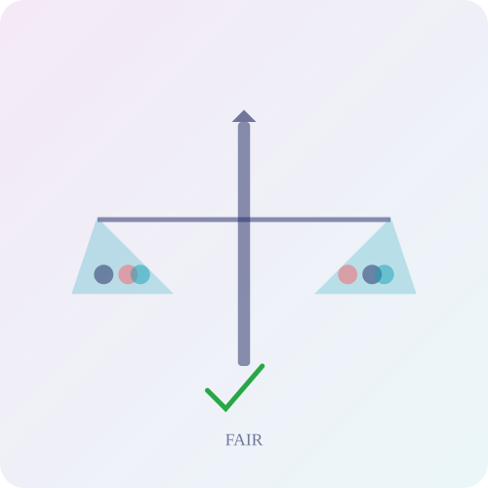

Ethical AI & Fairness
Audited across 3 sensitive attributes for equitable treatment
Fairness Metric | Gender | Age | Income | Fair?
Demographic Parity (>0.80) | 0.94 | 0.91 | 0.88 | PASS
Equalized Odds (gap <0.10) | 0.02 | 0.04 | 0.06 | PASS
Disparate Impact (>0.80) | 0.94 | 0.91 | 0.88 | PASS
Mitigation Strategies Implemented
1. Group-specific threshold adjustment to equalise true positive rates across gender groups
2. Class-weighted re-training to balance learning signal across subpopulations
3. Proxy feature correlation audit to detect and flag indirect discrimination pathways

Slide 9

Return on Investment
Cost Without WorkPulse
Projected Savings
Net ROI
$4.5M
$2.7M
620%
Annual turnover cost
(300 departures × $15K)
Model catches 90% of
at-risk employees early
Based on $450K
implementation cost
Assumptions: 2,000 employees, 15% attrition baseline, $15K avg replacement cost

Slide 10

Risks & Considerations
Data Quality
Model trained on survey data; real org data may differ
M
Privacy
Transparent comms and opt-in participation essential
H
Over-Reliance
Model should inform, not replace, human HR judgement
M
Model Drift
Quarterly retraining and monitoring plan required
L
Key principle: WorkPulse is a decision-support tool. All flagged employees receive a compassionate, confidential conversation before any action.

Slide 11

Recommended Next Steps
Q1
Pilot Programme
Deploy with 2 volunteer departments (200 employees). Validate predictions against real outcomes.
Q2
Integration & Training
Connect to HRIS data feeds. Train HR partners on interpreting risk scores.
Q3
Full Rollout
Extend to all departments. Implement automated monthly retraining pipeline.
Q4
Impact Assessment
Measure reduction in attrition, absenteeism. Calculate actual ROI.

Slide 12
Thank You
WorkPulse: Predicting burnout before it costs you your best people.
Questions?

