Slide 1

[CLIENT NAME]
[PROPOSAL SUBJECT]

Slide 3


Title |  | Page
Introduction |  | 4
About Taajeel |  | 6
About The Client |  | 10
Scope of work |  | 13
Time Frame |  | 16
Scope of work Additional "optional" |  | 19
The Fees |  | 23
Signoff |  | 26
Terms and Conditions |  | 28

Slide 4
Introduction

Slide 5



[REFERENCE]
[CLIENT NAME] [DATE]
[CLIENT ADDRESS]
Atte: [CONTACT NAME]
Mob: [CONTACT MOBILE]
Email: [CONTACT EMAIL]
Web: [CLIENT WEBSITE]
Subject: [PROPOSAL SUBJECT]
We would like to thank you for your trust in taajeel | تعجيل to propose [SERVICE DESCRIPTION]. (“Mission”/ “Assignment”).
Accordingly, attached to Your Excellency in the Proposal of this scope of work.
Truly yours,,,
Taajeel Business Solutions LLC

Slide 6
About Taajeel

Slide 7
نعجل خطوتك، لتبني منظومتك،،،
We accelerate your steps to build your company,,,

Slide 8




About Taajeel:
Taajeel stands as a beacon of excellence in the business solutions landscape, seamlessly merging innovation with expertise to empower organizations to reach their full potential. Rooted in a commitment to unparalleled quality, we provide comprehensive management consulting, administrative optimization, and strategic insights that drive success. At Taajeel, our mission transcends delivering services—we aspire to transform challenges into opportunities, fostering growth, resilience, and sustainable excellence for our clients in an ever-evolving Saudi market.
The Inspiration Behind Taajeel's Logo
The Taajeel logo draws inspiration from elements deeply rooted in Saudi culture and values, reflecting the essence of the company's mission and vision:
The Book:
A symbol of clarity, knowledge dissemination, and transparency, the book reflects Taajeel’s commitment to empowering clients through clear communication, shared insights, and expertise that drive their growth and success.
The Peregrine Falcon (Saqr Al-Shaheen | صقر الشاهين):
A powerful cultural symbol in Saudi Arabia, the falcon represents speed, precision, and excellence. This aligns seamlessly with Taajeel's promise of swift execution and outstanding performance, embodying the agility and cultural connection at the heart of its client relationships.
Open Hands:
Representing hospitality and care, the open hands symbolize Taajeel's welcoming approach and its dedication to nurturing and supporting clients, ensuring a sense of trust and partnership in every interaction.
Each element of the logo is thoughtfully designed to embody Taajeel's core values while emphasizing its unique identity as a leader in the consulting and professional services landscape.

Slide 9
About Taajeel:
Taajeel Mission:
At Taajeel, our mission is to become the preferred partner for businesses in the fields of consulting and professional services. We aim to deliver high-quality solutions tailored to meet our clients’ needs and support them in achieving their objectives.
Taajeel Vision:
To be a pioneer in consulting and professional services by offering innovative solutions that address client needs and contribute to the economic development of Saudi Arabia.
Taajeel Strategy:
Our strategy is built on three key pillars:
Taajeel Core Values:
Taajeel adding Value:
By choosing Taajeel, You are partnering with a leader dedicated to delivering results-driven solutions that align with your goals, backed by a proven track record of success and a commitment to innovation and excellence.
Focus Taajeel is committed to providing high-quality services that meet clients’ needs and expectations. A robust quality framework has been established to define the standards all our products and services must meet. | Innovation We continually strive to develop cutting-edge solutions that address client challenges and drive economic growth. A dedicated innovation team is in place to create new products and services that respond to evolving client demands. | Specialization Taajeel focuses on specialized consulting and professional services, including business setup, organizational structuring and restructuring, and comprehensive business solutions.
Quality Delivering exceptional services that align with client needs and expectations. | Innovation Developing creative solutions that foster economic growth and meet client demands. | Integrity Upholding honesty, fairness, and transparency in all dealings with clients, partners, and employees.
Confidentiality Safeguarding the privacy of information entrusted to us by clients, partners, and employees. | Partnership Building strategic alliances with clients and partners to achieve shared objectives. | Social Responsibility Contributing to the community and supporting sustainable development initiatives.

Slide 10
About the Client

Slide 12






About the Client:
[CLIENT LEGAL NAME] (“the Client”) is a [LEGAL FORM] registered in [COUNTRY] under [REGISTRATION NO].
[OWNERSHIP AND DIRECTORS]
[CLIENT BACKGROUND AND INTENT]
Accordingly, the Client is seeking from Taajeel | تعجيل [ENGAGEMENT DESCRIPTION] (the “Mission” / the “Assignment”).
[REQUIREMENTS HEADING]
[REQUIREMENT INTRO]
[REQUIREMENT ITEM]
[REQUIREMENT ITEM]
[DOCUMENTS HEADING]
[DOCUMENT ITEM]
[DOCUMENT ITEM]
[DOCUMENT ITEM]
[DOCUMENT ITEM]
[ATTESTATION NOTE]
Limited liability Company- Foreign
Subject to income tax provisions of 20% of net income

Slide 13
Scope of work

Slide 14















Scope of work | [SERVICE NAME]:
[SCOPE INTRO]
The Journey of Setup a Foreign Limited Liability Company
STEP 01
01
02
STEP 02
00
Steps
03
STEP 03
STEP 04
STEP 13
04
STEP 14
STEP 11
STEP 05
05
STEP 06
STEP 15
STEP 17
06
11
09
13
15
STEP 07
07
12
STEP 09
10
16
14
08
STEP 16
STEP 08
STEP 10
STEP 12

Slide 15




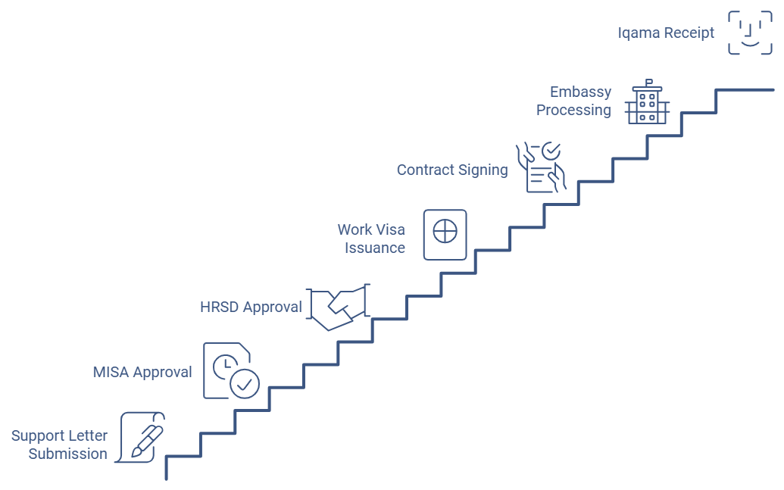



Scope of work | Issue the resident visa the main General Manager:
According to Issue the resident visa the main General Manager, So the scope of work is delivered into the following fifteen steps:
Resident visa the main General Manager Path:
15
Steps
Issue the resident visa the main General Manager Path:
Submit the support letter with MISA.
Get approval from MISA.
Starting the procedures for obtaining the employee's visa HRSD.
Get approval from HRSD.
issue a proof of work visa.
Assistance with Qualification Verification Program
Delegating a manpower office in the employee's country.
Signing the work contract and stamped from MOF.
Issuance the resident visa form the Saudi Embassy.
Stamping the working visa on the passport.
Arrival the Employee to KSA.
medical test examination.
Pay the fees Ministry of Interior.
Issuance of Medical insurance.
Issuance of a work permit from QIWA.
Receipt of residence Iqama (Resident Identity).

Slide 16
Time Frame

Slide 17
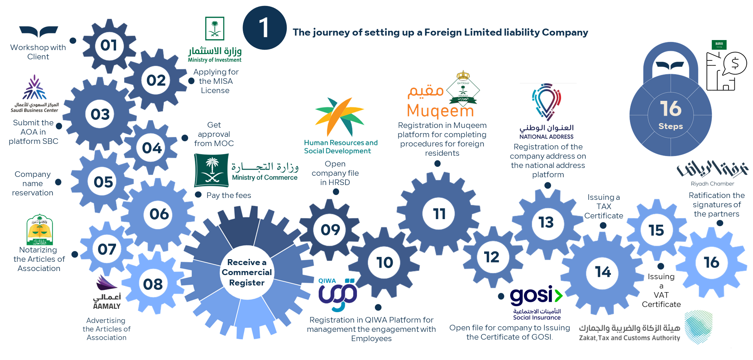
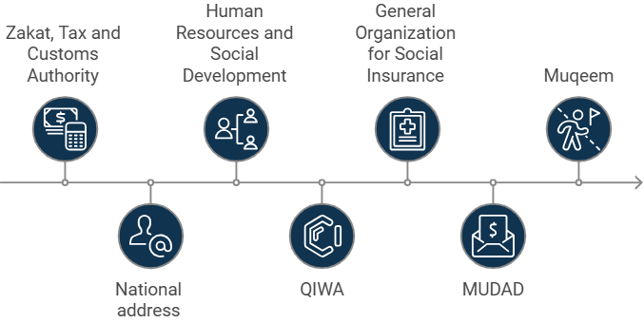
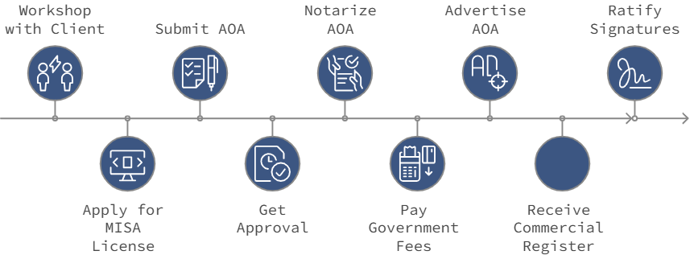
Time Frame:
We expect and plan for the mission to be delivered according to the Scope of Work in this Time Frame:
01 Day
05 Days
05 Days
02 Days
01 Day
01 Day
01 Day
03 Days
03 Days
01 Day
01 Day
01 Day
01 Day
02 Days
03 Days

Slide 18
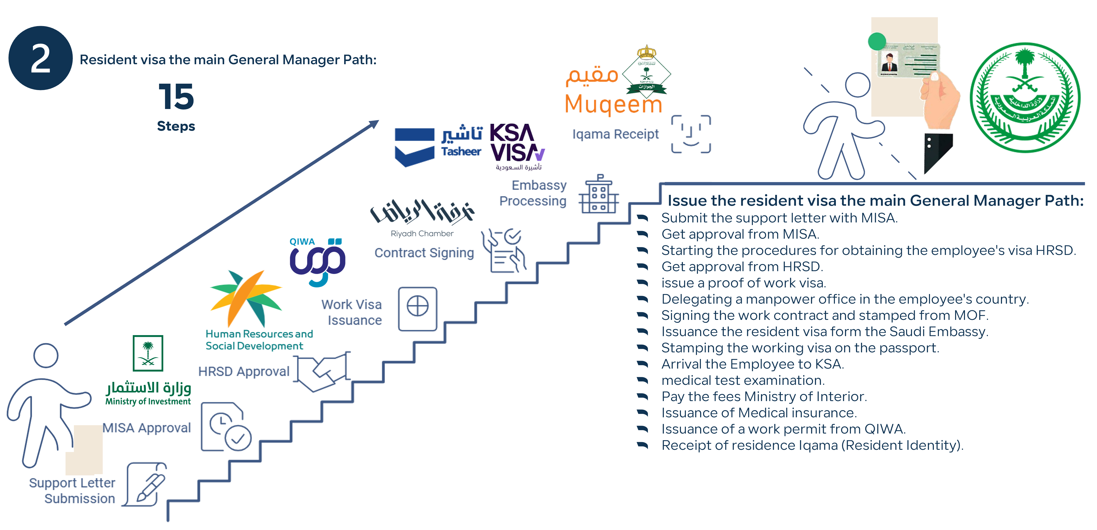

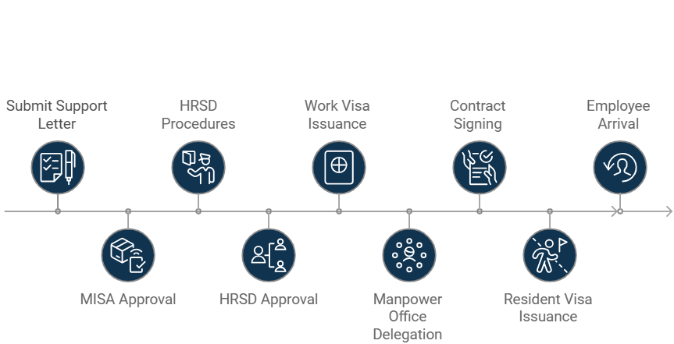
Time Frame:
We expect and plan for the mission to be delivered according to the Scope of Work in this Time Frame:
02 Day
02 Day
03 Day
01 Day
15 Days
01 Day
01 Day
15Days
03 Days
01 Day
03 Days

Slide 19
Scope of work
(Additional and Optional)

Slide 20











Scope of work | Additional and Optional:
According to (the “Assignment”), We have Additional services, it's optional if the client wants to add to the scope of work:
Open bank Account:
Address and office services:
HRO&GRO Operations:
Opening a bank account
Open sub accounts
Bank account structuring
Activate electronic services
Structuring users of electronic services
Signing of the salary agreement "Wages Protection System"
Saudi Address
Receive Documents
Send Documents
active company file in HRSD.
Registration in QIWA Platform
active file for company in GOSI.
Registration in MUQEEM platform
Registration in MUDAD a platform
Limited liability Company Foreign

Slide 21







Scope of work | Additional and Optional:
According to (the “Assignment”), We have Additional services, it's optional if the client wants to add to the scope of work:
6
Structure the Policies & Procedures
to comply with Saudi regulations:
Recruitment Services:
Registration of Trademark:
Issuance activity License:
International Regulations
Choose & Interview of Candidate
Personnel affairs
Support them from HADF if they are citizens
Saudi regulations
Workshop with Client
Advertising to register by IPN
Submit the application and provide the requirements
Financial
Human Resources
Operations & Contracts
Get initial approval from SAIP
Approval of registration
Follow up with government Department
®
Issuing the Registration Certificate
Issuance of The license

Slide 22








Scope of work | Additional and Optional:
According to (the “Assignment”), We have Additional services, it's optional if the client wants to add to the scope of work:
10
11
12
Translation services :
Attesting the Documents:
Temporary General Manager:
Appointing
Temporary
Saudi General Manager
(as a service agent)
Activation and issuance of visas and opening of the bank account
Removal of the Saudi General Manager
ع
Submit the application and provide the requirements
Writing document content
Draft it in the required language
Issuing the document after translation
Follow up with government Department
Issuance of The license

Slide 23
The Fees

Slide 24


The Fees | Taajeel Fees:
Set up foreign company & Issue resident visa for main General Manager:
[FEE]
[VAT]
Taajeel Fees
VAT Fees
15%
Payment Method:
[PAYMENT TERM 1]
[PAYMENT TERM 2]
[PAYMENT TERM 3]
3
Open Bank Account:
4
Address and office services:
5
HRO&GRO Operations:
4,500
2,500
4,800
Per Bank
Monthly subscriptions
Monthly subscriptions
6
Structure the Policies & procedures:
Recruitment Services:
Registration of Trademark:
Issuance activity License:
9,600
1Month Salary
8
9
7
18,000
15,000
Taajeel Fees
(Additional & Optional)
Per subject
Per Trademark or Registering Category
Per Employee
Per License
10
Translation:
Attestation:
Temporary General Manager:
150
11
12
850
8,000
for every 250 words
Per Document
For a period of three months, and if necessary to extend the period 4,000/ month
Notes:
Government Fees are not included in Taajeel fees, Government Fees page attached in separate slide.
Payments paid within five days of the maturity date.
Payments to be made are non-refundable and payable upon signing the contract.
We will issue the invoices based on the maturity date payments as described in the above method of payment.
VAT will be charged (15%) of the total fees paid by the Client to obtain the Value Added Tax (VAT) issued by Zakat, Tax, and Customs Authority “ZATCA”.

Slide 25




The Government fees:
The is the estimated government fees:
5,230*
for the first year.
Setup foreign company
Below is the fee Breakdown:
Residence Iqama (Resident Identity) government fees:
14,750/ Year/Person
This will cover 2,000 for visa, 9,600 for HRSD Work permit, 650 for MOI fees, 1,000 VIP Medical test in Saudi Aribia, 1,500 medical insurance
#,###
Yet to be determine once billed will share with client
1,775
for the first year, then 2,165 for the renewal fees.
1,265
Subscription fees QIWA platform for a year
1,840
1,265 Subscription fees to the Muqeem platform for a year, 575 Charging fees for 2,500 points on the Muqeem platform.
350
Charging a balance for the purpose of issuing 10 letters

Slide 26
Signoff

Slide 27
Signoff:
We hope our Proposal is satisfactory and meets your requirements in overall for the Assignment. This document constitutes an “Engagement Letter” for the Assignment presented, thus,
kindly sign off and affix your official stamp.
Yours faithfully,
Taajeel Team,
For and on behalf of: For and on behalf of :
Taajeel Business Solutions Co L.L.C. [CLIENT LEGAL NAME]
Muath Abdullah A AlZahrani Name:
General Manager Position:

Slide 28
Terms and Conditions

Slide 29
Terms and Conditions
DEFINITIONS:
References in these Terms to the “Letter” and/or “Proposal” mean the covering letter accompanying these Terms. Unless otherwise defined, words defined in the Letter and/or “Proposal” have the same meaning in these Terms.
ROLE OF Taajeel:
Taajeel will carry out the services set out in the “Letter” and/or “Proposal” and will not be obliged to provide any other advice or services unless it expressly agrees to do so. It will not be responsible for providing other specialist advice (such as on legal, regulatory, accounting, Zakat, or taxation matters), building certain infrastructure that the Client may require or set specifications (such as systems, servers, equipment, programs, etc), or services which the Client has agreed to provide or would usually provide (or which are being provided or would usually be provided by a third party), nor will it be responsible for any due diligence beyond the scope agreed in the “Letter” and/or “Proposal”. It is the Client’s responsibility to consider all advice received from its other advisors, if any, and to ensure that such advice is adequate for the purposes of the Assignment. Taajeel’s role in connection with the Assignment must not be disclosed by the Client or announced publicly unless Taajeel agrees or is required by law or appropriate regulatory authority.
AUTHORITY:
The Client agrees that its instructions in relation to the Assignment will be properly authorised if they are given (whether verbally or in writing) by any of the persons referred to in the Letter and/or “Proposal”. The Client undertakes to ensure that it and the parties connected with it retain all the authorisations and comply with all laws and regulatory requirements relevant to the Assignment and/or the Project.
Taajeel is authorised by the Client to carry out such steps as it considers necessary to complete the Assignment including acting through agents and using the services of separate legal or other professional advisers of its choice. Any of the services to be performed by Taajeel may, at Taajeel’s discretion to be performed by any of Taajeel’s subsidiaries and/or any of their respective officers, employees, representatives, or agents (together the “Taajeel Group” and each a “member of the Taajeel Group”).

Slide 30
Terms and Conditions
INFORMATION:
To enable it to carry out the Assignment, Taajeel may require certain information from the Client which may relate either to the business, assets, operation, or financial condition of the Client. Taajeel will rely on the Client to provide such information in a timely manner and to check that any such information supplied is true, fair, complete and accurate and not misleading in any material respect. If the Client discovers that any information so supplied or published which is material in the context of the Assignment is not true, fair, complete ,and accurate or is misleading in any material respect, the Client will notify Taajeel immediately.
CONFIDENTIALITY:
Taajeel shall not disclose to any person (other than to members of the Taajeel Group or, with the Client’s consent, Taajeel’s holding company (the Taajeel Group and Taajeel’s holding company together the “Group”) or its or the holding company’s professional advisers) any Confidential Information provided to Taajeel pursuant to the Assignment except in the performance of its duties and obligations hereunder or as required by law or any appropriate regulatory authority. For these purposes, “Confidential Information” means any information or data concerning the Client which has been provided to Taajeel by the Client that would appear to a reasonable person to be confidential or proprietary (or that the Client has indicated is confidential or proprietary) and which is not in the public domain (otherwise than as a result of a breach of these Terms by Taajeel) or was already in the possession of Taajeel.
Any advice or documentation provided by Taajeel is, unless otherwise agreed by Taajeel, solely for the benefit of the Client and may not be used or relied on by any third party without Taajeel’s prior written consent. The Client agrees that it will keep confidential and will not disclose to any person (other than to its other professional advisers) advice or documentation which it receives from Taajeel except as required by law or any appropriate regulatory authority.
Intellectual property rights in all advice and documentation prepared by Taajeel in relation to the Assignment shall vest in Taajeel absolutely, but the Client shall have a licence to copy the documentation in its entire form for the purpose of the Assignment.

Slide 31
Terms and Conditions
Taajeel LIABILITY:
The Client agrees that, and for all circumstances, Taajeel’s unforeseeable liability will not exceed total actual fees paid subject matter of the Letter and/or Proposal given that this Assignment is in effect, thus, after completion of the Project and turning in the deliverables indicated in the Letter and/or Proposal, the Client has no recourse on Taajeel for any fees paid relevant to the Assignment. Furthermore, Taajeel is entitled to renegotiate with the Client the circumstances for proper corrective actions otherwise actual costs incurred by Taajeel and Group will be subtracted from the actual fees received by Taajeel.
ADVERTISEMENTS:
Any advertisements relating to the Assignment must be agreed between the Client and Taajeel. The Client will ensure that all announcements or documents published, or statements made or issued by it or on its behalf, or previously specifically approved or authorised by it or by Taajeel, in connection with the Assignment or relevant to it will only be made, issued or published after consultation with Taajeel or, where Taajeel is asked to approve such announcement, document, or statement for the purposes of publicity, with the prior agreement of Taajeel. The Client will ensure that all such announcements, documents, and statements will be true and accurate in all material respects and not misleading or defamatory and, where appropriate, will contain all information and expressions of opinion necessary for legal or regulatory purposes and that all opinions expressed will be honestly held and made after due and careful consideration.
TERMINATION:
The Agreement Duration is what is specified in the timeframe section or one year starting from the date of signing on this Proposal. The Agreement will be automatically renewed for similar period (or periods) unless an official termination letter is furnished by one party to the other 90 days before the end of the Agreement Duration. Taajeel has the right to claim additional fees for additional takes requested by the Client.
Taajeel may terminate the Assignment at any time by notice in writing if the Client commits a material breach of its obligations under these Terms or the Letter which it fails to remedy within 14 days of being requested to do so or such breach is incapable of remedy.
Any conflicts emerging from this Proposal/Engagement Letter, and for any reason will be resolved via Arbitration. Such Arbitration will take place in GCC Commercial Arbitration Centre (www.gcccac.org).

Slide 32
Terms and Conditions
NOTICES
Any notice or other document which may be given or served by either the Client or Taajeel pursuant to the Letter and/or Proposal or these Terms shall be deemed to have been duly given or served on the other party if left at or sent by first class post, electronic mail, or by fax to its registered office or to the address (or fax number) of the other party set out in the Letter and/or Proposal or to such other address (or fax number) as may have been notified by one party to the other. In the case of posting, any such notice shall be deemed to have been received 96 hours after posting. In the case of fax transmission, any such notice shall be deemed to have been received by the addressee immediately upon receipt by the sender of such machine record as indicates that the entire fax was sent to the relevant number.

