Slide 1


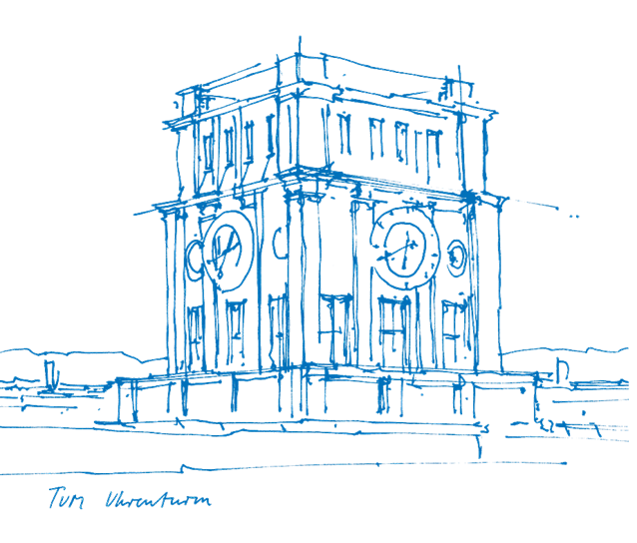
Levels of Building Fire Risk Modeling
Workflow and Generic Modeling Framework for Community Fire Risk Analysis
Chupei Lin

Slide 2
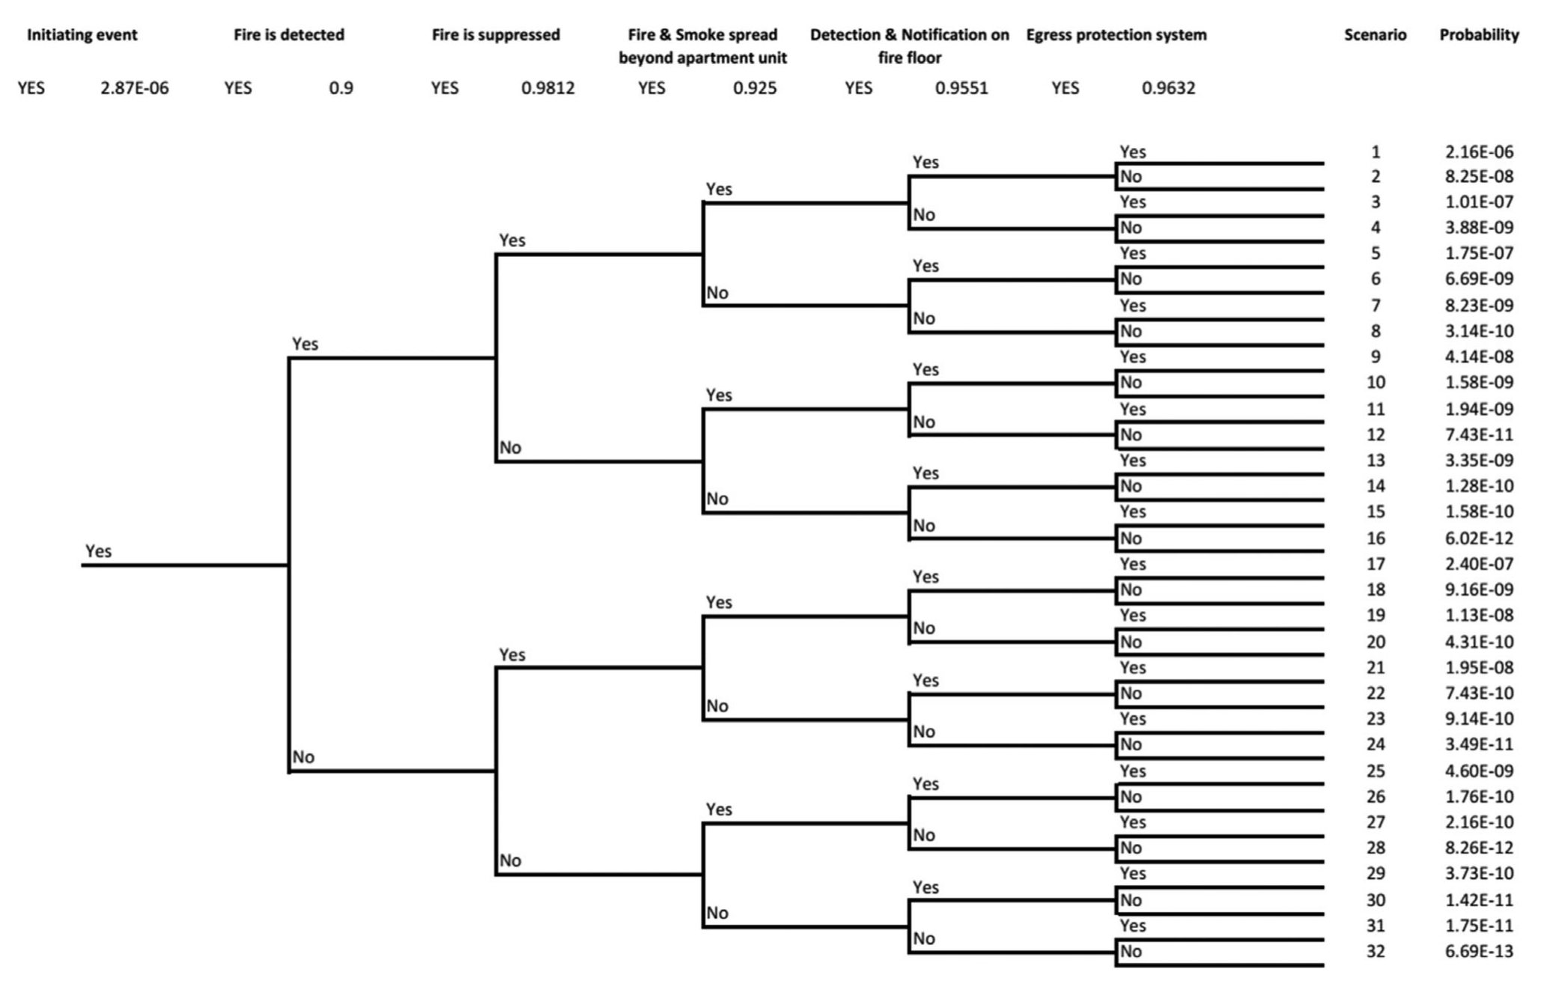
EXISTING FIRE-RISK MODELS · EXAMPLE 1 OF 4
Event Trees
Probabilistic decomposition of an initiating event into success/failure branches
KEY IDEA
An event tree examines the success and failure of systems following an initiating event (e.g., ignition).
Each branch is assigned a probability;
the leaves give the likelihood of every scenario
With the probability of each scenario, simulation tools are used to analyze the consequences.
Strengths
Transparent decision logic
Quantifies low-probability tails
Limitation
Static
Assumes branch independence and fixed probabilities
Fig. Typical event tree for a fire event in a building. Adapted from Tan et al. (2019).
2 / 14

Slide 3
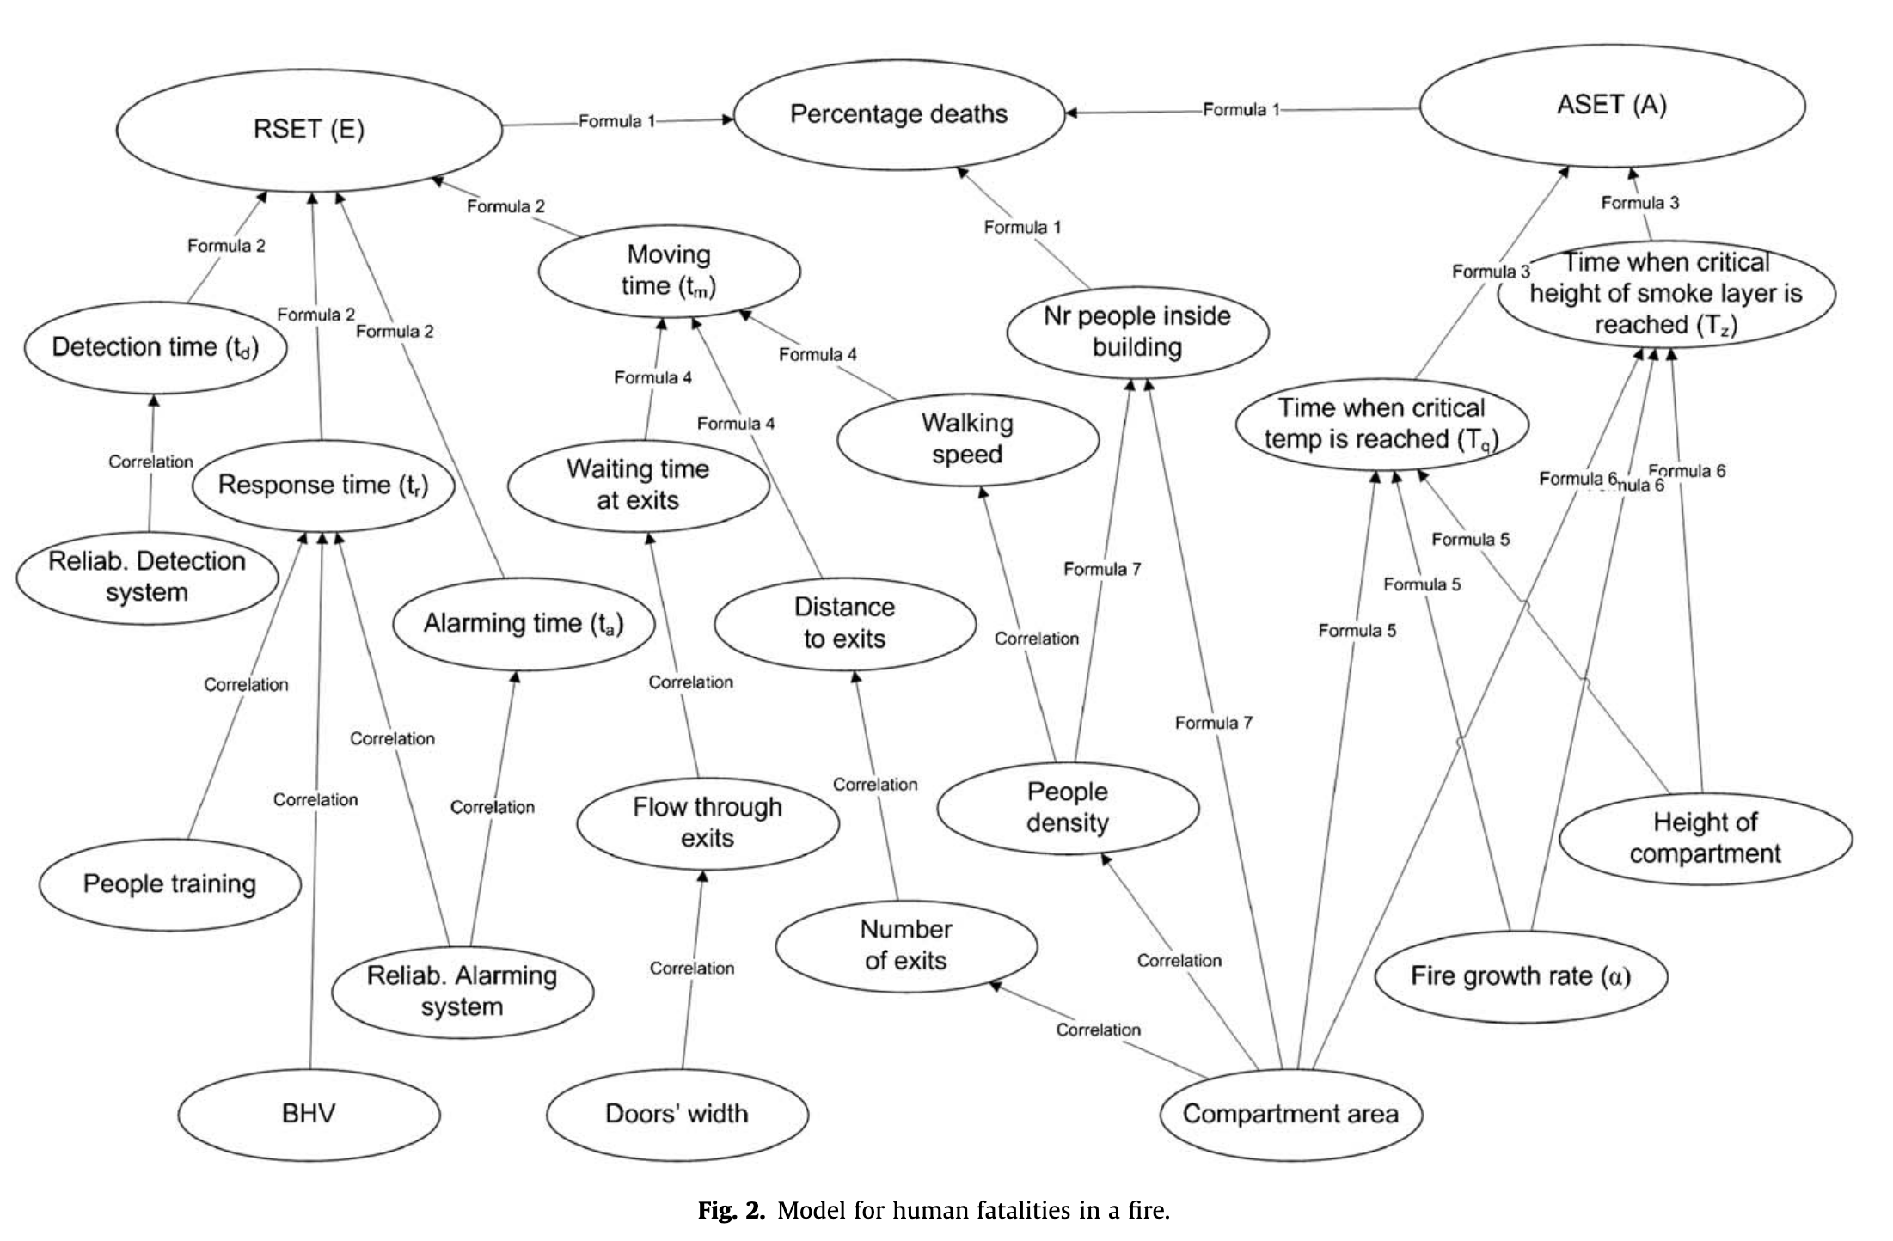
EXISTING FIRE-RISK MODELS · EXAMPLE 2 OF 4
Bayesian Networks
Directed acyclic graph of variables and conditional dependencies
KEY IDEA
Nodes represent random variables;
arcs encode causal relations between variables.
Computes posterior probabilities of outcomes given evidence.
Probabilistic, not deterministic.
Strengths
Handles partial evidence
Captures correlations between variables
Updates as new data arrives
Limitation
Requires informed conditional-probability tables.
Fig. Bayesian network for human fatalities in a fire. Adapted from Hanea and Ale (2009).
3 / 14

Slide 4
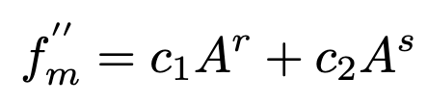
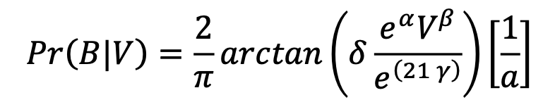
EXISTING FIRE-RISK MODELS · EXAMPLE 3 OF 4
Traditional Fire-Frequency Models
Volume / floor-area + activation-risk classification
Generalized Barrois model
Matrisk Fire Probability Model (top-down)
Tilander & Keski-Rahkonen, 2003
Matrisk BSV report, 2025
Ignition frequency:
Annual fire probability:
A is the floor area; c₁, c₂, r, s are coefficients, which are determined experimentally from observations for different building categories.
α, β, γ are determined by activation-risk class; V is the building volume.
Building categories
Activation-risk classification (VKG)
Residential buildings
Industrial buildings & warehouses
All other buildings
Classified based on the purpose code of the Association of Cantonal Building Insurance
No risk | Small | Medium | High
Room without electrical installations, without intended fire and without activating hazards | Retail, Shopping centers, Parking, Library, Hospital rooms | School classrooms, Restaurants (commercial), Industry buildings | Residential use, Hotel rooms, Kitchen use
4 / 14

Slide 5
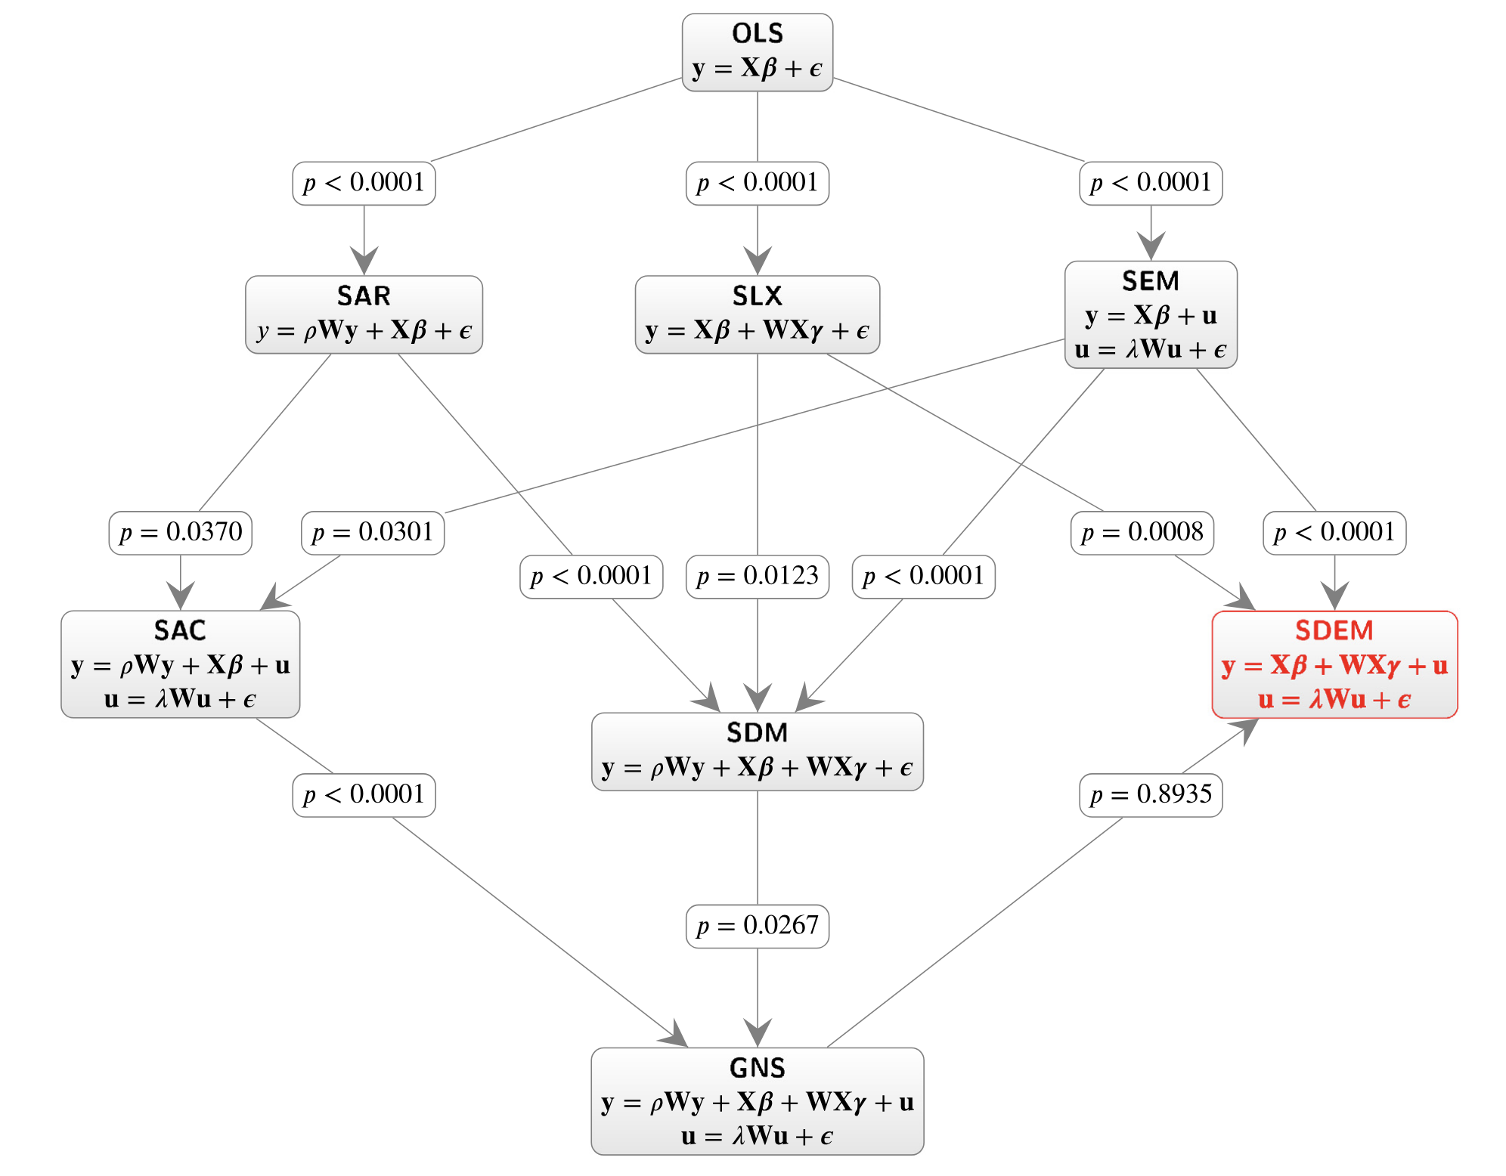
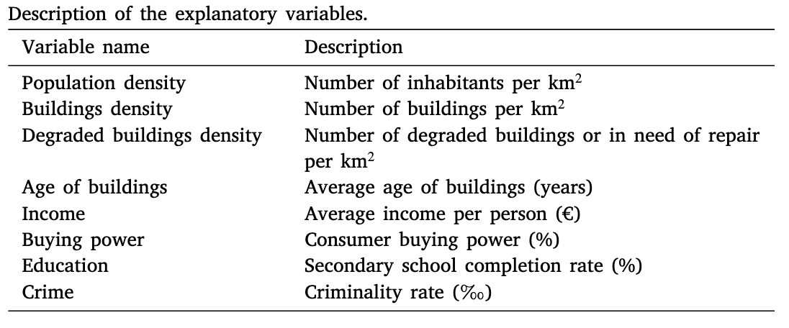
EXISTING FIRE-RISK MODELS · EXAMPLE 4 OF 4
Spatial Regression Models
OLS extended with three forms of spatial dependence
THREE SPATIAL REGRESSORS
1
Spatially lagged dependent variable
y depends on neighbors' y (ρWy term)
2
Spatially lagged explanatory variables
neighbors' X influence local y (WXγ term)
3
Spatially lagged error term
residuals correlated with neighbors (λWu term)
Fig. Ordinary Linear Regression hierarchy with spatial dependence. Adapted from Bispo et al. (2023).
5 / 14

Slide 6
INTRODUCTION
The Problem and Research Gap
6 / 14
Fires remain a substantial risk to life, property, and urban infrastructure — risk-reduction decisions operate at two scales
Research Gap · A generic model connecting occurrence / ignition and consequence for building-level fire-risk analysis.
BUILDING-LEVEL
COMMUNITY-LEVEL
Consequence analysis
Occurrence prediction
SCALE
SCALE
Single building
Urban area / community / census tracts
METHODS
METHODS
Event/fault trees, Bayesian networks
Spatial regression, machine learning
INPUTS
INPUTS
Building & occupant-behavior factors
Socio-demographic predictors (income, density, housing age)
KEY WORKS
KEY WORKS
Matellini et al. (2013) · Hanea & Ale (2009) · Tan et al. (T-H-O) (2021)
Buffington et al. (2021) · Bispo et al. (2023) · Hao et al. (2023)

Slide 7
Multi-Scale Fire Risk for Community Risk Management
Forward propagation
Forward propagation generates risk; backward selection refines models and data
Backward selection
Training procedure
Prediction procedure
Building-level
Community-level
DATA
Inputs (training set)
fire events + features
Building-level data
(building area, occupancy)
Community-level statistical data
(socio-demographic factors)
MODEL
Training
fit · validate · select
Building-level generic fire-risk model
FIRE-RISK
ASSESSMENT
Fire events
(training output)
Building fire-risk
assessment
Aggregation
Community fire risk
(aggregated)
Sensitivity analysis
DECISION
Building-level decisions
(risk-reduction measures)
Community-level decisions
(risk-reduction measures)
VOI
7 / 14

Slide 8
COMMUNITY-LEVEL INPUTS
Critical Factors for Fire Occurrence
Predictors and effects identified in the empirical literature
HUMAN-RELATED
BUILDING-RELATED
The number of occupants
Proxy
To occupants' behaviors
Building volume / area
Building usage
More occupants → more ignition sources, greater exposure.
Population density is the most critical predictor (Buffington et al. 2021, Bispo et al. 2023, Ma et al. 2023)
Activation-risk class (VKG): residential, hotel, retail, industrial, etc.
Tradition model
Income
Age / condition / degradation
Low-income communities cannot afford detectors, maintenance, or fire-safe heating.
Higher income → lower fire incidence (Duncanson et al. 2002, Buffington et al. 2023).
Poor housing quality creates structural vulnerabilities:
Deteriorated wiring, failing heaters, substandard materials → higher ignition rates.
Captured via pre-1950 stock (Buffington), degraded density (Bispo), post-1980 ratio (Ma).
Bispo et al. (2023) represent this factor through degraded building density; Buffington et al. (2021) through pre-1950 housing stock; and Ma et al. (2025) through the ratio of buildings constructed after 1980.
Education-level
Lower education → reduced risk awareness → higher fire frequency
(Corcoran et al. 2007, Hu et al. 2019, Anderson-Bell et al. 2021).
Effects
Time effect
Cold winters drive seasonal peaks consistently across U.S. regions (Ma et al. 2025).
Spatial effect
Spatial dependence demonstrated at census-tract level in Portugal (Bispo et al. 2023).
8 / 14

Slide 9
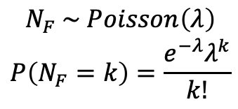

FIRE-RISK MODEL — OCCURRENCE / IGNITION
LEVEL
Level 1 · Traditional (Volume-based) Models
1
Fire rate λ as a function of building volume / floor area and building (activation-risk) type
POISSON FRAMEWORK
LEVEL 1 · TRADITIONAL
Annual number of fire incidents:
Building volume / floor area as proxy for occupant population
$$N_{F} \sim Poisson\left(λ\right)$$
$$P\left(N_{F}=k\right)=\frac{e^{−λ}λ^{k}}{k!}$$
$$λ=f(V, type)$$
N_{F} = annual fire-incident count in a building
λ = fire rate (modelled at three levels)
V building volume
type building usage type / activation-risk class (VKG)
f( · ) empirical fit (Barrois / Matrisk)
Level 1: Volume
Level 2: Socio-demographic factors + Linear additive
Level 3: Nonlinear intercorrelated
Limitation Ignores socio-demographic and temporal predictors. Volume alone is a coarse proxy for the true ignition drivers.
9 / 14

Slide 10


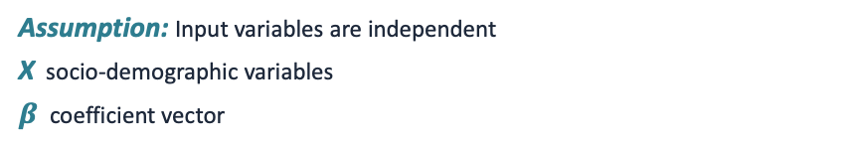



FIRE-RISK MODEL — OCCURRENCE / IGNITION
LEVEL
Level 2 · Linear-Additive with Socio-Demographic Predictors
2
Volume + linear contributions from input variables, hierarchical across spatial scales
MODEL FORMULATION
HIERARCHICAL BAYESIAN
Add a generalized linear-additive part:
Individual building → Community → City → Country
Country level
$$f\left(V\right), μ_{coun}, σ_{coun}^{2}$$
Assumption: Input variables are independent
X socio-demographic variables
$β$ coefficient vector
City level
$$μ_{city}\sim N\left(μ_{coun},σ_{coun}^{2}\right), σ_{city}^{2}$$
Spatial-temporal extension (time effect):
Community level
$$β\sim N\left(μ_{city},σ_{city}^{2}\right)$$
Seasonal / temporal heterogeneity captured via $β_{t}$.
Assumption:
within the same community, $β$ is the same at the building level
10 / 14

Slide 11


FIRE-RISK MODEL — OCCURRENCE / IGNITION
LEVEL
Level 3 · Nonlinear with Variable Correlations
3
Capturing interactions and complex relationships among input variables
VARIANT A · VOLUME INDEPENDENT
VARIANT B · FULLY GENERALIZED
Building volume kept independent;
nonlinear function for the remaining input variables.
All inputs, including building volume, enter a single nonlinear function.
g( · ) fully nonlinear (e.g. GAM, neural network)
Most flexible: captures interactions and correlations among all input variables.
Trade-off: less interpretability, higher data requirements.
f(V) traditional volume-based contribution
g(X) nonlinear function of socio-demographic / building factors
Captures complex correlations among inputs while preserving the well-understood role of building volume.
11 / 14

Slide 12
GENERIC MODELING FRAMEWORK
Fire-Induced Fatalities
Hazard · Exposure · Vulnerability — performance-based fire-safety design for consequence analysis
HAZARD
VULNERABILITY
Occupant
behavior
Building
characteristics
Building-level data
Community-level statistical data
ASET
RSET
Building-level generic model
Fire ignition
Major
Probability of fatalities
Damage state
EXPOSURE
Fire fighting
Occupants
Performance-based fire-safety design: timelines, damage states, and occupant states for fatality estimation.
12 / 14

Slide 13
VULNERABILITY DEEP-DIVE
ASET / RSET — Inputs and Sub-Timeline Uncertainty
Each sub-time is itself uncertain; ASET and RSET combine to determine fatality probability
ASET — Available Safe Egress Time
RSET — Required Safe Egress Time
Definition
Time from ignition until conditions become untenable for occupants.
Drivers
Fire-growth curve (slow / medium / fast / ultra-fast), compartment geometry, ventilation, and the chosen untenability criterion.
Inputs
Fire-growth rate
Peak heat-release rate (HRR)
Ventilation conditions
Compartment volume
Definition
Detection + alarm + pre-movement (reaction) + movement time required for occupants to evacuate.
Drivers
Pre-movement varies from under a minute (alert workers) to many minutes (sleeping occupants, mobility-limited, or those attempting to fight the fire).
Movement depends on geometry, exit width, density, and walking speed.
Inputs
Occupant population (age, mobility, familiarity)
Pre-movement time distribution
Exit availability and geometry
Alarm reliability
Time from ignition
Ignition (t = 0)
Detection
Alarm
Pre-movement
Movement
Sensors react
Notification
Decide, prepare
Walk to exit
RSET
ASET
Last occupant out
Untenability
Fatality occurs when RSET > ASET.

Slide 14
QUANTIFYING UNCERTAINTY
Sources of Uncertainty
Model and inputs for the model; ASET and RSET each contribute consequence-side uncertainty
Model
Input variables
M
X
Parameters uncertainty
uncertainty in fitted coefficients (β, σ²) and prior choices
Model-structure uncertainty
wrong functional form, omitted variables, residual errors
Statistical-level inputs
income, education, housing age reported at tract / census level — not available per individual building
Consequence analysis · ASET
Consequence analysis · RSET
A
R
Ignition location & initial fuel load
Heat-release rate · Fire-growth rate
Flashover probability and timing
Ventilation conditions (doors/windows open or closed?)
Suppression activation time & effectiveness
Zone-model uncertainty
CFD model
Each sub-time is a random variable
detection · alarm · pre-movement · movement
Population heterogeneity
age, mobility, familiarity vary across the occupant pool
Behavioral uncertainty
decisions under stress, mis-perceptions, panic, group dynamics
14 / 14

Slide 15
CLOSING
Conclusion
A generic probabilistic model connecting occurrence and consequence for building-level fire-risk analysis
Goal · A generic probabilistic model connecting occurrence and consequence for building-level fire-risk analysis.
Why probabilistic
Why building-level
Fire-risk analysis exposes uncertainty explicitly; instead of a conservative deterministic estimate, we report what we don’t know and make better decision-making under risk with the distribution of possible outcomes.
Building-level models capture fine-grained building and occupant detail.
Why Bayesian networks
Then what
A graphical model encodes the conditional dependence structure among key factors; expert knowledge (and/or data) supplies the conditional probability tables; the DAG makes the inference logic intuitive.
Use the model to support decision-makers and policy-makers: reduce community-level fire risk and identify the most influential factors for each individual building.
15 / 17

Slide 16
DECISION SPACE
Decisions
Risk-reduction and urban-planning decisions identified in the literature
Single building
Portfolio / community
RISK REDUCTION
URBAN PLANNING
Intervention
Resource allocation
Matellini et al. (2018) · Hao et al. (2023)
Buffington et al. (2021) · Wu et al. (2026) · Song et al. (2017) · Hossain (2023)
Fire-station location planning
Performance-based structural fire design
Bispo et al. (2023) · Cui et al. (2024) · Lee et al. (2025)
Hasofer et al. (2007) · Chu & Sun (2008) · Gernay et al. (2016) · Zhang et al. (2017)
Insurance risk stratification
De Sanctis & Fisher (2015) · Du et al. (2025)
Open questions
- Which decisions matter most for community fire-risk management?
- Given an estimate of fatality risk in a building, what decisions does it support, and for whom?
- In fire risk analysis/modeling, where does uncertainty matter most?
16 / 17

Slide 17
INPUTS
Data
Critical factors identified from literature and additional sources needed
FOR THE MODEL
WANTED
Identified critical factors
Wanted data
Building information
Fire event reports
Building volume
Building type
Building age / condition / degradation
Building-level incident records.
Occupant information
Fire occurrence statistics
Number of occupants
Income status
Education level
Census-tract / municipality fire-related data with socio-demographic predictors.
17 / 17

Slide 18



