Slide 1

COLOUR SYNC
Department of Computer Science and Engineering Interdisciplinary Project
COLOR SYNC
Project Student
J.Sravanti
41111209
Guide
Dr.Vaissnave.V
M.E.,Ph.D
Department of CSE

Slide 2
Presentation Outline
Objectives of the Proposed Work
Literature Survey
Ideation Map
Proposed System
Modules
Results and Discussions
Conclusion
References
2

Slide 3
Objectives
The primary objective of this project is to develop a machine learning-based solution for automating and enhancing the process of color coordination in clothing.
This objective can be broken down into several key components:
Image Classification: Implement a Convolutional Neural Network (CNN) to classify clothing items as either shirts or pants from input images. This classification forms the foundation for subsequent color analysis.
Dominant Color Extraction: Utilize the Color Thief library to extract the dominant color from each clothing item image, providing a hexadecimal representation of the dominant color..
3

Slide 4
Objectives
Color Similarity Calculation: Calculate the similarity percentage between the dominant colors of the shirt and pants. This percentage quantifies how well the colors of the two clothing items match.
User-Friendly Interface: Create an intuitive and user-friendly interface that allows users to upload images of clothing items and receive instant feedback on color coordination.
Real-World Application: Showcase the practicality of the system by analyzing a collection of clothing item images and providing feedback on color matching.
Accuracy and Efficiency: Ensure that the image classification and color analysis processes are accurate and efficient, providing reliable results to users.
4

Slide 5
Literature Survey
Color synchronization, also known as color sync, is a crucial aspect of various technological applications, including image processing, multimedia, printing, and display technologies. Understanding color synchronization requires exploring its underpinnings in human color perception and psychology.
Color synchronization relies on the utilization of different color spaces and models for accurate representation and conversion. This encompasses RGB, CMYK, CIE Lab, and HSV models, each offering unique advantages in specific contexts. Techniques and algorithms for color synchronization involve intricate processes such as color matching, calibration, transfer, mapping, correction, and enhancement.

Slide 6
Literature Survey
The applications of color synchronization are widespread and diverse. From image and video processing to printing and color management, color sync plays a pivotal role in enhancing visual quality and user experience. It is also integral to multimedia broadcasting, streaming, and immersive technologies like virtual reality (VR) and augmented reality (AR).
Evaluating the performance of color synchronization techniques involves rigorous methodologies and metrics, including color accuracy, perceptual quality, and computational efficiency. Recent research efforts focus on exploring innovative approaches and anticipating future trends in color synchronization, underscoring its significance in advancing technological applications.

Slide 7
Proposed System
In the ever-evolving world of fashion and technology, finding the perfect color coordination for clothing can be a creative challenge. However, with the power of machine learning and image analysis, it's now possible to streamline this process and make it more accessible. This project harnesses the capabilities of computer vision and deep learning to create a versatile tool that can assist in color-matching outfits.
The project then proceeds to measure the color similarity between the shirt and pants. This is achieved by converting the extracted color information into RGB format and calculating the similarity percentage based on the Euclidean distance between the two colors in a three-dimensional color space.
The resulting percentage represents how well the colors of the shirt and pants match.
7

Slide 8
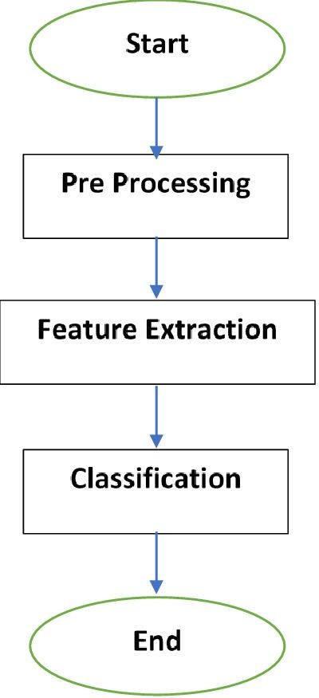
Ideation Map

Slide 9
Modules Needed
There are some of the important modules used in this project. These are needed to installed before running the program.
Modules are:
Open cv- OpenCV is used for image processing
Matplotlib- It is used for displaying images and plots
Numpy- It is used for numerical operations on arrays.
Tensor flow- It is used for building and training deep learning models
Pillow- It is used for image loading and manipulation.
Colour theif- It is used for extracting dominant colors from images.
Web color- It is used for working with color names

Slide 10
Modules
Color Space Management Module: This module handles the conversion of colors between different color spaces (e.g., RGB, CMYK, CIE Lab) to ensure uniform color representation across devices and platforms.
Color Matching Module: This module compares colors from different sources and adjusts them to match a reference color. It ensures consistency in color appearance across different media and devices.
Real-time Color Synchronization Module: This module provides real-time adjustment and synchronization of colors to accommodate dynamic changes in input data or environmental conditions.
Quality Assessment and Monitoring Module: This module evaluates the quality of color synchronization by analyzing color accuracy, consistency, and uniformity.

Slide 11
Software & Hardware Requirements
Software Requirements & Hardware Requirements
PROCESSOR : Intel Core i5 or a better processor
OPERATING SYSTEM : Windows 8, Windows 10, MAC OS, Linux.
MEMORY : 8 GB RAM or higher
HARD DISK SPACE : Minimum 30 GB or higher
GRAPHICS CARD: A better graphics card is recommended for better performance of emulator.
INTERNET : Must have a good internet connection.

Slide 12
Results Section
The code can be runned in Jupyter Notebook or VS code or idle. The code was executed successfully.
Data Description:
For this project we created dataset Manually .Data set Size: 70 images
Model Performance:
Accuracy : 90%

Slide 13
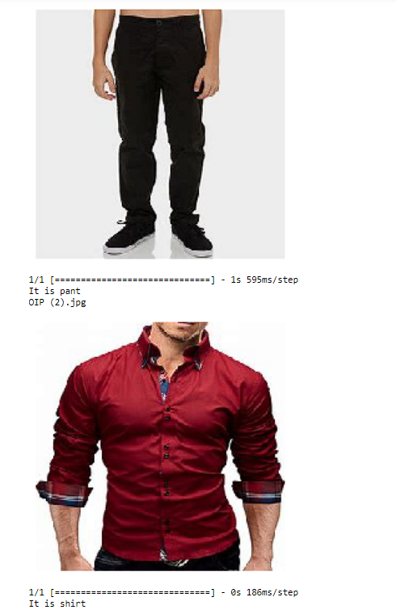
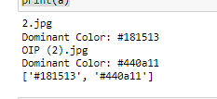

Application - Snapshot
Predicting its Shirt or Phant
Extracting the color from the image
Extracting the color from the image
Final result of the model

Slide 14
CONCLUSION
In conclusion, the integration of machine learning techniques for color synchronization represents a significant advancement with far-reaching implications across numerous domains.
By harnessing the power of machine learning, we have the potential to enhance the quality and consistency of visual content, leading to more accurate and visually appealing representations in the digital realm.
This ongoing research and innovation in color synchronization through machine learning are poised to revolutionize how we perceive and interact with visual information.

Slide 15
Reference
"Image Processing Techniques for Object Detection in Fashion" Authors: Fahad Saeed, Muhammad Sharif, et al. Published in: Journal of Theoretical and Applied Information Technology, 2013.
"Color Image Segmentation: A State-of-the-Art Survey" Authors: Junaid Ali Siddiqui, M. Usman Akram, et al. Published in: IEEE Access, 2020.This comprehensive survey covers color image segmentation methods, which can be relevant for color extraction in clothing images.
"Fashion-MNIST: A Novel Image Dataset for Benchmarking Machine Learning Algorithms" Authors: Han Xiao, Kashif Rasul, et al.Published in: arXiv, 2017. While this dataset is primarily for fashion classification, it can be useful for color analysis and matching as well.
"Machine Learning Techniques for Color Harmonization in Fashion" Authors: S. Vijayalakshmi, S. M. Shalinie, et al.Published in: Procedia Computer Science, 2018.The paper discusses how machine learning techniques can be applied for color harmonization in fashion design.

