Slide 2
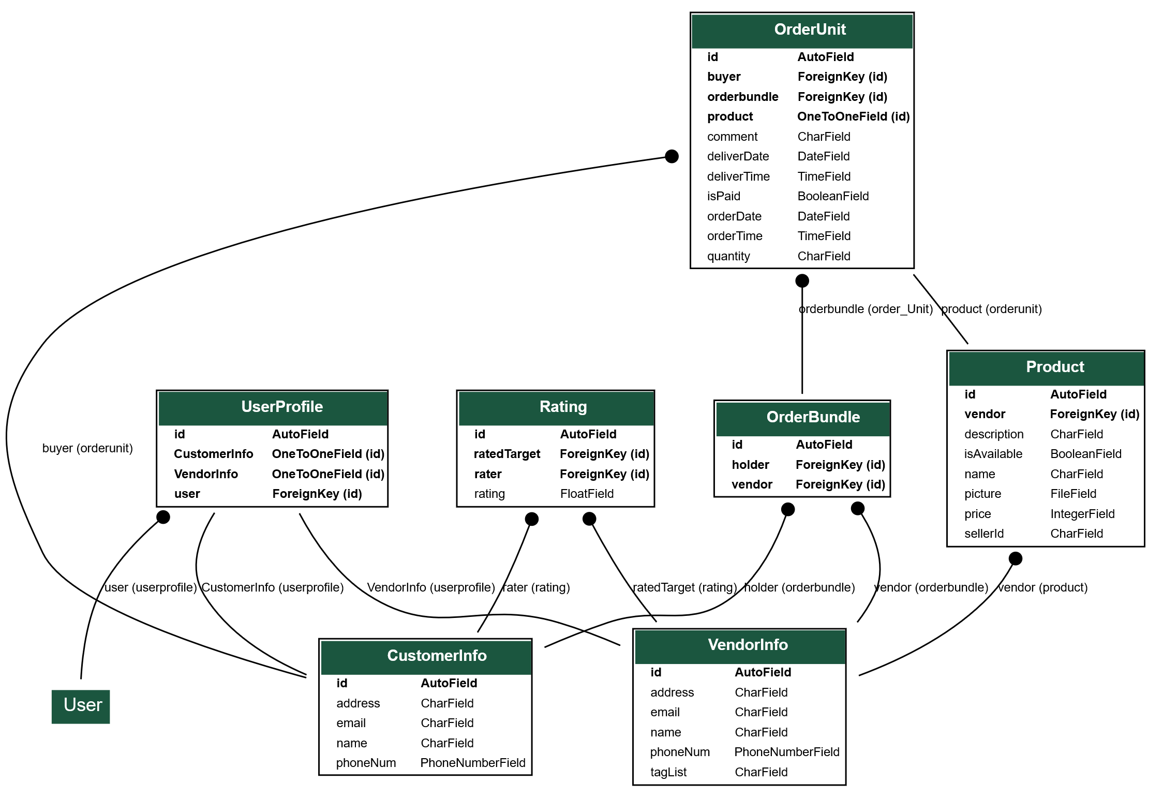

Slide 3
Search by vendor name
VendorInfo.objects.filter(name__contains=‘searchText')
Search by address (?)
VendorInfo.objects.filter(address__contains=' searchText ')
Search by tag
VendorInfo.objects.filter(tagList__contains=' searchText ‘)
OR/AND search
from django.db.models import Q
VendorInfo.objects.filter(Q(tagList__contains=' searchTextA') & Q(tagList__contains=' searchTextB’))
VendorInfo.objects.filter(Q(tagList__contains=' searchTextA’) | Q(tagList__contains=' searchTextB’))

Slide 4
Search by rating
from django.db.models import Avg
avg_rating = Rating.objects.values('ratedTarget').annotate(avg_rating=Avg('rating')).order_by('ratedTarget')
avg_rating_filtered = avg_rating.filter(rating__gte=3)
avg_rating_filtered.values('ratedTarget')
VendorInfo.objects.filter(id__in = avg_rating_filtered.values('ratedTarget'))

Slide 5
ShareLink
Need to store shareLink in order Model?
Create garbled text for unique link?
Use GET requests with parameters in order Model to create the link?
Ex: /groupbuying/sharelink?UniqueInfo=xxxxx
There should be a relationship field, and we will check that between order creator and others to determine whether show the order after the link is opened by someone(?)

