Slide 1


RESTAURANT RECOMMENDATION SYSTEM
Student Name: J SUBHASREE |  | Univ Reg No: 160501163
DOMAIN: | Information Retrieval
Date of Review | 30-10-2019

Slide 2
Abstract -Restaurant Recommendation System
Online recommendation service had brought economic benefits for traditional catering industry . They are being enforced to offer personalized set of services to the users. There are lot of projects developing restaurant recommendation system using only user Id, business Id, and rating. In my project, we will move to the next level and consider the review text to develop a recommendation system. Here , we extract the features from the text which helps to make better recommendations and use them to build recommendation model.

Slide 3
PROBLEM STATEMENT

Slide 4
Problem Statement
To develope a restaurant recommendation system in python that uses reviews of the users to make recommendations.The recommender strategies used is a collaborative filtering method,Matrix factorisation method.

Slide 5
INTRODUCTION

Slide 6
Introduction
In this project, we will move to the next level and consider the review text to develop a recommendation system.Here,we extract the features from the text which helps to make better recommendations and use them to build recommendation model.
The recommendations are done using collaborative filtering method,matrix factorisation.

Slide 7
Introduction
a) COLLABORATIVE FILTERING
Analyzing relationships between users and inter-dependencies among products to identify new user-item associations.
In general there is two method to achieve Collaborative filtering:1.Neighborhood Methods 2.Matrix factorisation methods

Slide 8
Introduction
b) MATRIX FACTORIZATION METHODS
When a user gives feed back to a certain movie they saw (say they can rate from one to five), this collection of feedback can be represented in a form of a matrix.
One strength of matrix factorization is the fact that it can incorporate implicit feedback, information that are not directly given but can be derived by analyzing user behavior. Using this strength we can estimate if a user is going to like a movie that (he/she) never saw. And if that estimated rating is high, we can recommend that movie to the user.

Slide 9
Limitations Of Collaborative Filtering
Sparsity
The Cold Start Problrm
Fraud

Slide 10
LITERATURE SURVEY

Slide 11
Literature Survey - 1
Restaurant Recommendation System for User Preference and Services Based on Rating and Amenities.
Author : R.M. Gomathi ; P. Ajitha ; G. Hari Satya Krishna ; I. Harsha Pranay
Year of Publication : 2009
Published in : IEEE
Learnings :The NLP - Natural Language Processing is imbibed for examining and tagging all the previous user’s comments (whether positive or negative) for every hotel, thereafter computing the overall % of the comments and storing the output. In the process of Restaurant recommendation, first the user chooses the hotel’s features according to his interest and centered on this, the corresponding hotels are fetched and the user comments are examined to identify the hotel with the highest ranking. Eventually, the highest rated hotel is being recommended to the user by the restaurant recommended system.

Slide 12
Literature Survey - 2
A Collaborative Filtering Recommendation Algorithm Based On User Clustering And Item Clustering
Authors: SONGJIE GONG AND ZHEJIANG
Year of Publication: 2010
Published in:IEEE
Learnings: SongJie Gong and Zhejiang proposes a 'personalized recommendation systems' is widely utilized in e-commerce websites to provide recommendations to its users. The paper states that the recommendation systems use Collaborative Filtering technique which has been successful in providing recommendations. A technique to solve the common problems that are encountered in recommender systems namely, scarcity and scalability is suggested in this paper. This paper suggests the recommender system which combines both user clustering and item clustering can be used to provide recommendations

Slide 13
PROPOSED WORK

Slide 14
RECOMMENDED SYSTEM
1. OBJECTIVE
The system recommends a restaurant based on user preferences and depending upon the ratings of that restaurant . Here we take preferences from the user and evaluate them by using algorithms such as Collaborative filtering and Matrix factorisation.
2. COLLECTING AND PREPROCESSING OF DATA
The review texts of many users for various restaurants they have been to are collected along with BUSINESS_ID , USER_ID and ratings . This review texts are then cleaned by removing stop words and features are extracted, which which recommendations can be made.

Slide 15
RECOMMENDED SYSTEM
3. RECOMMENDATIONS
The users enters his preference ,the recommendation engine uses the collaborative filtering technique, matrix factorisation and suggests top 3 restaurants for the user along with the restaurant’s ratings.

Slide 16
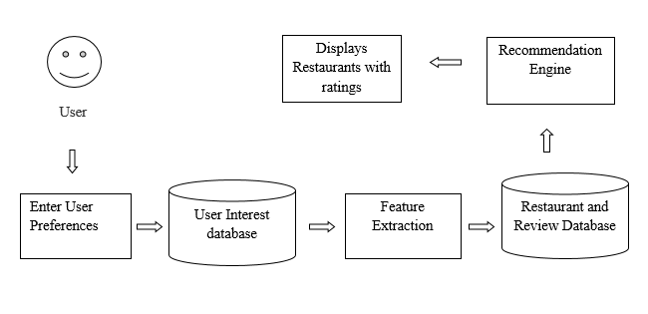
Architecture Diagram

Slide 17
SYSTEM REQUIREMENTS

Slide 18
System Requirements
HARDWARE REQUIREMENTS
PROCESSOR : Intel Core i5 and above
HARD DISK DRIVE : 1TB
RAM : 4GB+
SOFTWARE REQUIREMENTS
OPERATING SYSTEM : Windows 10
LANGUAGES NEEDED : Python
RUNTIME PLATFORM : Spyder

Slide 19
MODULE IMPLEMENTATION AND SNAPSHOTS

Slide 20
Implementation Modules
Preprocessing of review texts
Feature Extraction
Matrix Factorisation
Restaurant recommendations

Slide 21
1.Preprocessing of Review text
Load the required packages and the dataset.
We are using review text to improve the model performance hence the initial step is to clean the text as much as possible.
Consider the required attributes and apply clean_text method on review text

Slide 22
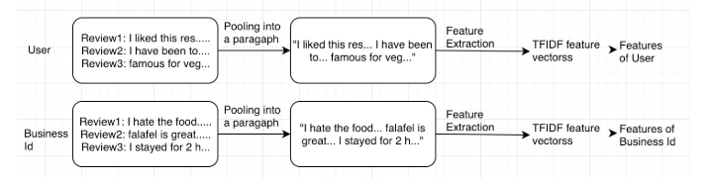
2.Feature Extraction Architecture

Slide 23
3. Matrix Factorisation
Feature vectors for user__id and business_id are obtained.
Now, create a user item rating matrix by using the attributes user_id, business_id, rating_stars.
The Objective of Matrix Factorization is to decompose each user rating into a User-Factor Vector and A Product-Vector

Slide 24
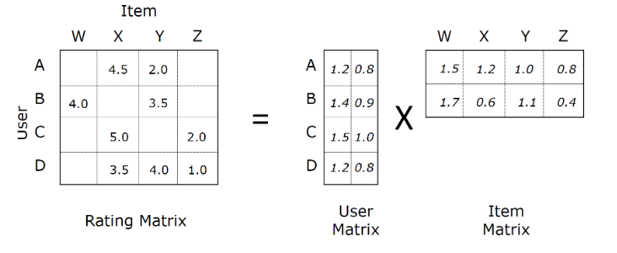
3. Matrix Factorisation

Slide 25
4.Prediction
Predict the most relevant restaurant based on the user search i.e. simply the inner product of the feature vector of plain text and feature vectors of business Id. Out of all, top N records to be fetched.

Slide 26
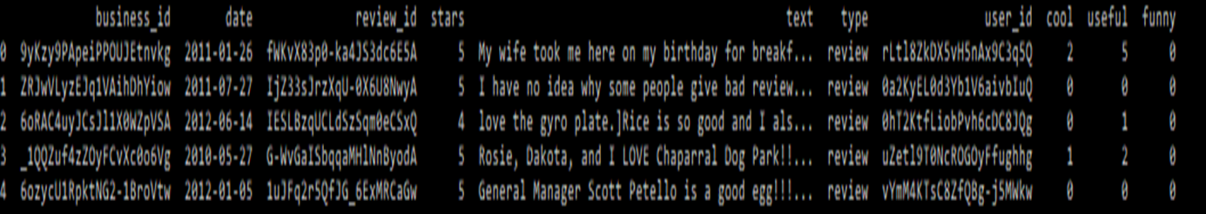
SNAP SHOT- DATA SET

Slide 27
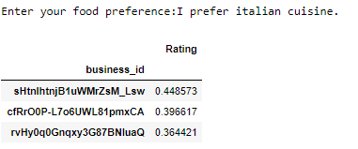
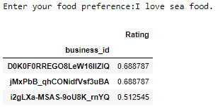
SNAP SHOT – FINAL OUTPUT

Slide 28
CONCLUSION AND FUTURE WORK

Slide 29
Conclusion and Future Work
Conclusion
The project Restaurant Recommendation System was successfully completed by using User based collaboration method and matrix filterisation technique .The user’s preference was obtained and the are compared with featured from the review texts of other users and the restaurant recommendations are obtained.

Slide 30
Conclusion and Future Work
Future Work
In order to commercially use the product, it is important to collect data of all the restaurants across the city long with review text. Furthermore, since the use of mobile phones is huge, the application will be more effective if built in mobile platform.

Slide 31
REFERENCES

Slide 32
References
1. Restaurant Recommendation System for User Preference and Services Based on Rating and Amenities;R.M. Gomathi ; P. Ajitha ; G. Hari Satya Krishna ; I. Harsha Pranay;2019 International Conference on Computational Intelligence in Data Science (ICCIDS)Year: 2019
2Arcuti .S, M. Copetti, A. Fontana ,G. Logroscino, D. Martino and Rizzo (2016) “ A categorical review of recommender Systems” International Journal of Distributed and Parallel Systems (IJDPS) Vol.3, No.5.
3. SongJie Gong, Zhejiang (2009)“A Collaborative Filtering Recommendation Algorithm based on User Clustering and Item Clustering”. Business Technology Institute vol. 16, 2016, pp. 265–283.

Slide 33
Thank You

