Slide 1

A Watermark for Large Language Models
Generative Intelligence Lab, Chungnam National University
Jaesung Hwang

Slide 2
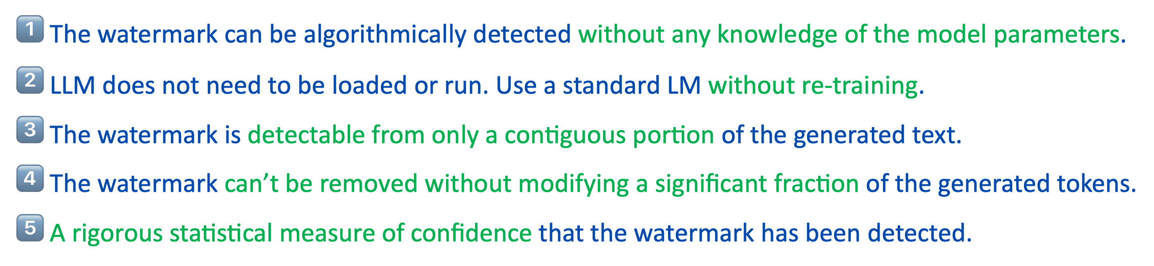
01. A Watermark for Large Language Models
Kirchenbauer et al. – ICML 2023
$\text{1️⃣}$ The watermark can be algorithmically detected without any knowledge of the model parameters.
2️⃣ LLM does not need to be loaded or run. Use a standard LM without re-training.
3️⃣ The watermark is detectable from only a contiguous portion of the generated text.
4️⃣ The watermark can’t be removed without modifying a significant fraction of the generated tokens.
5️⃣ A rigorous statistical measure of confidence that the watermark has been detected.
https://arxiv.org/pdf/2301.10226

Slide 3
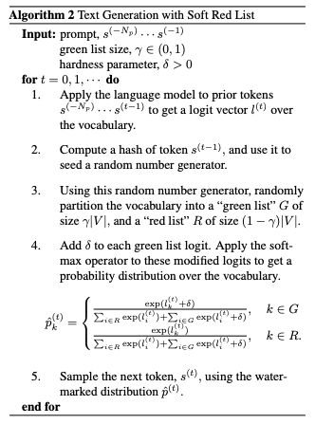
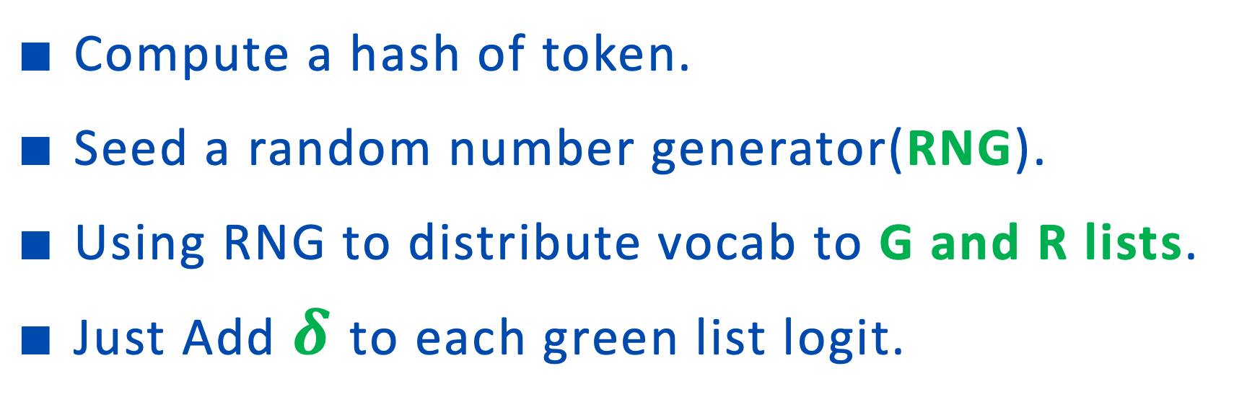
01. A Watermark for Large Language Models
$∎$ Text Generation with Soft Red List
$∎$Compute a hash of token.
$∎$Seed a random number generator(RNG).
$∎$Using RNG to distribute vocab to G and R lists.
$∎$Just Add $δ$to each green list logit.

Slide 4
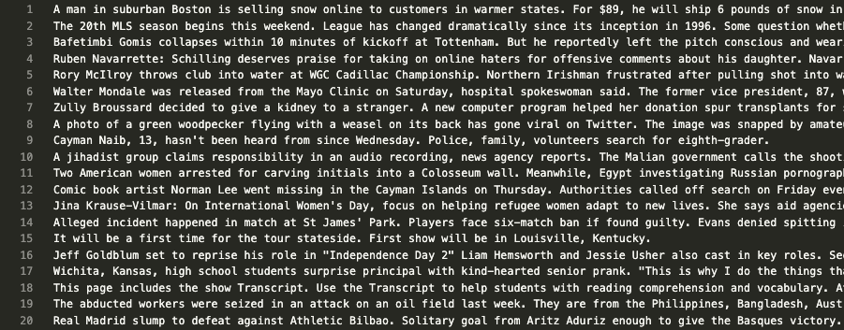
02. Preliminary test
$∎$ English Datasets test
CNNDM_sum_val 500 samples.
Model : facebook/opt-1.3b

Slide 5
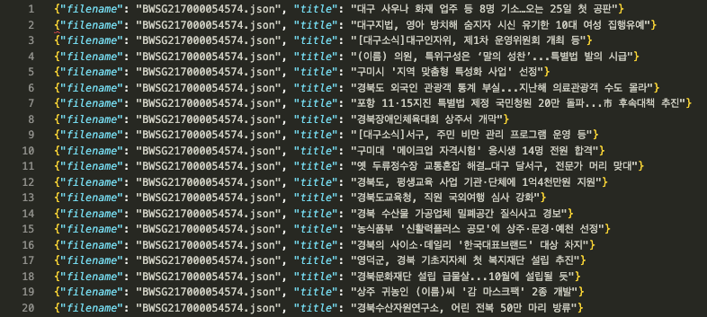
02. Preliminary test
$∎$ Korean Datasets.
Ai허브 대규모 웹데이터 기반 한국어 말뭉치 – 뉴스 헤드라인 500 samples.
Model : KoAlpaca-llama-1-7b

Slide 6
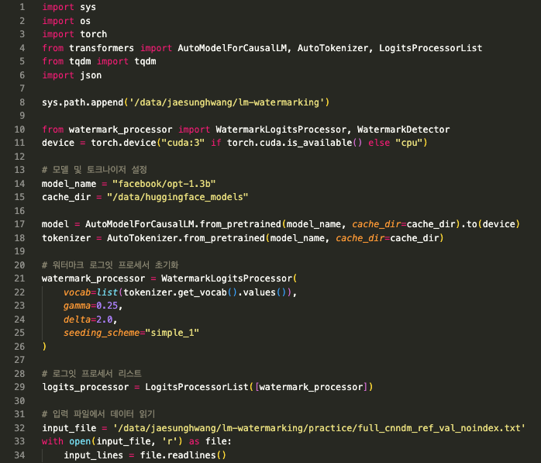
03. Code
Initialize

Slide 7
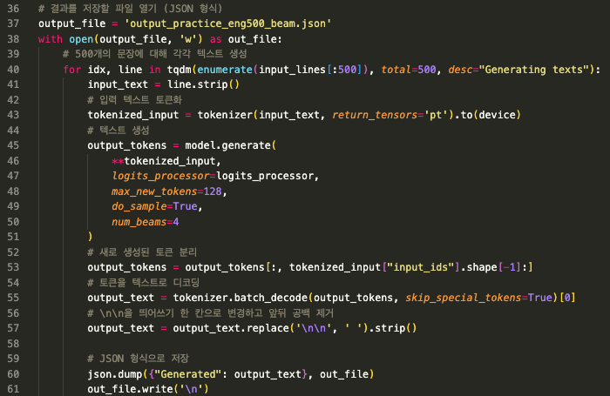
03. Code
Insert into Generate function

Slide 8
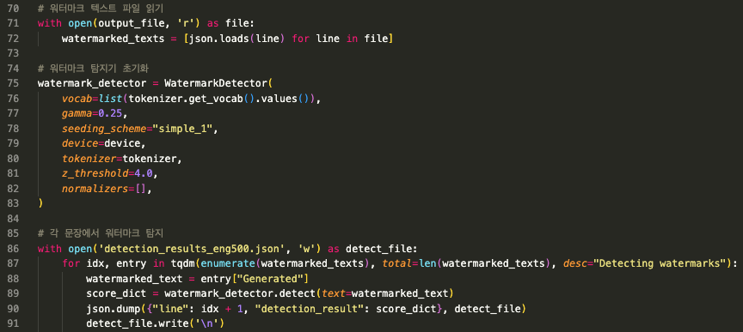
03. Code
Detect watermark

Slide 9
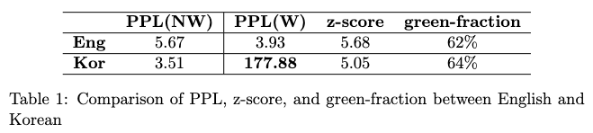
04. Results

Slide 10
THANK YOU.

