Slide 1
[320] Reproducibility (Dependencies)
Department of Computer Sciences
University of Wisconsin-Madison

Slide 2
Reproducibility
Big question: will my program run on someone else's computer?
Things to match:
a program must fit the CPU;
python.exe will do this, so
program.py won't have to
1
Hardware
2
Operating System
we'll use Ubuntu Linux on
virtual machines in the cloud
3
Dependencies
today: versioning

Slide 3
Dependency Versions
this program "depends" on pandas
program.py
import os, sys, json
import pandas
import pandas
print("Pandas Version:", pandas.__version__)
# code that uses pandas
you can check a
module version
behavior depends on which release was installed
pip install pandas
or
pip install pandas==0.25.1
or
pip install pandas==0.24.0
or...

Slide 4
Versioning: motivation and basic concepts

Slide 5
Many tools auto-track history (e.g., Google Docs)
when
it changed
what
changed
who
changed it
https://zapier.com/apps/google-docs/tutorials/google-docs-revision-history

Slide 6
Version Control Systems (VCS)
Useful for many kinds of projects
code, papers, websites, etc
manages all files for same project (maybe thousands) in a repository
Explicit snapshots/checkpoints, called commits
users manually run commands to preserve good versions
Explicit commit messages
who, what, when, why
Work can branch out and be merged back
people can work offline
can get feedback before merging
humans need to resolve conflicts when versions being merged are too different
partner A working on hw.py at school
partner B also working on hw.py, without wifi
what happens when the plane lands?

Slide 7
Example
add file
edit file
edit+add
hello.py
hello.py
hello.py
print("hi")
print("hello")
print("world")
import dog
dog.bark()
commits:
dog.py
def bark():
print("bark"*10)
time
at any point in time,
you just see one version
of the files on your computer

Slide 8
Use case 1: troubleshooting discovered bug
commit 1
msg: first version
author: Gurmail
commit 2
msg: upgrade light
author: Gurmail
commit 3
msg: save energy
author: Musa
time
bug introduced
along with feature
somebody notices
bug after commit 3
who will get blamed?

Slide 9
Use case 1: troubleshooting discovered bug
test.py:
test.py:
test.py:
commit 1
msg: first version
author: Gurmail
commit 2
msg: upgrade light
author: Gurmail
commit 3
msg: save energy
author: Musa
time
bug introduced
along with feature
somebody notices
bug after commit 3

Slide 10
Use case 1: troubleshooting discovered bug
test.py:
test.py:
test.py:
test.py:
commit 1
msg: first version
author: Gurmail
commit 2
msg: upgrade light
author: Gurmail
commit 3
msg: save energy
author: Musa
commit 4
msg: my bad, my bad!
author: Gurmail
time

Slide 11
Use case 2: versioned releases
1
2
3
4
5
6
7
8
time
which version would you use?

Slide 12
Use case 2: versioned releases
1
2
3
4
5
6
7
8
v1.0
v2.0
v2.1
v2.2
time
tag "good" commits to create releases
https://pypi.org/project/pandas/#history
https://github.com/pandas-dev/pandas/releases

Slide 13
Use case 2: versioned releases
1
2
3
4
5a
6
7
8
v1.0
v2.0
5b
v2.2
it's possible to branch out,
with some people adding features (5a) and others debugging (5b)
v2.1

Slide 14
Use case 3: feedback
main branch
of code
developer’s personal branch
with experimental feature

Slide 15
Use case 3: feedback
main branch
of code
can I merge my
code back to
the main branch?
developer’s personal branch
with experimental feature

Slide 16
git

Slide 17
Version Control System Tools
tools
git providers
svn
git
Mercurial
TeamFoundation
GitLab (don’t delay, signup for a free GitLab account today, it is necessary for this class)
BitBucket
GitHub:
Linus Torvalds developed git to manage Linux as a
BitKeeper replacement
https://www.linuxjournal.com/content/25-years-later-interview-linus-torvalds

Slide 18
Git Demos
Activities:
connect to a VM via SSH
copy ("clone") a GitLab repo to the VM
view history
switch between versions
write ("commit") new versions
Notes:
LEC 001
LEC 002

Slide 19
HEAD, Branches, and Tags
Remembering commit numbers is a pain! Various kinds of labels can serve as easy-to-remember aliases
v1.0 [tag]
v2.0 [tag]
v2.1 [tag]
HEAD
main [branch]
experiment [branch]
intern [branch]
HEAD: wherever you currently are (only one of these)
tag: label tied to a specific commit number
branch: label tied to end of chain (moves upon new commits)

Slide 20
HEAD, Branches, and Tags
What branch are we on?
git branch
Create new branch
git branch branchname
Switch branch
git checkout branchname
Notes:
- create multiple branches, commit to both
- switch back and forth, show files, git log
- delete a branch

Slide 21
Branching and Merging

Slide 22
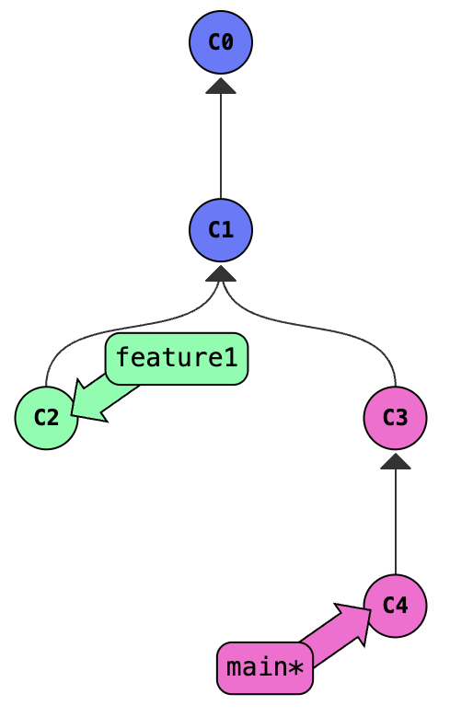
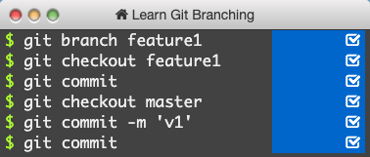
Practice Branching
Git equivalent of PythonTutor:
https://learngitbranching.js.org/?NODEMO

Slide 23
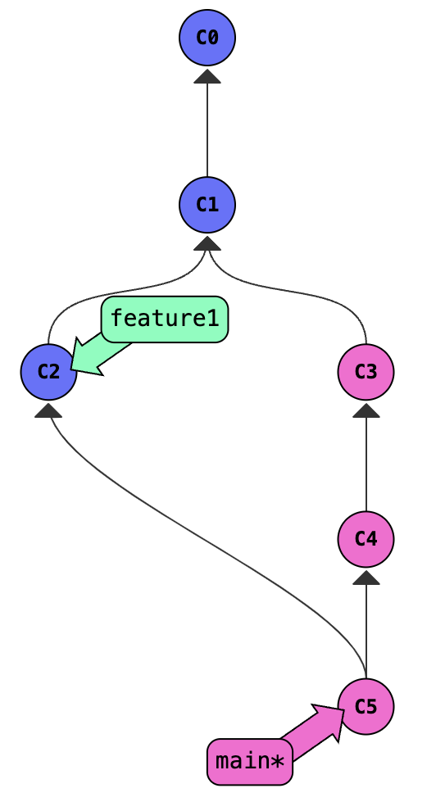
Merging without Conflicts
Switch branch
git merge frombranch
add whatever is there to the current branch
tip (or learn vim): export EDITOR=nano
Notes:
do the same thing with feature1, but in an actual repo

Slide 24
Merging with Conflicts
What happens when two people try to fix the same issue, in two different (incompatible) ways?
main branch
paper.txt
My bike which has a broken seat is in the garage
time
https://www.grammarly.com/blog/which-vs-that/

Slide 25
Merging with Conflicts
What happens when two people try to fix the same issue, in two different (incompatible) ways?
paper.txt
main branch
My bike, which has a broken seat, is in the garage.
paper.txt
My bike which has a broken seat is in the garage
paper.txt
My mountain bike that has a broken seat is in the garage
that branch
time
https://www.grammarly.com/blog/which-vs-that/

Slide 26
Merging with Conflicts
What happens when two people try to fix the same issue, in two different (incompatible) ways?
paper.txt
main branch
paper.txt
My bike, which has a broken seat, is in the garage.
My mountain bike, which has a broken seat, is in the garage.
paper.txt
My bike which has a broken seat is in the garage
paper.txt
My mountain bike that has a broken seat is in the garage
needs manual conflict resolution because only a human knows what is intended
that branch
time
https://www.grammarly.com/blog/which-vs-that/

Slide 27
Summary of Terms
commit: a snapshot of files at a point in time
HEAD: a convenient label for the current commit
tag: a long-term label associated with a commit
branch: a label attached to a commit that re-attaches to new commits
merge: to combine changes on another branch into the current branch
conflict: differences that cannot automatically be merged

Slide 28
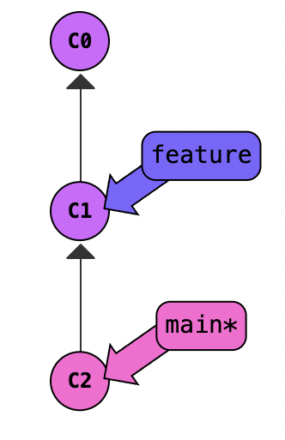
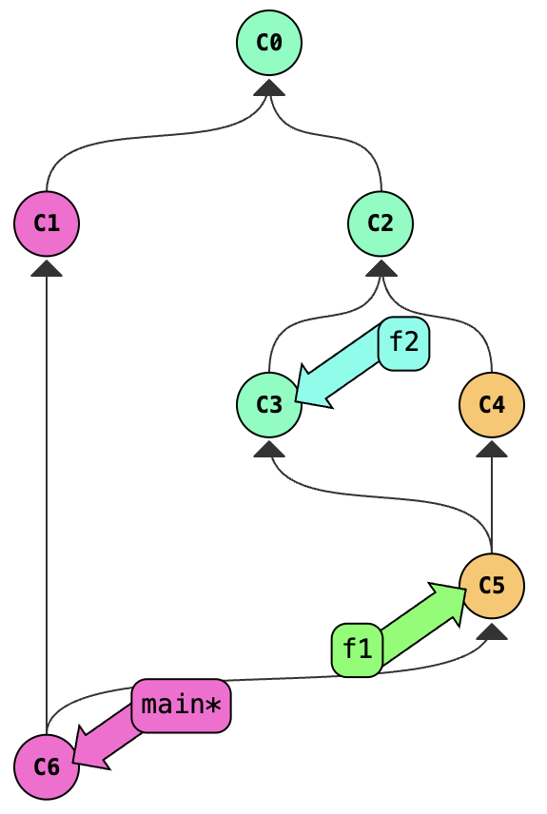
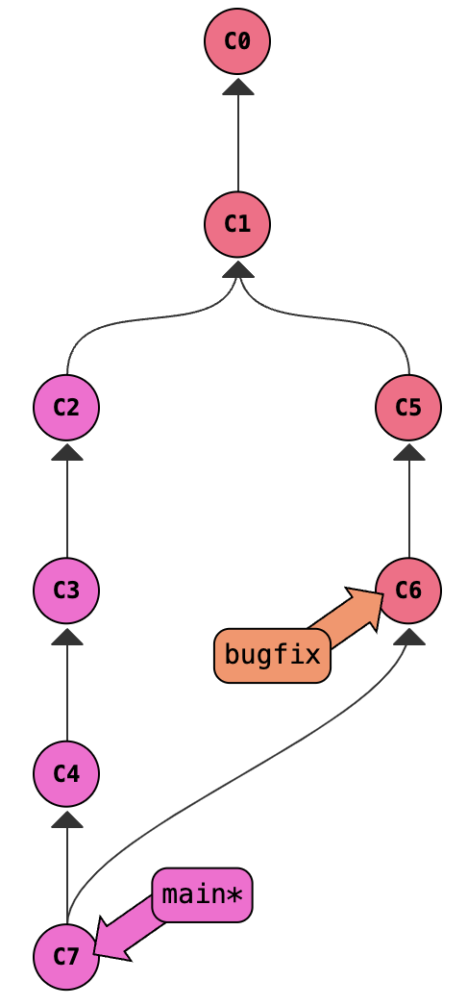
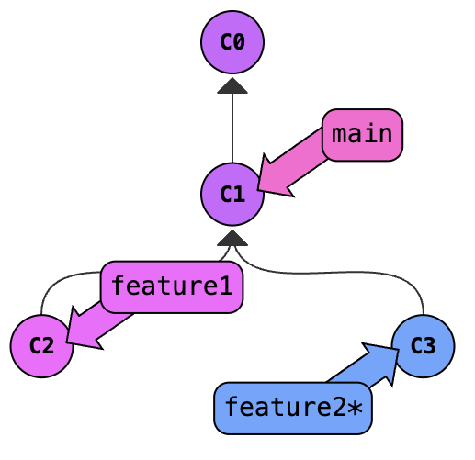
Challenges (figure out how to reproduce):

