Slide 1
[320] Object Oriented Programming
Department of Computer Sciences
University of Wisconsin-Madison

Slide 2
Creating New Types

Slide 3
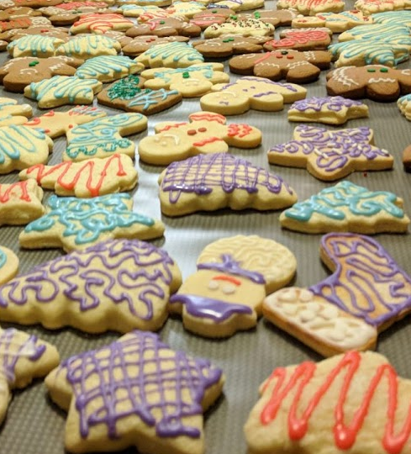
Classes and Other Types
Objects
list
dict
movie
str
person
player
https://www.macys.com/shop/product/martha-stewart-collection-set-of-6-cookie-cutters-created-for-macys?ID=5467270

Slide 4
Classes

Slide 5
dicts can represent many kinds of things
classes (today) are often a better option when all your keys are the same

Slide 6
create some objects
of type dict for movies
m1 = {...}
m2 = {...}
p1 = {}
p2 = {}
p3 = dict()
p1["Fname"] = "Joseph"
p2["fname"] = "Peyman"
p3["fname"] = "Shri Shruthi"
print(type(m1))
print(type(p1))
create some objects
of type dict for people
set some keys/values

Slide 7
class Person:
pass
p1 = Person()
p2 = Person()
p3 = Person()
p1.Fname = "Joseph"
p2.fname = "Peyman"
p3.fname = "Shri Shruthi"
print(type(p3))
create a Person
type/class
create some objects
of type Person
set some attributes
Objects created from classes are mutable.
Attribute names are not fixed at creation.

Slide 8
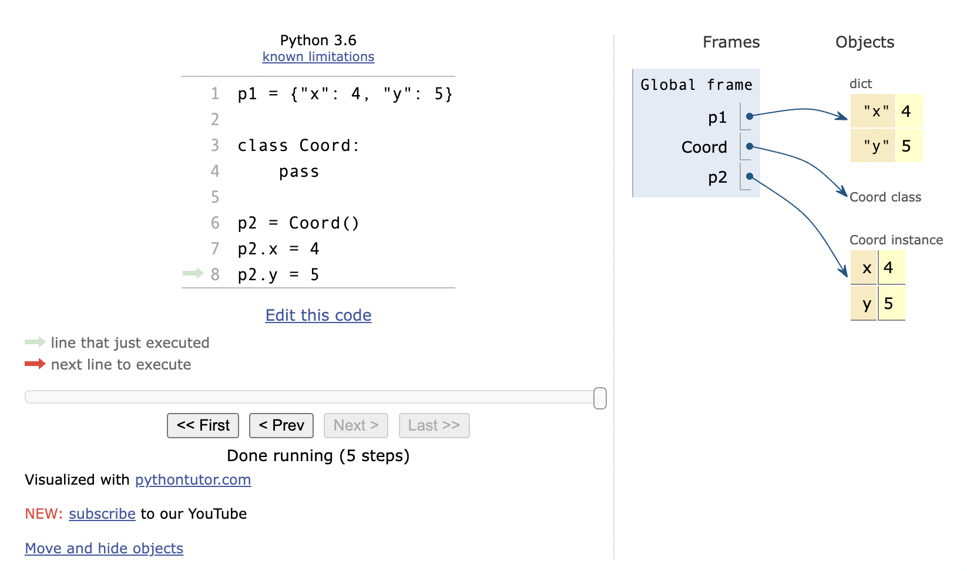
PythonTutor: Compare dicts to class types

Slide 9
Coding Examples: Animal Classes
Principals
objects and functions
methods
checking object type
type-based dispatch
receiver (self parameter)
constructors

Slide 10
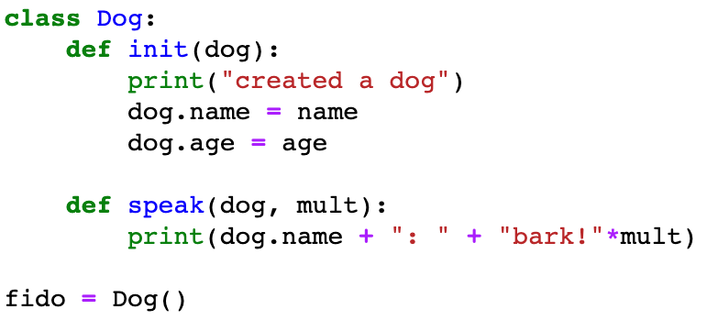
Classes
which one is an attribute?
dog
name
mult
fido

Slide 11
Classes
is this printed? do we crash?

Slide 12
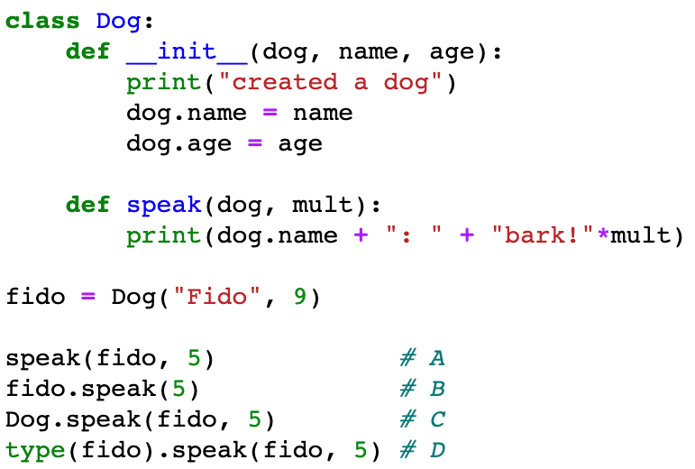
Classes
is this printed? do we crash?

Slide 13
Classes
# 1
# 2
# 3
# 4
which call won't work?

Slide 14
Classes
# 1
# 2
# 3
# 4
which call won't work?

Slide 15
Classes
# 1
# 2
# 3
# 4
which one is NOT an example
of type-based dispatch?

Slide 16
Classes
# 1
# 2
# 3
# 4
which one is NOT an example
of type-based dispatch?

Slide 17
Classes
# 1
# 2
# 3
# 4
which call style is preferred?

Slide 18
Classes
preferred style

Slide 19
Classes
what will be passed to the dog param?

Slide 20
Classes
what is a better name for the receiver parameter?

Slide 21
Classes
what is a better name for the receiver parameter?
answer: self

