Slide 1
[320] Special Methods and Inheritance
Department of Computer Sciences
University of Wisconsin-Madison

Slide 2
Special Methods

Slide 3
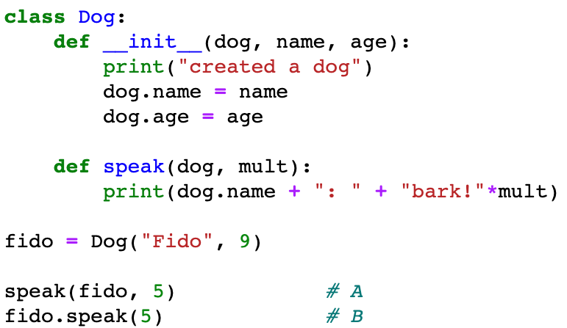
Special Methods
__init__ is a special method, with non-standard behavior

Slide 4
Special Methods
There are MANY special method names:
https://docs.python.org/3/reference/datamodel.html#special-method-names
We'll learn a few:
__str__, __repr__, _repr_html_
__eq__, __lt__
__len__, __getitem__
__enter__, __exit__
control how an object looks when we print it or see it in Out[N]
generate HTML to create more visual representations of objects in Jupyter. Like tables for DataFrames

Slide 5
Special Methods
There are MANY special method names:
https://docs.python.org/3/reference/datamodel.html#special-method-names
We'll learn a few:
__str__, __repr__, _repr_html_
__eq__, __lt__
__len__, __getitem__
__enter__, __exit__
define how == behaves for two different objects
define how a list of objects should be sorted
c = (a==b) # type of c?

Slide 6
Special Methods
There are MANY special method names:
https://docs.python.org/3/reference/datamodel.html#special-method-names
We'll learn a few:
__str__, __repr__, _repr_html_
__eq__, __lt__
__len__, __getitem__
__enter__, __exit__
build our own sequences that we index, slice, and loop over:
val = obj[idx]
vals = obj[3:7]
for x in obj:
print(x)
what goes
in brackets?

Slide 7
Special Methods
There are MANY special method names:
https://docs.python.org/3/reference/datamodel.html#special-method-names
We'll learn a few:
__str__, __repr__, _repr_html_
__eq__, __lt__
__len__, __getitem__
__enter__, __exit__
context managers
with open("file.txt") as f:
data = f.read()
# automatically close

Slide 8
Inheritance

Slide 9
Types, Sub Types, and Objects
namedtuple
hierarchy of types
Person
Hurricane
????
objects
classes (and types in general) form a hierarchy

Slide 10
Types, Sub Types, and Objects
object
namedtuple
hierarchy of types
Person
Hurricane
????
objects
weird naming: the top type is called "object"

Slide 11
Types, Sub Types, and Objects
object
Dog
Person
parent class / base class
hierarchy
of types
child class / sub class
CoursePerson
Employee
Student
Instructor
TA
Admin
Janitor
objects
we can design the hierarchy with inheritance

Slide 12
Types, Sub Types, and Objects
object
Dog
Person
CoursePerson
Employee
Student
Instructor
TA
Admin
Janitor
multiple inheritance

Slide 13
Coding Examples
Principals
method inheritance
method resolution order
overriding methods, constructor
calling overridden methods
abc's (abstract base classes)

