Slide 1
[320] Queue Structures
Department of Computer Sciences
University of Wisconsin-Madison

Slide 2
Queueing Structures

Slide 3
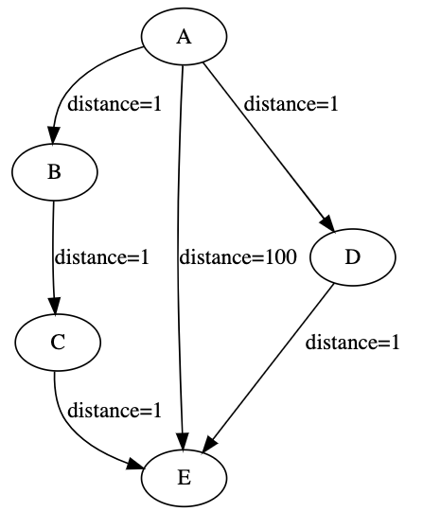
Shortest Weighted Path
What path will DFS choose?
What path will BFS choose?
What path would you choose?

Slide 4
Work queues ("to do" list)
Stack
end
end
(FILO)
Queue
front
end
(FIFO)
Priority Queue
end
smallest/biggest
Notes:
LEC 001 Finished Here (s22)

Slide 5
Work queues ("to do" list)
L.append(x)
Stack
end
end
(FILO)
x = L.pop(-1)
Queue
front
end
(FIFO)
L.append(x)
x = L.pop(0)
Priority Queue
end
L.append(x)
smallest/biggest
L.sort()
x = L.pop(-1)
what operations are slow?

Slide 6
Work queues ("to do" list)
L.append(x)
Stack
end
end
(FILO)
x = L.pop(-1)
Queue
front
end
(FIFO)
!
L.append(x)
x = L.pop(0)
Priority Queue
end
L.append(x)
smallest/biggest
!
L.sort()
x = L.pop(-1)
what operations are slow?

