Slide 1
[320] Web 3: A/B Testing
Department of Computer Sciences
University of Wisconsin-Madison

Slide 2
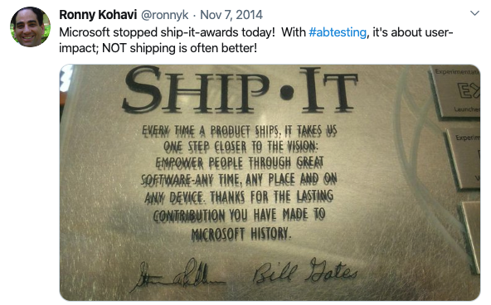
Source for Examples/Lessons
Ronny Kohavi Keynote Talk at KDD conference (Knowledge Discovery and Data Mining)
Title: Online Controlled Experiments: Lessons from Running A/B/n Tests for 12 years
Video: https://exp-platform.com/kdd2015keynotekohavi/

Slide 3
Experiment Design:
Does Coffee Improve Programming Ability?
programmers:

Slide 4
Experiment Design:
Does Coffee Improve Programming Ability?
Design 1: before and after
programmers:
average of 16 hours
for the project before
(no coffee)

Slide 5
Experiment Design:
Does Coffee Improve Programming Ability?
Design 1: before and after
programmers:
average of 16 hours
for the project before
(no coffee)
average of 8 hours
for the project after
(with coffee)

Slide 6
Experiment Design:
Does Coffee Improve Programming Ability?
Design 1: before and after
programmers:
concerns???
average of 16 hours
for the project before
(no coffee)
average of 8 hours
for the project after
(with coffee)

Slide 7
Experiment Design:
Does Coffee Improve Programming Ability?
Design 2: randomly assigned control and treatment groups
randomly assigned
control
treatment
average 16.3 hours
average 15.4 hours
significant difference?

Slide 8
Experiment Design:
Is coffee or tea better for programming?
A/B Testing
randomly assigned
A
B
average 16.3 hours
average 15.4 hours

Slide 9
A/B Test Overview (for web applications!)
Version A
metrics
some traffic
control
(previous version)
compare
act, learn,
or debug
users/requests
Version B
metrics
some traffic
treatment
(change some factors)

Slide 10
Example 1: Link to Donation Page
3
CTR (Click Through Rate)
clicks / impressions
Version A
metrics
1
5
50%
switch to best
control
(previous version)
compare
act, learn,
or debug
users/requests
max CTR
Version B
metrics
4
50%
treatment
(change some factors)
2
bigger font
red font

Slide 11
Lecture Outline
3
CTR (Click Through Rate)
clicks / impressions
Version A
metrics
1
5
50%
switch to best
control
(previous version)
compare
act, learn,
or debug
users/requests
max CTR
Version B
metrics
4
50%
treatment
(change some factors)
2
bigger font
red font

Slide 12
Example 2: Facebook Emotional Contagion Study
Reading: https://techcrunch.com/2014/06/29/ethics-in-a-data-driven-world/
Version A
metrics
is emotion
contagious?
control
(previous version)
compare
act, learn,
or debug
users/requests
Version B
metrics
treatment
(change some factors)
positive/negative words used
make feed more positive or negative

Slide 13
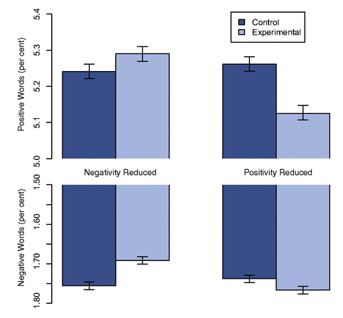
Example 2: Facebook Emotional Contagion Study
Reading: https://techcrunch.com/2014/06/29/ethics-in-a-data-driven-world/
Version A
metrics
is emotion
contagious?
control
(previous version)
compare
act, learn,
or debug
users/requests
Version B
metrics
treatment
(change some factors)
positive/negative words used
make feed more positive or negative
didn't need to submit to the IRB (Institutional Review Board) -- when should it be required?

Slide 14
Example 3: Update Python Version
Version A
metrics
control
(previous version)
Python 3.9
compare
act, learn,
or debug
users/requests
Version B
metrics
treatment
(change some factors)
sales
Python 3.10

Slide 15
Lecture Outline
3
CTR (Click Through Rate)
clicks / impressions
Version A
metrics
1
5
50%
switch to best
control
(previous version)
compare
act, learn,
or debug
users/requests
max CTR
Version B
metrics
4
50%
treatment
(change some factors)
2
bigger font
red font

Slide 16
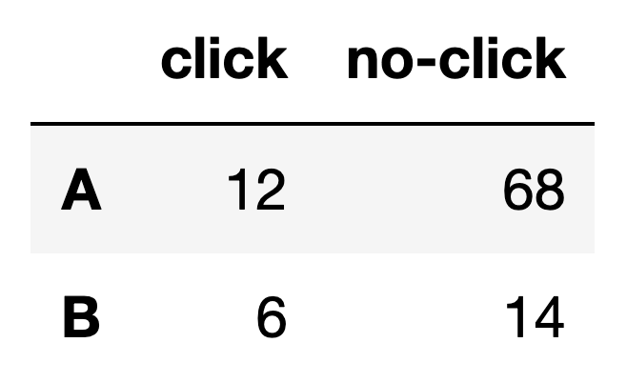
Comparisons
Example Metric: CTR (Click-Through Rate)
CTR = clicks / impressions
"Impression" means user saw it
how many B impressions were there?
what was B's CTR?
df: contingency table

Slide 17
Comparisons
Example Metric: CTR (Click-Through Rate)
CTR = clicks / impressions
"Impression" means user saw it
how many B impressions were there? 20
what was B's CTR? 6/20 = 30%
df: contingency table

Slide 18
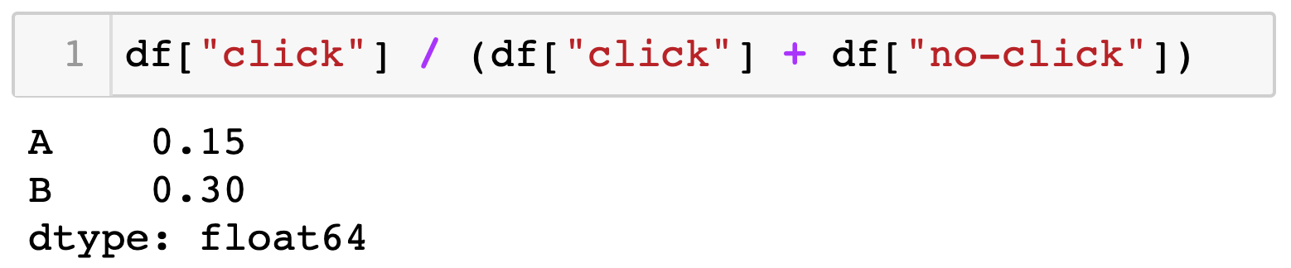
Comparisons
Example Metric: CTR (Click-Through Rate)
CTR = clicks / impressions
"Impression" means user saw it
df: contingency table
is the improvement noise?

Slide 19
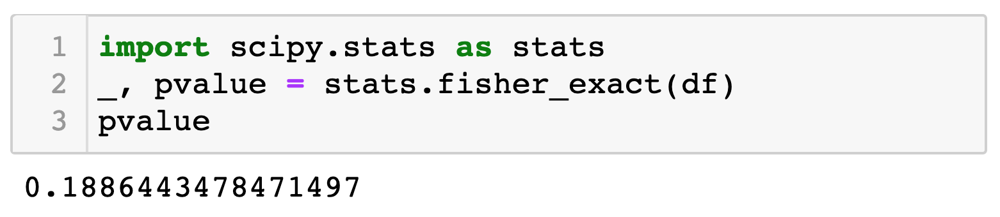
Comparisons
Example Metric: CTR (Click-Through Rate)
CTR = clicks / impressions
"Impression" means user saw it
df: contingency table
pip3 install scipy
https://docs.scipy.org/doc/scipy/reference/generated/scipy.stats.fisher_exact.html

Slide 20
Comparisons
Example Metric: CTR (Click-Through Rate)
CTR = clicks / impressions
"Impression" means user saw it
p-value is probability of seeing a difference this extreme (or more) if both ratios were generated by the same underlying process (the one most likely to generate this)
"significant" means p-value is less than some threshold (e.g., 5%)
false positive means it is significant even though underlying process is same
df: contingency table
https://docs.scipy.org/doc/scipy/reference/generated/scipy.stats.fisher_exact.html

Slide 21
Comparisons
out of 200 neutral changes, how many will falsely show up as significant if we set our p-value threshold to 5%?
Example Metric: CTR (Click-Through Rate)
CTR = clicks / impressions
"Impression" means user saw it
p-value is probability of seeing a difference this extreme (or more) if both ratios were generated by the same underlying process (the one most likely to generate this)
"significant" means p-value is less than some threshold (e.g., 5%)
false positive means it is significant even though underlying process is same
df: contingency table
https://docs.scipy.org/doc/scipy/reference/generated/scipy.stats.fisher_exact.html

Slide 22
Comparisons
out of 200 neutral changes, how many will falsely show up as significant if we set our p-value threshold to 5%?
Example Metric: CTR (Click-Through Rate)
CTR = clicks / impressions
"Impression" means user saw it
10
p-value is probability of seeing a difference this extreme (or more) if both ratios were generated by the same underlying process (the one most likely to generate this)
"significant" means p-value is less than some threshold (e.g., 5%)
false positive means it is significant even though underlying process is same
df: contingency table
https://docs.scipy.org/doc/scipy/reference/generated/scipy.stats.fisher_exact.html

Slide 23
Comparisons
out of 200 neutral changes, how many will falsely show up as significant if we set our p-value threshold to 5%?
Example Metric: CTR (Click-Through Rate)
CTR = clicks / impressions
"Impression" means user saw it
10
occasionally run A/A tests to make sure the system is working (false positive rate should be as expected)
df: contingency table
https://docs.scipy.org/doc/scipy/reference/generated/scipy.stats.fisher_exact.html

Slide 24
Comparisons
Example Metric: CTR (Click-Through Rate)
CTR = clicks / impressions
"Impression" means user saw it
3 outcomes, based on CTRs and significance
A is significantly better
B is significantly better
neither wins
what to do?
ideas???
df: contingency table

Slide 25
Comparisons
Example Metric: CTR (Click-Through Rate)
CTR = clicks / impressions
"Impression" means user saw it
3 outcomes, based on CTRs and significance
A is significantly better
B is significantly better
neither wins
what to do?
collect more data
ignore significance, just look at CTR (indecision may be the worst decision)
choose previous version A (probably fewer bugs)
choose new version B (for simplicity or other merits)
df: contingency table

Slide 26
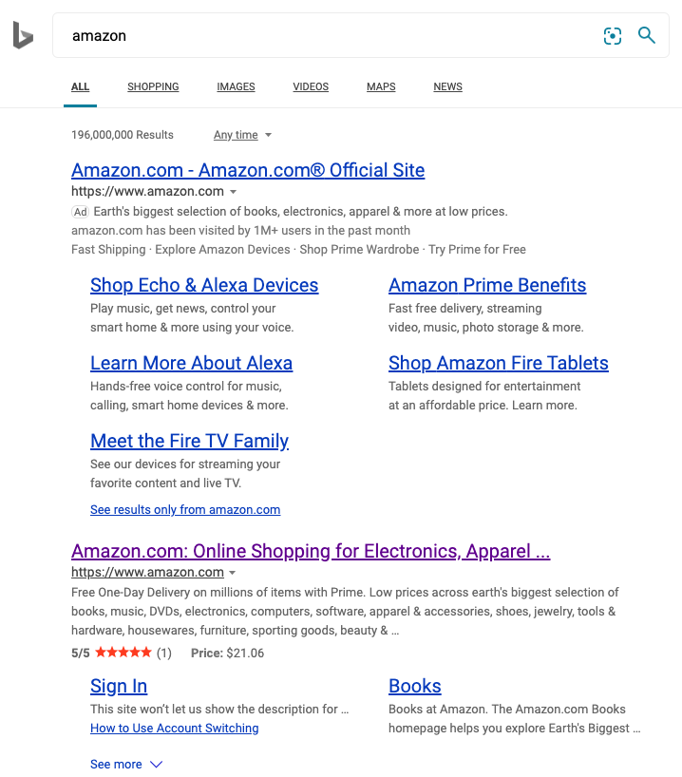
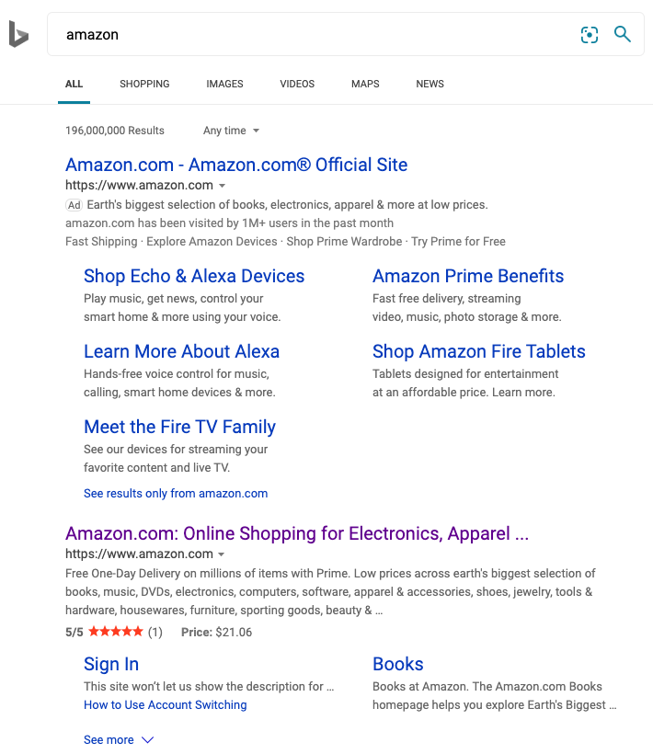
Which Version Has Higher Whole-page CTR?
Version A
Version B
https://youtu.be/qtboCGd_hTA?t=2873

Slide 27
Which Version Has Higher Whole-page CTR?
Version A
Version B
Lesson: metrics should inform humans, not directly determine decisions
https://youtu.be/qtboCGd_hTA?t=2873

Slide 28
Lecture Outline
3
CTR (Click Through Rate)
clicks / impressions
Version A
metrics
1
5
50%
switch to best
control
(previous version)
compare
act, learn,
or debug
users/requests
max CTR
Version B
metrics
4
50%
treatment
(change some factors)
2
bigger font
red font

Slide 29
Metrics
Things to measure:
clicks -- when are they bad?

Slide 30
Metrics
Things to measure:
clicks
scroll (did they read it?)
subscribe/unsubscribe
other ideas?

Slide 31
Metrics
Things to measure:
clicks
scroll (did they read it?)
subscribe/unsubscribe
purchases/returns
hover (did they think about it?)
shares
likes/upvotes
comments

Slide 32
Metrics
Things to measure:
clicks
scroll (did they read it?)
subscribe/unsubscribe
purchases/returns
hover (did they think about it?)
shares
likes/upvotes
comments
combos: Bing measures how often people click a result link and don't hit back within 30 seconds

Slide 33
Metrics
Things to measure:
clicks
scroll (did they read it?)
subscribe/unsubscribe
purchases/returns
hover (did they think about it?)
shares
likes/upvotes
comments
combos: Bing measures how often people click a result link and don't hit back within 30 seconds
what is the effect of B?
B is send twice as many spammy emails

Slide 34
Metrics
Things to measure:
clicks
scroll (did they read it?)
subscribe/unsubscribe
purchases/returns
hover (did they think about it?)
shares
likes/upvotes
comments
combos: Bing measures how often people click a result link and don't hit back within 30 seconds
what is the effect of B?
B is send twice as many spammy emails
what is the effect of B?
B is remove price from product page link

Slide 35
Metrics
Things to measure:
clicks
scroll (did they read it?)
subscribe/unsubscribe
purchases/returns
hover (did they think about it?)
shares
likes/upvotes
comments
combos: Bing measures how often people click a result link and don't hit back within 30 seconds
what is the effect of B?
B is send twice as many spammy emails
what is the effect of B?
B is remove price from product page link
Lesson: it's hard to measure long-term
effects (noisy!), so use common sense
Lesson: it's easy to shift clicks

Slide 36
Metrics
Things to measure:
clicks
scroll (did they read it?)
subscribe/unsubscribe
purchases/returns
hover (did they think about it?)
shares
likes/upvotes
comments
combos: Bing measures how often people click a result link and don't hit back within 30 seconds
what is the effect of B?
B is send twice as many spammy emails
what is the effect of B?
B is remove price from product page link
Decide beforehand on one OEC metric: Overall Experiment Criterion
Bing has thousands of debug metrics, but only 4 OECs.

Slide 37
Metrics
Things to measure:
clicks
scroll (did they read it?)
subscribe/unsubscribe
purchases/returns
hover (did they think about it?)
shares
likes/upvotes
comments
combos: Bing measures how often people click a result link and don't hit back within 30 seconds
what is the effect of B?
B is send twice as many spammy emails
what is the effect of B?
B is remove price from product page link
Decide beforehand on one OEC metric: Overall Experiment Criterion
Bing has thousands of debug metrics, but only 4 OECs. Try to consider cost as well as benefit!
As a rule of thumb, "if you make something bigger, more people will click on it" ~ Ron Kovani
Making part of the site better could hurt other parts if you have a naive OEC

Slide 38
Metrics Should be on Uniformly Cleaned Data
Bot Detector and Filter
click-through
rate (CTR)
>half of all Bing traffic is from unauthorized bots!

Slide 39
Lecture Outline
3
CTR (Click Through Rate)
clicks / impressions
Version A
metrics
1
5
50%
switch to best
control
(previous version)
compare
act, learn,
or debug
users/requests
max CTR
Version B
metrics
4
50%
treatment
(change some factors)
2
bigger font
red font

Slide 40
Treatment
Run two variants side by side: control (A) and treatment (B)
Treatment consists of one or more factors changed:
wording
slowdown
changes "invisible" to user (e.g., software updates)
what else?

Slide 41
Treatment
Run two variants side by side: control (A) and treatment (B)
Treatment consists of one or more factors changed:
wording
slowdown
changes "invisible" to user (e.g., software updates)
time of day (for emails sent)
font, size, color, icons, graphic design in general
recommendation algorithm used
sequence of steps necessary to make a purchase
database that is faster for some queries (and slower for others)

Slide 42
Treatment
Run two variants side by side: control (A) and treatment (B)
Treatment consists of one or more factors changed:
wording
slowdown
changes "invisible" to user (e.g., software updates)
time of day (for emails sent)
font, size, color, icons, graphic design in general
recommendation algorithm used
sequence of steps necessary to make a purchase
database that is faster for some queries (and slower for others)
many experiments are big time investments (require significant coding)!
Lesson: don't be too attached to your work, be redundant and ready to throw things away

Slide 43
Treatment
Run two variants side by side: control (A) and treatment (B)
Treatment consists of one or more factors changed:
wording
slowdown
changes "invisible" to user (e.g., software updates)
time of day (for emails sent)
font, size, color, icons, graphic design in general
recommendation algorithm used
sequence of steps necessary to make a purchase
database that is faster for some queries (and slower for others)
many experiments are big time investments (require significant coding)!
Lesson: don't be too attached to your work, be redundant and ready to throw things away
there's also plenty of low-hanging fruit!
"stop debating, it's easier to get the data" ~ Ron Kohavi

Slide 44
Finding the Best Combination
color
text
text
Option 1: OFAT (one factor at a time)
10%
???
size
text
text
???
???
CTR
Hypothesis: large red font will be better

Slide 45
Finding the Best Combination
color
text
text
Option 1: OFAT (one factor at a time)
10%
???
size
text
text
Option 2: introduce two factors at once
???
???
CTR
Hypothesis: large red font will be better

Slide 46
Finding the Best Combination
color
text
text
Option 1: OFAT (one factor at a time)
10%
9%
can usually learn more, but will never exploit factor interactions
size
text
text
Option 2: introduce two factors at once
8%
15%
can choose a good design, but didn't learn what factors are important
CTR
Hypothesis: large red font will be better

Slide 47
Control/Treatment Disruptions
Version A
metrics
some traffic
control
(previous version)
compare
act, learn,
or debug
users/requests
Database
Version B
metrics
some traffic
treatment
(change some factors)
same server
Different variants may save databases/servers, affecting performance of both. Bugs crashing the server will be especially bad! Metrics won't show the true blame.

Slide 48
Lecture Outline
3
CTR (Click Through Rate)
clicks / impressions
Version A
metrics
1
5
50%
switch to best
control
(previous version)
compare
act, learn,
or debug
users/requests
max CTR
Version B
metrics
4
50%
treatment
(change some factors)
2
bigger font
red font

Slide 49
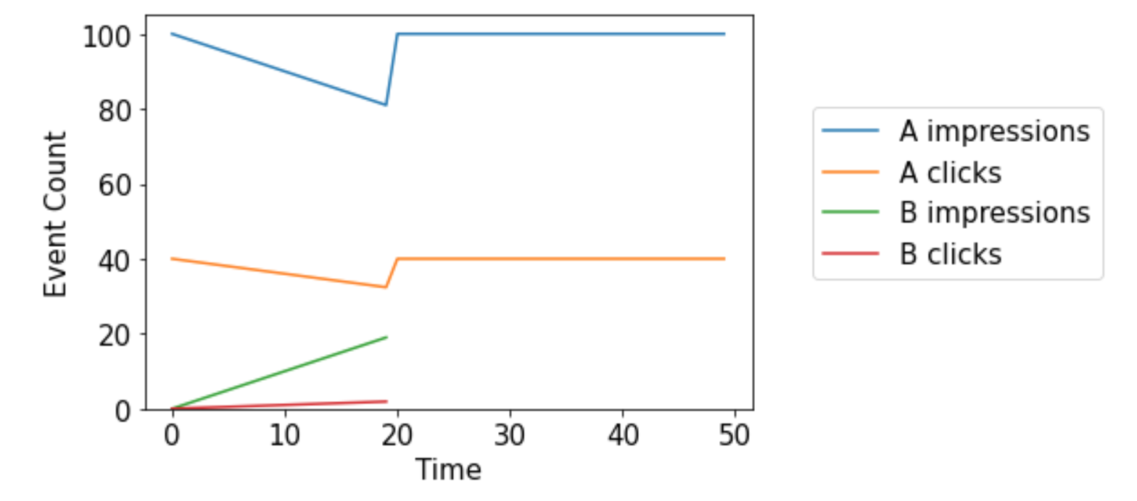
What to split
Don't go straight to 50/50!

Slide 50
What if the real factor is novelty?
Version B (treatment)
Version B (control)
requests
Version A (control)
Version A (treatment)
time
watch B to consider switching back
we determine
version B is better

Slide 51
What to split between control+treatment?
requests
over time
server
split users?
how to identify?
IP addresses
signed-in services
cookies
or requests?
easier, but can't test over-time metrics or provide consistent experience

Slide 52
What to split between control+treatment?
organization
IP A
Shared Global IP
IP B
IP C
requests
over time
server
split users?
too many share
how to identify?
IP addresses
signed-in services
cookies
or requests?
easier, but can't test over-time metrics or provide consistent experience

Slide 53
What to split between control+treatment?
organization
IP A
Shared Global IP
IP B
IP C
requests
over time
server
split users?
how to identify?
IP addresses
signed-in services
cookies
or requests?
easier, but can't test over-time metrics or provide consistent experience
ideal for when applicable

Slide 54
What to split between control+treatment?
organization
IP A
Shared Global IP
IP B
IP C
requests
over time
server
split users?
how to identify?
IP addresses
signed-in services
cookies
or requests?
easier, but can't test over-time metrics or provide consistent experience

Slide 55
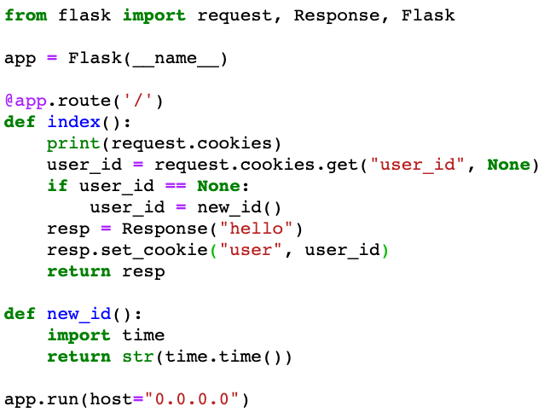
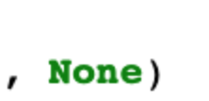

Cookies
Cookies are info that sites ask browsers to store locally and upload later.
dict of cookies
key
key
value
#TODO: get better identifiers

Slide 56

Cookies
Cookies are info that sites ask browsers to store locally and upload later.
dict of cookies
key
key
value
#TODO: get better identifiers
More accurate than IP, but cookie churn, incognito mode, and local laws may limit...

Slide 57
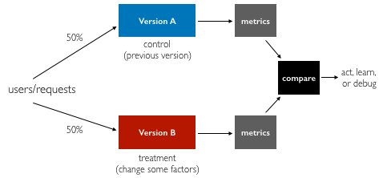
Summary
Goals
make decisions, learn, debug
Comparisons
significance testing
Metrics
simple or combos
clean uniformly
choose OEC up front
think long-term
Treatments
one or more factors
factors may require a lot of coding/design work!
OFAT usually best for learning
check the novelty factor with a flipped A/B test after decision
Splitting Traffic
ramp up slowly
split requests or users (how to distinguish?)

