Slide 1
[320] Classification
Department of Computer Sciences
University of Wisconsin-Madison

Slide 2
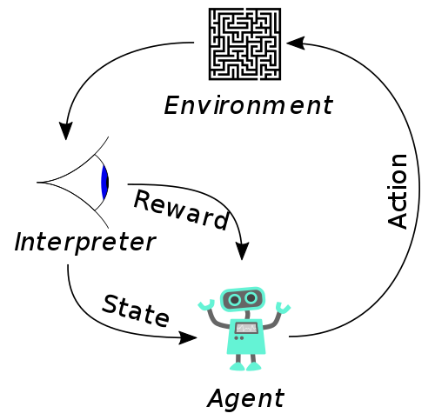
Machine Learning
Reinforcement Learning
https://en.wikipedia.org/wiki/Reinforcement_learning
not covered in CS 320
Regression
Supervised Machine Learning
predict a quantity
data is labeled, we know what we want to predict
Classification
predict a category
Unsupervised Machine Learning
Clustering
place rows in groups
data is unlabeled, we're just looking for patterns
Decomposition
represent rows as combos of "component" rows
this semester, we'll learn at least one technique in each of these four categories

Slide 3
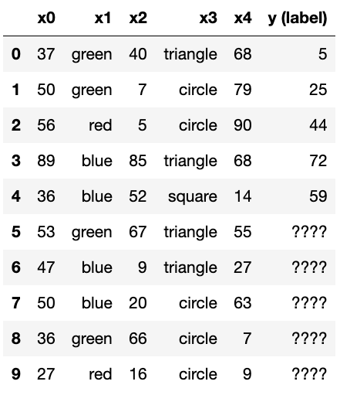
quantitative
label
1. Regression (Supervised)
fit
predict
problem: can we predict an unknown quantity?

Slide 4
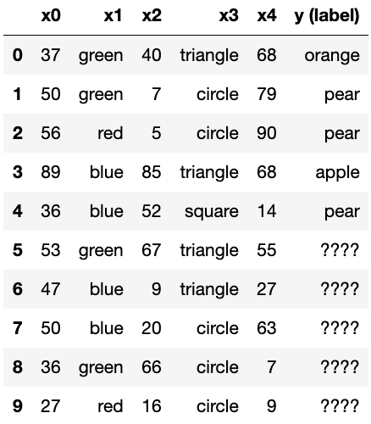
categorical
label
2. Classification (Supervised)
fit
predict
problem: can we predict an unknown category?

Slide 5
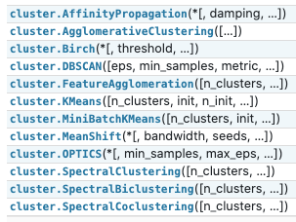
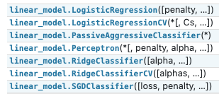

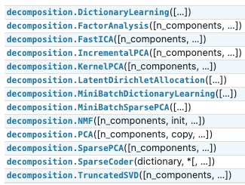



1. Regression (Supervised)
3. Clustering (Unsupervised)
+
2. Classification (Supervised)
4. Decomposition (Unsupervised)
scikit-learn machine learning modules: https://scikit-learn.org/stable/modules/classes.html

Slide 6
1. Regression (Supervised)
+
2. Classification (Supervised)
LogisticRegression is a classifier (today)
LinearRegression is a regressor (learned previously)
scikit-learn machine learning modules: https://scikit-learn.org/stable/modules/classes.html

