Slide 1
[320] Unsupervised ML Recap
Department of Computer Sciences
University of Wisconsin-Madison

Slide 2
????
Tree
A | B | C | D
50 | 50 | 110 | 90
... | ... | ... | ...
...hundreds of rows...
????
Centroids
A | B | C | D
50 | 50 | 110 | 90
... | ... | ... | ...
A | B | C | D
250 | 0 | 15 | 12
45 | 45 | 100 | 102
0 | 95 | 24 | 80
...hundreds of rows...
????
Component Rows
A | B | C | D
50 | 50 | 110 | 90
... | ... | ... | ...
50
A | B | C | D
1 | 1 | 2 | 2
0 | 0 | 1 | -1
10
...hundreds of rows...

Slide 3
Hierarchical Clustering
(for example, AgglomerativeClustering)
Tree
A | B | C | D
50 | 50 | 110 | 90
... | ... | ... | ...
...hundreds of rows...
Non-Hierarchical Clustering
(for example, KMeans)
Centroids
A | B | C | D
50 | 50 | 110 | 90
... | ... | ... | ...
A | B | C | D
250 | 0 | 15 | 12
45 | 45 | 100 | 102
0 | 95 | 24 | 80
...hundreds of rows...
Decomposition
(for example, PCA)
Component Rows
A | B | C | D
50 | 50 | 110 | 90
... | ... | ... | ...
50
A | B | C | D
1 | 1 | 2 | 2
0 | 0 | 1 | -1
10
...hundreds of rows...

Slide 4
Hierarchical Clustering
(for example, AgglomerativeClustering)
Tree
A | B | C | D
50 | 50 | 110 | 90
... | ... | ... | ...
...hundreds of rows...
ac.children_
Non-Hierarchical Clustering
(for example, KMeans)
Centroids
A | B | C | D
50 | 50 | 110 | 90
... | ... | ... | ...
A | B | C | D
250 | 0 | 15 | 12
45 | 45 | 100 | 102
0 | 95 | 24 | 80
...hundreds of rows...
km.cluster_centers_
Decomposition
(for example, PCA)
Component Rows
A | B | C | D
50 | 50 | 110 | 90
... | ... | ... | ...
50
A | B | C | D
1 | 1 | 2 | 2
0 | 0 | 1 | -1
10
...hundreds of rows...
pca.components_

Slide 5
Preprocessing: Clustering or Decomposition?
x2
x2
x1
x1
x1 | x2 | y
10 | 5 | TRUE
... | ... | ...
model = Pipeline([
????,
("lr", LogisticRegression())
])

Slide 6
Preprocessing: Clustering or Decomposition?
PCA(1)
KMeans(3)
pc0
x2
x2
x1
x1
x1 | x2 | y
10 | 5 | TRUE
... | ... | ...
model = Pipeline([
????,
("lr", LogisticRegression())
])

Slide 7
KMeans or Agglomerative Clustering?
x2
x1

Slide 8
KMeans or Agglomerative Clustering?
x2
x1
AgglomerativeClustering can show us that the two big clusters contain sub clusters.

Slide 9
KMeans or Agglomerative Clustering?
x2
?
x1
After identifying some clusters from initial data, we will need to look at new data points and find what cluster is the best match

Slide 10
Strategy: Combine Nearby Points/Groups (and repeat!)
D
F
A
E
G
B
C
A B C D E F G

Slide 11
KMeans or Agglomerative Clustering?
x2
?
x1
Use KMeans, because it can do fit and predict on separate datasets.
AgglomerativeClustering can only do fit_predict on a single dataset.

Slide 12
Hierarchical clusters can contain other custers (example: AgglomerativeClustering)
Non-hierarchical clusters cannot contain other custers (example: KMeans)

Slide 13
Hierarchical clusters: AgglomerativeClustering

Slide 14
Strategy: Combine Nearby Points/Groups (and repeat!)

Slide 15
Strategy: Combine Nearby Points/Groups (and repeat!)

Slide 16
Strategy: Combine Nearby Points/Groups (and repeat!)

Slide 17
Strategy: Combine Nearby Points/Groups (and repeat!)

Slide 18
Strategy: Combine Nearby Points/Groups (and repeat!)

Slide 19
Strategy: Combine Nearby Points/Groups (and repeat!)

Slide 20
Strategy: Combine Nearby Points/Groups (and repeat!)
D
F
A
E
G
B
C
A B C D E F G

Slide 21
Configuration: what is "nearest"?
option: linkage

Slide 22
Configuration: what is "nearest"?
OR...

Slide 23
Configuration: what is "nearest"?
linkage="single"
OR...

Slide 24
Configuration: what is "nearest"?
linkage="complete"
OR...

Slide 25
Configuration: what is "nearest"?
linkage="????"
From docs: https://scikit-learn.org/stable/modules/generated/sklearn.cluster.AgglomerativeClustering.html
ward minimizes the variance of the clusters being merged.
average uses the average of the distances of each observation of the two sets.
complete or maximum linkage uses the maximum distances between all observations of the two sets.
single uses the minimum of the distances between all observations of the two sets.

Slide 26
Configuration: when to stop?
option: n_clusters or distance_threshold

Slide 27
Configuration: when to stop?
n_clusters=3
each cluster is it's own tree!

Slide 28
Configuration: when to stop?
distance_threshold=10
14

Slide 29
Configuration: when to stop?
distance_threshold=0

Slide 30
Strategy: Combine Nearby Points/Groups (and repeat!)
D
F
A
E
G
B
C
A B C D E F G

Slide 31
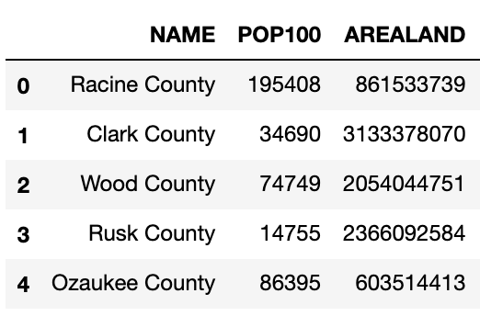
Node Representation
.fit
Agglomerative
Clustering
all
nodes
...
72
array([[ 3, 1],
[ 4, 72],
[ 11, 12],
[ 19, 73],
[ 31, 43],
...
])
73
74
...
.children

Slide 32
Linkage Matrix
left child
right child
distances
node count
N
N+1
N+2
...

Slide 33
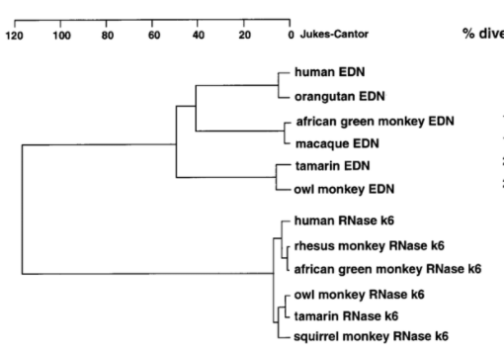
Hierarchical Clusters with Dendrograms
https://www.researchgate.net/figure/A-Dendrogram-depicting-the-relationships-among-human-and-non-human-primate-EDNs-and_fig1_13459488

Slide 34
Hierarchical Clusters with Dendrograms
this node's children have ~40 distance
leaves correspond
to original data
every non-leaf has
EXACTLY 2 children
https://www.researchgate.net/figure/A-Dendrogram-depicting-the-relationships-among-human-and-non-human-primate-EDNs-and_fig1_13459488
We'll represent hierarchies as special binary trees.

Slide 35
Demos...

