Slide 1
[320] Parallelism
Department of Computer Sciences
University of Wisconsin-Madison

Slide 2
Parallelism: doing multiple things at once
Other Terms Today:
process, thread, instruction pointer,
state (running, ready, blocked), CPU, GPU, core
Outline:
Mental Model
Two problems
Parallelism: Thread, Process, GPU

Slide 3
Mental Model: Tasks and Cores

Slide 4
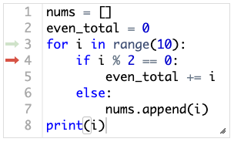
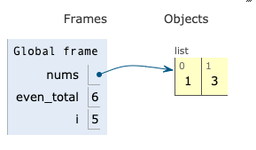
One Python Program Running
Code
Data
what is currently being done

Slide 5
Code
Data
instruction pointer
(also called "program counter")

Slide 6
process
Code
Data
instruction pointer belongs to a thread within the process

Slide 7
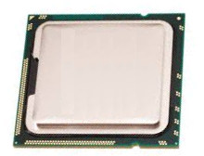
process 1 (P)
process 2 (Q)
process 3 (R)
process 4 (P)
Code
Data
Code
Data
Code
Data
Code
Data
Core
(CPU)
Core
(CPU)
CPU
Multi-Core Processor (CPU)

Slide 8
process 1 (P)
process 2 (Q)
process 3 (R)
process 4 (P)
Code
Data
Code
Data
Code
Data
Code
Data
Core
(CPU)
Core
(CPU)
Running: 1, 2
Ready: 3, 4
Multi-Core Processor (CPU)

Slide 9
process 1 (P)
process 2 (Q)
process 3 (R)
process 4 (P)
Code
Data
Code
Data
Code
Data
Code
Data
Core
(CPU)
Core
(CPU)
Running: 1, 2
Ready: 3, 4
Multi-Core Processor (CPU)

Slide 10
process 1 (P)
process 2 (Q)
process 3 (R)
process 4 (P)
Code
Data
Code
Data
Code
Data
Code
Data
Core
(CPU)
Core
(CPU)
Running: 1, 3
Ready: 2, 4
Multi-Core Processor (CPU)

Slide 11
process 1 (P)
process 2 (Q)
process 3 (R)
process 4 (P)
Code
Data
Code
Data
Code
Data
Code
Data
the more cores we have, the more tasks we can run simultaneously
Core
(CPU)
Core
(CPU)
Running: 1, 3
Ready: 2, 4
Multi-Core Processor (CPU)

Slide 12
Wasted Compute Resources: Two Problems

Slide 13
Problem 1: not enough distinct tasks to utilize all cores
process 1 (P)
Code
Data
wasted!
Core
(CPU)
Core
(CPU)
Running: 1
Ready:
Multi-Core Processor (CPU)

Slide 14
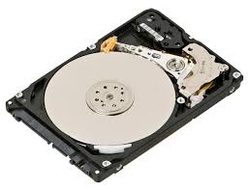
Problem 2: some operations requires waiting (task is "blocked")
operation may require us to wait on an external resource
f.read()
requests.get(URL)
time.sleep(SECONDS)
x = input()
process 1 (P)
Code
Data
wasted!
wasted!
Core
(CPU)
Core
(CPU)
Running:
Ready:
Blocked: 1
Multi-Core Processor (CPU)

Slide 15
Solution: Parallelism
1
thread-level parallelism
very complicated, not covered in detail
2
process-level parallelism
covered in CS 320
3
GPU parallelism

Slide 16
(1) Thread-level Parallelism
process
Code
Data
Threads give us multiple instruction pointers in a process, allowing us to execute multiple parts of the code, at the same time!
1
2
3
Core
(CPU)
Core
(CPU)
Multi-Core Processor (CPU)

Slide 17
(1) Thread-level Parallelism
process
Code
Data
In general, threads help:
use multiple cores
do useful work when threads are blocking
1
2
3
Core
(CPU)
Core
(CPU)
Running: 1, 2
Ready: 3, 4
Blocked:
Multi-Core Processor (CPU)

Slide 18
(1) Thread-level Parallelism
process
Code
Data
In general, threads help:
use multiple cores
do useful work when threads are blocking
1
2
3
Core
(CPU)
Core
(CPU)
Running: 1, 3
Ready: 4
Blocked: 2
Multi-Core Processor (CPU)

Slide 19
(1) Thread-level Parallelism
process
Code
Data
In general Python, threads help:
use multiple cores
do useful work when threads are blocking
1
2
3
wasted!
Core
(CPU)
Core
(CPU)
Running: 1
Ready: 3, 4
Blocked: 2
Multi-Core Processor (CPU)

Slide 20
(1) Thread-level Parallelism
recommendation: don't use threads unless you learn a LOT more about multi-threading than covered in CS 320
Example: two countdown threads
import time
from threading import Thread
def f(name, n):
for i in range(n):
print(name, n-i)
time.sleep(1)
# f("A", 3)
# f("B", 5)
t1 = Thread(target=f, args=("A", 3))
t2 = Thread(target=f, args=("B", 5))
t1.start()
t2.start()
t1.join()
t2.join()
process
Code
Data
1
2
3
wasted!
Core
(CPU)
Core
(CPU)
Running: 1
Ready: 3, 4
Blocked: 2
Multi-Core Processor (CPU)

Slide 21
Solution: Parallelism
1
thread-level parallelism
very complicated, not covered in detail
2
process-level parallelism
covered in CS 320
3
GPU parallelism

Slide 22
(2) Process-level Parallelism
process 1 (Q)
Code
Data
Core
(CPU)
Core
(CPU)
Multi-Core Processor (CPU)

Slide 23
(2) Process-level Parallelism
clones
process 1 (Q)
process 2 (Q)
process 3 (Q)
process 4 (Q)
Code
Data
Code
Data
Code
Data
Code
Data
Core
(CPU)
Core
(CPU)
Multi-Core Processor (CPU)

Slide 24
(2) Process-level Parallelism
process 1 (Q)
process 2 (Q)
process 3 (Q)
process 4 (Q)
Code
Data
Code
Data
Code
Data
Code
Data
Core
(CPU)
Core
(CPU)
Multi-Core Processor (CPU)

Slide 25
(2) Process-level Parallelism
process 1 (Q)
process 2 (Q)
process 3 (Q)
process 4 (Q)
Code
Data
Code
Data
Code
Data
Code
Data
Core
(CPU)
Core
(CPU)
Multi-Core Processor (CPU)

Slide 26
(2) Process-level Parallelism
process 1 (Q)
process 2 (Q)
process 3 (Q)
process 4 (Q)
Code
Data
Code
Data
Code
Data
Code
Data
Core
(CPU)
Core
(CPU)
Multi-Core Processor (CPU)

Slide 27
(2) Process-level Parallelism
send data back
process 1 (Q)
process 2 (Q)
process 3 (Q)
process 4 (Q)
Code
Data
Code
Data
Code
Data
Code
Data
Core
(CPU)
Core
(CPU)
Multi-Core Processor (CPU)

Slide 28
(2) Process-level Parallelism
process 1 (Q)
Code
Data
Core
(CPU)
Core
(CPU)
Multi-Core Processor (CPU)

Slide 29
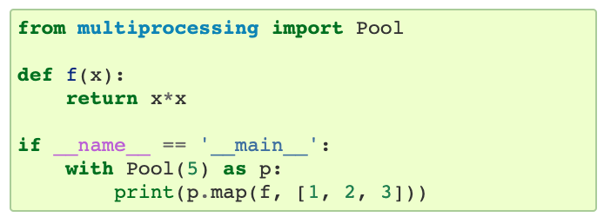
(2) Process-level Parallelism
https://docs.python.org/3/library/multiprocessing.html
process 1 (Q)
Code
Data
Core
(CPU)
Core
(CPU)
Multi-Core Processor (CPU)

Slide 30
Solution: Parallelism
1
thread-level parallelism
very complicated, not covered in detail
2
process-level parallelism
covered in CS 320
3
GPU parallelism

Slide 31

(3) GPU Parallelism
CPU
https://en.wikipedia.org/wiki/Nvidia_Tesla
...
...
...
...
few cores that are fast, flexible, independent
many cores that are slow, float-optimized, coordinated

Slide 32
GPU Limitations
limitation 1: need to move data back and forth to GPU
process 1 (Q)
Code
Data
Code
GPU Data
limitation 2: execution of most cores in lock step
on CPU

Slide 33
GPU Limitations
limitation 1: need to move data back and forth to GPU
process 1 (Q)
Code
Data
Code
GPU Data
limitation 2: execution of most cores in lock step
on CPU

Slide 34
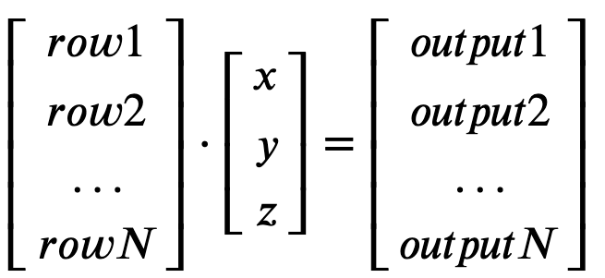
GPU Limitations
limitation 1: need to move data back and forth to GPU
process 1 (Q)
Code
Data
Code
GPU Data
limitation 2: execution of most cores in lock step
on CPU
great use case:
matrix multiplication
multiply row 1 of matrix by vector,
multiply row 2 of matrix by vector,
multiply row 3 of matrix by vector,
...

Slide 35
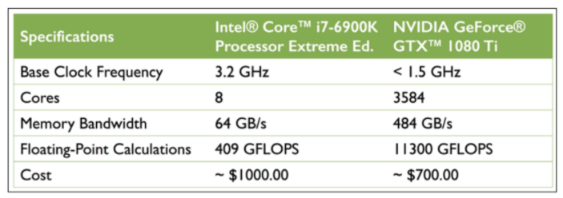
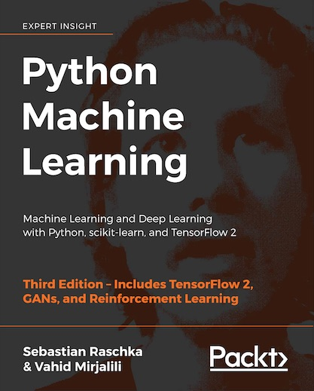
GPU vs. CPU: Cost Comparison
https://sebastianraschka.com/books.html
The GPU is 30% cheaper but 28x faster at floating-point operations!

Slide 36
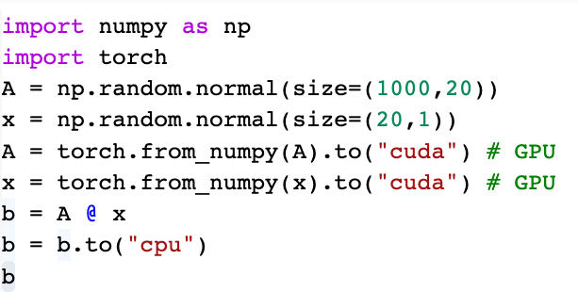
PyTorch
CUDA: Compute Unified Device Architecture
pytorch tensor is like numpy array
.to("cuda") moves data to GPU
.to("cpu") moves output back to CPU

Slide 37
Parallelism
1
thread-level parallelism
2
process-level parallelism
3
GPU parallelism

