Slide 1
Survival is a Lie
A DeltaV 201d4 Presentation by the Jacaja Group

Slide 2
Overview
Our group made a “choose your own adventure” game, with a post-apocalyptic theme.
It has four pages, a “Choose Name” page, a “Game” page, an “About Us” page and a “Citations” page.

Slide 3
Choose Name Page
Choose Name has just one feature, a text box and submission button to set your name for the story.

Slide 4
Game Page
The Game page contains a turn counter, and a content element that contains the current scene and options relating to the scene.
The scene and it’s elements are generated automatically from a “story” JSON object, and each scene can have an optional picture, which gets displayed on the page background and updates with each scene visited.
The game ends when the only remaining option is to restart the game.

Slide 5
About Us Page
The About Us page just contains a profile picture and a small biography for each of our team members.

Slide 6
Citations Page
The citations page includes a list of sources for all the media used in our project.

Slide 7
Demo
It’s DEMO TIME!!!

Slide 8
Planning - User Stories
We started out by writing quite a few epic user stories that lined up with what we want.
Then we broke those epics up into more, smaller user stories that have tangible goals.
Finally we distilled these user stories into an MVP

Slide 9
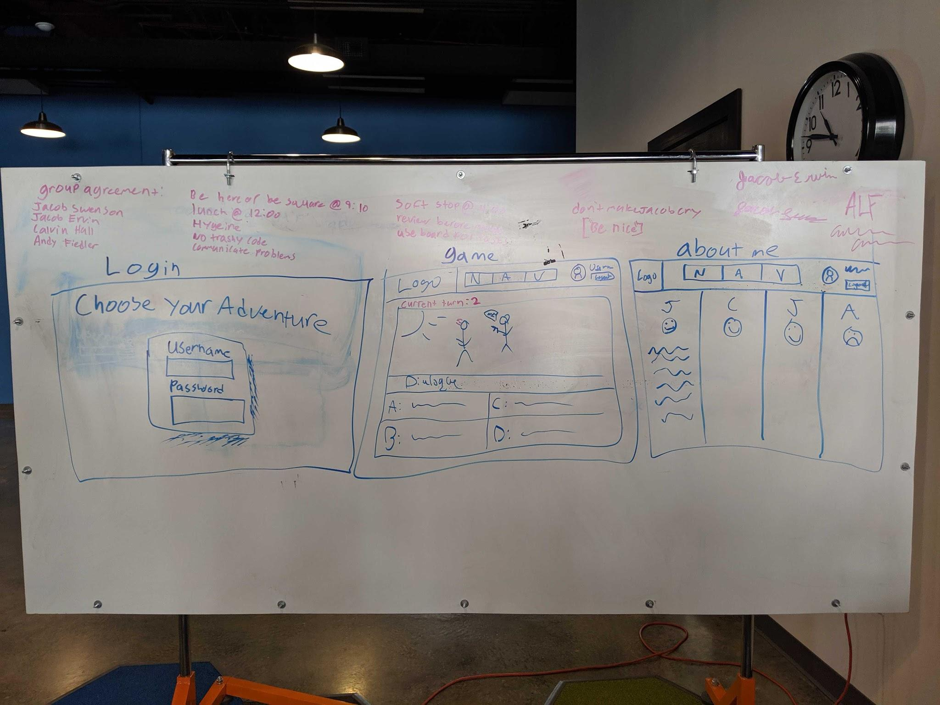
Planning - Wireframes
After we had agreed upon an MVP, we turned our attention to creating a wireframe for each page of the MVP.

Slide 10
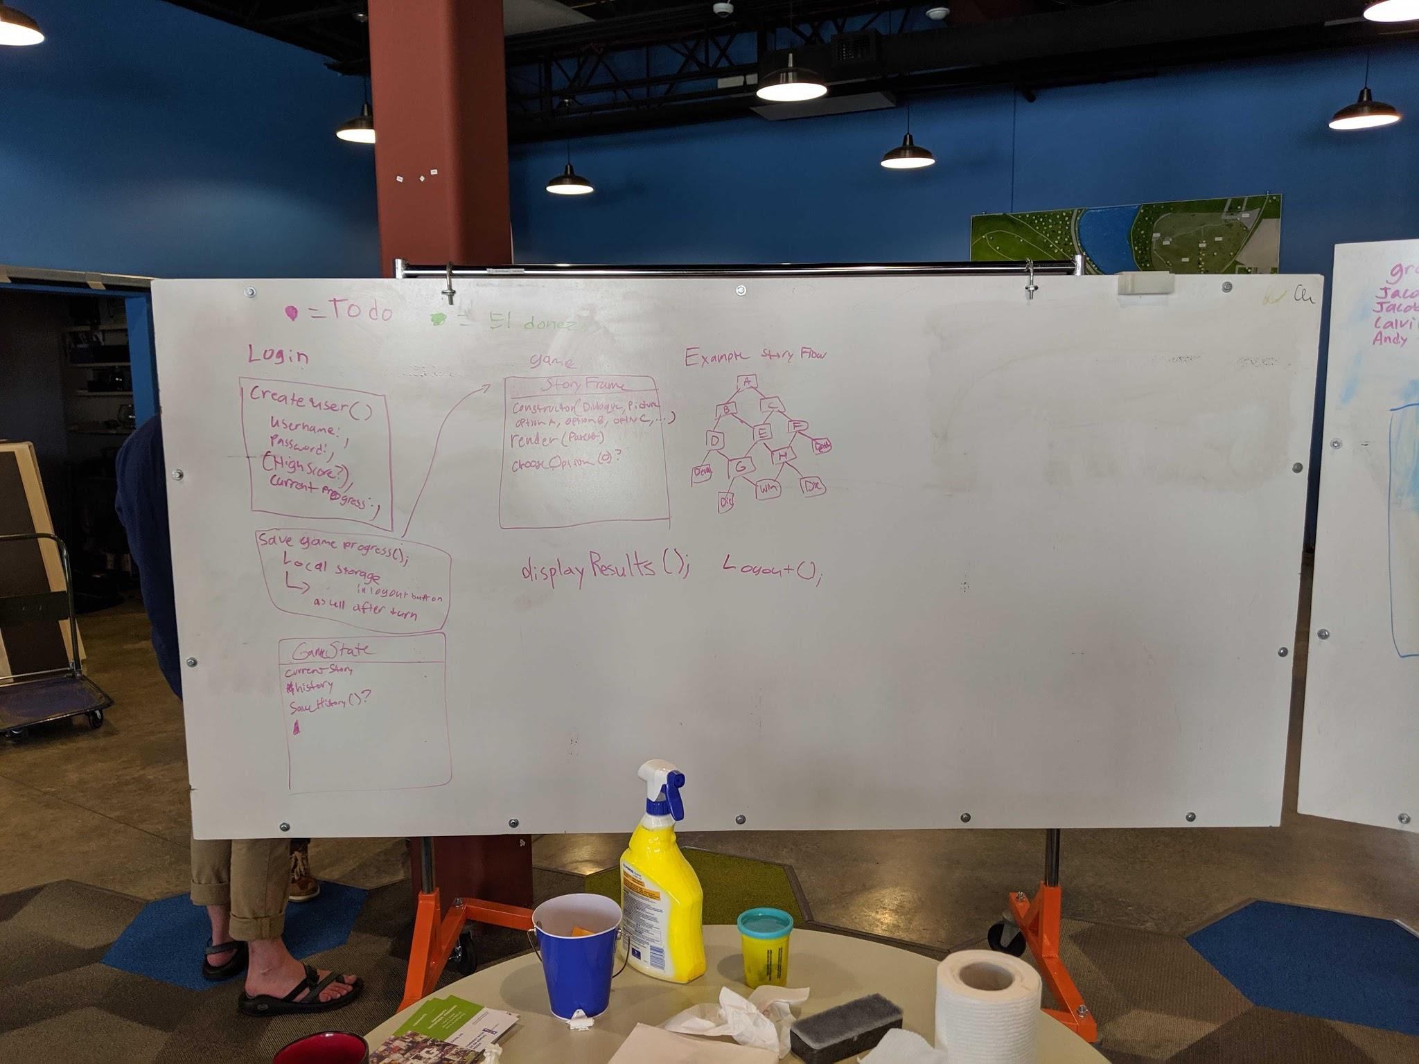
Planning - Domain Model
After we had the wireframes made, we worked on the domain model.

Slide 11
Beginning of construction
On the first day of development, we got the basics of all the pages done (mostly without style still), and then spent a decent amount of the end of the day discussing how we were going to implement the “scene” objects.

Slide 12
MVP
On the second day, we created a “scene” JavaScript file, added a really basic story to test the scene functionality, and then spent a lot of the day styling the pages.

Slide 13
Story JSON structure:
{
'sceneName': {
text: 'Scene dialogue here',
pre: function() {
},
options: [
['Option text here', 'consequence'],
['Option text here', 'sceneName'],
... etc ...
]
},
'sceneName': {
text: 'Scene dialogue here',
options: [
['Option text here', 'sceneName'],
['Option text here', 'sceneName'],
... etc ...
]
},
... etc ...
}
Scene JS
Scene.js contains the story template, in JSON format, a “renderScene” function, and some other functions for managing the scenes, inventory and turn counter.

Slide 14
Style
@keyframes shadow-pulse
{
0% {
box-shadow: 0 0 0 0px rgba(1, 255, 255, 1);
}
100% {
box-shadow: 0 0 0 35px rgba(1, 255, 255, 0);
}
}
@keyframes shadow-pulsehover
{
0% {
box-shadow: 0 0 0 0px rgba(251, 51, 219, 1);
}
100% {
box-shadow: 0 0 0 35px rgba(1, 255, 255, 0);
}
}
Our group also added some neat CSS, mainly a pulsing animation on our options buttons that change when you hover over them.
.option {
…
animation: shadow-pulse 2s infinite;
…
}
.option:hover {
…
animation: shadow-pulsehover 2s infinite;
…
}

Slide 15
Stretch Goals
Since we finished the MVP rather early, we were able to implement some of our stretch goals, such as:
Background Music
Background Images
More than a single story-line
Added basic inventory, but didn’t have time to implement in the story

Slide 16
What we would have done with more time
Implement the inventory into the actual story
Added the ability to create your own stories
Random chance options

Slide 17
QA
Questions? Answers.

