Slide 1
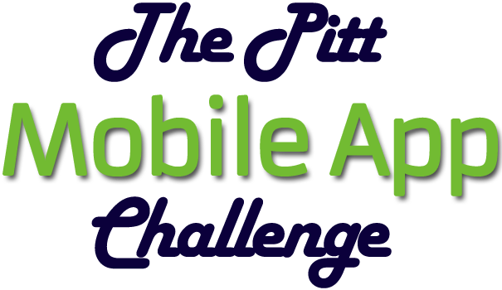

“CODE IT” CATEGORY
BABL
Notes:
[Jinx takes the stage.]

Slide 2
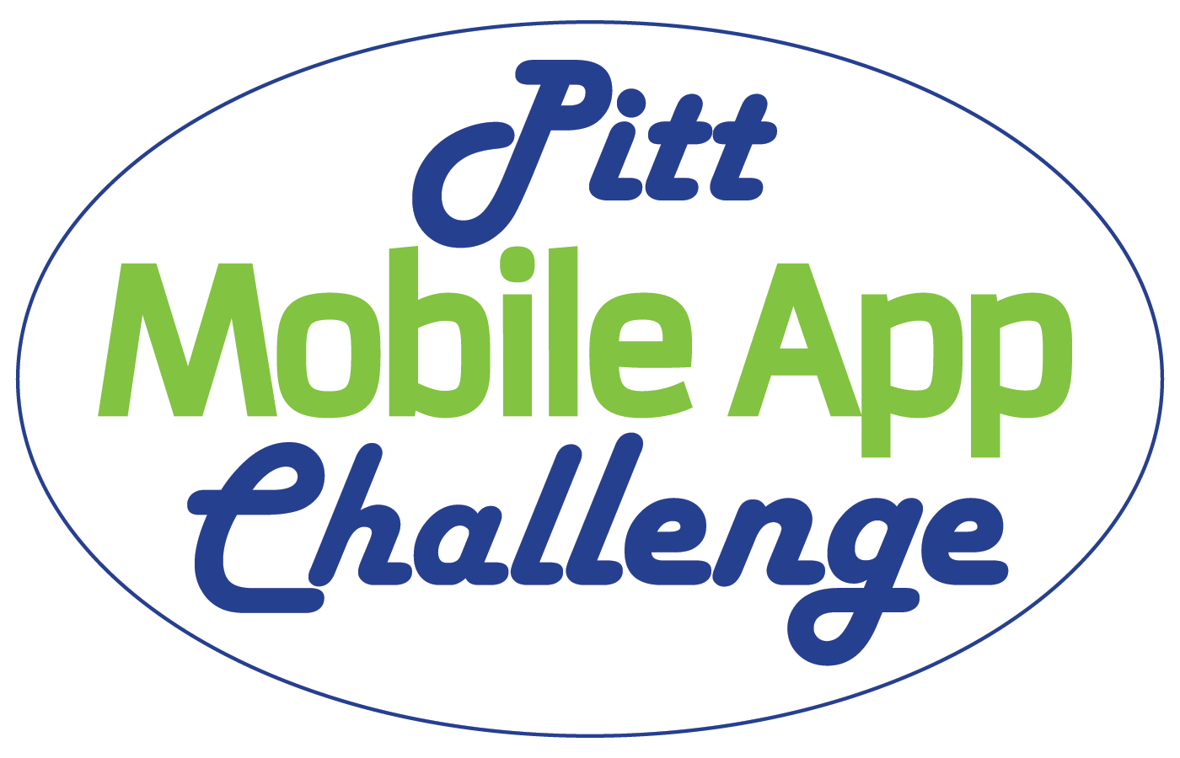
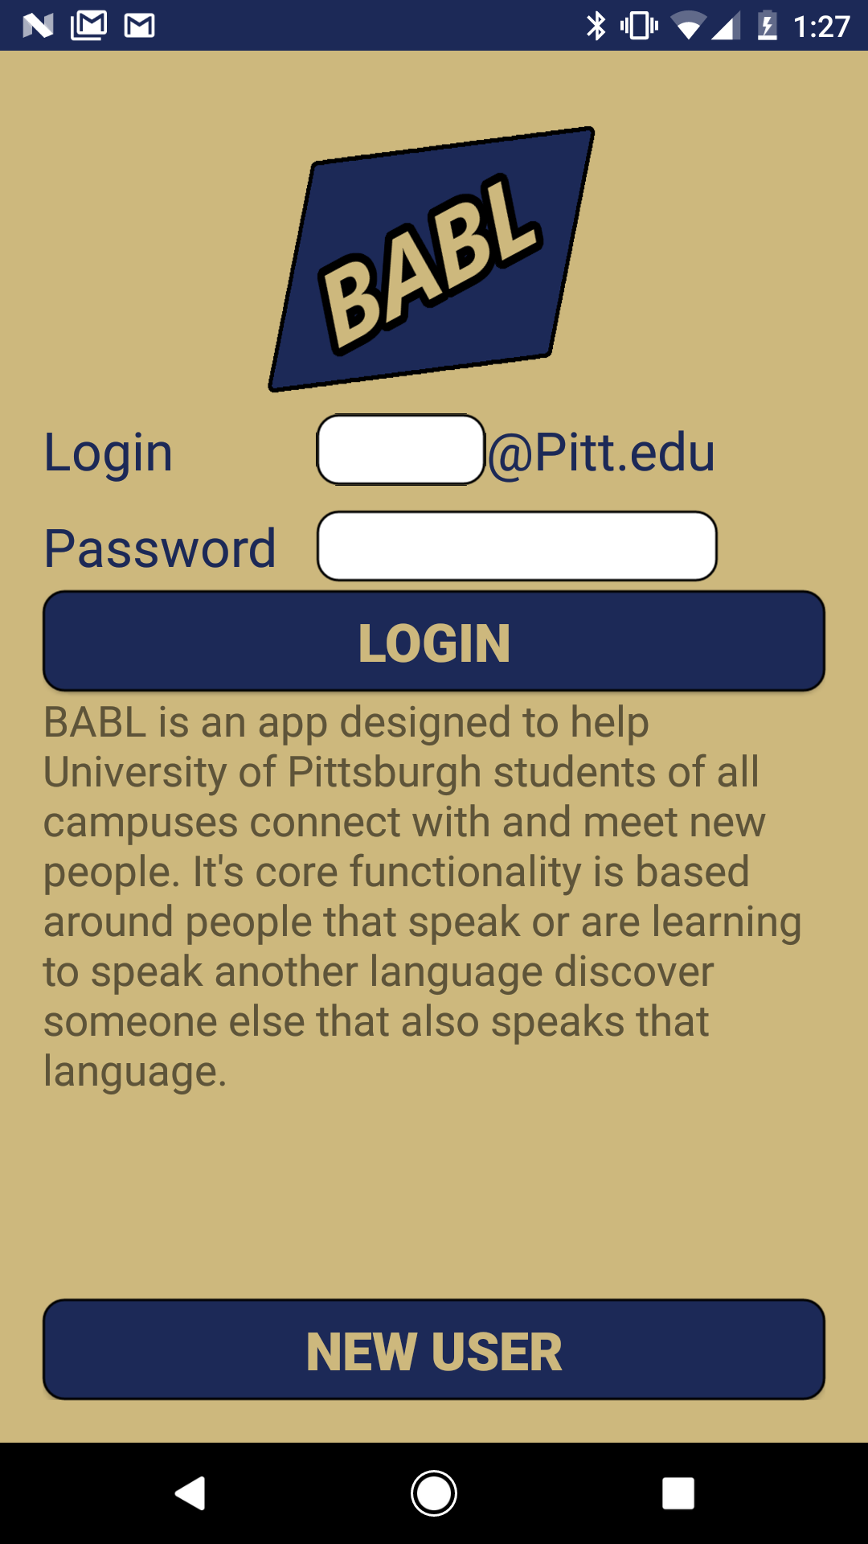
BABL: Overview
BABL is a Simple, Clean, and User-Friendly app coded in Java for Android Devices. It’s core functionality is based around helping Pitt students of all campuses meet and connect with other students for the purpose of speaking or learning to speak bilingually.
BABL acts as means of increasing cultural understanding and intellectual diversity on campus by attempting to diminish communication barriers between students.

Slide 3
BABL: Marketing Summary
Target market: Our target market is Android Users at the University of Pittsburgh main and regional campuses that speak or want to speak bilingually.
Pitch: BABL is unique because it ties Pitt Usernames to Facebook accounts, and uses that as means of connection and communication. It matches users up together that speak the same language, and are on the users chosen campuses.

Slide 4
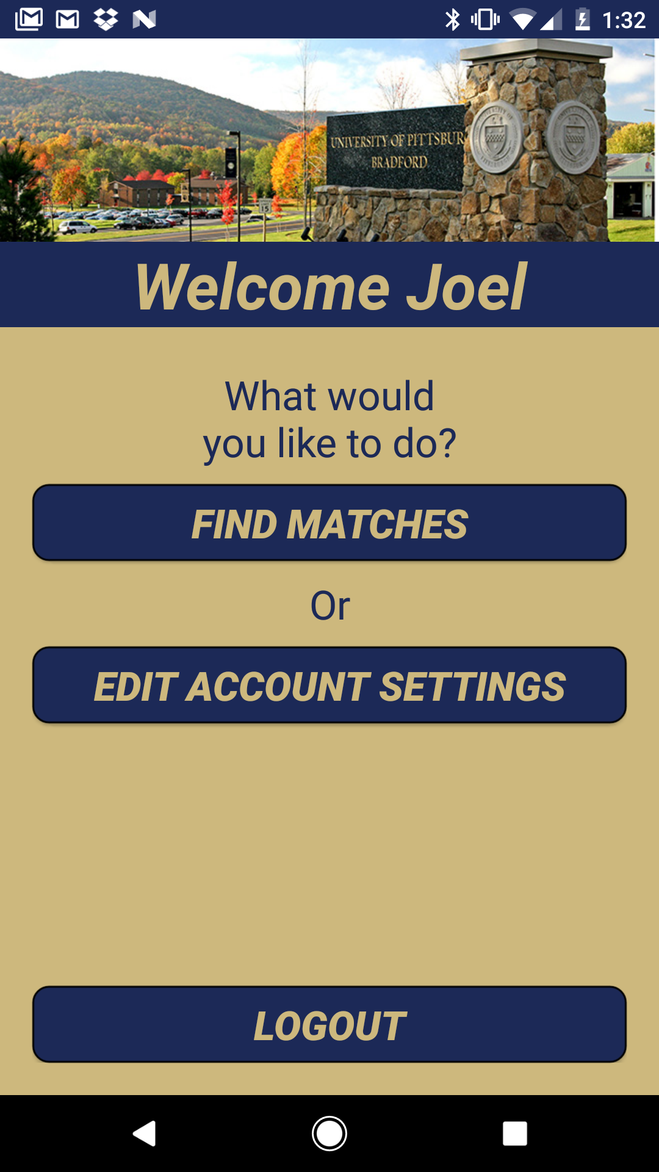
BABL: Technology Summary
BABL utilizes the idea of matching, and the publicly available Facebook profiles to help students get to know other people based on which language they wish to speak. What makes BABL awesome is the tech behind the scenes. It has fully featured Facebook integration, asynchronous tasking, and password encryption. BABL’s user data storage, matching algorithm, and stored procedures are all done using Microsoft SQL Server and are hosted on Amazon Web Services.
Banner Image
Changes Based
On Campus

Slide 5
BABL: Upload Prototype
Upload a video showing a working prototype of your app to the following location along with this completed PowerPoint presentation:
appchallenge.pitt.edu
Note: you’ll be asked to provide the code later.

