Slide 1

2018 CODE-IT CATEGORY

Slide 2
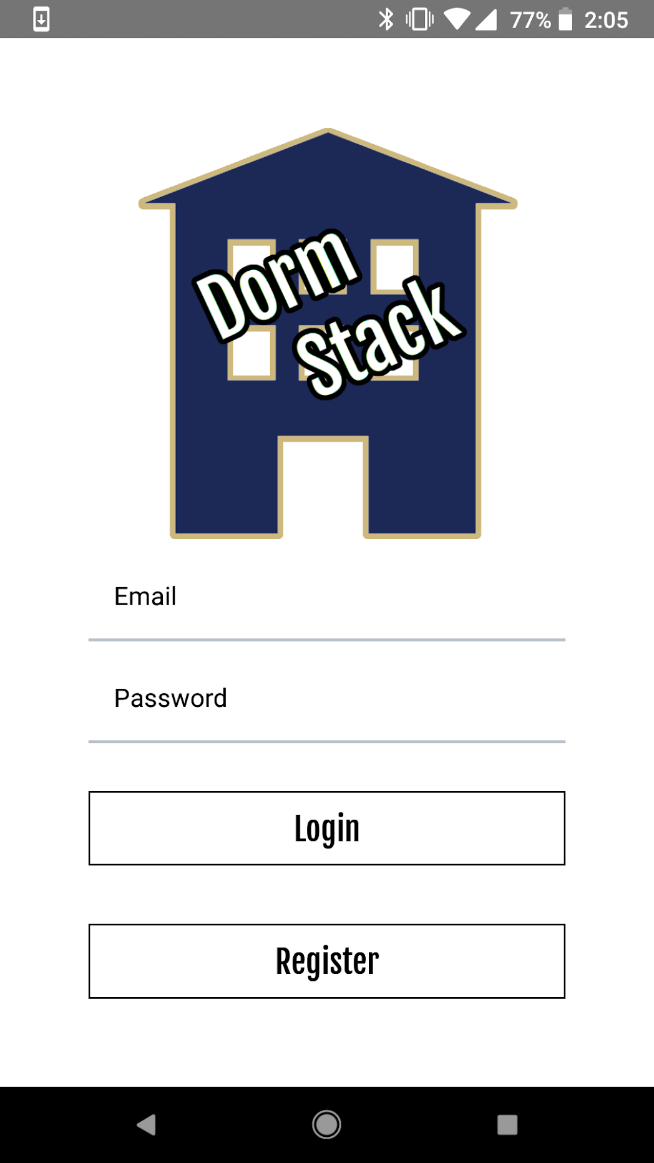
DormStack: Overview
Briefly summarize your app. What problem does it solve or what need does it meet? What are its key features?
DormStack is an app available on iOS and Android built to meet an apparent desire from students living in dorms to have a centralized social network for each individual dorm building on a university campus. Each dorm in the DormStack is a unique social and cultural system created by it’s students. A dorm’s resident assistants are the administrators of their dorm in the DormStack.
Which of the eight challenges did you choose, and how does your app address that challenge?
DormStack is being submitted into the Strengthen Communities challenge because, in it’s very nature, it allows people to obtain a better understanding of what life in their dorm community is like. Many living in dorms are unaware of any events that happen around them, and some are hosting events, and need more people.
DormStack Features:
Dorm Creation
Photo Creation/Viewing
Event/Member Registration
QR Code scanning member additions
Role-Based Authentication

Slide 3
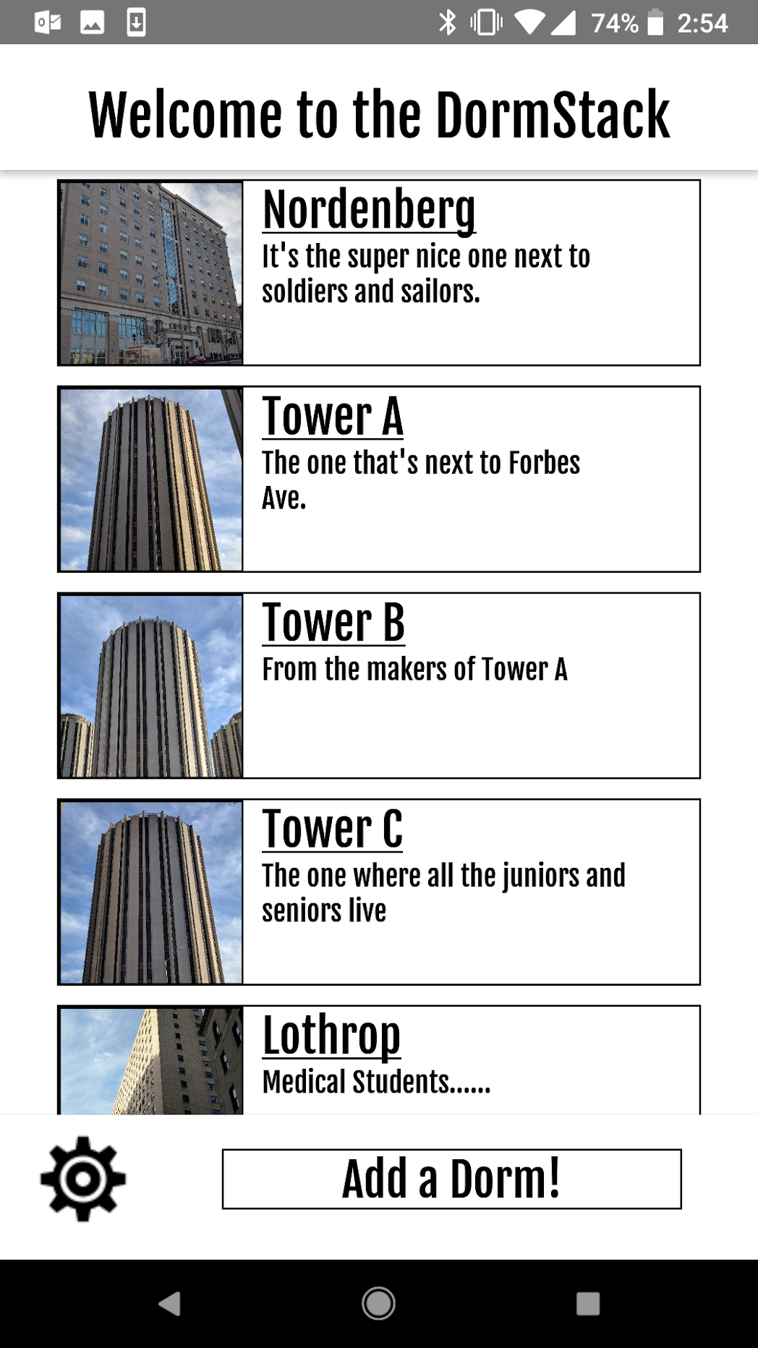
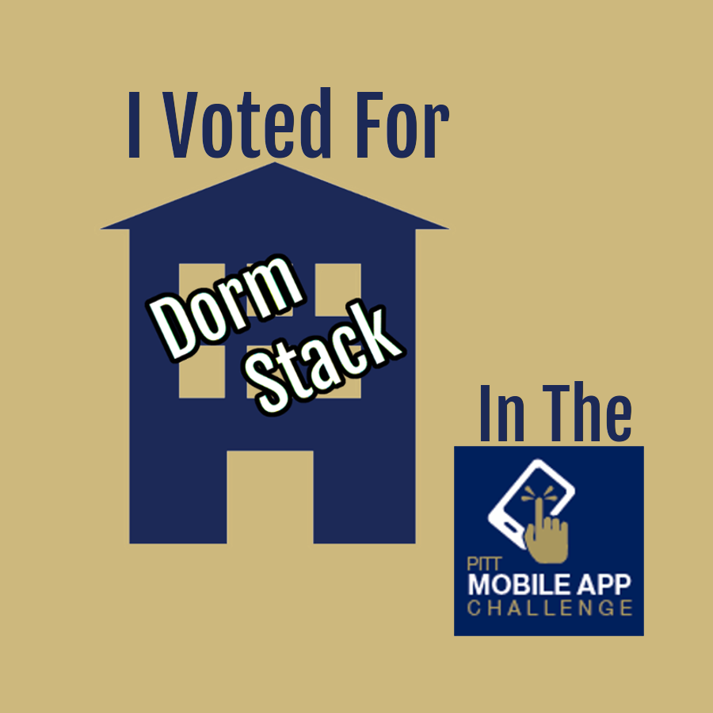
DormStack: Marketing
Define the target market for your app. You may include factors such as age, sex, geographic location, and others.
The primary demographic for DormStack is college students who are living in a large dormitory building. Each dorm in the DormStack is meant to be a general overview of the life of each dorm building, and is meant to have more than 100 people per dorm.
What makes your app unique? Why should people use your app instead of another app that meets a similar need?
DormStack is different than many other social networks because the primary focus is on the relationship between a resident and the hundreds of others living in their dorm. The barrier for entry is extremely low as well. A user can create an account without the hassle of needing to enter copious amounts of personal information. All they need is a name, email, and profile picture and they’re good to go!

Slide 4
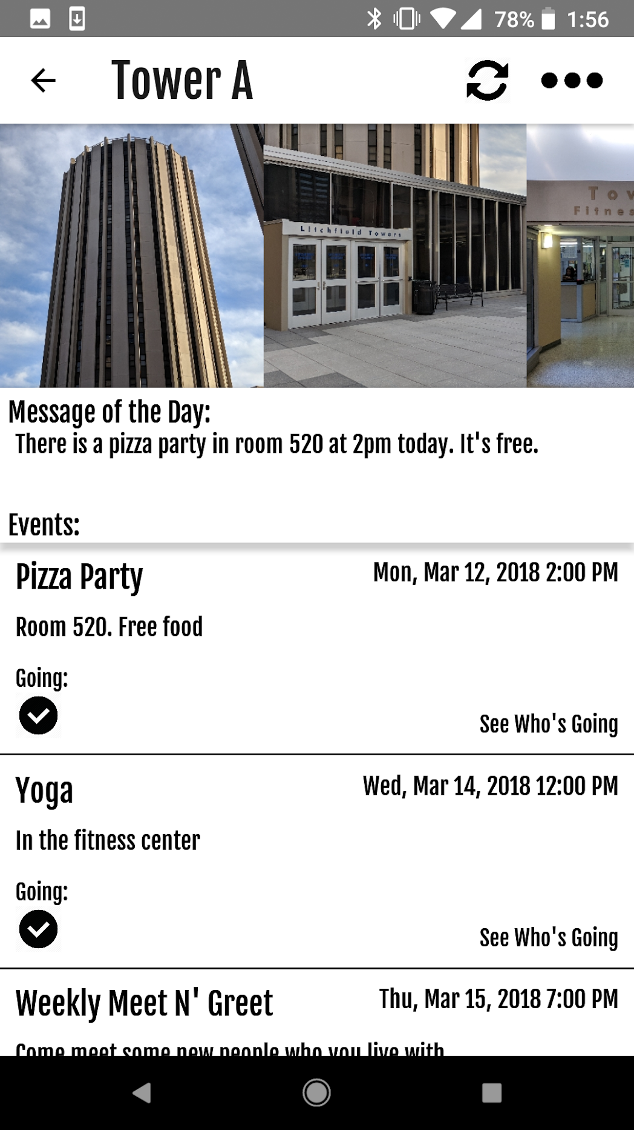
DormStack: Technology
What platform was your app built for and why?
Being a social network, DormStack had to be available on iOS and Android, the two types of devices that people who are college aged generally own. Any social networking app that is not available to 99% of it’s demographic will fail. It is for this reason that DormStack is developed for both iOS and Android devices.
What programming language did you use to build your app?
DormStack is built using JavaScript, and utilizes React-Native, a framework made by Facebook designed as a compatibility layer for a JavaScript interpreter, and the Java/Objective-C compilers for Android/iOS.
New Images, Messages of the Day, and Events are updated automatically, and Events expire and remove themselves after their event date.

Slide 5
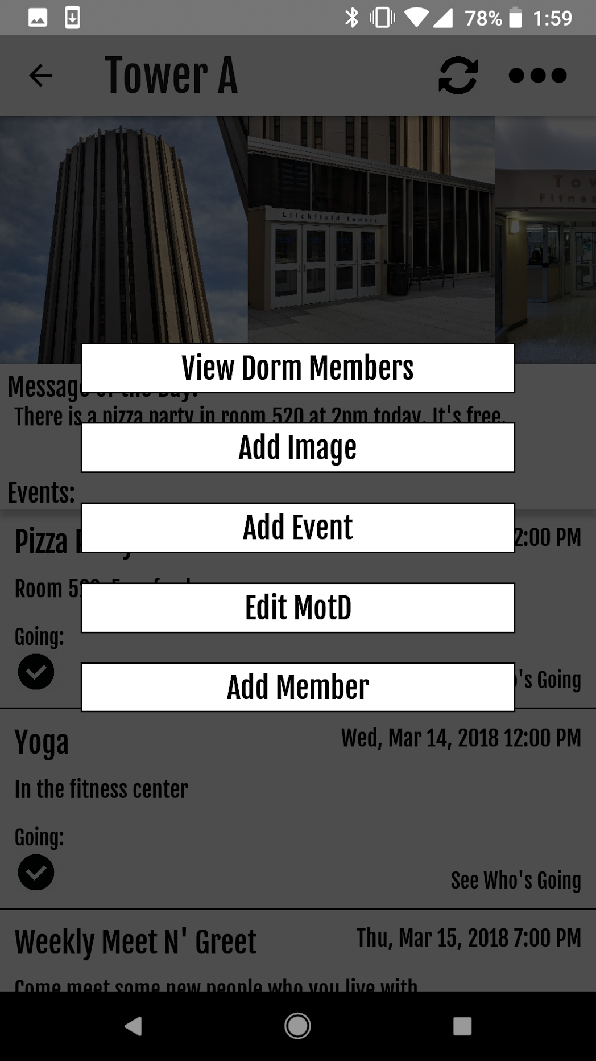
DormStack: Technology
What technologies does your app take advantage of? For example, does it use GPS to provide real-time location information? Does it interface with any data sources?
DormStack utilizes the phone’s camera and local storage to host photos and scan QR codes. DormStack also uses the iOS and Android push notification system to feed notifications prior dorm events to the user.
What resources did you use to build your app? For example, did you reference a Java tutorial on lynda.pitt.edu? Did you use Google Cloud to host a database?
DormStack utilizes a variety of npm packages in order to function. authentication, as well as all stored information is handled through Firebase from Google.
These 2 selections are only available to Resident Assistants.

Slide 6
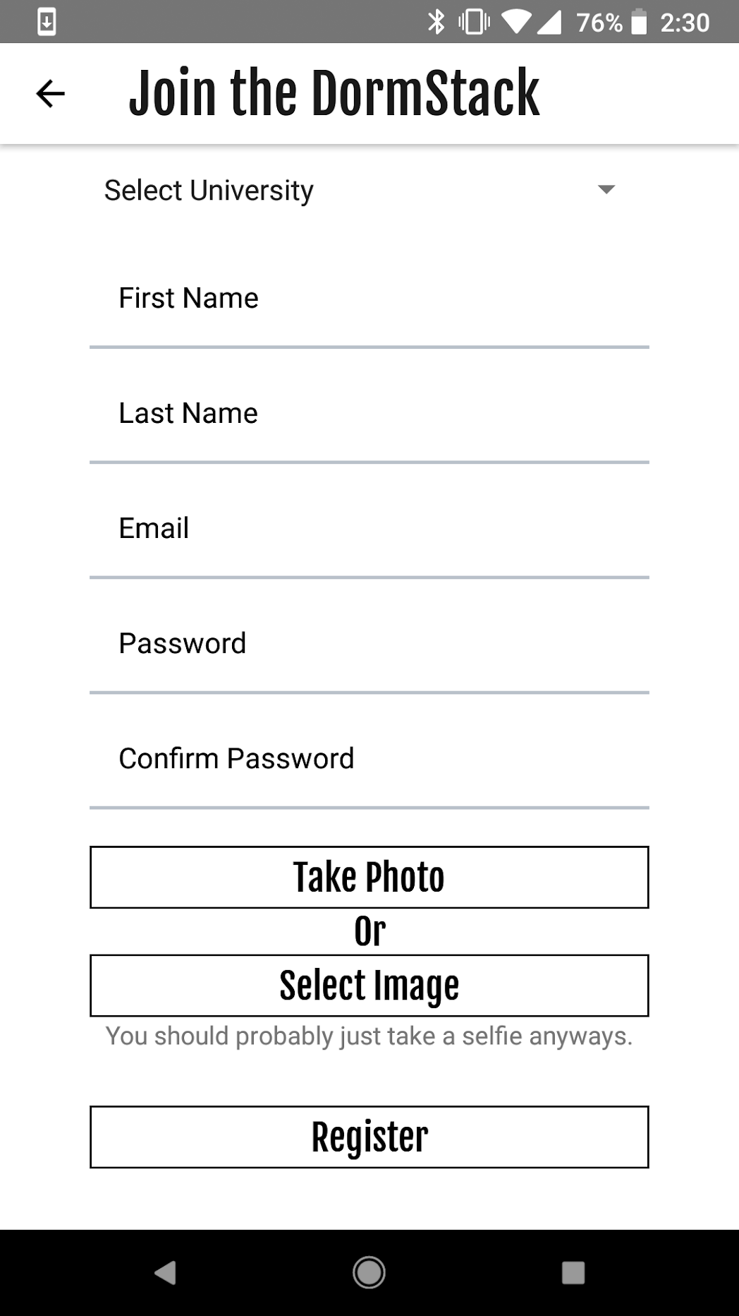
DormStack: User Experience
What assumptions, if any, does your app make about its users?
DormStack was crafted with the idea users are going to want a social networking app for their dorm, and that using DormStack is much better than hanging a flyer in the hall to make students aware of events. DormStack is built for all universities will dorm life.
What kind of training, if any, will people need to use your app?
The only thing users will need in order to use DormStack is a basic understand of how their smartphone operates, which most college aged people do.
Users join based on university
Selecting one of these will open either the phone’s camera or local image storage

Slide 7
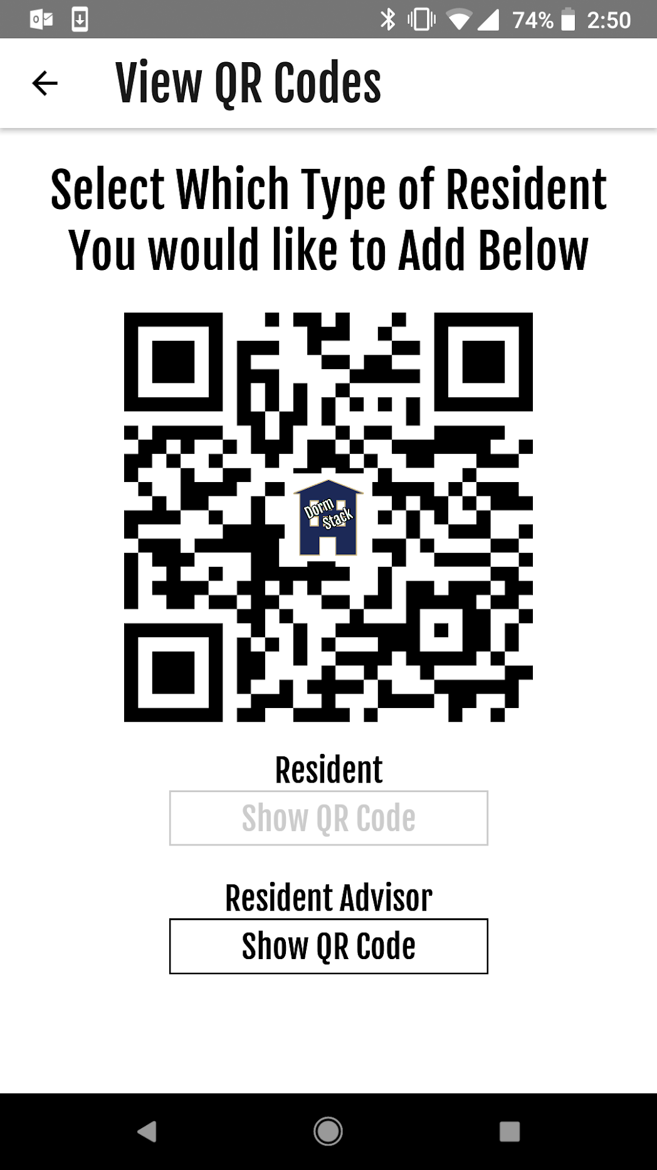
DormStack: Looking Forward
What enhancements, if any, could you add to the app that have not already been introduced?
If I had more time to work on the app, I would have added a “DormChat” feature where each dorm would have an open chat room for people to communicate on.
What are the major steps required to fully distribute your app from its current development state? How long do you estimate that would take?
The actual DormStack mobile application is feature complete for the scope of my project, however the Firebase database that stores the data needs rules for the actual types of data that users are able to read and write. DormStack could be distributed onto an app store in less than 30 hours of work

Slide 8
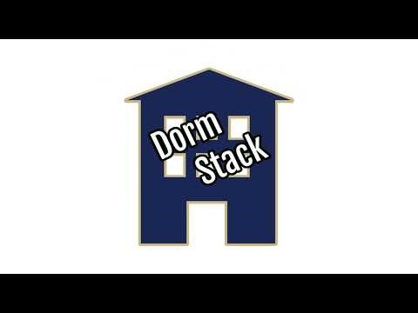
DormStack: Video Demo

