Slide 1
ADL Final Project: Fake News Maker
TEAM 30
R05525059 蔡志豪
R06525111 廖偉傑
R07525062 孫晨翔
R07525084 廖宸廷

Slide 2
Idea
A language model for writing Chinese news.
Finish a paragraph given the beginning contexts.
Write news on a specific topic.

Slide 3
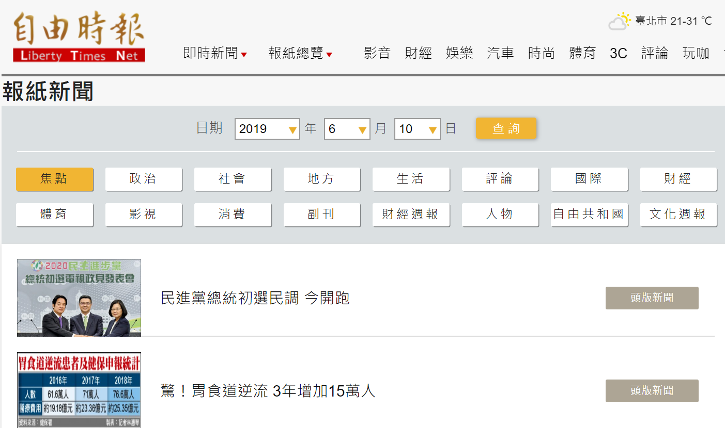
1. A language model for writing news
Corpus:
Liberty Times Net,
Newtalk
Model:
N-gram model or
Pretrained Chinese LM

Slide 4
2. Finish a paragraph given the beginning contexts
Given: 台北市昨日發生6.3級大地震，導致
Output: 台北市昨日發生6.3級大地震，導致市長跌倒了。

Slide 5
3. Write news on a specific topic
Input: 吳敦義昨首度鬆口表示, label: 政治
Output: 吳敦義昨首度鬆口表示，參選總統大選，「我已經準備了30幾年」。
Input: 吳敦義昨首度鬆口表示, label: 生態
Output: 吳敦義昨首度鬆口表示，白海豚到了將軍港就會轉彎。

Slide 6
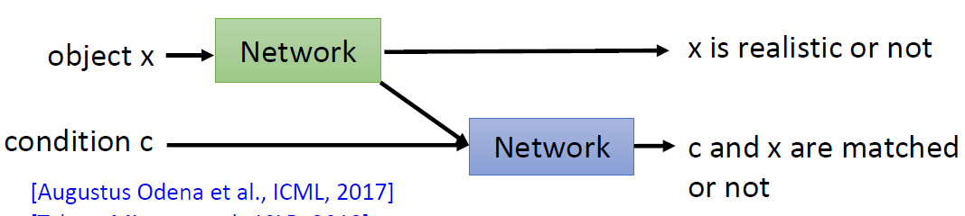

3. Write news on a specific topic
Can it really improve the performance of language model or will just crash it?

