Slide 1
EKX9030: Advanced characterization techniques Report
PRESENTER: ADEMOLA MICHAEL ADEGBILE
DATE: 21.05.2025
LABORATORY OF INORGANIC MATERIALS,
DEPARTMENT OF MATERIALS AND ENVIRONMENTAL TECHNOLOGY

Slide 2
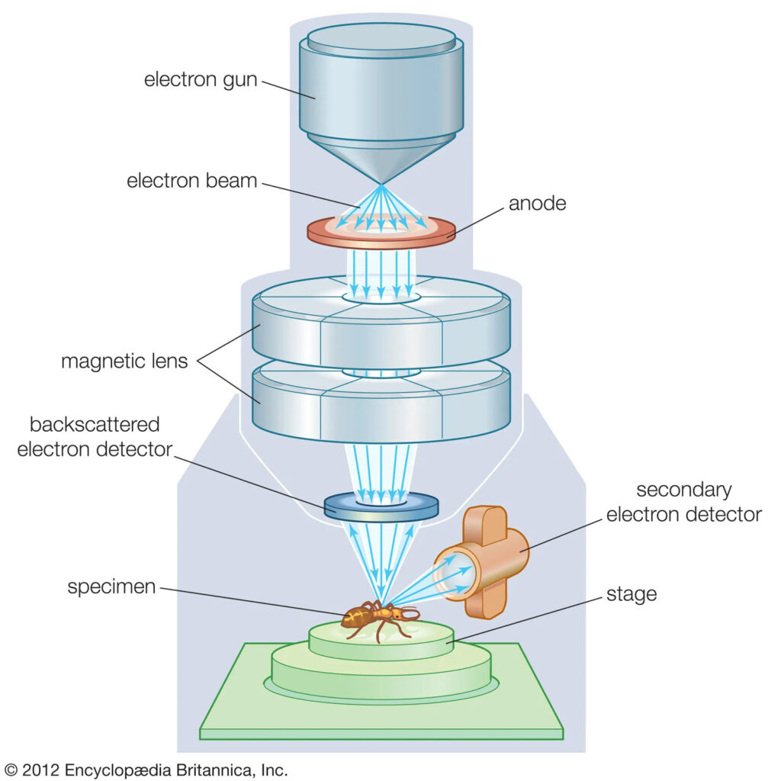
Background: Scanning Electron Microscopy (SEM)
Background:
Electron Beam: A focused beam of high-energy electrons scans the sample surface.
Interaction: Electrons interact with surface atoms, generating various signals.
Signal Emission: Secondary electrons, backscattered electrons, and X-rays are emitted.
Secondary Electrons (SE): Low-energy electrons used to produce high-resolution images of surface topography.
Backscattered Electrons (BSE): High-energy electrons that provide atomic number contrast and compositional information.
X-rays (EDS/EDX): Element-specific X-ray emissions used for qualitative and quantitative chemical analysis.
Detection: Detectors collect signals to form high-resolution images of surface topography.
Figure 1: Simplified schematic diagram of a Scanning Electron Microscope (SEM)
2
Notes:
1. https://www.tribonet.org/wiki/scanning-electron-microscope/

Slide 3
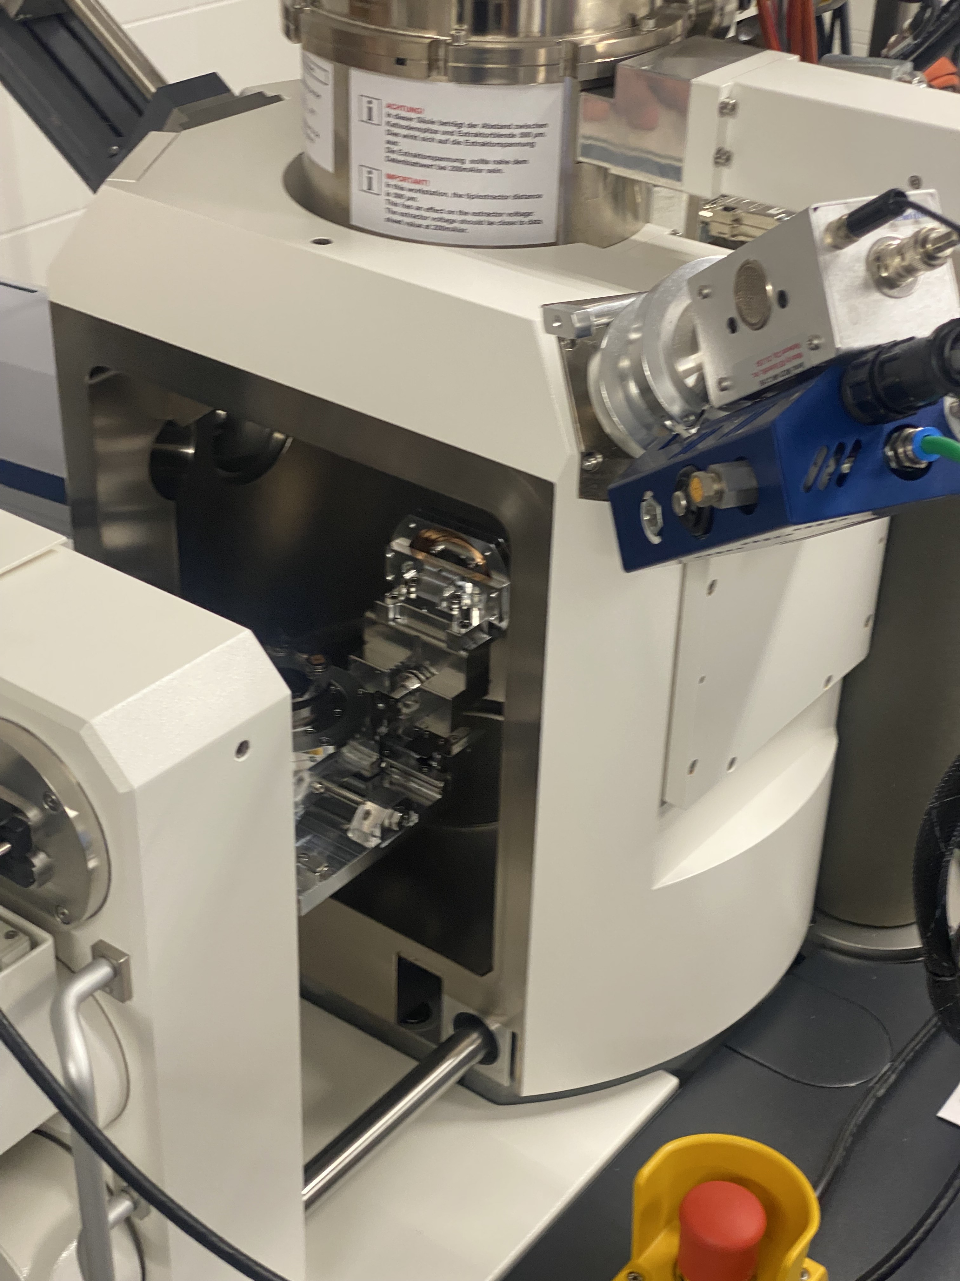
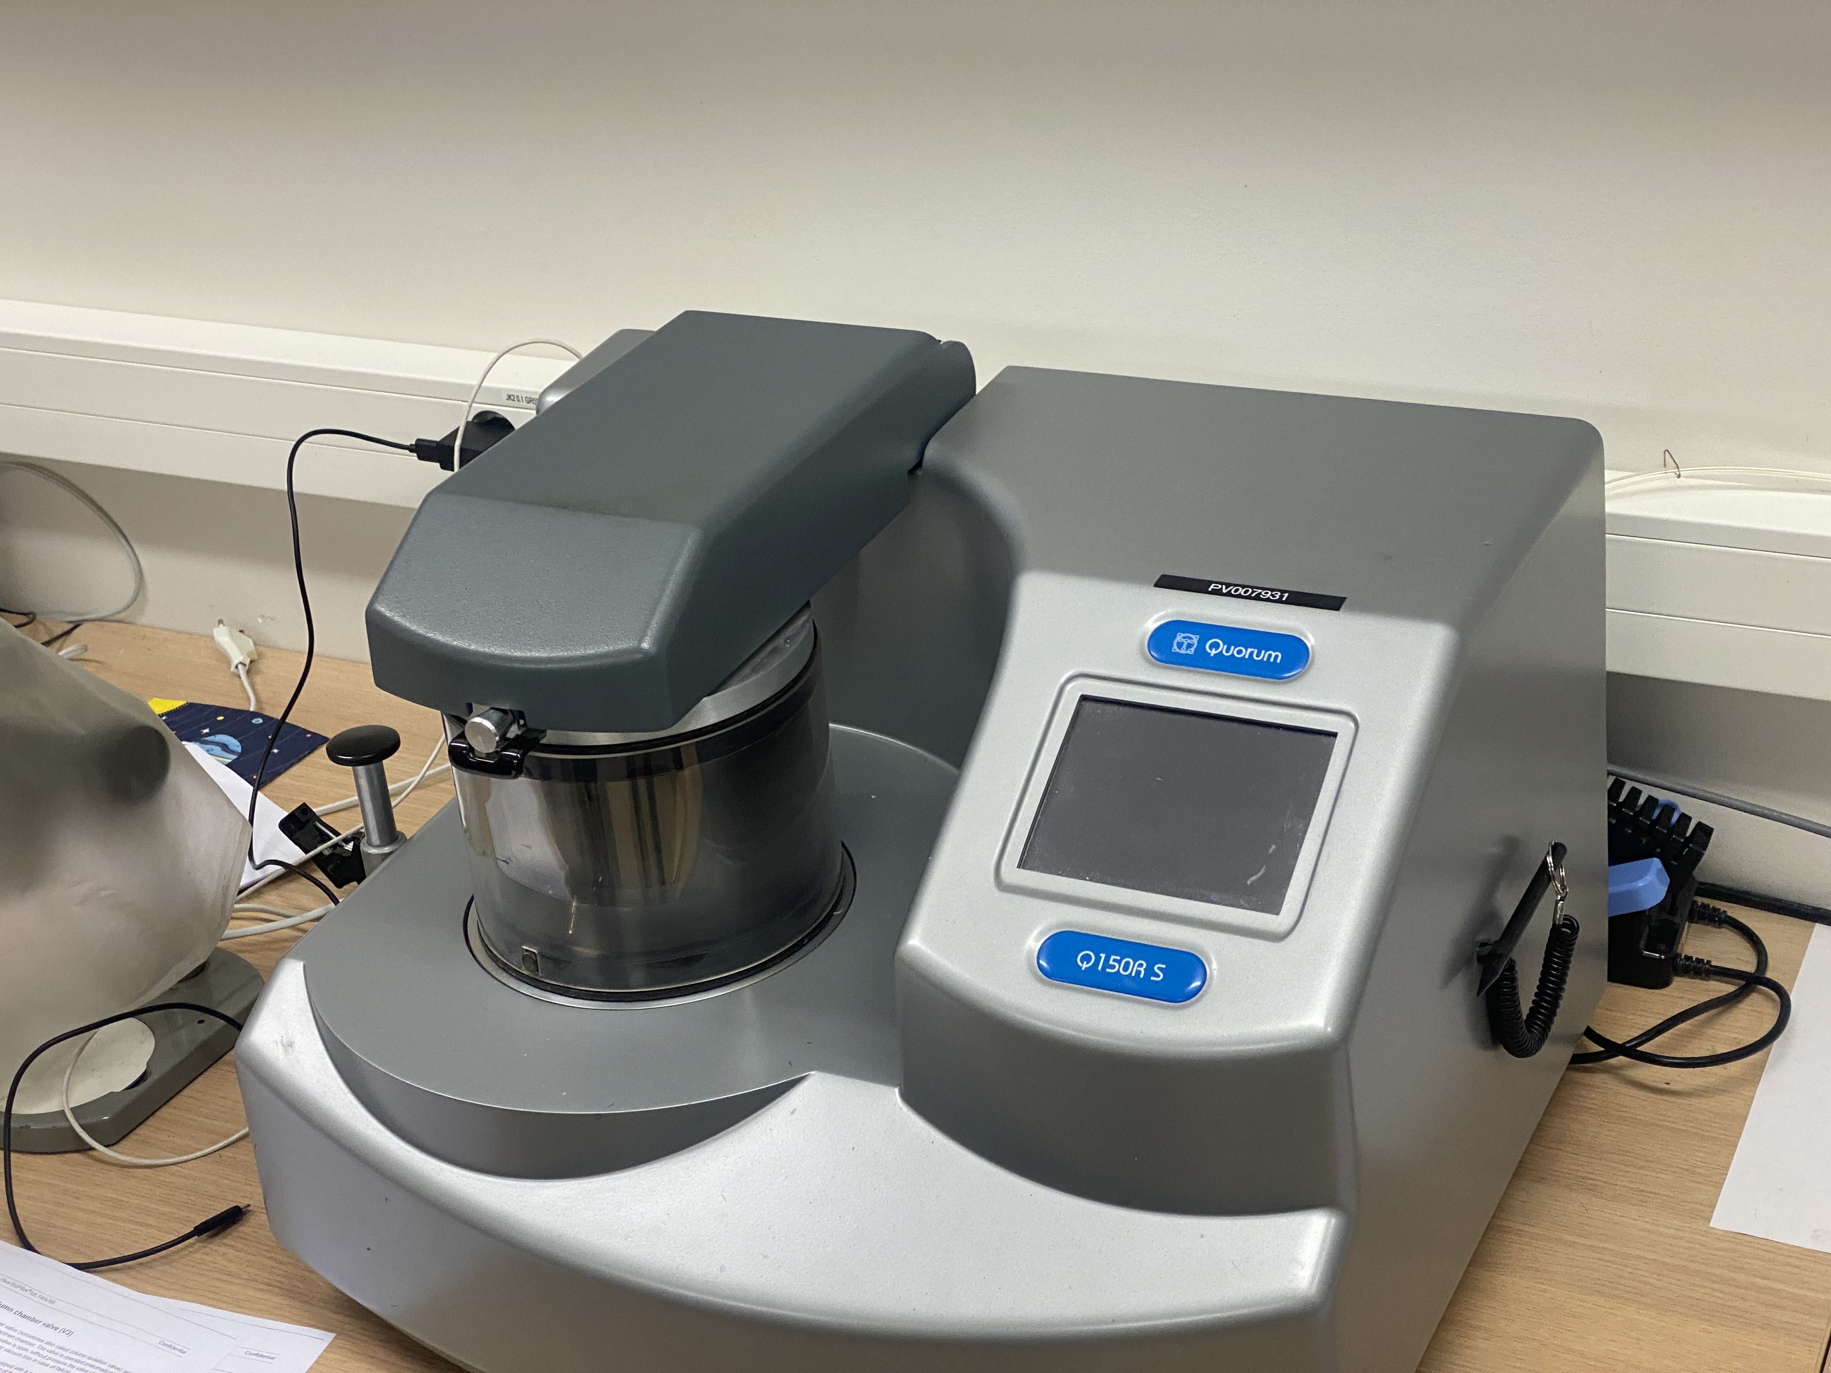
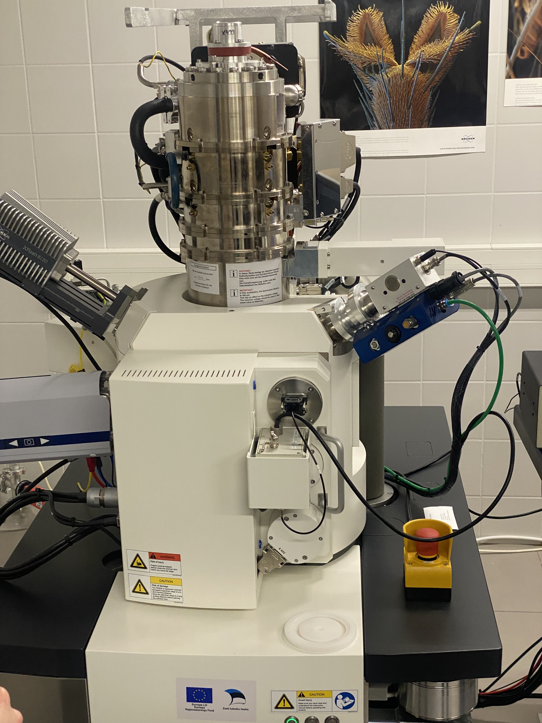
Background: Scanning Electron Microscopy (SEM)
Sample Preparation
Conductive Samples
Naturally conductive; minimal prep required
Clean surface (e.g., solvents, ultrasonic)
Mount with conductive adhesive (carbon/silver paste)
No coating needed
Non-Conductive Samples:
Prone to charging; require extra prep
Fixation & dehydration (for biological samples)
Mount with conductive adhesive
Coat with thin conductive layer appr. 10 nm gold
Figure 2: Gold sputter coating equipment used for SEM sample preparation
Figure 3: SEM before closing
3
Figure 4: SEM after closing

Slide 4
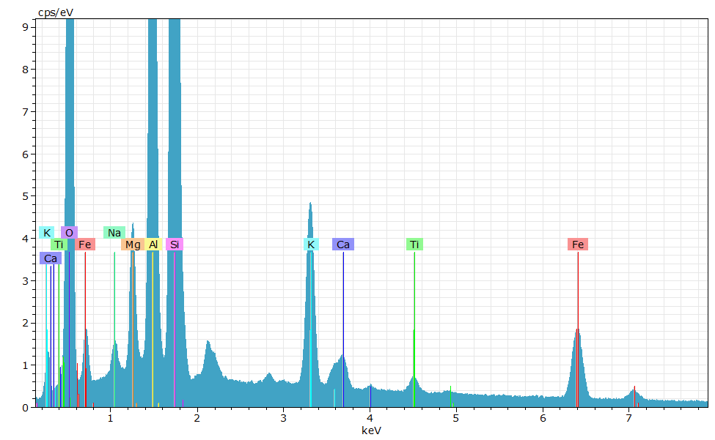
RESULTS: Scanning Electron Microscopy (SEM)
My sample: Calcined clay (900 ℃) sourced from Arumetsa
Figure 5: Cacined clay SEM image
Figure 6: Elemental composition via EDS
4

Slide 5
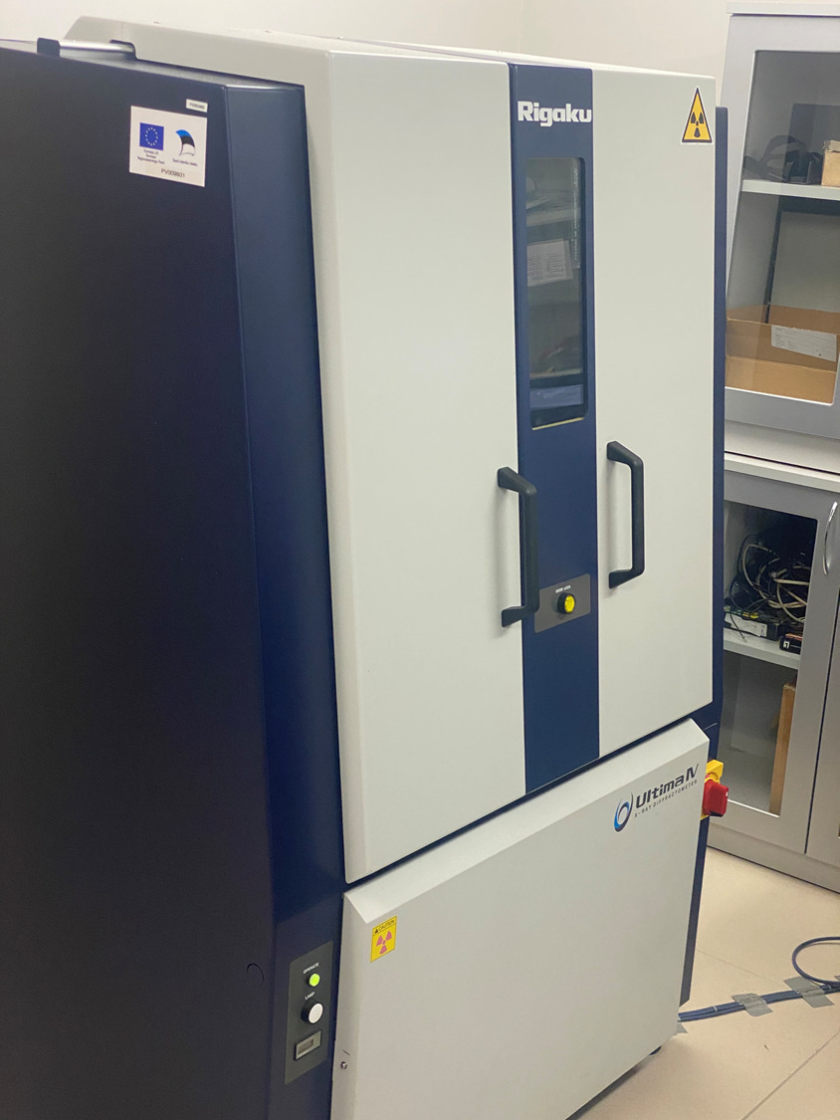
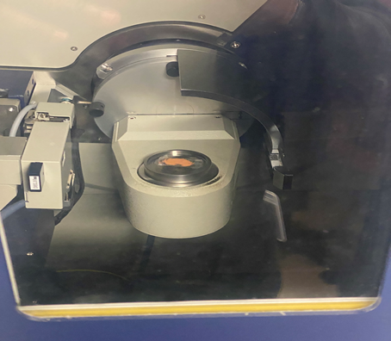
Background: X-Ray Diffraction (XRD)
Working Principle
Irradiation: A monochromatic X-ray beam is directed at a crystalline sample.
Diffraction: X-rays are scattered by the crystal lattice planes.
Constructive Interference: Occurs at specific angles satisfying Bragg’s Law (nλ = 2d sin θ).
Detection: The diffracted rays form a pattern unique to the crystal structure.
Sample Preparation
Ground calcined clay (900 ℃) is spread over a double sided transparent tape.
Ensure it is level with the rim or edge of the sample holder.
Figure 7: Rigaku XRD instrument
5
Figure 8: Calcined clay on sample stage

Slide 6
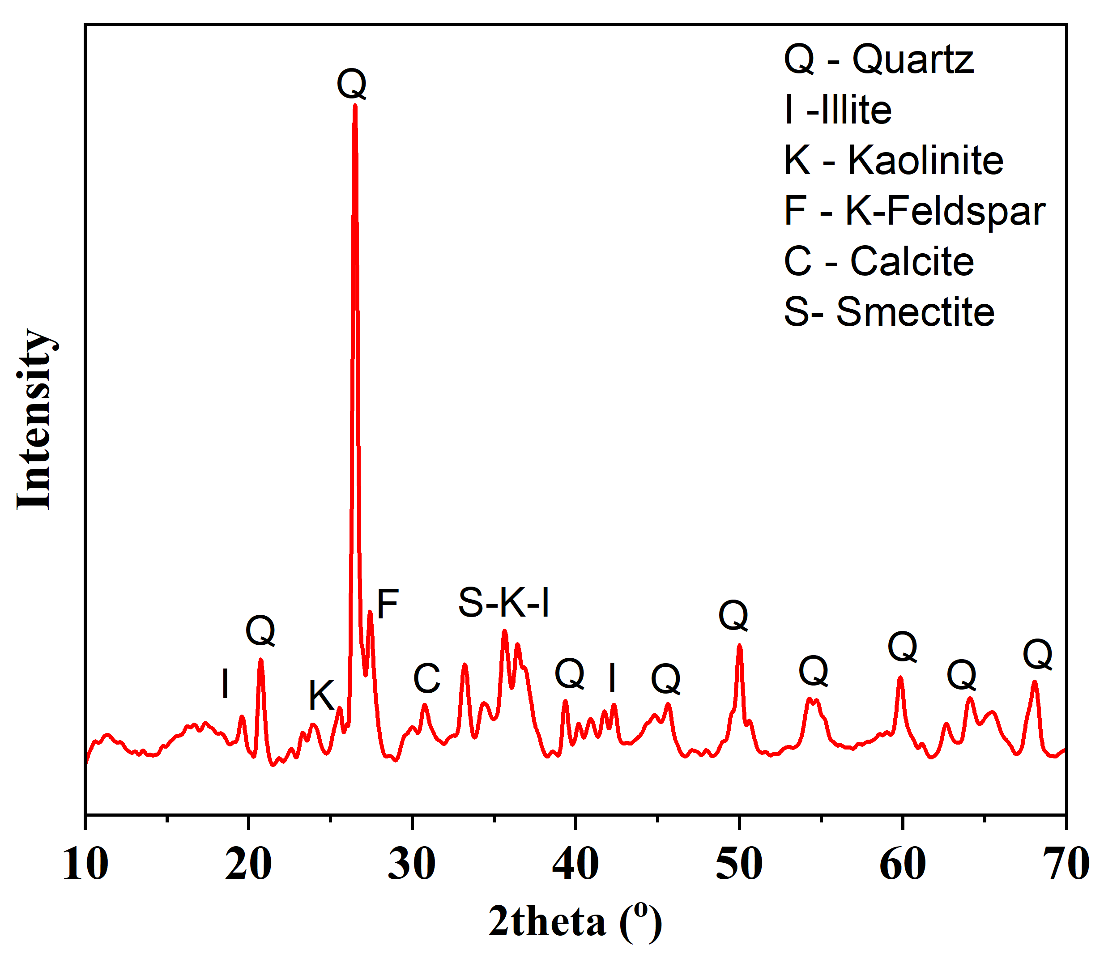
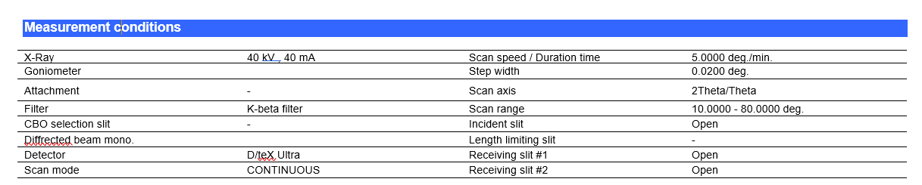
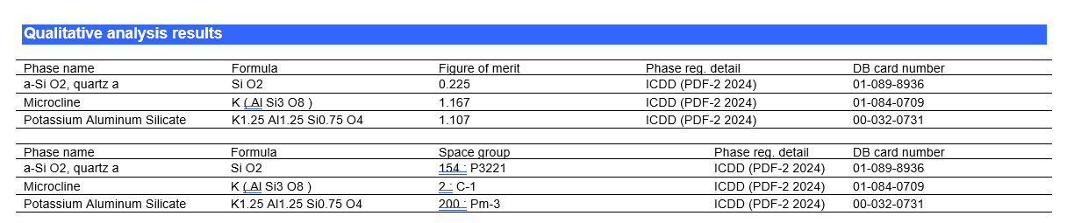
RESULTS: X-Ray Diffraction (XRD)
Figure 10: XRD pattern with phase identification overlay for calcined clay
Table 1: Measuring conditions
Figure 9: XRD for calcined clay via Origin
Table 2: Phases
6

Slide 7
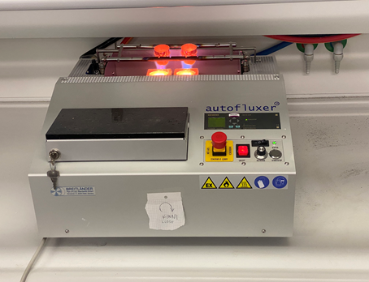
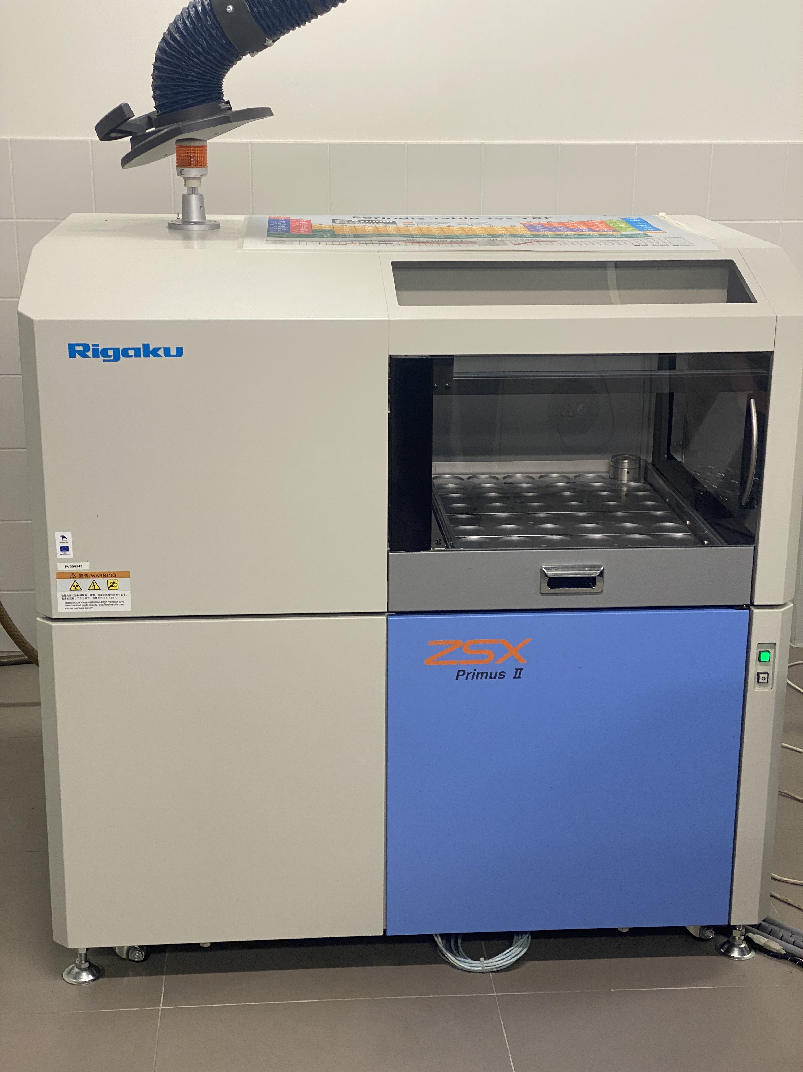
Background: XRF
Background
Excitation: High-energy X-rays strike the sample, ejecting inner-shell electrons.
Relaxation: Electrons from higher energy levels fill the vacancies.
Emission: The energy difference is released as characteristic X-ray fluorescence.
Detection: A detector measures the emitted X-rays to identify and quantify elements.
Wavelength-Dispersive XRF (WDXRF): Separates X-rays by wavelength using diffraction crystals for high precision and accuracy.
Energy-Dispersive XRF (EDXRF): Measures the energy of emitted X-rays using solid-state detectors for faster, simpler analysis.
Figure 11: Auto-fluxing instrument
7
Figure 12: XRF equipment

Slide 8
RESULTS: XRF
Composition | Composite Cement
Na₂O (mass %) | 0.19
MgO (mass %) | 3.82
Al₂O₃ (mass %) | 4.94
SiO₂ (mass %) | 20.37
P₂O₅ (mass %) | 0.07
SO₃ (mass %) | 3.97
K₂O (mass %) | 1.15
CaO (mass %) | 59.43
TiO₂ (mass %) | 0.39
Cr₂O₃ (mass %) | 0.007
Mn₂O₃ (mass %) | 0.09
Fe₂O₃ (mass %) | 2.57
ZnO (mass %) | 0.07
SrO (mass %) | 0.04
Composition | Wood Pellet
C (mass %) | 53.60
Na (mass %) | 0.05
Mg (mass %) | 0.03
Al (mass %) | 0
K (mass %) | 0.01
Ti (mass %) | 0
Mn (mass %) | 0.01
Fe (mass %) | 0.004
Zn (mass %) | 0.001
Rb (mass %) | 0
O (mass %) | 46.30
Sample Preparation
Composite cement:
LOI (950 ℃) to remove volatiles that could adversely affect platinum-ware.
Fusion involving 7g of flux (Lithium Tetraborate) to 0.7g of sample.
Fused for 15 minutes and poured.
Cooling and analysis.
Wood Pellet:
Reduction of particle size below 1mm.
Pressing with a load of 21 tonnes for 5 minutes.
Analysis.
8
Table 3: Chemical composition of composite cement
Table 4: Chemical composition of composite wood pellet

Slide 9
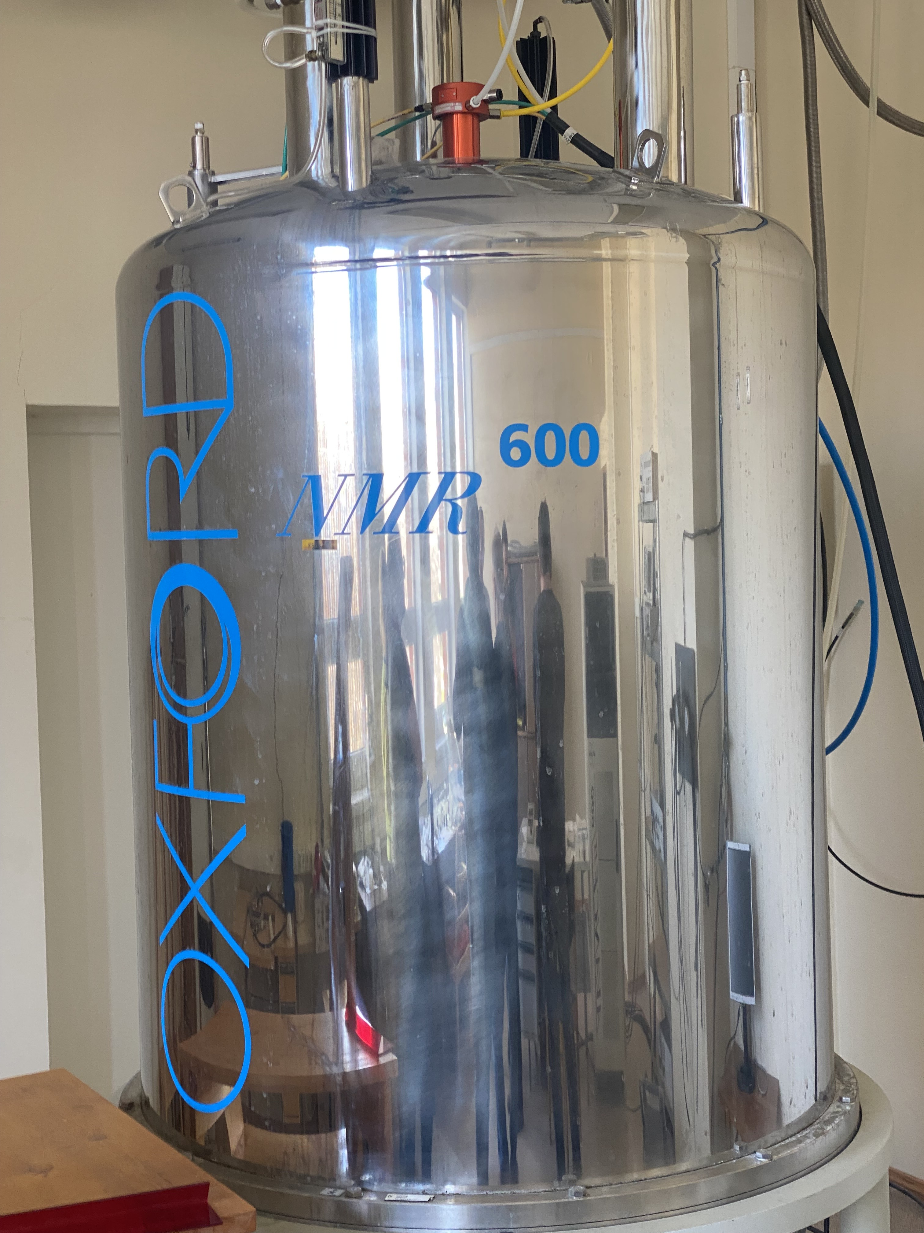
Background: NMR
Background:
Magnetic Field: Nuclei with spin (like ¹H, ¹³C) are placed in a strong magnetic field.
Radiofrequency Pulse: A specific RF pulse excites the nuclei, flipping their spin states.
Relaxation: Nuclei return to lower energy state, emitting RF signals.
Detection: Emitted signals are detected and transformed into a spectrum via Fourier Transform.
Sample Preparation
Solution-State NMR:
Dissolve ~5 mg of sample in 0.6–0.7 mL of deuterated solvent (e.g., CDCl₃, DMSO-d₆).
Transfer solution into a clean 5 mm NMR tube, cap and label correctly.
Solid-State NMR:
Finely grind sample.
Fill sample into zirconia rotors for magic angle spinning.
Figure 13: Solid-state NMR (600 MHz) equipment
9

Slide 10
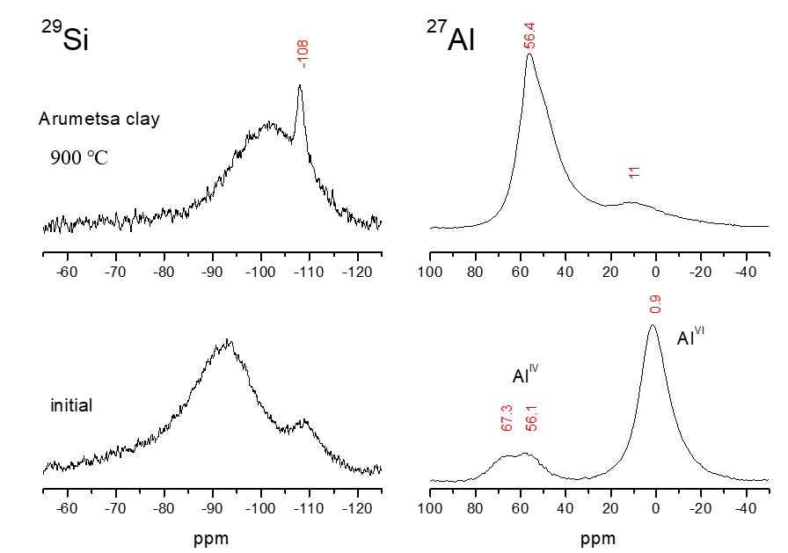
RESULTS: Solid state NMR (¹³C-NMR)
Figure 14: ²⁹Si (left panels) and ²⁷Al (right panels) MAS NMR spectra of Arumetsa clay samples. The ²⁹Si spectrum of initial clay consists of a broad resonance with a maximum at -93 ppm and a shoulder at 109 ppm. After heating at 900 ℃ the resonance becomes narrower and the maximum shifts to -102 ppm. The narrow peak at -108 ppm can be assigned to almost crystalline SiO₂. The ²⁷Al spectrum of initial clay shows the main peak at 0.9 ppm belonging to octahedral aluminum sites. The two peaks at 56.1 and 67.3 ppm belong to the tetrahedral aluminum sites. After calcination, the spectrum shows that majority of the aluminum obtains tetrahedral surrounding as seen in the spectrum in right top panel.
10

Slide 11
Thank you
11

