Slide 1
Soiree catering
In-house
Hotel Gotham will provide catering.
Food cost can increase as use of private members bar is free.
Budget £15/head.
Trainer Ben’s favourite food is Sausage Roll
Outside caterers
Bring in canapes/event catering.
Might be Plate/cover charge.
Can use best suppliers.
What is best for Ben? Greggs or Savin Hill or Harrods?
What is best for guests? Halal, Vegan, Gluten-free…
What looks best? Finger food or massive metre-long monster?

Slide 2


Slide 3
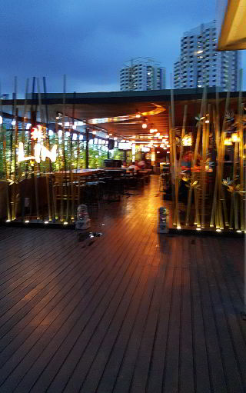
Location Choice
Gotham/action movie dramatic setting.
City Centre – best for transport routes.
Guest accommodation – plenty of luxury hotels to stay in.
Researched resources
VisitManchester Database
Best rooftop locations/bars
Gotham Hotel had right styling, impact and service offer for a celebrity birthday

Slide 4

Fruit Ciderama! Full tanker with massive choice of added flavours

