Slide 1

Smart Spaces Project: Pupil augmented presentation system
Bertieaux Julien, Finet Cyrille, Moulin Charles,
Vandebrouck Robin & Vidotto Benoît

Slide 2
Plan of the presentation
Introduction
Context and objective
Pipeline Presentation
Implemented modules
Demonstration
Additional options
Prospects for improvement
Conclusion

Slide 3
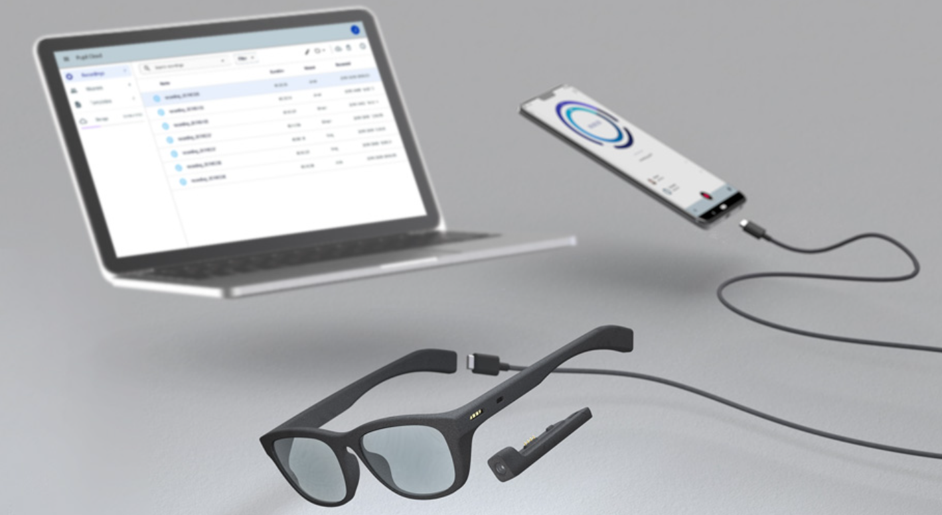
Introduction
Pupil Invisible
Mobile eye tracking powered by a novel end-to-end gaze estimation pipeline with :
- No adjustments
- No calibration
- No environment limitations

Slide 4
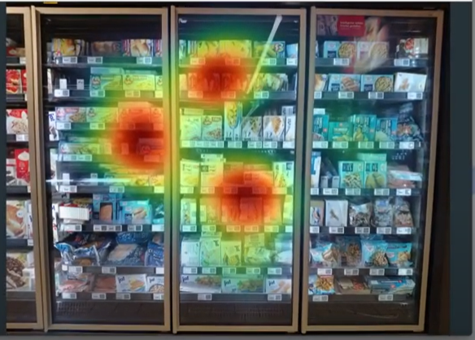
Introduction

Slide 5
Context and objective
Context: There's a need for hand-free mouse control. For instance, it can help people with upper limbs motor impairment.
Solution: Use an eye-tracking device to control the mouse
Notes:
Parmis toutes ces applications, nous avons réfléchi à une nouvelle innovante qui permettrait d'aider les gens. C'est pourquoi, nous avons voulu développer un outil permettant aux personnes manquant de motricité dans les membres supérieur d'utiliser une souris. Alors comment accomplir cette tâche ? Slide suivant

Slide 6
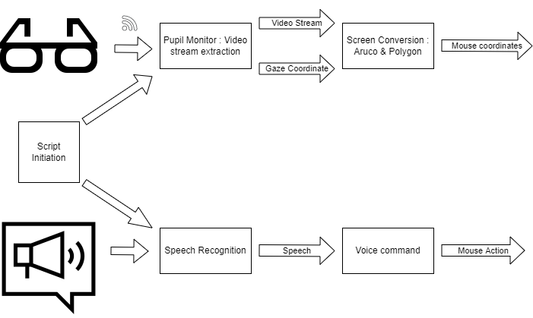
Pipeline Presentation
Notes:
Nous avons décidé de travailler avec deux processus s'exécutant en parallèle. D'une part, on récupère le flux vidéo émanant des lunettes pour en extraire les coordonnées du regard. Après une conversion, on obtient des coordonnées utilisables pour la souris. D'autre part, pour faciliter davantage l'utilisation, nous avons intégré une commande vocal pour exécuter certains actions. Ainsi, le clic ou le scroll peuvent est utilisé sans lever le petit doigt.

Slide 7
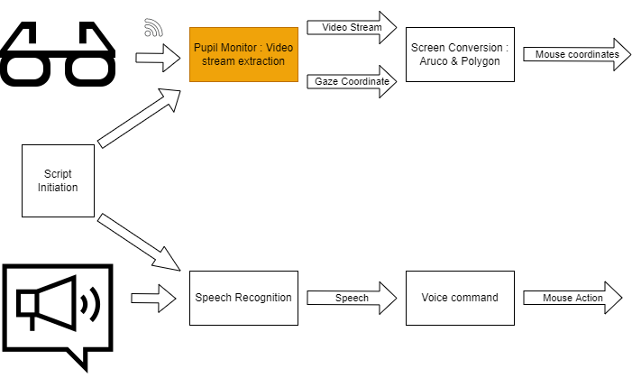
Pipeline : Video stream extraction

Slide 8
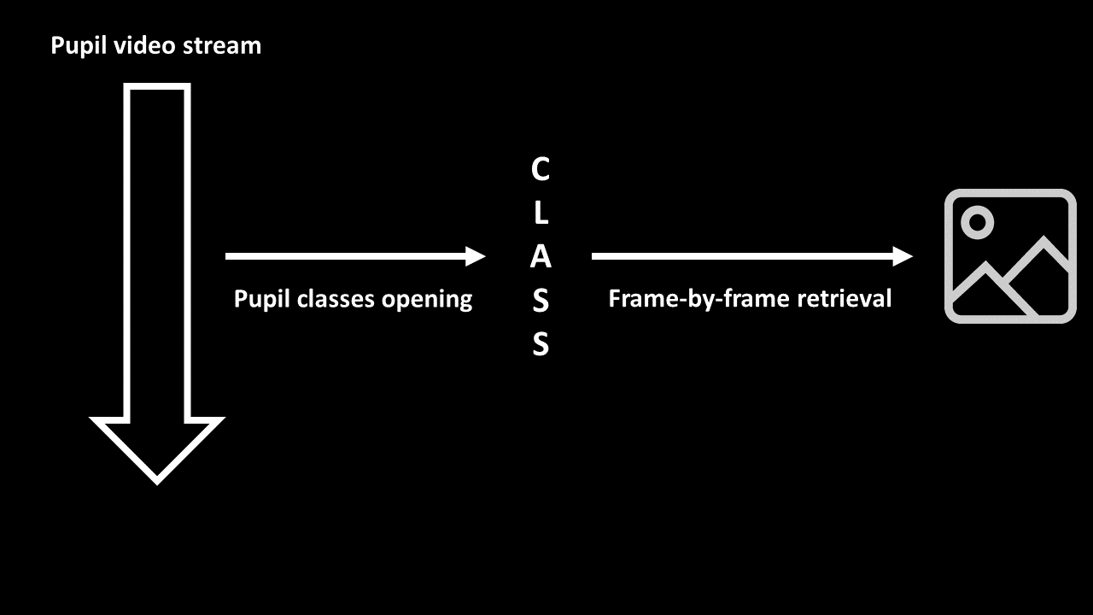
Implemented modules
GitHub
Use of the Pupils Invisible Monitor repo
Similar to phone app but on PC (Python)
Makes connection with glasses
Shows video stream with gaze representation
Retrieval/data fetch
Frame rate of 60 Hz
Gaze and image retrieved simultaneously
Project is heavily based on GitHub app (only 1 function changed)

Slide 9
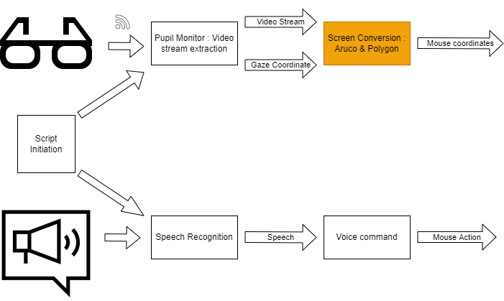
Pipeline : Screen Conversion

Slide 10
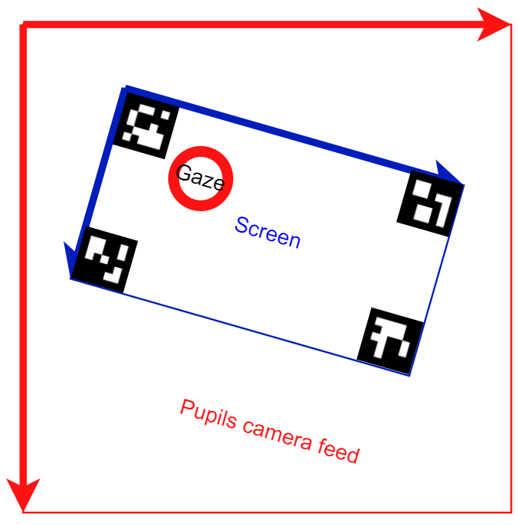
Implemented modules : Aruco & polygons
Convert gaze from pupils camera feed coordinates to the screen coordinates delimited by the markers
Use of OpenCV ArUco library for the markers
Use the Polygons library to confirm that the gaze is included within the markers
Transformation method (e.g. X):
Width of screen from pupils coordinates using marker IDs
Relative gaze position : (gaze_X – Marker_TopLeft_X)/width
Mouse position : rel_pos_X * screen_width

Slide 11
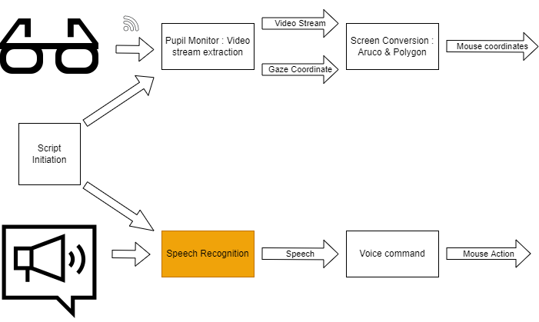
Pipeline : Speech recognition

Slide 12
Implemented modules : vosk
Partial prediction
Speech recognition is performed with the vosk API
Offline open-source speech recognition toolkit
Simplified or complex linguistic models
Low-latency
Interesting for embedded systems (e.g. Raspberry Pi)
x10
Complete prediction
Word division of the sentence
Comparison with voice cammands

Slide 13
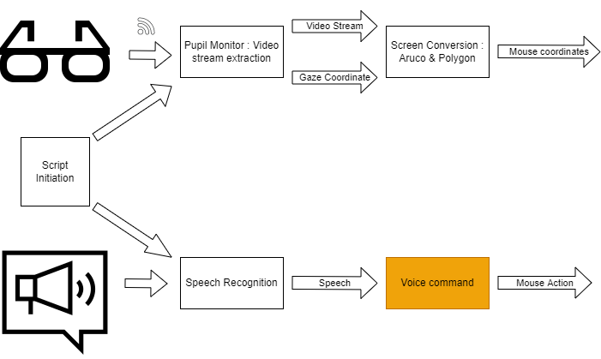
Pipeline : Voice Command

Slide 14

Implemented modules : mouse
Application of a command on the computer according to the previously recognised voice command.
Imported library: Mouse. To control the computer mouse.
Commands :
« Sélection »
« Option »
« Montée »
« Descente »

Slide 15
Demonstration
Notes:
To do after (when the teacher come)

Slide 16
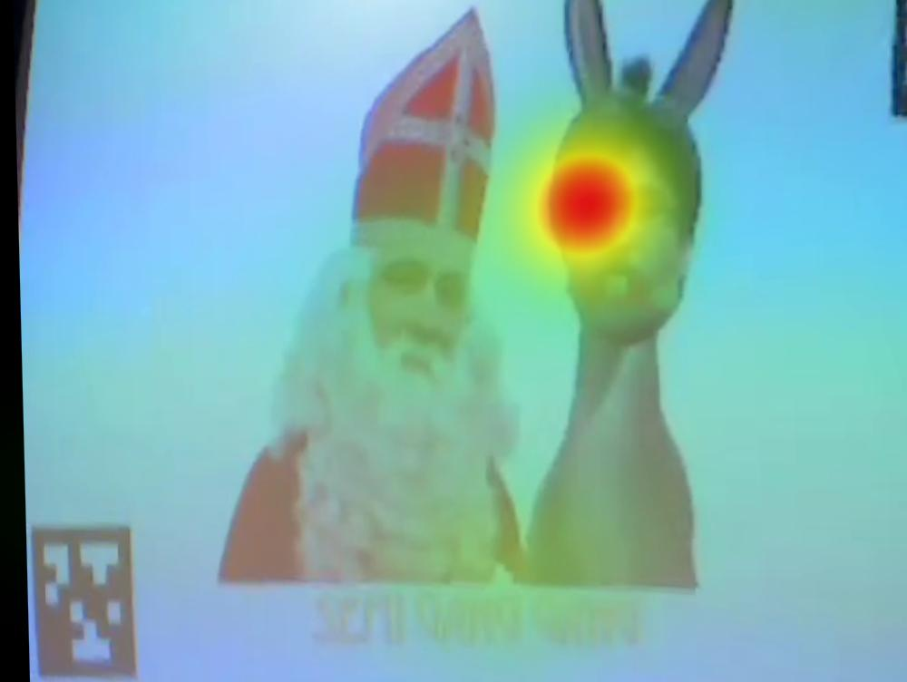
Additional options: Heatmaps
Result:
Notes:
Robin/Cyrille Video

Slide 17
Prospect for improvement
Stabilization of mouse tracking with the eyes.
Improved mouse response time.
Use of a library with a better language model.
Combining the HeatMap application with the general code.

Slide 18
Conclusion
Positive :
Project works well
Good development for the limited working time available
Several ideas to go further
Negative:
Many prospects for improvement
Little possibility of use in everyday life
Very limited documentation for this model

Slide 19

Thank you for your attention !
Questions ?

