Slide 1



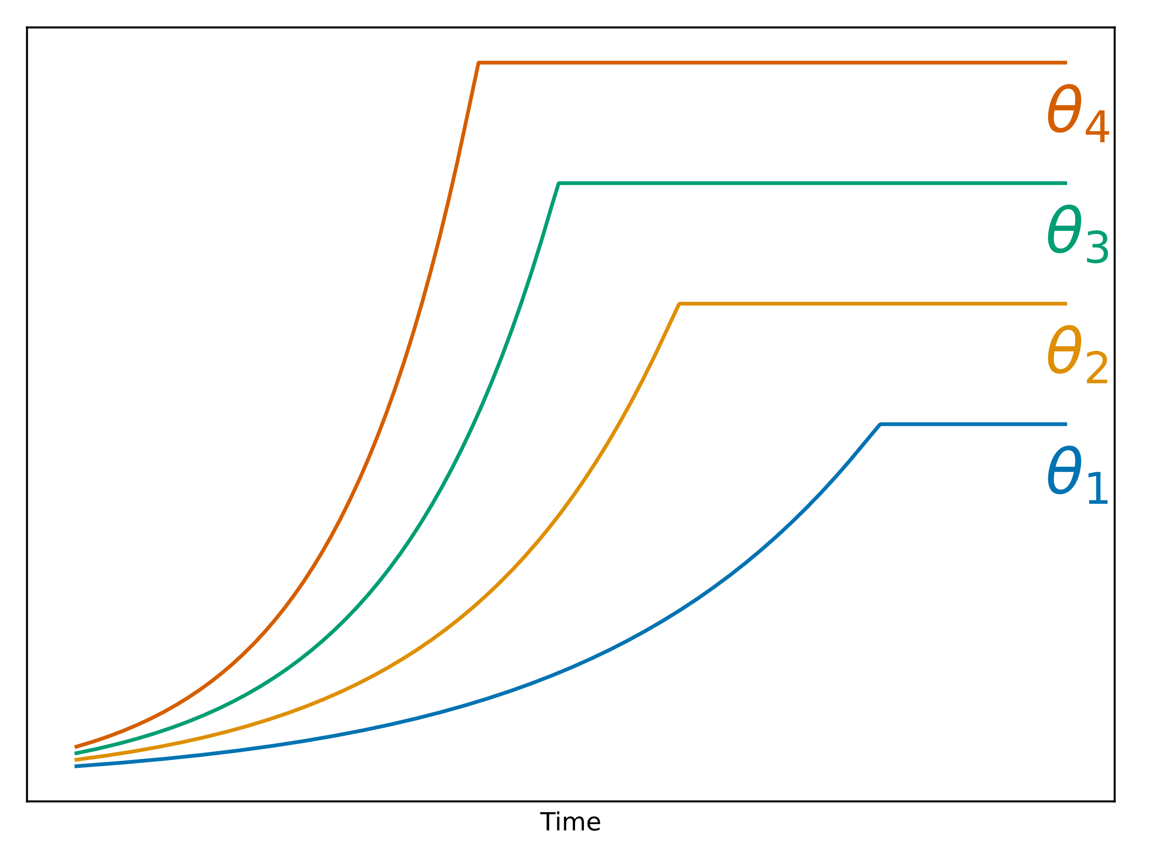


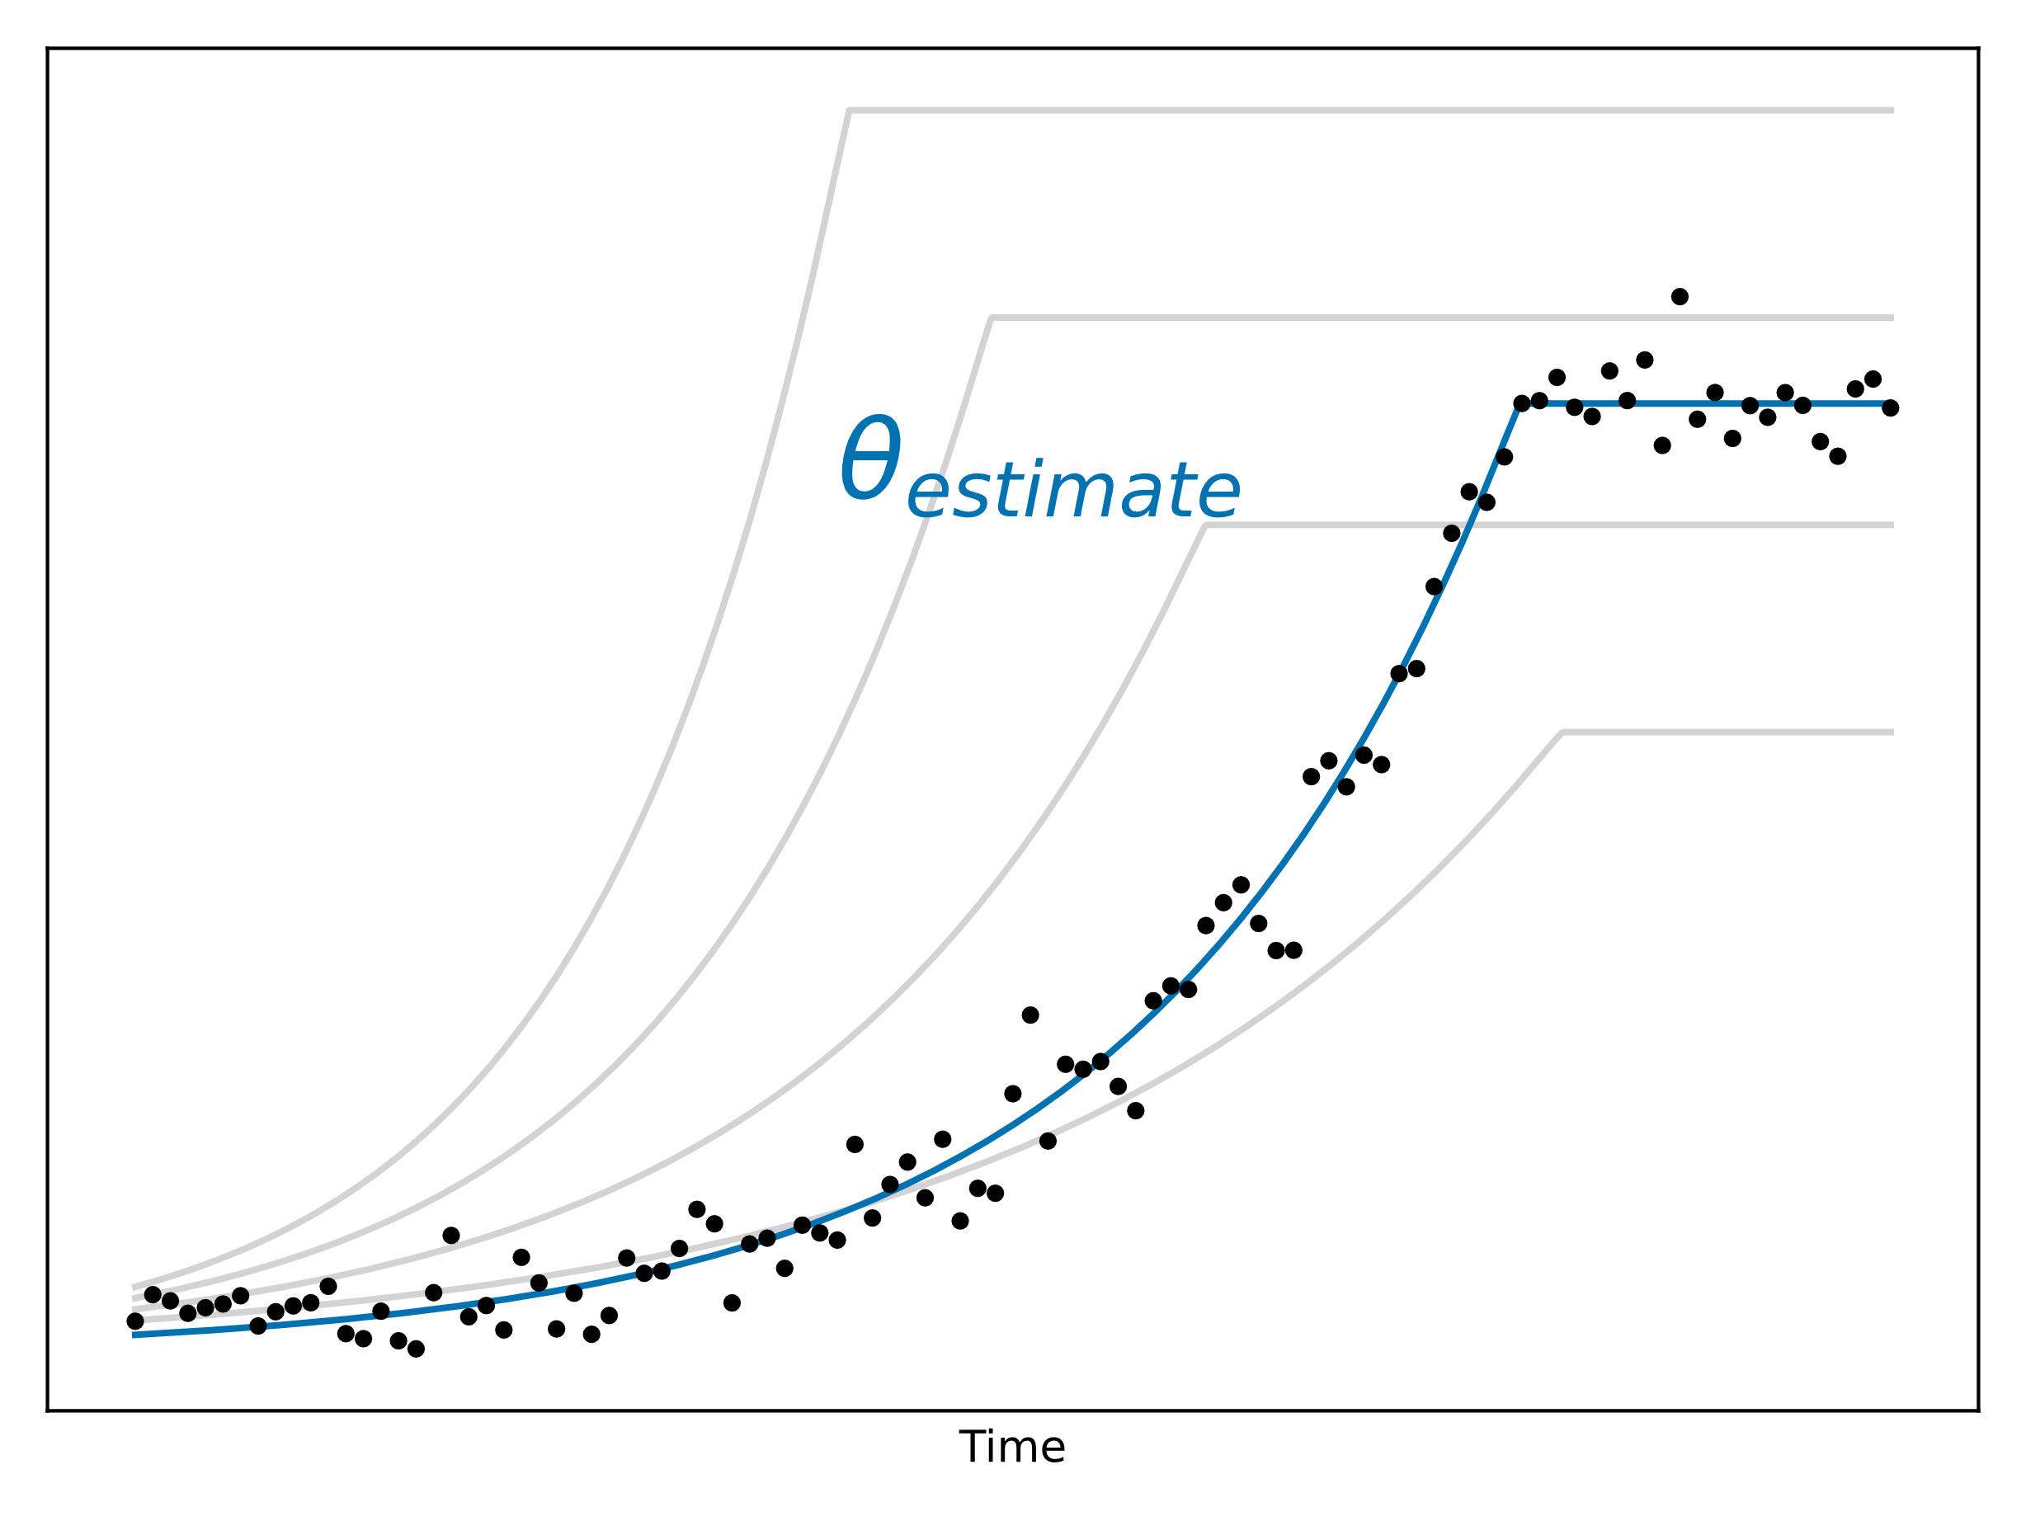
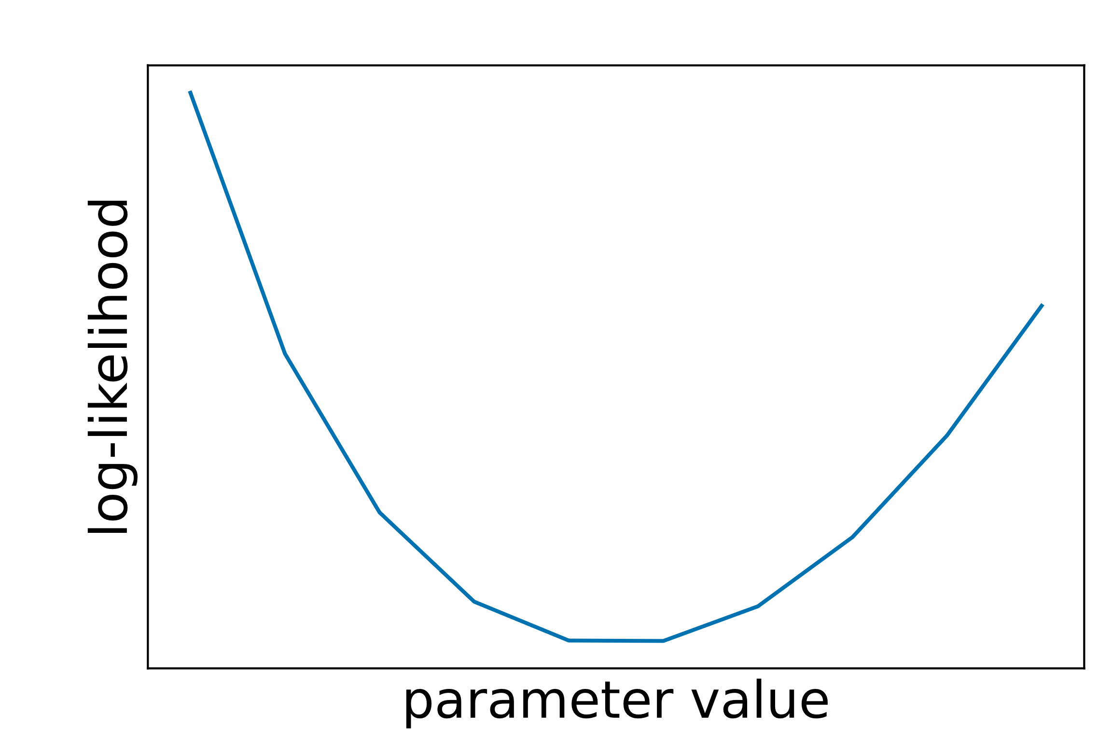
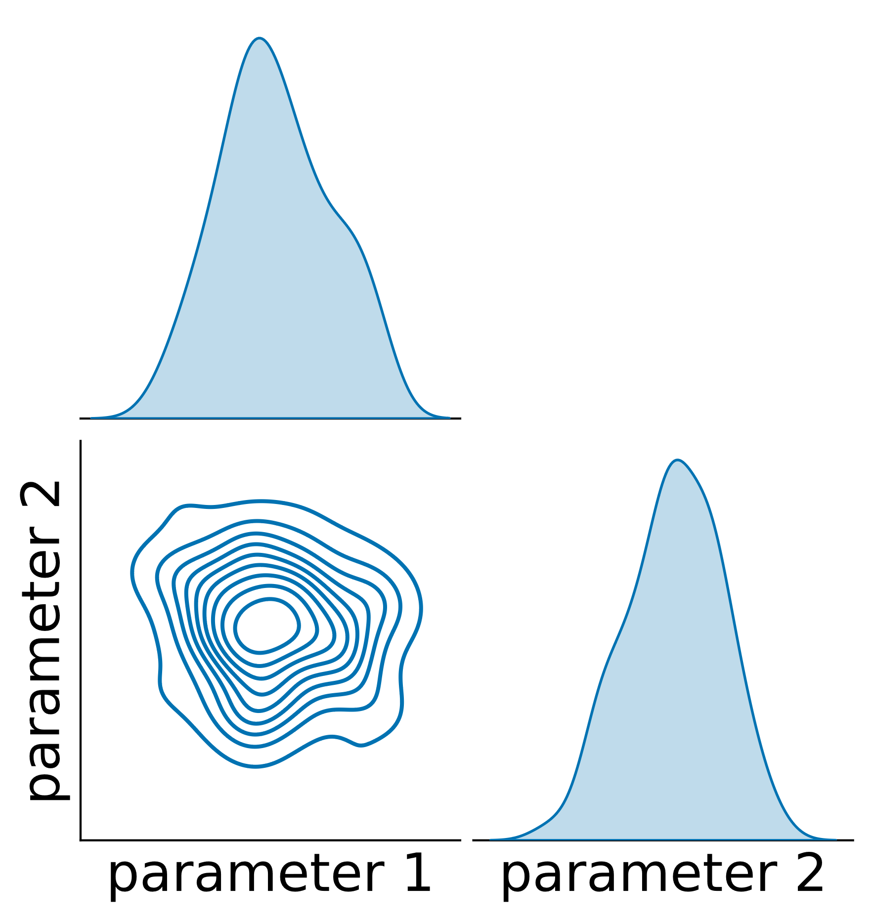
3rd party modeling tool
e.g. OpenModelica
Raw timeseries data
FMI export
FmuModel
Experiment
1st replicate
Experiment
n^{th} replicate
Default parameters
Simulation flags
Measurement x
Measurement y
Measurement x
Measurement y
> FmuModel.simulate(..) →
Modeling & Simulation
Data structure setup & error modeling
Problem definition
Replicate handling & parameter mapping
Unknown parameters & bounds
Point estimates:
> estimator.estimate(..)
Parameter identifiability check:
> estimator.profile_likelihood(..)
Parameter distributions:
> estimator.mc_sampling(..)
Estimator methodology
Analysis plots

Slide 2




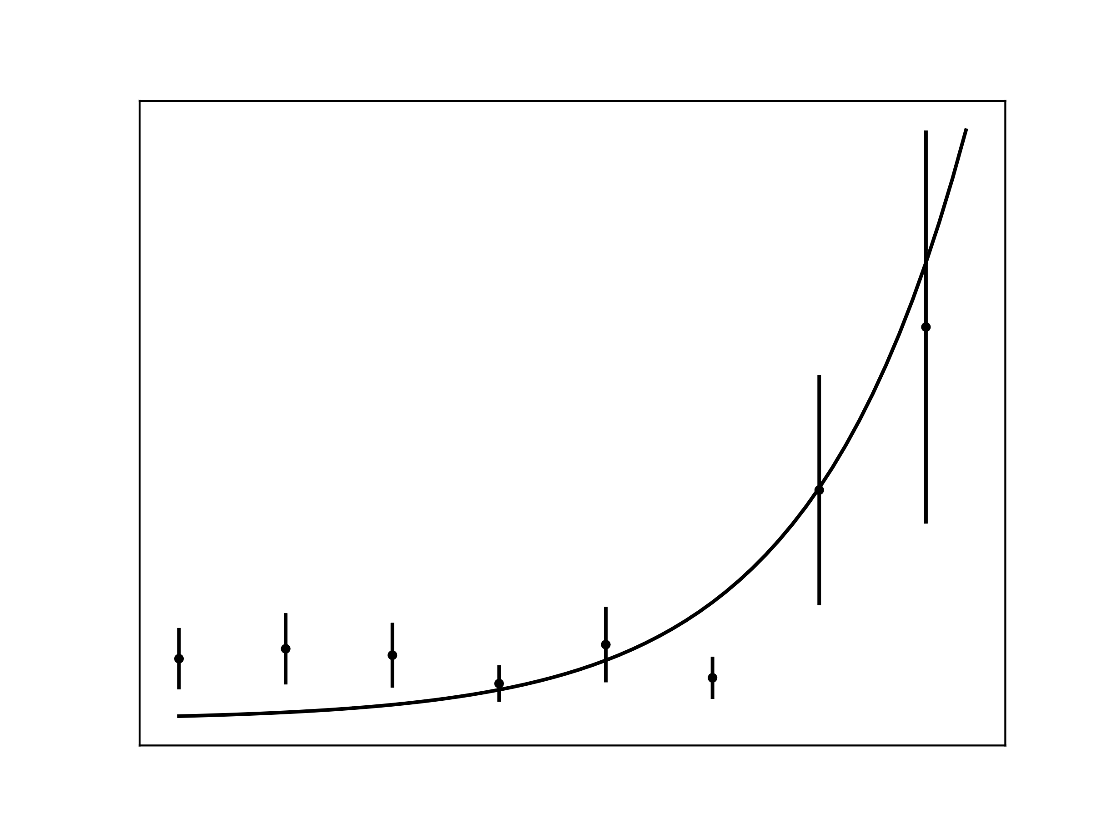



Population-based optimization algorithm
Parallelization
Process pool
Process 1
. . . .
Process n
Objective function
Objective function
Replicate handling
Parallelization
Worker 1
Host: localhost
Port: 9500
Worker 2
Host: localhost
Port: 9501
. . .
Worker n
Host: IP address
Port: 9500
Machine A
Machine B

