Slide 1
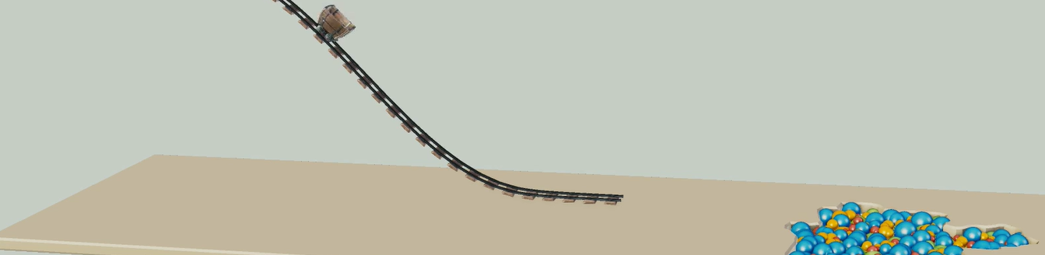
Physically-based Simulation: Final Project Ball Pool
Yannick Huber, Julia Giger
Notes:
Hello everybody, Welcome to the presentation of our final project. As we already have presented the mid-project milestone presentation, our goal was to create a simple rollercoast that ends in pool filled with small balls.

Slide 2
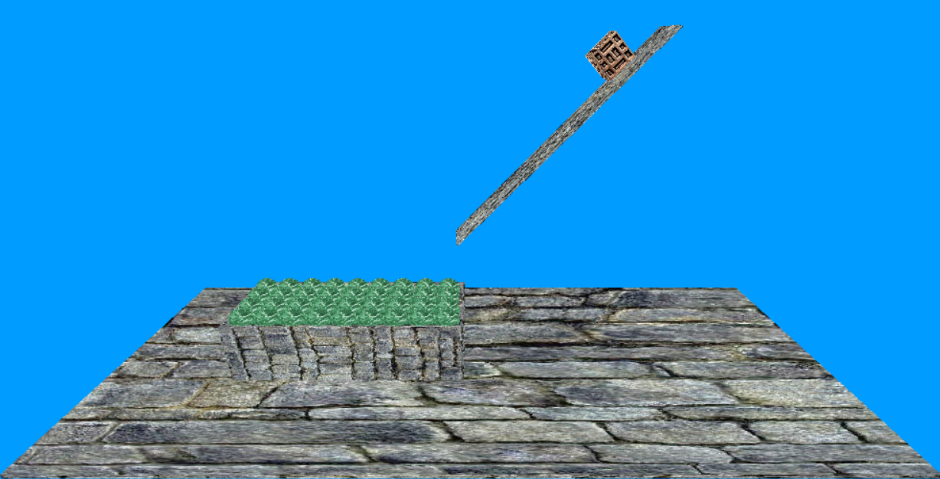
Desired scene
Notes:
We decided to simplify this scene in the following way: We modelled a very simple slide instead of a complex rollercoaster. Furthermore, we represented the cart of the rollercoaster as a simple box in order to simplify the collision detection of the cart and the balls.

Slide 3

Yannick’s fancy part
${\left(x+a\right)}^{n}=\sum_{k=0}^{n}{\left({n \atop k}\right)x^{k}a^{n−k}}$
${\left(1+x\right)}^{n}=1+\frac{nx}{1!}+\frac{n\left(n−1\right)x^{2}}{2!}+…$
$f\left(x\right)=a_{0}+\sum_{n=1}^{∞}{\left(a_{n}\cos{\frac{nπx}{L}}+b_{n}\sin{\frac{nπx}{L}}\right)}$
Notes:
Apart from many small problems, we faced two main challenges. The first one was the box around the balls and the second one was the stacking of the balls.

Slide 4
Problems
Box
Stacking
Notes:
Apart from many small problems, we faced two main challenges. The first one was the box around the balls and the second one was the stacking of the balls.

Slide 5
Box
Box_problem.mp4
Notes:
Let’s look at the first problem, the box around the balls. For distributing the balls in the box, we decided to create a mesh with the balls above the box and let them fall from a low height into the box. Unfortunately, the balls showed a very strange behaviour inside the box.

Slide 6
Box: Concave objects
Gilbert-Johnson-Keerthi algorithm for collision detection
Only for convex objects
Inside of the box: concave
Notes:
We guess that the problem might be the algorithm, which we used for the collision detection. We implemented the Gilbert-Johnson-Keerthi algorithm for the collision detection. However, this algorithm only considers convex objects and the inside of the box is clearly not convex.

Slide 7
Concave objects: Solution
Without_box.mp4
Notes:
In order to solve this issue, we decided to simply remove the box, because we did not have the time to implement a more sophisticated algorithm for the collision detection, which also considers concave objects,

Slide 8
Problems
Box
Stacking
Notes:
As already mentioned, another issue was the stacking of the balls.

Slide 9
Stacking
Stacking.mp4
Notes:
We constructed a mesh with the balls. However, some of the balls show sometimes a very strange behaviour, which we were not able to explain.

Slide 10
Stacking
Stacking2.mp4
Notes:
Here is a different mesh, which suffers from the same problem, but the effect is not as so strong as before. We were not able to solve this issue. Therefore, we selected a mesh, which is not highly influenced of this effect.

Slide 11
Result
Finalform_weight10.mp4
Notes:
Here is the overall result of our simulation. The box is 10 times heavier than each sphere.
(Weight of the spheres: 10)

Slide 12
Result
Finalform_weight1.mp4
Notes:
If we decrease the weight of the spheres, so that the box is a 100 times heavier than a sphere, we get this result.
(Weight of the spheres: 1)

Slide 13
Questions?
Notes:
If we decrease the weight of the spheres, so that the box is a 100 times heavier than a sphere, we get this result.
(Weight of the spheres: 1)

