Slide 1
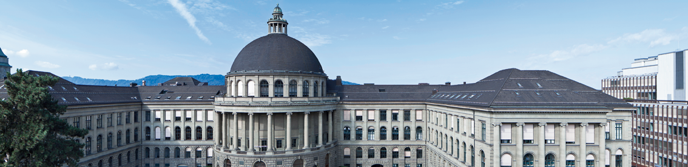
Physically-based Simulation: Final Project Ball Pool
Yannick Huber, Julia Giger, Ueli Wechsler

Slide 2
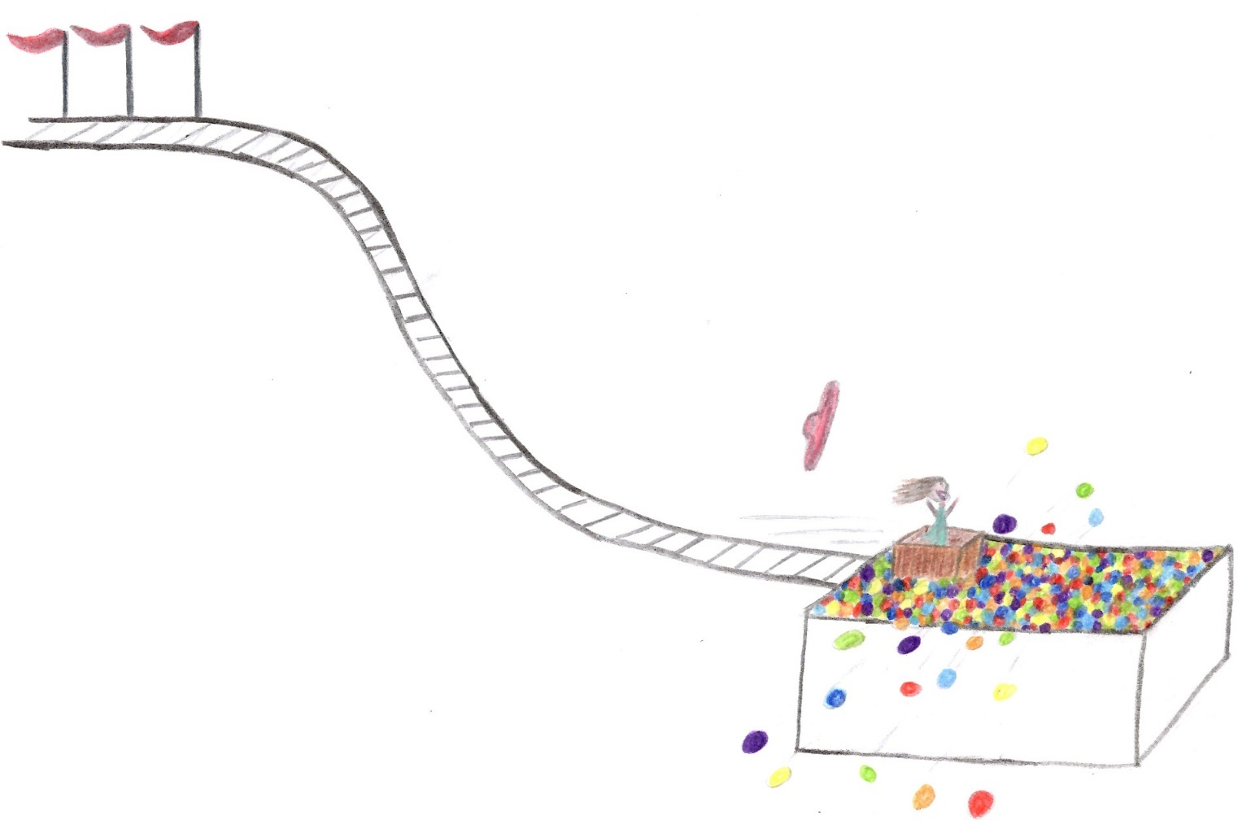
Rollercoaster with a ball pool

Slide 3
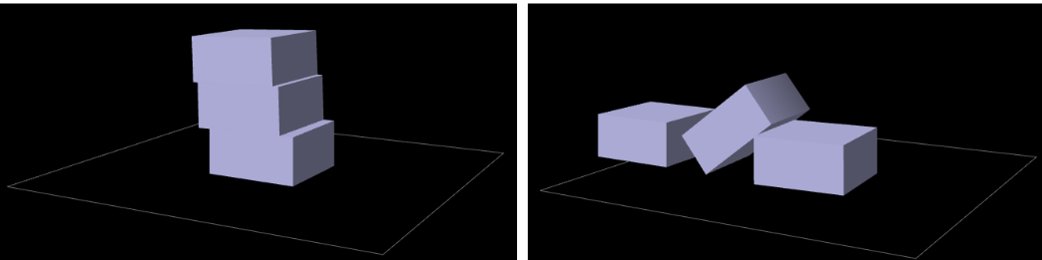
Key Elements
Rigid bodies
Stacking

Slide 4
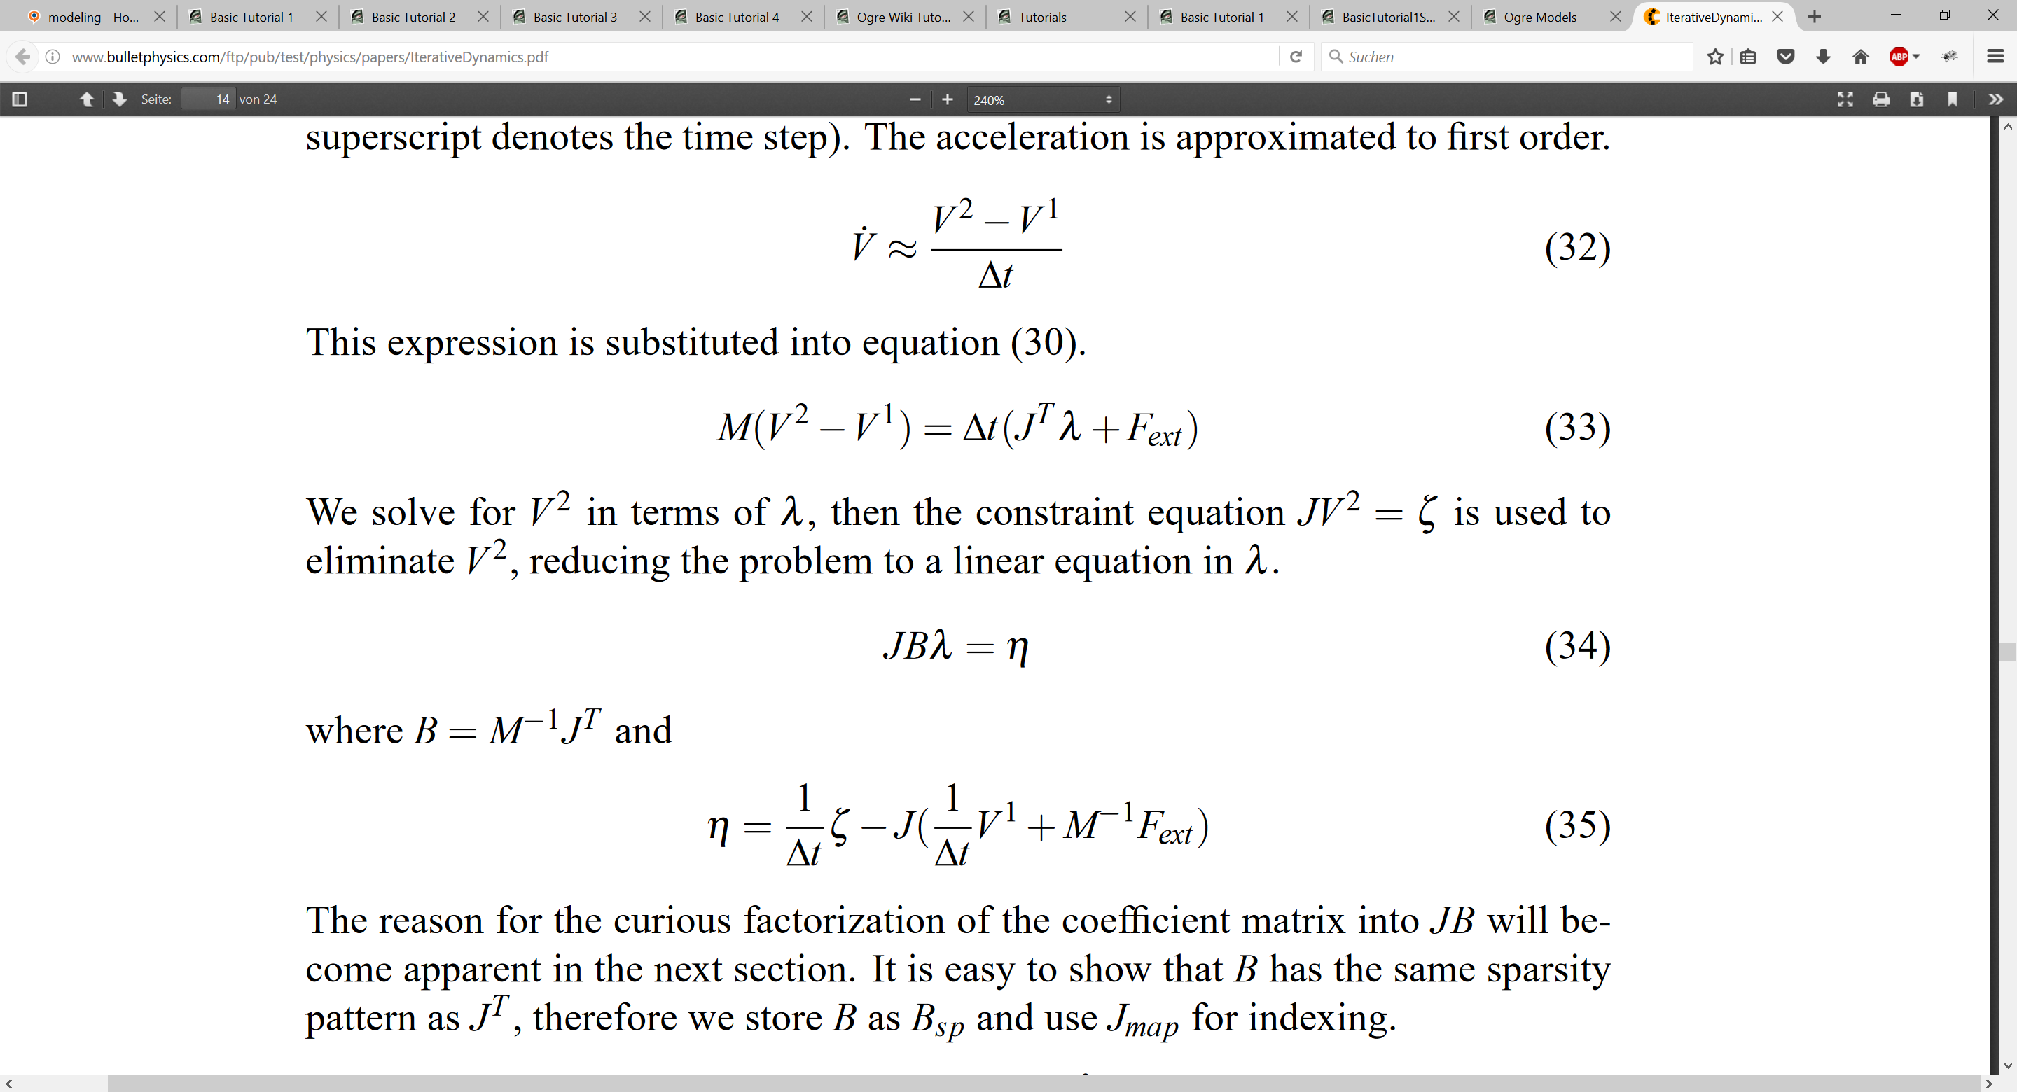
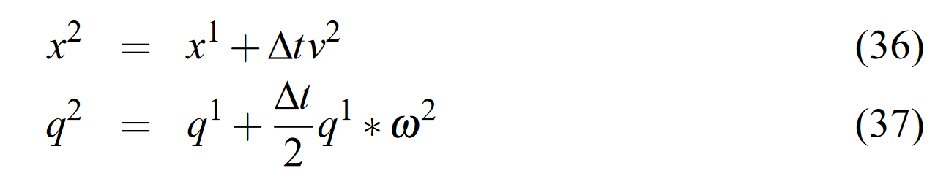
Approach
Iterative dynamics with temporal coherence
Constraints for physics
Notes:
Iterative Dynamics with Temporal Coherence
Erin Catto
Crystal Dynamics
Menlo Park, California
February 22, 2005
Describe constraint
Calculate derivative
Separate velocities->get jacobian

Slide 5
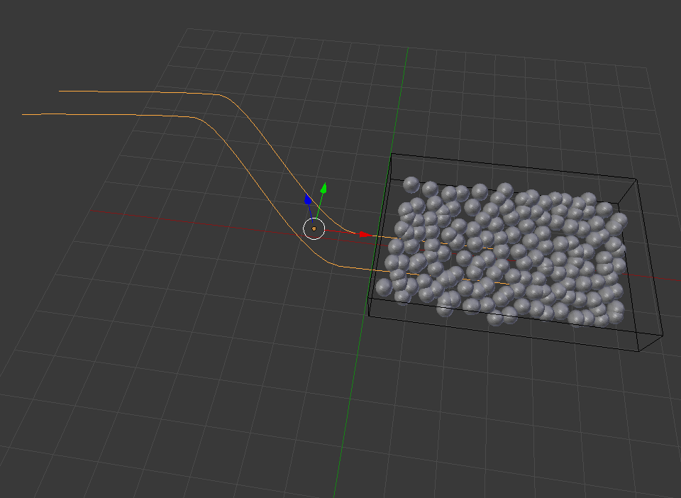
Blender model
Notes:
Iterative Dynamics with Temporal Coherence
Erin Catto
Crystal Dynamics
Menlo Park, California
February 22, 2005
Describe constraint
Calculate derivative
Separate velocities->get jacobian

Slide 6
Problems
Integration and usage of Ogre3D framework
Notes:
Iterative Dynamics with Temporal Coherence
Erin Catto
Crystal Dynamics
Menlo Park, California
February 22, 2005
Describe constraint
Calculate derivative
Separate velocities->get jacobian

Slide 7
Already done
Sphere-sphere collision
Sphere-box collision
Notes:
Iterative Dynamics with Temporal Coherence
Erin Catto
Crystal Dynamics
Menlo Park, California
February 22, 2005
Describe constraint
Calculate derivative
Separate velocities->get jacobian

Slide 8
TODO
VISUALIZATION
Environment interaction
Friction
Notes:
Iterative Dynamics with Temporal Coherence
Erin Catto
Crystal Dynamics
Menlo Park, California
February 22, 2005
Describe constraint
Calculate derivative
Separate velocities->get jacobian

