Slide 1
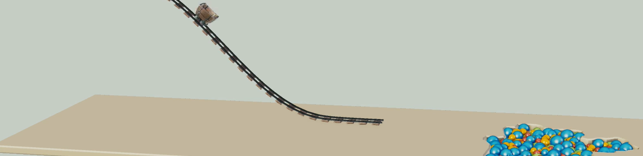
Physically-based Simulation: Final Project Ball Pool
Yannick Huber, Julia Giger
Notes:
Hello everybody, Welcome to the presentation of our project.

Slide 2
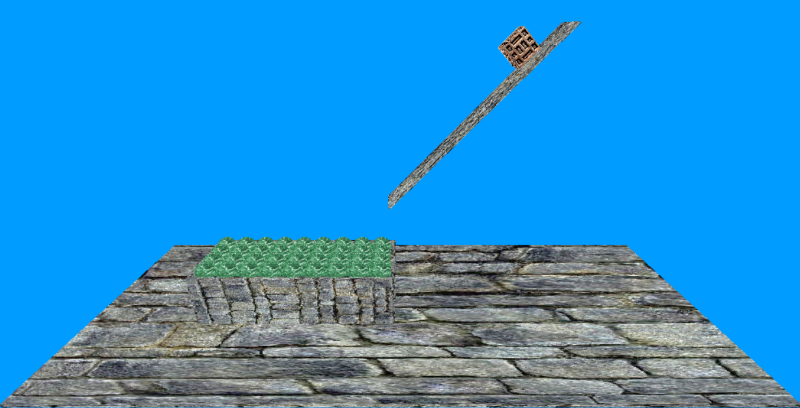
Desired scene

Slide 3
Problems
Concave objects
Stacking

Slide 4
Concave objects
Used Gilbert-Johnson-Keerthi algorithm for the collision detection
Only for convex objects
But inside of the box is not convex

Slide 5
Concave objects
Box_problem.mp4

Slide 6
Concave objects: Solution
Without_box.mp4

Slide 7
Stacking
Stacking.mp4

Slide 8
Stacking
Stacking2.mp4

Slide 9
Result
Finalform_weight10.mp4
Notes:
Weight of the spheres: 10

Slide 10
Result
Finalform_weight1.mp4
Notes:
Weight of the spheres: 1

