Slide 1
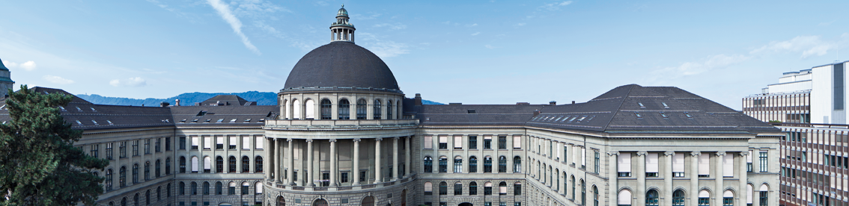
Physically-based Simulation: Final Project Ball Pool
Yannick Huber, Julia Giger, Ueli Wechsler
Notes:
Hello everybody, Welcome to the presentation of our project.

Slide 2
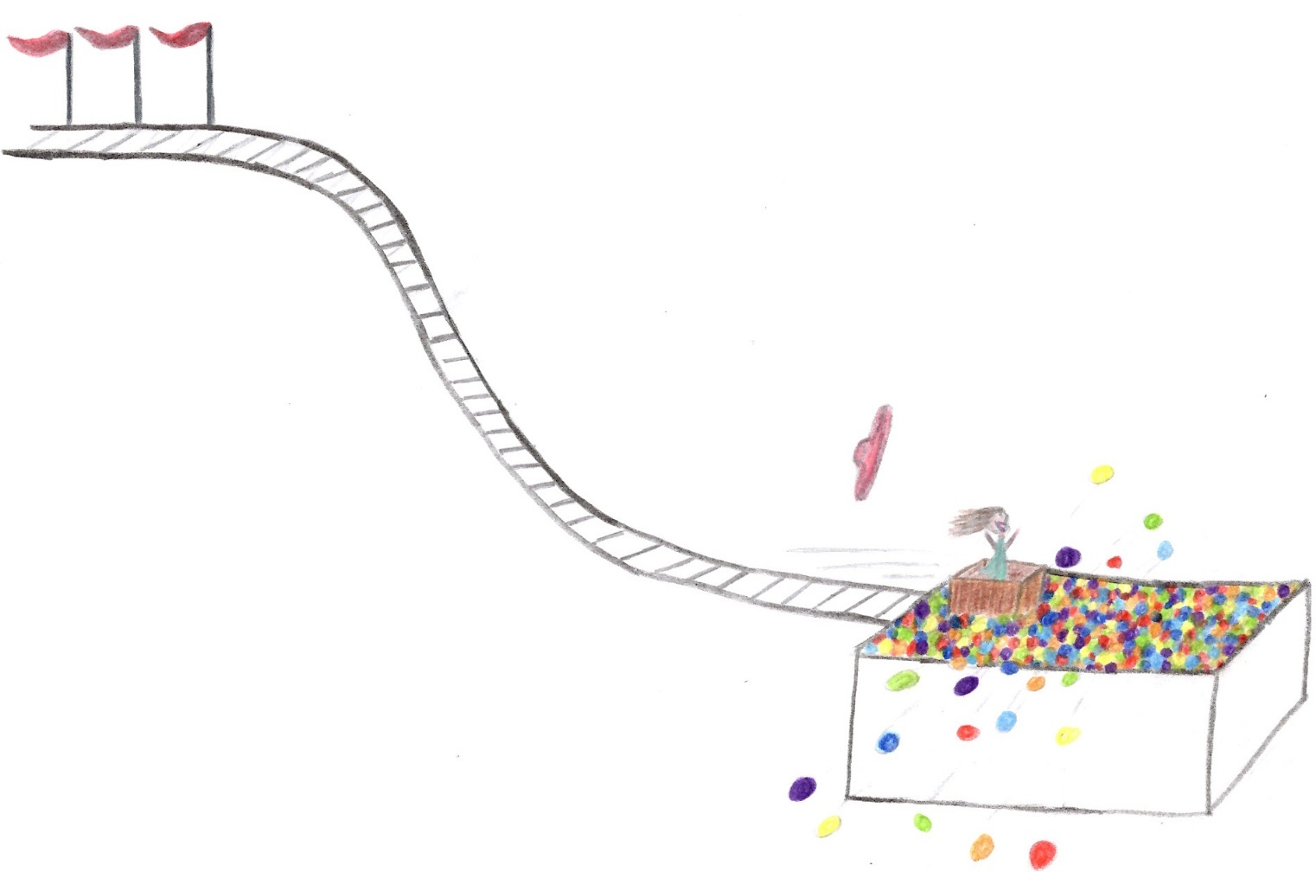
Rollercoaster with a ball pool
Notes:
The goal of our project is to simulate a rollercoaster or a slide, which ends in a pool filled with little balls.

Slide 3
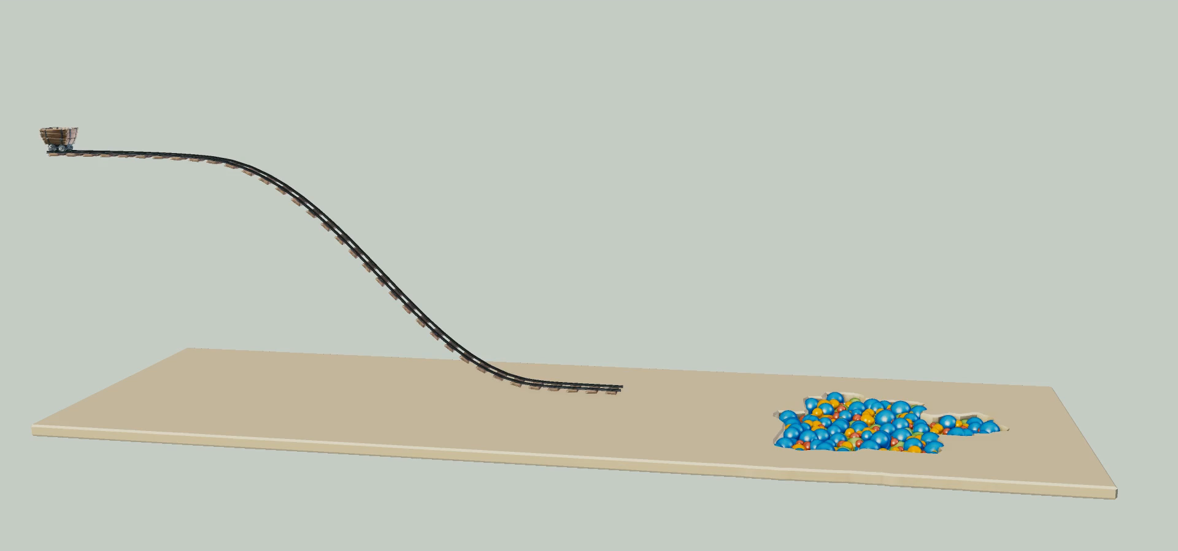
Blender model
Notes:
Here is a Blender model of our scene without the actual physics

Slide 4
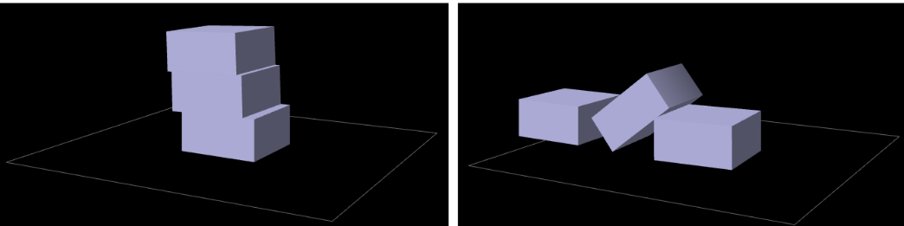
Key Elements
Rigid bodies
Stacking

Slide 5
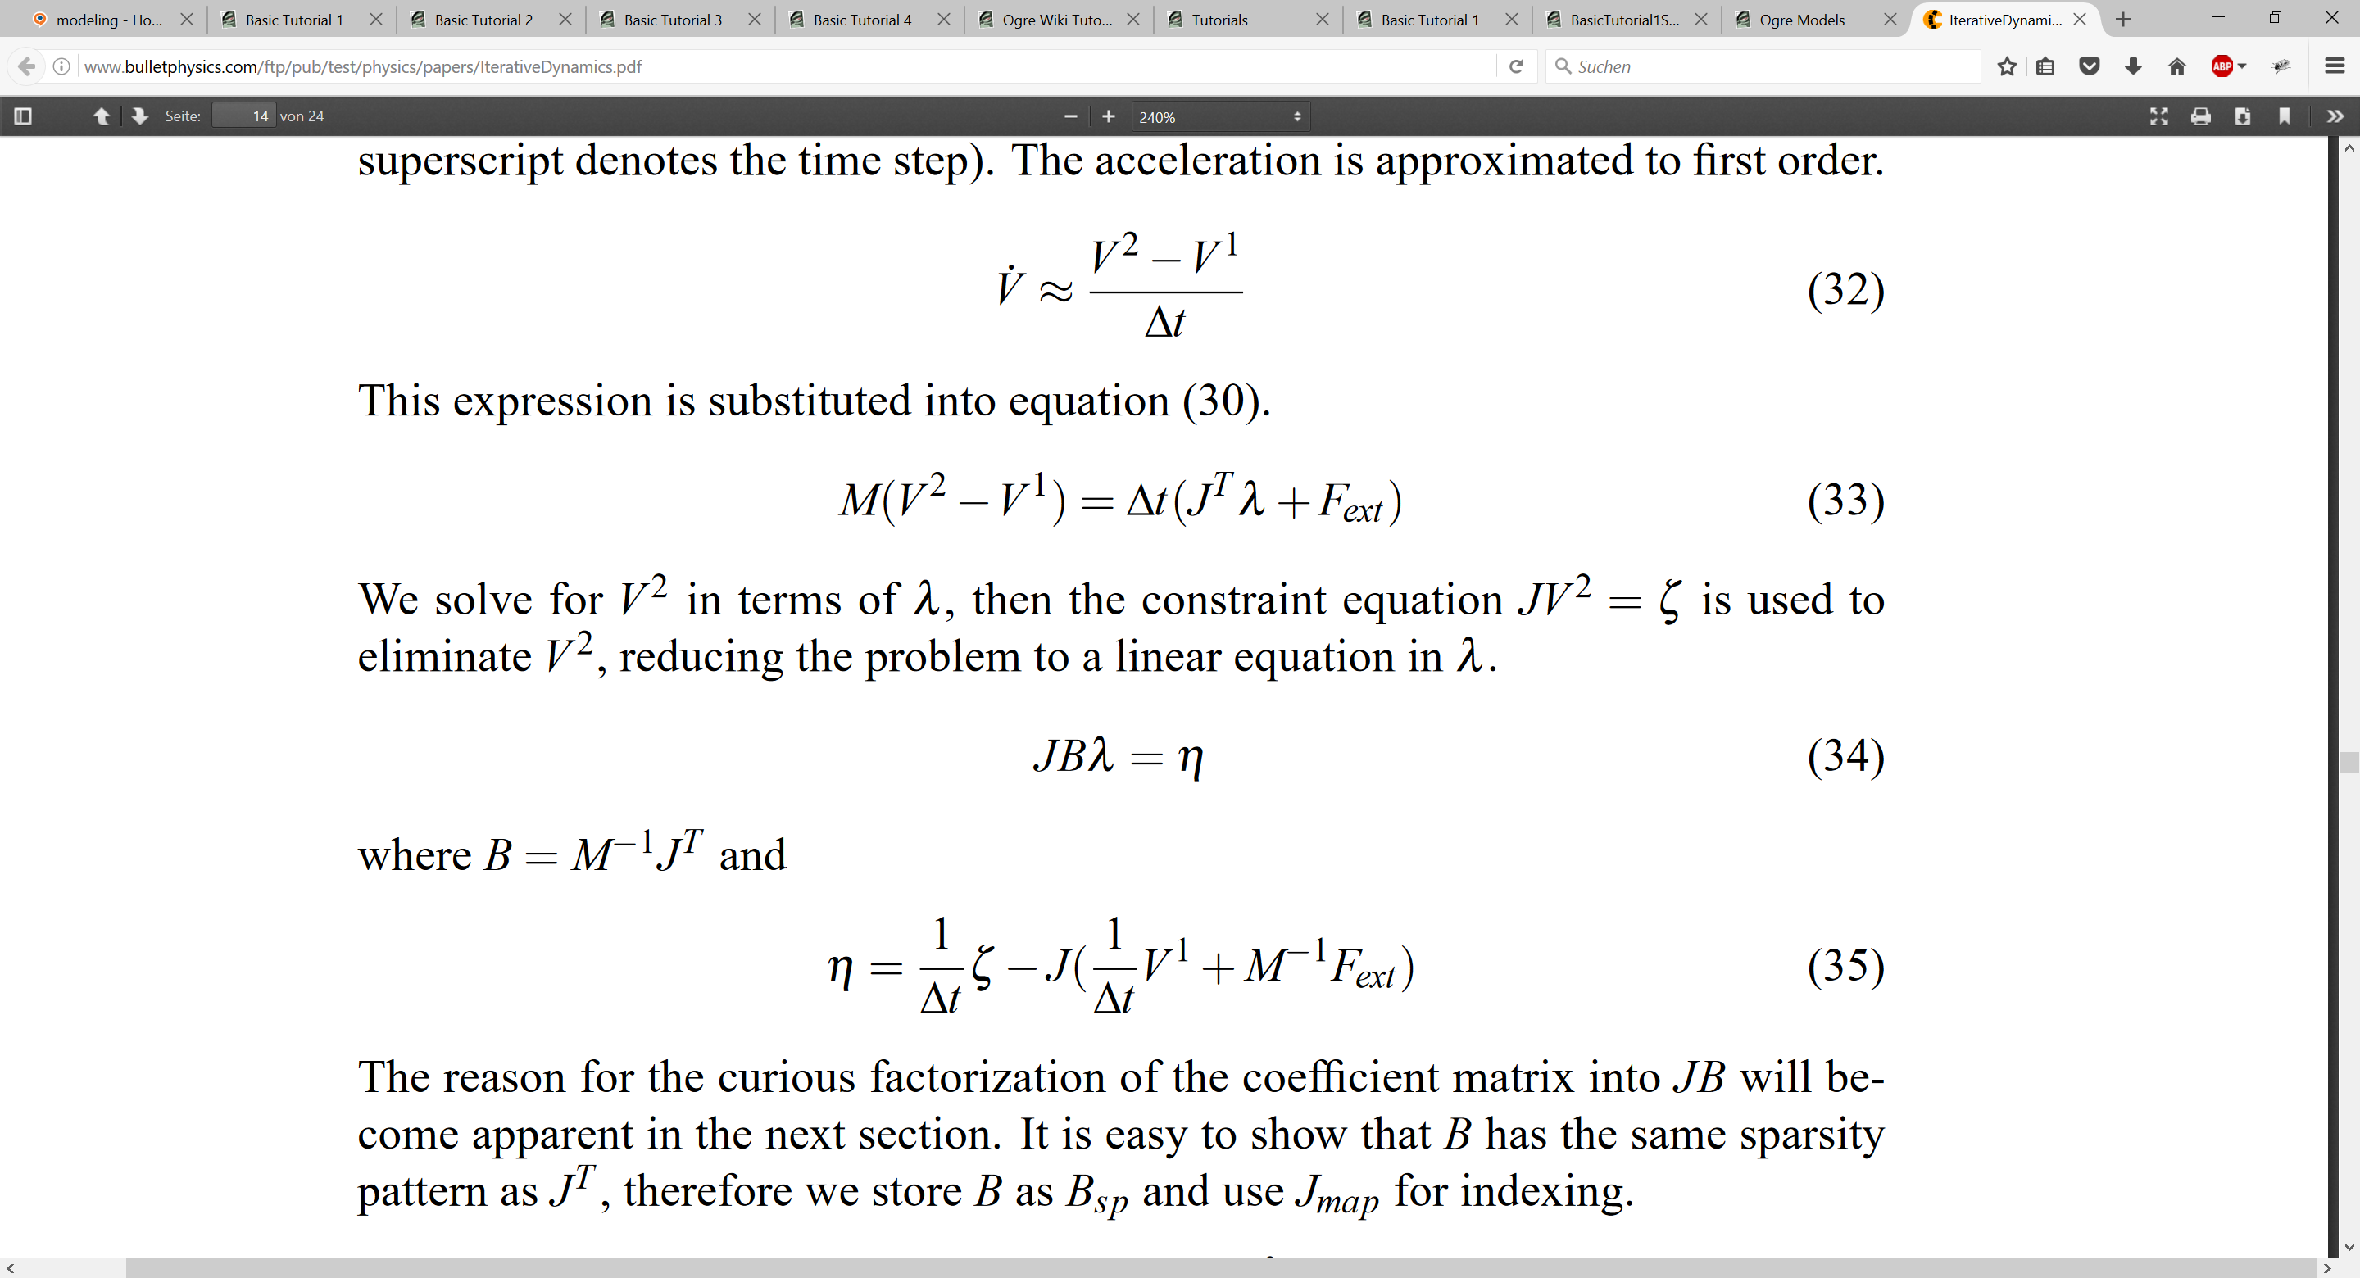
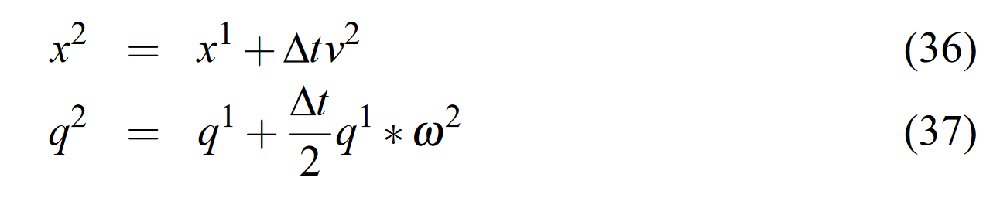
Approach
Iterative dynamics with temporal coherence
Constraints for physics
Notes:
Iterative Dynamics with Temporal Coherence
Erin Catto
Crystal Dynamics
Menlo Park, California
February 22, 2005
Describe constraint
Calculate derivative
Separate velocities->get jacobian

Slide 6
Current status
Problems: - Integration and usage of Ogre3D framework
Completed tasks: - Sphere-sphere collision - Sphere-box collision
Pending tasks: - Visualization - Environment interaction - Friction

