Slide 1
Ball Pool
Julia Giger, Yannick Huber, Ueli Wechsler?

Slide 2
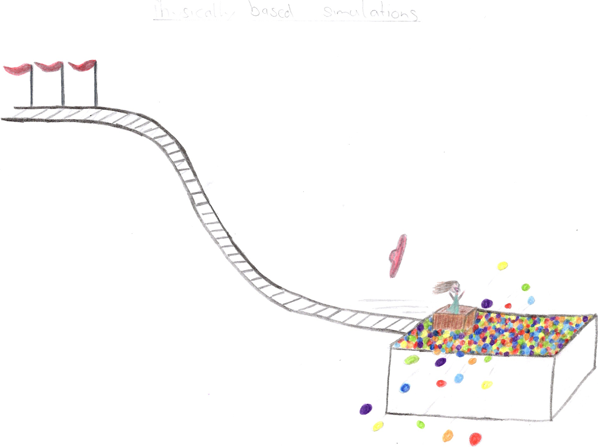

Slide 3
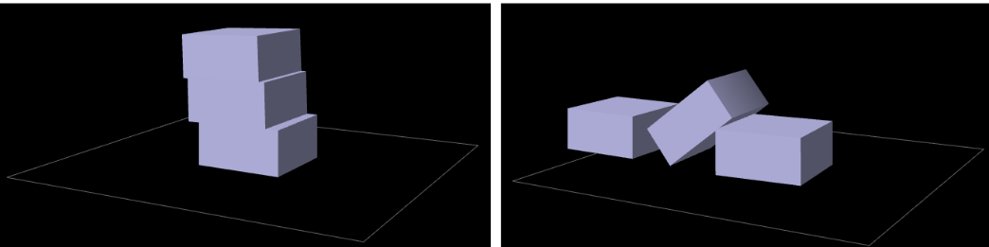
Key Elements
Rigid Bodies
Stacking

Slide 4
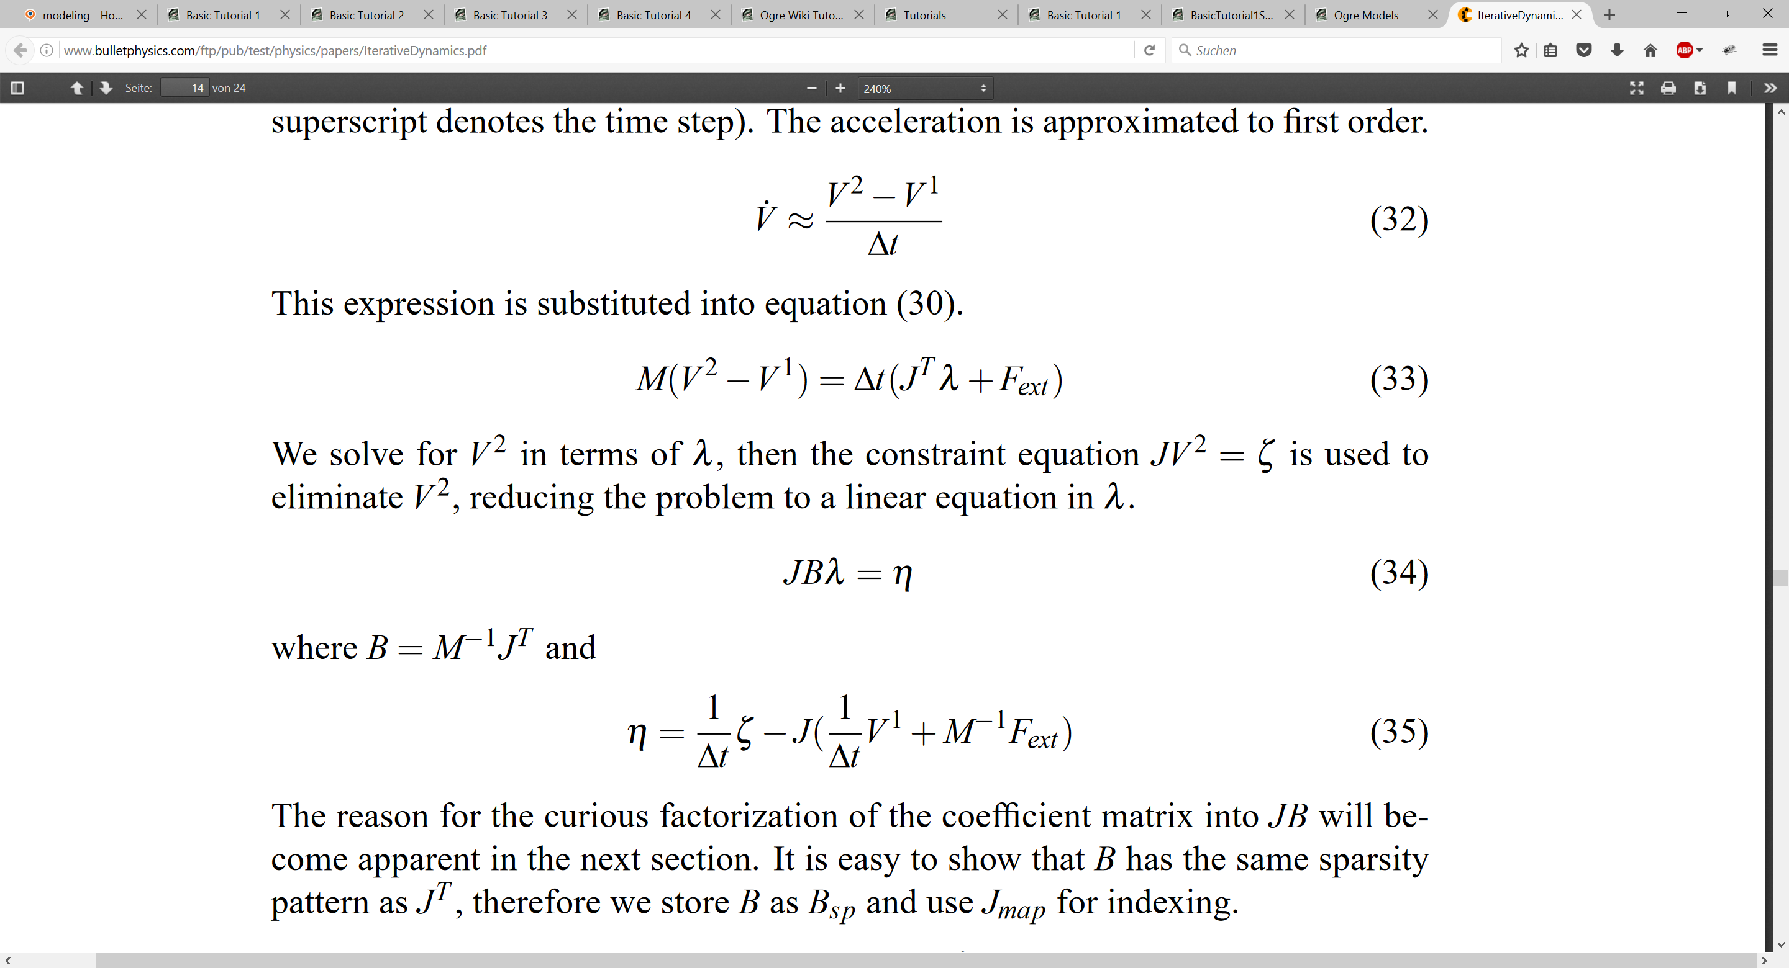
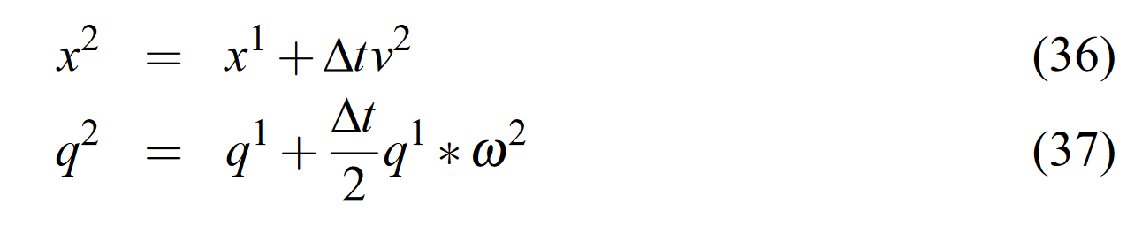
Approach
Iterative Dynamics with Temporal Coherence
Constraints for Physics
Notes:
Iterative Dynamics with Temporal Coherence
Erin Catto
Crystal Dynamics
Menlo Park, California
February 22, 2005
Describe constraint
Calculate derivative
Separate velocities->get jacobian

Slide 5
Already done
Sphere-Sphere Collision
Sphere-Box Collision

Slide 6
TODO
GRAPHICS
Environment interaction
Friction

