Slide 1
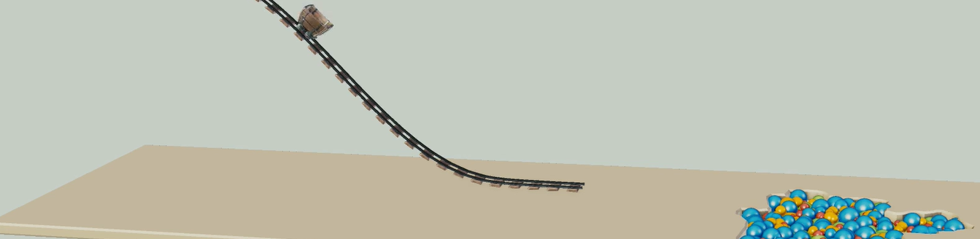
Physically-based Simulation: Final Project Ball Pool
Yannick Huber, Julia Giger
Notes:
Hello everybody, Welcome to the presentation of our final project. As we have mentioned at the mid-project milestone presentation, our goal was to create a simple rollercoaster that ends in a pool filled with small balls.

Slide 2
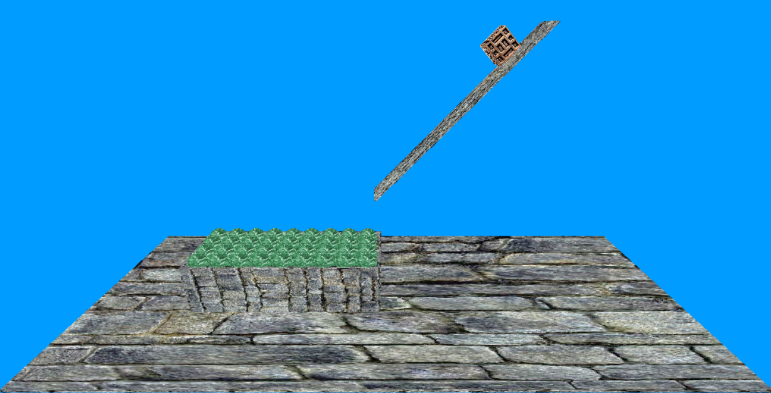
Desired scene
Notes:
We decided to simplify this scene in the following way: We modelled a very simple slide instead of a complex rollercoaster. Furthermore, we represented the cart of the rollercoaster as a simple box in order to simplify the collision detection of the cart. In addition, we designed the surface of the balls with some texture instead of an uniform color, so that the rotation of the spheres is visible.

Slide 3

Yannick’s fancy part
${\left(x+a\right)}^{n}=\sum_{k=0}^{n}{\left({n \atop k}\right)x^{k}a^{n−k}}$
${\left(1+x\right)}^{n}=1+\frac{nx}{1!}+\frac{n\left(n−1\right)x^{2}}{2!}+…$
$f\left(x\right)=a_{0}+\sum_{n=1}^{∞}{\left(a_{n}\cos{\frac{nπx}{L}}+b_{n}\sin{\frac{nπx}{L}}\right)}$
Notes:
It’s all very trivial

Slide 4
Problems
Box
Stacking
Notes:
Apart from many small problems, we faced two main challenges. The first one was the box around the balls and the second one was the stacking of the balls.

Slide 5
Box
Box_problem.mp4
Notes:
Let’s look at the first problem, the box around the balls. For distributing the balls in the box, we decided to create a mesh with the balls above the box at the initialization. When the simulation starts, they fall down because of the gravity and should distributed in a nice and natural way. Unfortunately, the balls showed a very strange behaviour, when they move inside the box.

Slide 6
Box: Concave objects
Gilbert-Johnson-Keerthi algorithm for collision detection
Only for convex objects
Inside of the box: concave
Notes:
We guess that the problem might be the algorithm, which we used for the collision detection. We implemented the Gilbert-Johnson-Keerthi algorithm for this purpose. However, this algorithm only considers convex objects and the inside of the box is clearly not convex in the corners.

Slide 7
Concave objects: Solution
Without_box.mp4
Notes:
In order to solve this issue, we decided to simply remove the box, because we did not have the time to implement a more sophisticated algorithm for the collision detection, which would also consider concave objects.

Slide 8
Problems
Box
Stacking
Notes:
As already mentioned, another issue was the stacking of the balls.

Slide 9
Stacking
Stacking.mp4
Notes:
We constructed a mesh with the balls, where there is a very small distance at the beginning between them. However, some of the balls show sometimes an unexpected behaviour, which we were not able to explain.

Slide 10
Stacking
Stacking2.mp4
Notes:
Here is a different mesh, which suffers from the same problem, but the effect is not as so strong as before. We were not able to solve this issue. Therefore, we selected a mesh, which is not highly influenced by this effect.

Slide 11
Final result
Finalform_weight10.mp4
Notes:
Here is the final result of our simulation. The box is 10 times heavier than each sphere.
(Weight of the spheres: 10)

Slide 12
Final result
Finalform_weight1.mp4
Notes:
If we decrease the weight of the spheres, so that the box is a 100 times heavier than a sphere, we get this result.
(Weight of the spheres: 1)

Slide 13
Questions?
Notes:
Are there any questions?

