Slide 1
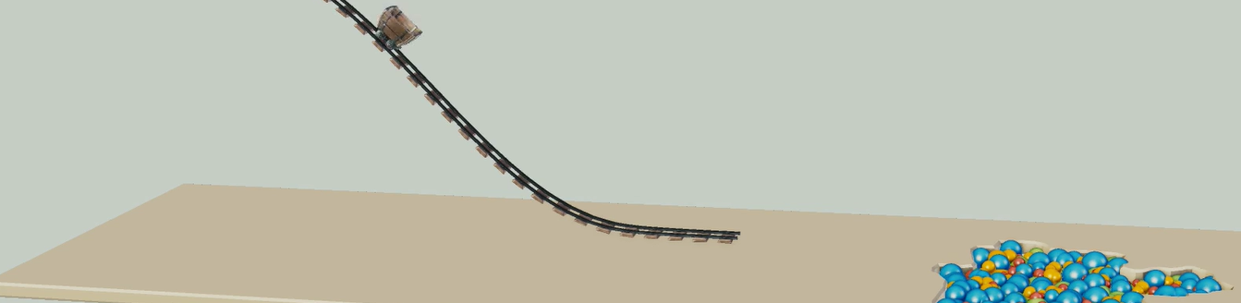
Physically-based Simulation: Final Project Ball Pool
Yannick Huber, Julia Giger
Notes:
Hello everybody, Welcome to the presentation of our project.

Slide 2
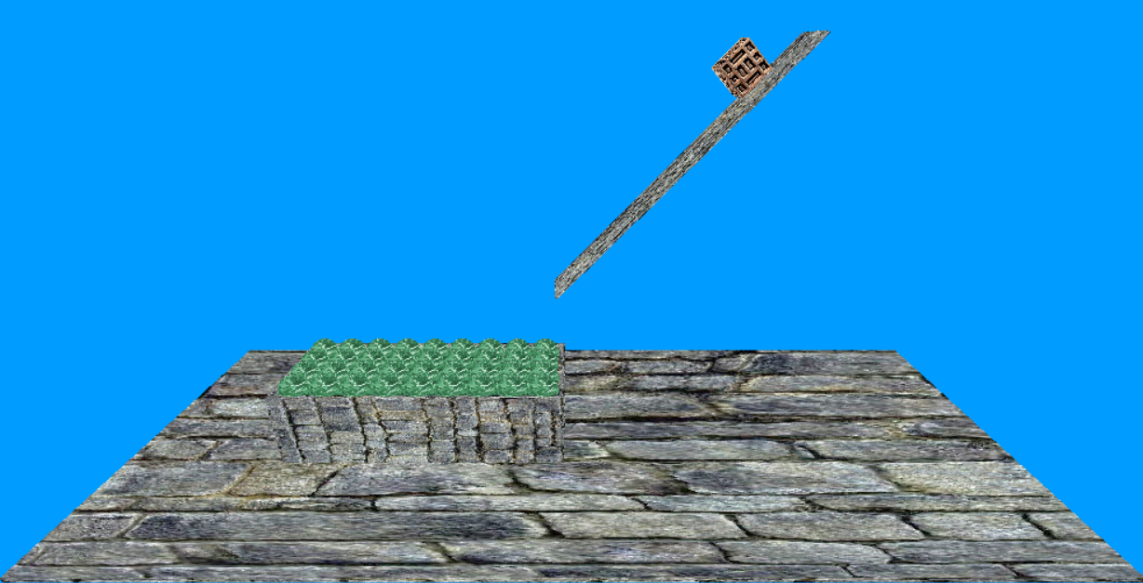
Desired scene
Notes:
The goal of our project is to simulate a rollercoaster or a slide, which ends in a pool filled with little balls.

Slide 3
Problems
Used Gilbert-Johnson-Keerthi algorithm for the collision detection
Only for convex objects
But inside of the box is not convex
Notes:
The goal of our project is to simulate a rollercoaster or a slide, which ends in a pool filled with little balls.

