Slide 1
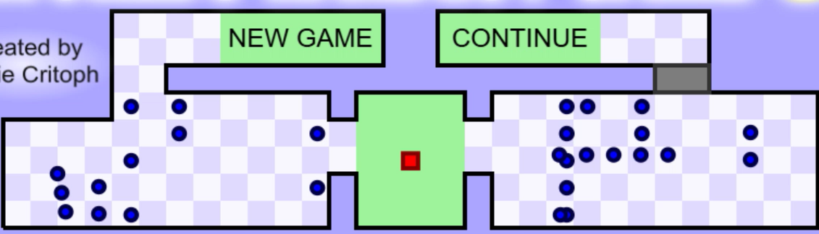
THE
DOPO Hardest Game
SETTINGS
LOAD GAME

Slide 2
Settings
MUSIC
SFX
BACK TO MENU
SET KEY BINDS

Slide 3
BACK TO SETTINGS
Key Binds
PLAYER 1
PLAYER 2
UP
DOWN
LEFT
RIGTH
PAUSE

Slide 4
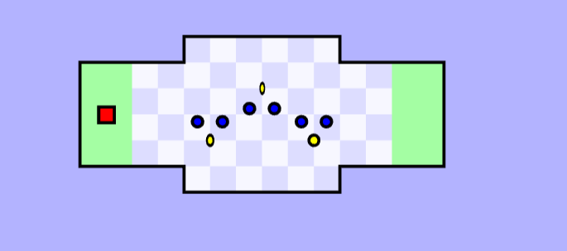
MENU
PAUSE
TIME
SAVE
LIFES
FAILS

Slide 5
MENU
PAUSE
TIME
SAVE
LIFES 1°
FAILS 1°
LIFES 2°
FAILS 2°

Slide 6
Loader Board
BACK TO MENU
OPEN OTHERS

Slide 7
Select Level
BACK TO MENU
OPEN OTHERS

Slide 8
Instruction
You are the RED square. Avoid the BLUE circles and collect the yellows circles. Once you have collected all of the yellow circles, move to the green beacon to complete the level. Some levels consist of more than one beacon: the intermediary beacons act as checkpoints.
BACK TO MENU
SELECT MODE

Slide 9

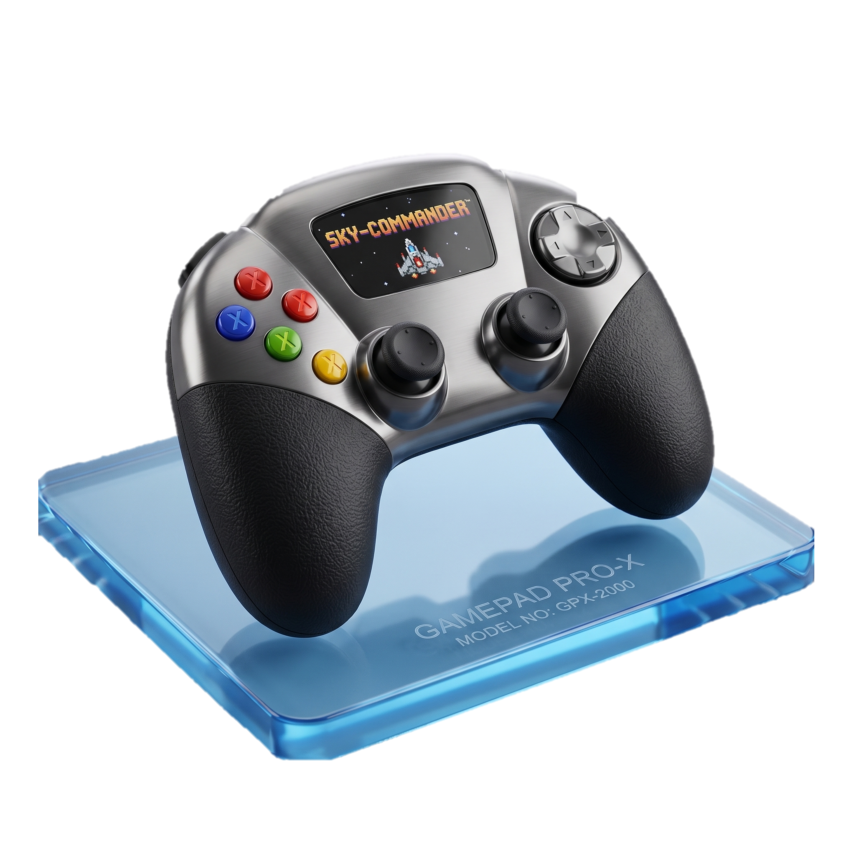

Games modes
Solo
PVP
PVsM

Slide 10
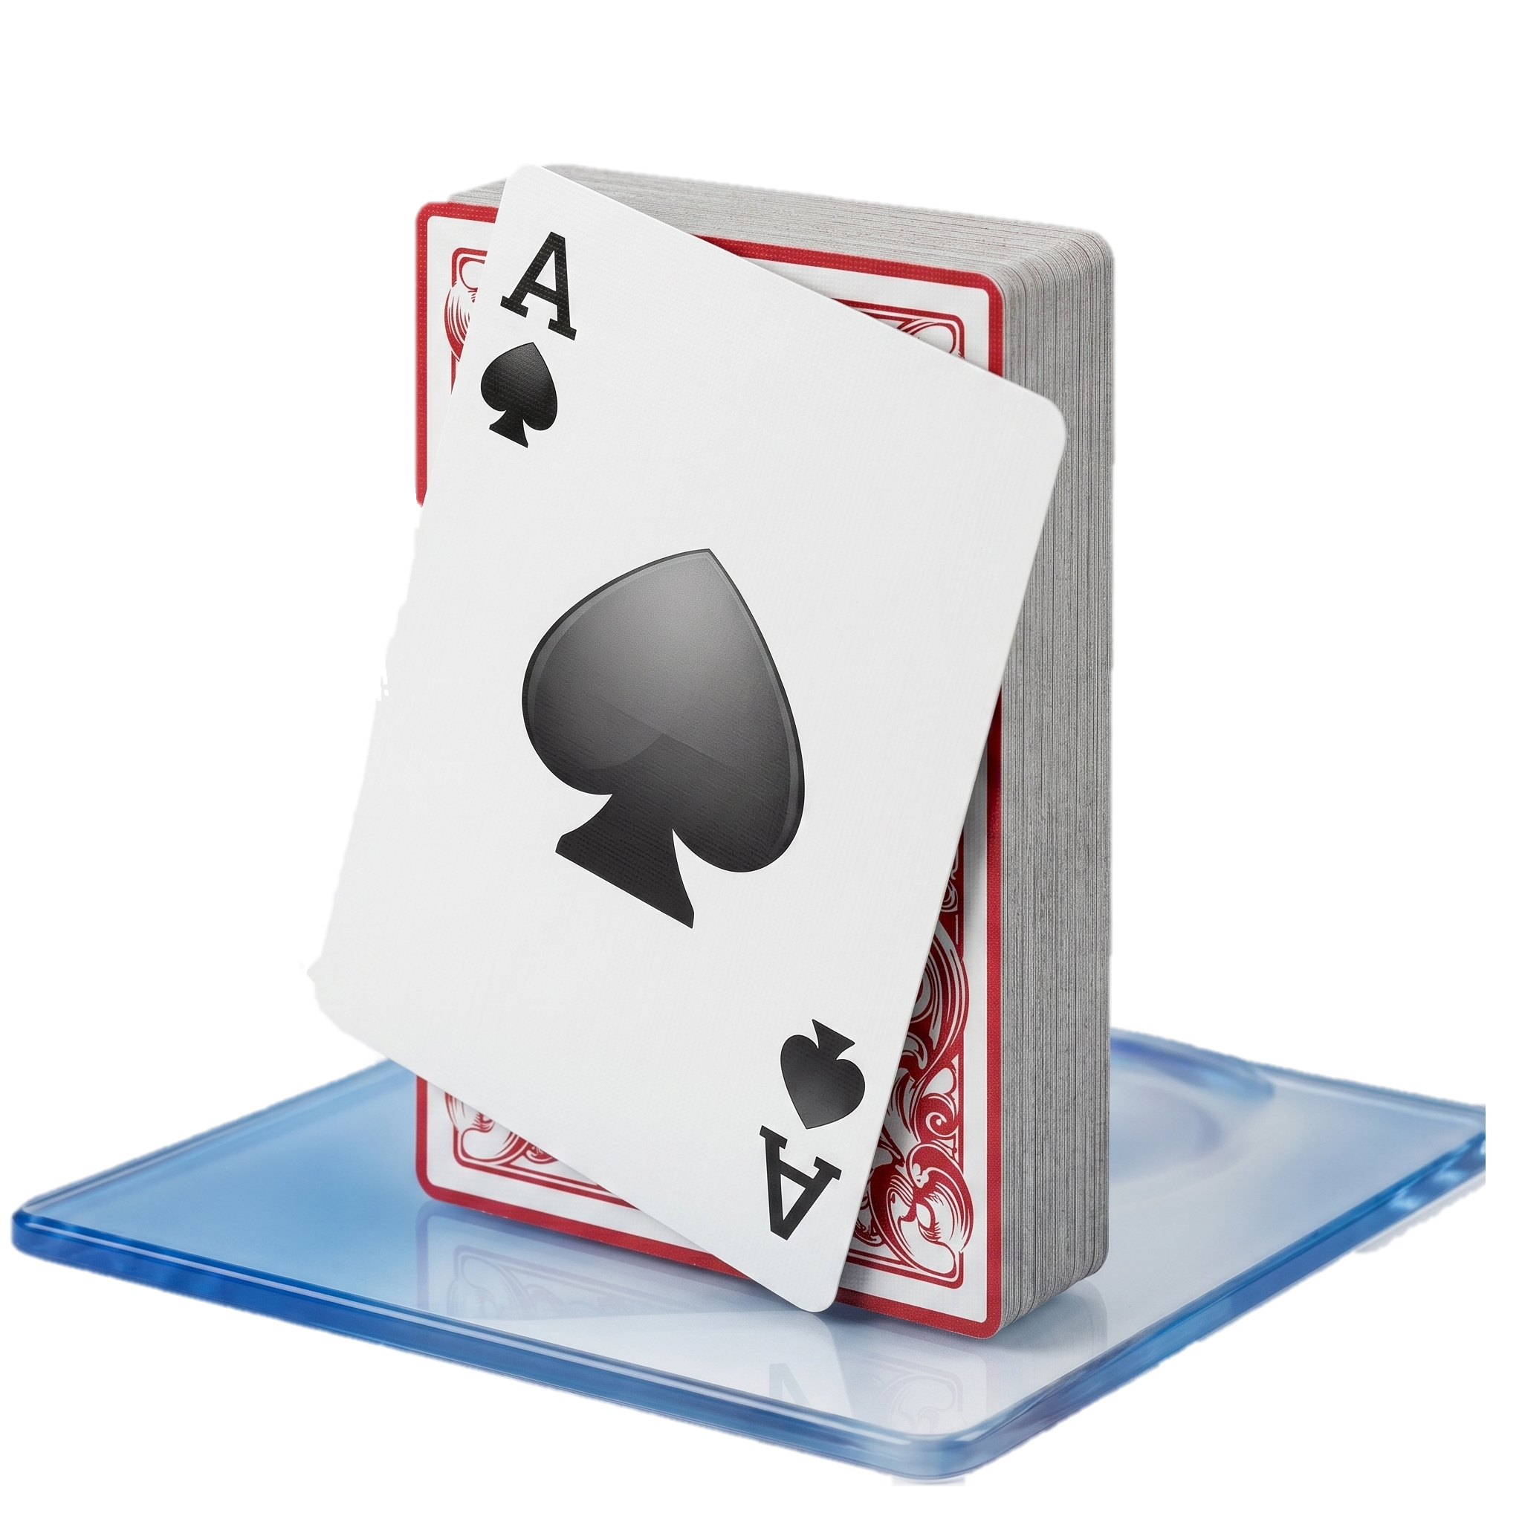

PVsM
Easy
Hard

Slide 11
Character
Blinky
Inky
Clyde

