Slide 1
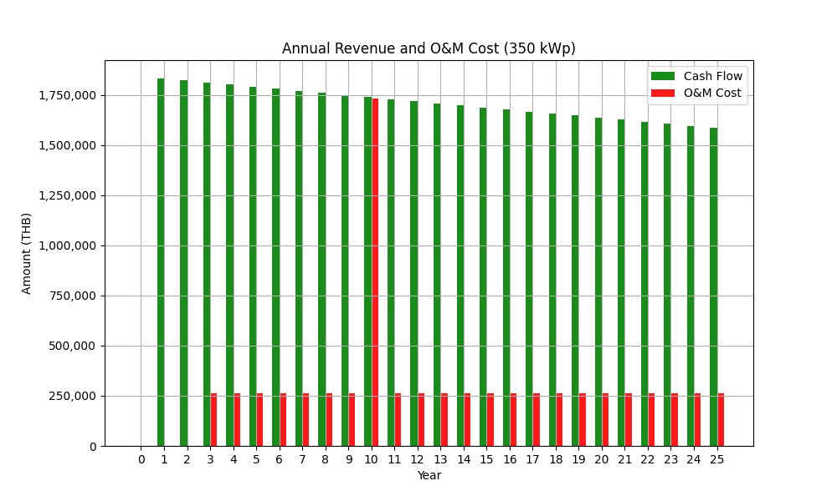
Image from EPC: anual_revenue_350kW.png

Slide 2
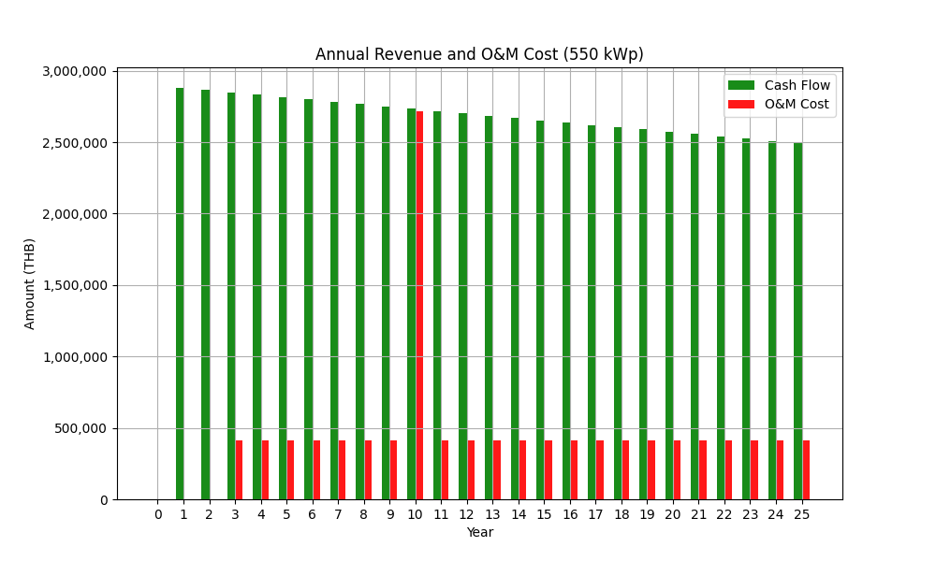
Image from EPC: anual_revenue_550kW.png

Slide 3
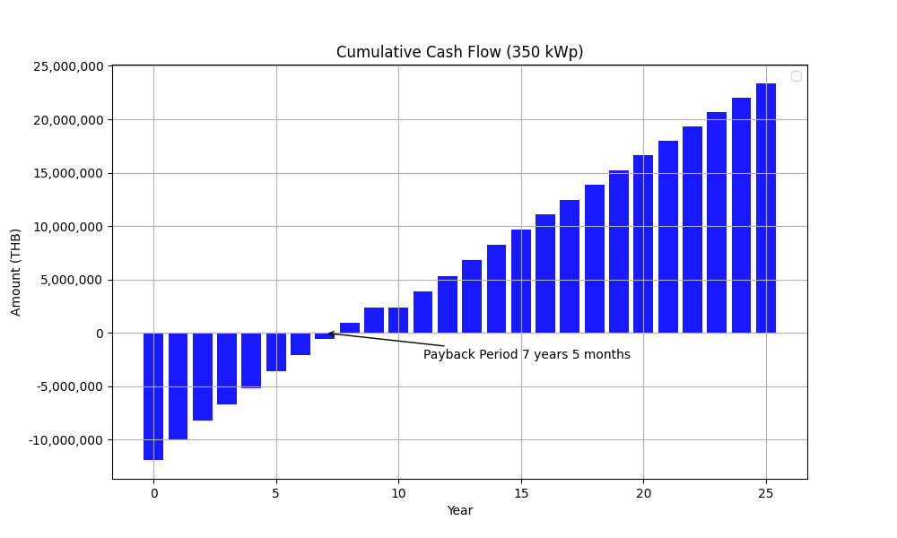
Image from EPC: cumulative_cashflow_350kW.png

Slide 4

Image from EPC: cumulative_cashflow_550kW.png

Slide 5
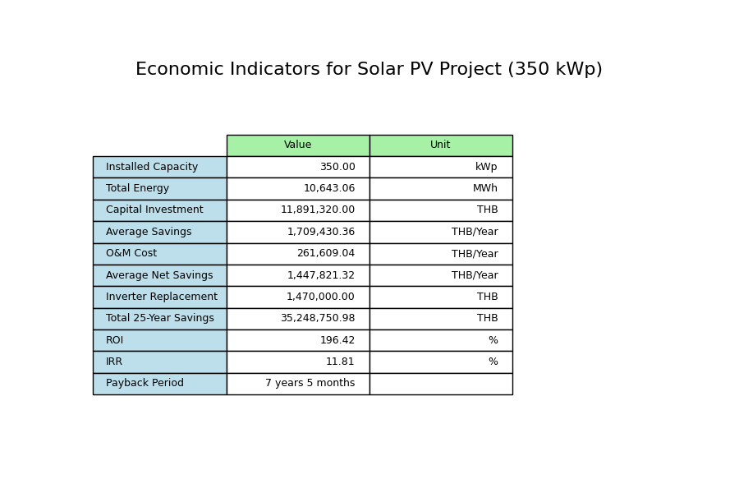
Image from EPC: economic_indicators_350kW.png

Slide 6

Image from EPC: economic_indicators_550kW.png

Slide 7
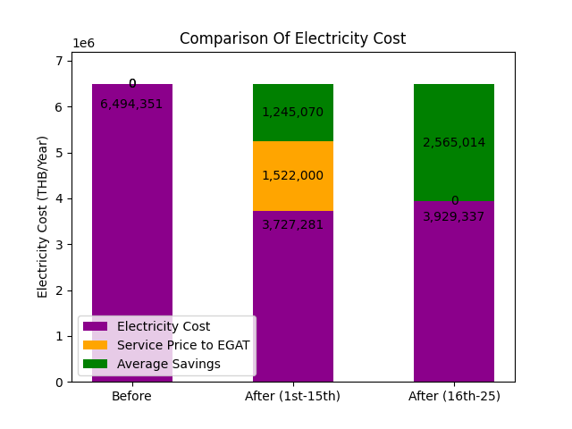
Image from GSA: electricity_cost_comparison_15yr.png

Slide 8
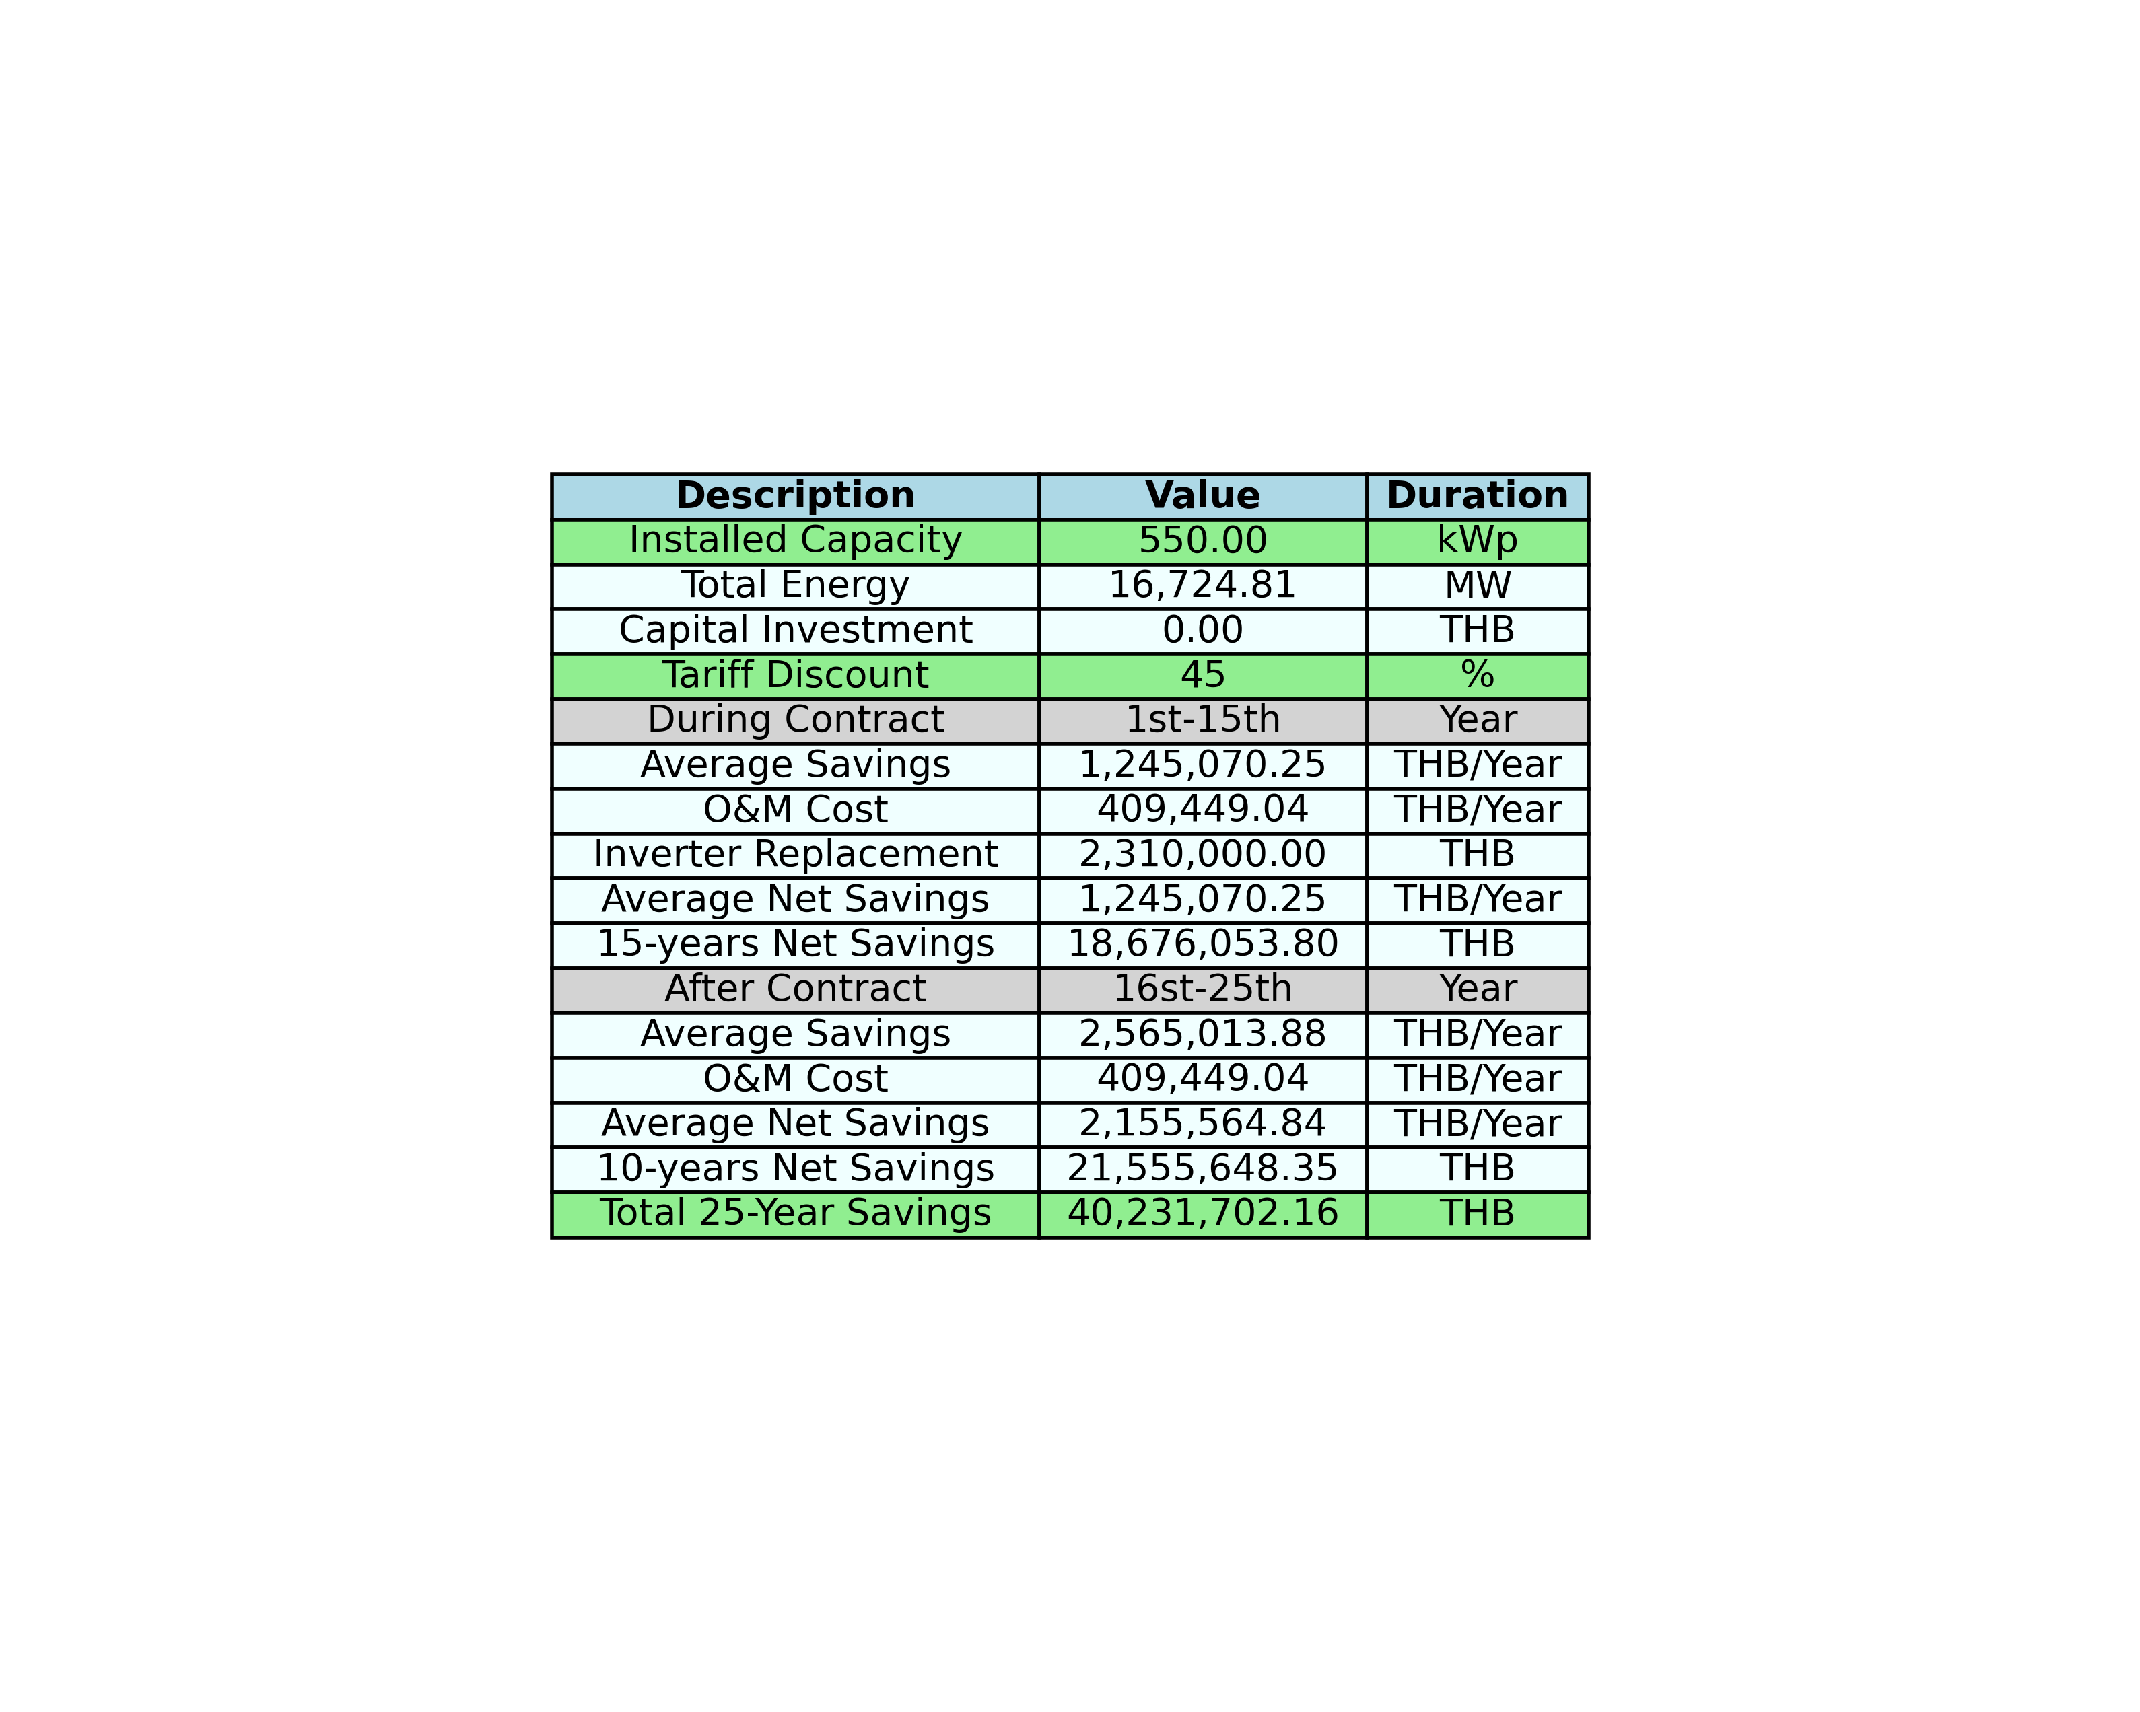
Image from GSA: table_image_15yr.png

