Slide 1
Analysis and Prediction of Regional Based Landslides

Slide 2
Contents
1. Graphical Analysis
2. Data Cleaning
3. Data Set
4. Classification Techniques
5.Training Stages
6.Testing Stages
7.References
8.Future Work

Slide 3
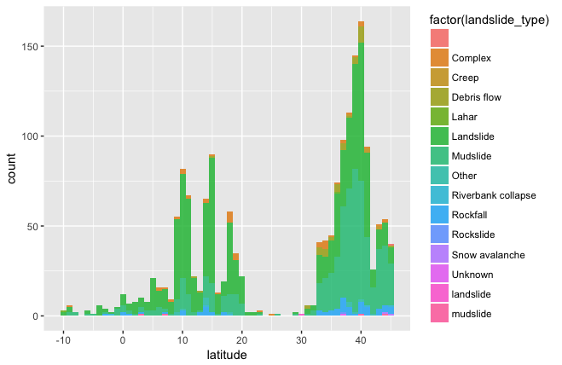
Comparison of Latitude and Landslide Type

Slide 4
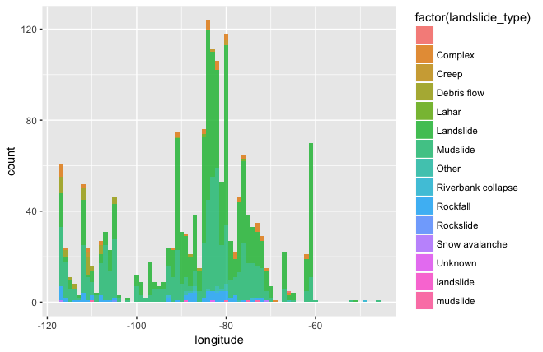
Comparison of Longitude and Landslide Type

Slide 5
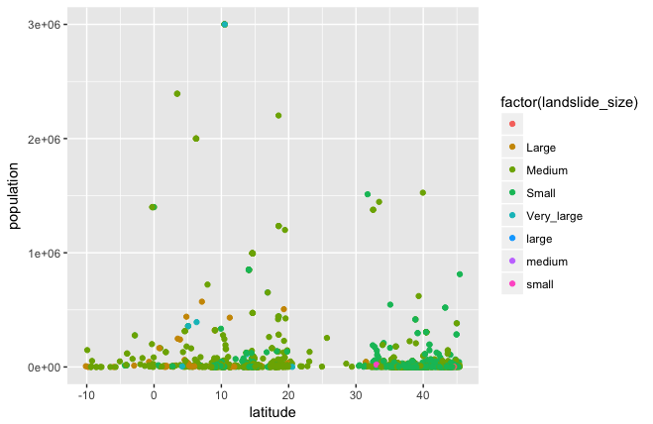
Comparison of Latitude ,Population and Landslide Size

Slide 6
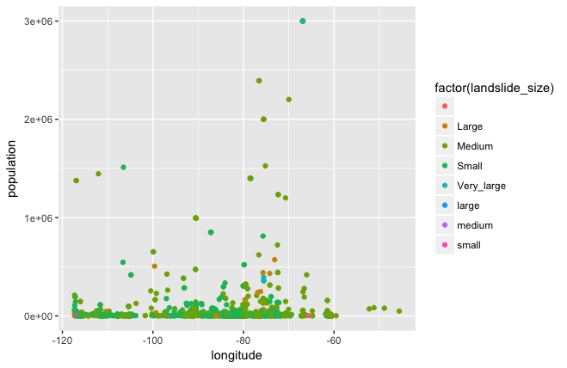
Comparison of Longitude ,Population and Landslide Size

Slide 7
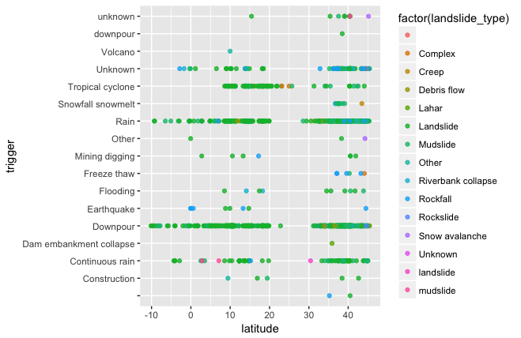
Comparison of Latitude ,Trigger and Landslide Type

Slide 8
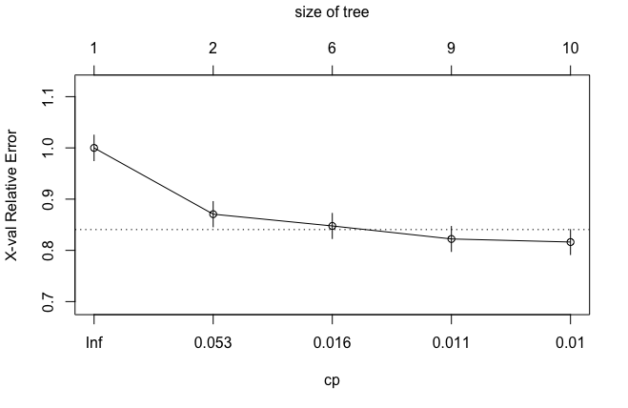

Slide 9
CODE

Slide 10
Thank You

