Slide 1
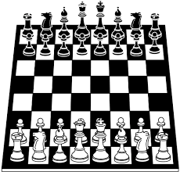
a chess game software

Slide 2
IDEA DESCRIPTION
A game of chess opposing two players (or one player and an AI).
Everyone could see the stats of the different players on the website (number of victories, defeats and draws)
The history of the games can be downloaded after each game

Slide 3
SWOT aNALYSIS
1. Knowledge of the rules of the game
2. Have experience in creating a game with unity
Never create a website
I don't know yet how a database works
1.Various books on chess
2. Observing games of great players
3. There is a large community using Unity that can help me solve problems.
Change in the rules of the game
Computer can crash

Slide 4
SIPOC aNALYSIS
Suppliers | Inputs | Process | Outputs | Customers
Computer chess players | Create an account with pseudonym and password Login | Mode selection: Player vs Player ; Player vs AI Choose who starts Lunch the game Play | A winner and a loser (or make a draw) The history of the game Updated player stat on the website | Computer chess players

Slide 5


Description and justification of the technologies and tools you will use
Unity is a video game engine ; I use it because I've already used it to code another video game, so I know how to use it.
I intend to use the C# language because it is the language that I master the most.

Slide 6
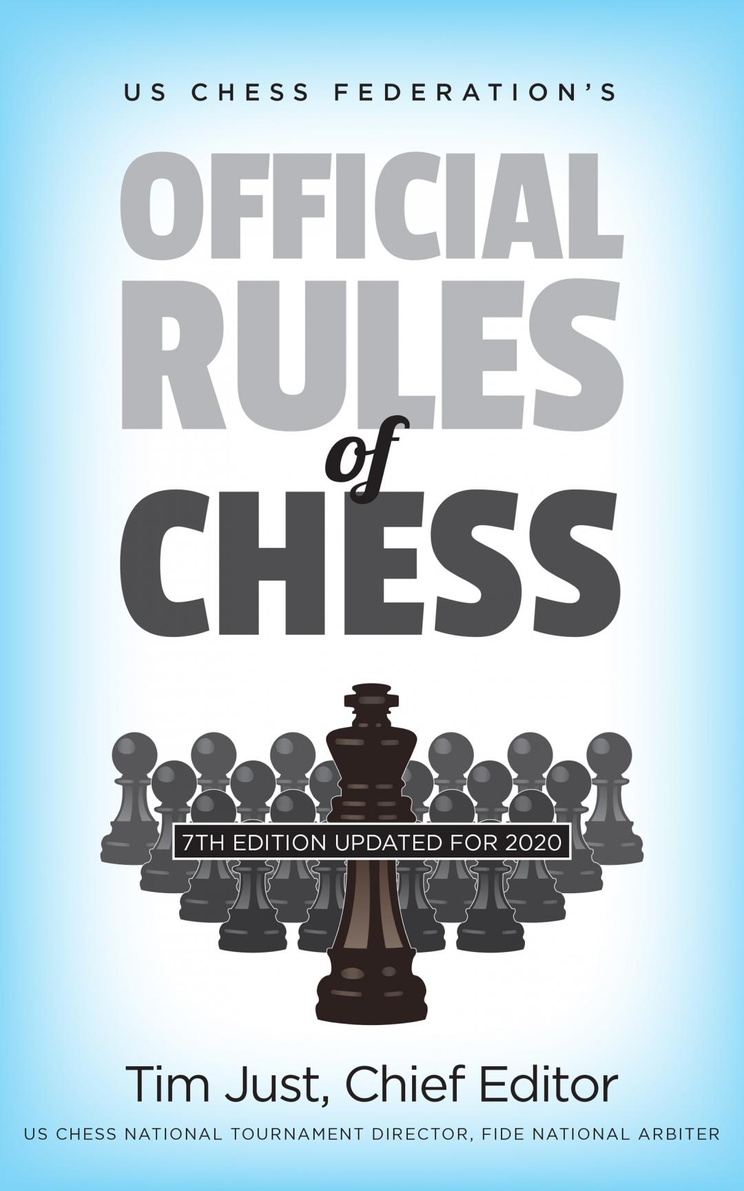

Description and justification of the technologies and tools you will use
Wix is an online platform that allows you to create websites in HTML5. I'm thinking of using wix to create my site
I will use different websites and books on chess to get as much information as possible.

