Slide 1
WELCOME TO CSE461 PROJECT PRESENTATION OF GROUP 04
Gardening System

Slide 2
Group members
Name:
Tasnim Rahman
Juaria Tashin
Jahidul Hassan Rifat
Aarshi Durriya Raihan
Nuhash Kabir Neeha
ID:
21201114
23241054
21201300
22101546
21301025

Slide 3
Key Features
Remote-controlled car via mobile app.
Grass cutting blade activated by commands.
Soil moisture sensor activates water pump if needed.
Temperature sensor displays readings through mobile app

Slide 4
Project Overview:
Components:
Arduino uno R3
Relay mod 2 channel -80
Servo motor SG90-2 ta-200
battery 4+ battery holder-380
Wire
Breadboard
5v water pump
Soil moisture sensor
Temperature sensor
Buck module-50
Bluetooth mod-250

Slide 5
Purpose of the project
Increasing efficiency, flexibility of the system.
To save our time and effort by taking over the task of keeping our lawn neatly trimmed and watered.
Improving management, productivity,Versatility of traditional ways.
Reducing monotony, tiredness,mistakes in work when humans are associate with the system management.

Slide 6
Functionality Of The Project
Remote control car which is controlled by our mobile phone app.
It will turn on the grass cutting blade when we send commands and will turn off after getting commands.
Embedded soil sensors analyze moisture levels beneath the surface, autonomously triggering the water pump to nourish your plants when needed. The garden thrives effortlessly as the system adjusts water delivery, conserving resources when moisture levels are optimal.
Stay informed about environmental conditions through mobile phone app, providing instant feedback on temperature fluctuations. Keep your plants comfortable and healthy in any weather.

Slide 7
Planning & Design
To make the robot move, so we laid out a blueprint to make it resemble a four wheeler car
The ultimate design of the robot included a PVC board to mimic the body of a car
The PVC board has four movable wheels attached to it, and on top of the PVC board, all the components that make up our system is laid out
There are moisture and temperature sensors to measure the moisture and temperature of soil
There are motor to move the wheels and servo motors for water dispensing and for soil moisture sensing
The robot has a bluetooth module attached to the board so it can connect to our cell phones which will act as the remote.

Slide 8
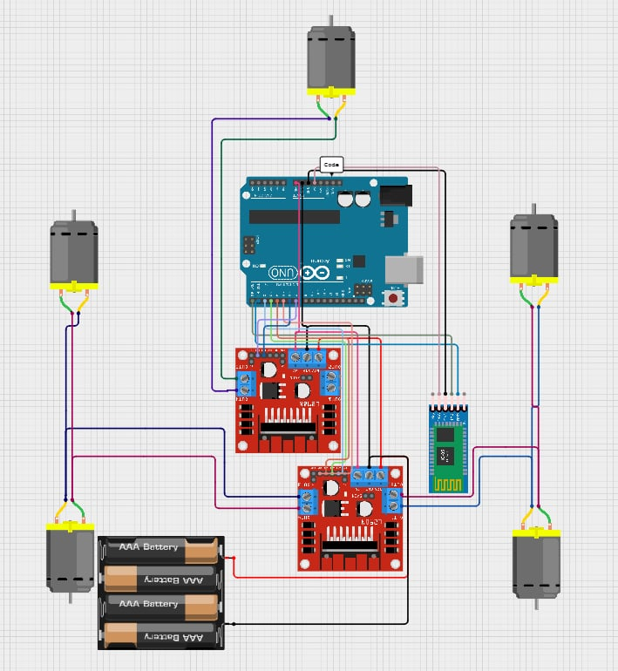
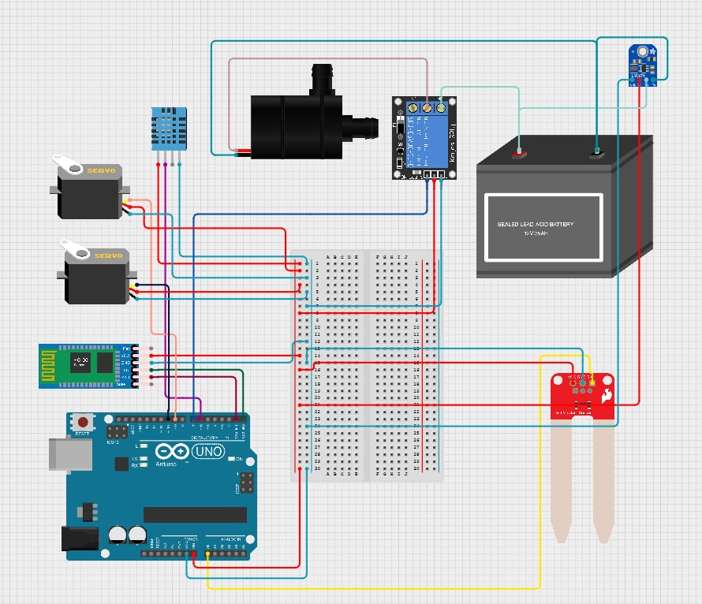
Diagram
Schematic diagram of the bluetooth controlled car body and the cutter:
Schematic diagram of the DHT11 and soil moisture sensor and automated water pump:

Slide 9
System Demonstration
The video link:
Robot Demonstration
User manual link:
User Manual for the car and cutter
User manual for the DHT11(temperature sensor) and soil moisture sensor and automated water pump.pdf

Slide 10
Challenges faced:
Bluetooth module wasn’t connecting
Moisture sensor movement with servo motor had an issue
Some components have been damaged and need replacement
ESP32 have been damaged (was to be used for iot connection bluetooth module used instead)
Debugging - didn't get output through single computer
Code wasn’t working after merging
Power supply wasn’t enough to power the arduino.

Slide 11


