Slide 1
TaskHub
Lucy Wilkinson, Sean O’Neal, Justin Alvey, Brandon Spitler

Slide 2
Product

Slide 3
What is TaskHub?
A social media system for work that allows managers to send task requests to employees and keep track of performance based on task history

Slide 4
Challenges
Time
More features we wanted to implement
Learning Curve
phpMyAdmin

Slide 5
Demonstration

Slide 6
Methods & Tools

Slide 7

Methodology - Agile
Daily scrum meetings
Occasional group programming after class
Careful collaboration
Effectiveness Rating: 5/5
Notes:
Sean

Slide 8

Project Tracker - Trello
Ease of use made it simple to catch up on what everybody was working on
If teammates needed to be contacted more quickly, group texting was a great way to get everybody involved
Effectiveness Rating: 3/5
Notes:
Sean

Slide 9

VCS Repository - GitHub
Keep track of everyone’s progress
Easy to receive code you pair-programmed on someone else’s computer
Merge conflicts
Needed to revert to previous edition
Only works when you use it
Also hosted AutoDoc results through GitHub Pages
Too many files to upload at one time
Effectiveness Rating: 4/5
Notes:
Lucy

Slide 10

Deployment - XAMPP
XAMPP is an Apache platform distribution for developers
Local web server setup
Testing and deployment purposes
Allowed us to run MySQL remotely and connect with our local Apache
server on each machine
Cross-Platform (X), Apache (A), MariaDB (M), PHP (P), and Perl (P)
Effectiveness rating: 5/5
Notes:
Justin

Slide 11

Frameworks - Bootstrap
Free, open-source framework developed at Twitter
Concerned solely with front-end development
Easy to implement, made for responsive design
Used in the Taskhub front-end
Effectiveness rating: 5/5
Notes:
Justin

Slide 12

Database - phpMyAdmin
A tool written in PHP for database-management
Handles administrations in MySQL or MariaDB
Requires a local web server to be running
Packaged with XAMPP software, ease of use
Effectiveness rating: 4/5
Notes:
Justin

Slide 13


Testing
Codeception
First tool used
Ran into debugging issues
Effectiveness Rating: 2/5
Selenium
Easy to use
Great for debugging
Effectiveness Rating: 5/5

Slide 14
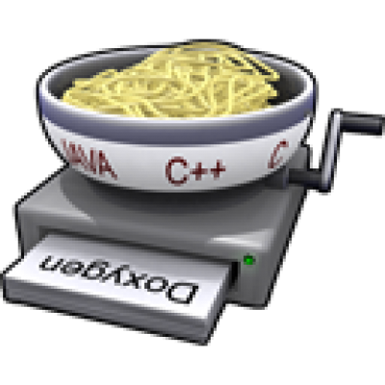
Auto-Doc - Doxygen
Nicely generated HTML pages
See breakdown of what variables will or might be declared
Shows if statements, etc.
Search bar not particularly helpful
Effectiveness Rating: 3/5
Notes:
Lucy

Slide 15
Any questions?

