Slide 1
Text File Comparer Automation Project
By
JUAN MOCTEZUMA

Slide 2
Important Note:
The goal of this presentation is to demonstrate how the author’s automation project (using Python) works and NOT to reveal any confidential information from any former employer.
This presentation will NOT reveal the identity of any client or company related with any former employer.
Segments from the code created by the author, that are shown in this presentation, demonstrate how dummy data gets extracted from text files created in a personal computer and NOT obtained from any files or database(s) associated with any former employer.
The term presented as ‘Broker Dealer Exclusions IDs’ is NOT an actual term from any employer; this was created by the author.
Terms associated with 'category’, such as ‘Wholesaler’, ‘Manager’ and ‘Divisional Manager’ are NOT actual terms from any employer; these were created by the author.
The original script is now officially property of a former employer according to the Employee Confidential Information and Inventions Agreement.
The Text File Comparer script (NOT the original code – which is currently named differently) will be available in the author’s Github repository as a coding sample, however this will not run on the reader’s computer.

Slide 3
Terms & Definitions
Market Metrics: Mobile application that shows clients with insights (sales and assets transactions) into exactly what their customers need.
Broker Dealer: Third party (an individual or a firm) that buys and sells securities on behalf of his/her/their client.
Broker Dealer Exclusion IDs: List (requested by client) of unique elements that get loaded into the Market Metrics’ app, with the goal of ignoring certain transactions performed by some broker dealers.
Categories: Data displayed per client in the mobile app is divided into three classes: ‘manager’, ‘wholesaler’ and ‘divisional manager’ (some clients lack this category)

Slide 4
Technical Terms & Definitions
Programming Languages: Formal language that comprises a set of instructions (in computers or electronics) which produce distinct types of outputs. Although each has it’s own set of rules and syntax, these are based under the same principles. These may serve different purposes and have distinct characteristics among each.
Integrated Development Environment (IDE): Refers to the platform or program used to code with programming languages.
Object: In Object-Oriented Programming (OOP), these are units of code of it’s own class. For example, in Space Invaders (video game), the code that creates the main character/user’s ship is an object, where as the enemies (aliens) are objects themselves.
Python: General-purpose programming language.
Code blocks: Vaguely known as sections of an entire code/script. These might look like paragraphs or might be delimited by brackets.
List: Data structure designed to be changeable; it’s purpose is to store an ordered sequence of elements (words, sentences or numbers).

Slide 5
Technical Abbreviations
Please take a look at the following terms mentioned during the presentation that correspond to the author’s script/code:
p or pq: abbreviations for previous quarter.
q or cq: abbreviations for current quarter.
ph: abbreviation for placeholder.
mgr: abbreviation for manager.
ws: abbreviation for wholesaler.
dmgr: abbreviation for divisional manager.

Slide 6
Origin of Automation Project
One of my tasks as a Data Analyst was to compare several text files by manually manipulating data on Microsoft Excel (spreadsheet) prior to updating the Market Metrics mobile application.
At the beginning of each quarter, every ‘iPad’ client would deliver a list of their ‘Broker Dealer Exclusion IDs’ or ‘BDE IDs’ that were related to certain data/transactions that each client did not want to see in their account linked with the Market Metrics app.
As part of the process, these lists (or txt files) containing the BDE IDs were compared to those lists submitted by each iPad client during the previous quarter.
One of my goals at some point during my career would be to automate a manual process using Python, to reduce some of the work done manually.

Slide 7
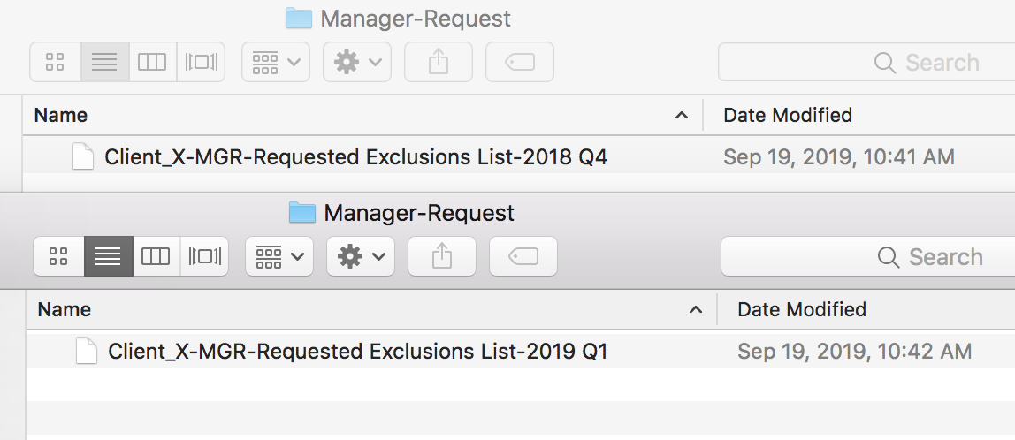
What did the process look like when done manually? (Part 1)
The analyst would first search for the lists in the folders corresponding to his/her assigned client. For instance, category corresponding to ‘Manager’ for ‘Client_X’.
Recall that all clients have more than one category. For instance, ‘Manager’ and ‘Wholesaler’.
The next step would be to open the client-requested lists from both previous and current quarter. In this example the current quarter is 2019 Q1, the previous one is 2018 Q4.

Slide 8
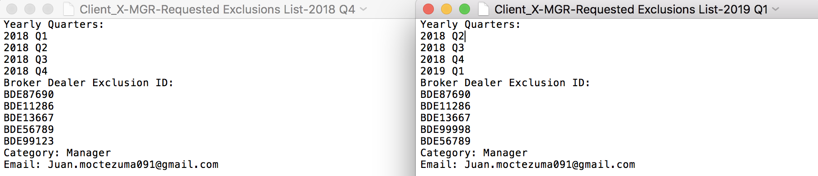
What did the process look like when done manually? (Part 2)
The analyst would then copy and paste the information contained in these txt files into a spreadsheet (or Excel file).
The analyst wants to make sure that elements that follow the ‘BDEXXXXX’ format are almost identical. If not, then the analyst should figure out why these are different before the current BDE IDs get loaded into the mobile app.

Slide 9
What did the process look like when done manually? (Part 3)
The analyst would then compare the BDE IDs by inserting a ‘True/False’ formula and manually dragging it in a new column.
In some occasions txt files would not contain the same number of BDE IDs, meaning that more manual work needs to be done in order to align every element and confirm the ones that are true vs. false.
‘True’ implied that current BDE IDs were the same as the ones from the previous quarter. The ‘False’ result would imply that the BDE IDs changed on a quarterly basis.
This process needed to be done repeatedly per ‘iPad’ client and for each category (in multiple tabs within the spreadsheet). However, as a former analyst, the process implied dealing with a greater number of BDE IDs and more ‘categories’.

Slide 10
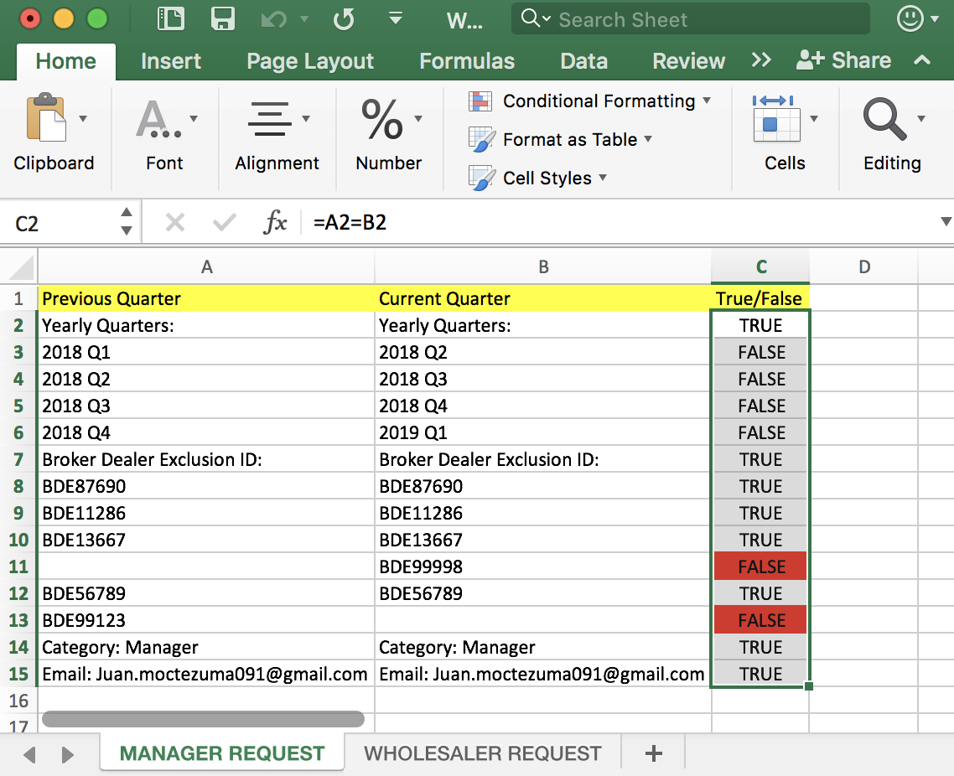
What did the process look like when done manually? (Part 4)
When the number of exclusion IDs didn’t match, manual labor would become tedious. Please look at the circled blank cells on the picture below.

Slide 11

Wouldn’t it be more practical to automate this process?
This process may not seem too difficult and it may not require advanced knowledge in Microsoft Excel, however, it is time consuming and unnecessary.
There is no denying that most technical processes are still required to be performed by humans, but it is both more time and resource efficient to have a script or code that can handle copying and pasting large amounts of data from different paths (with several folders within), and display the results in a matter of seconds!

Slide 12
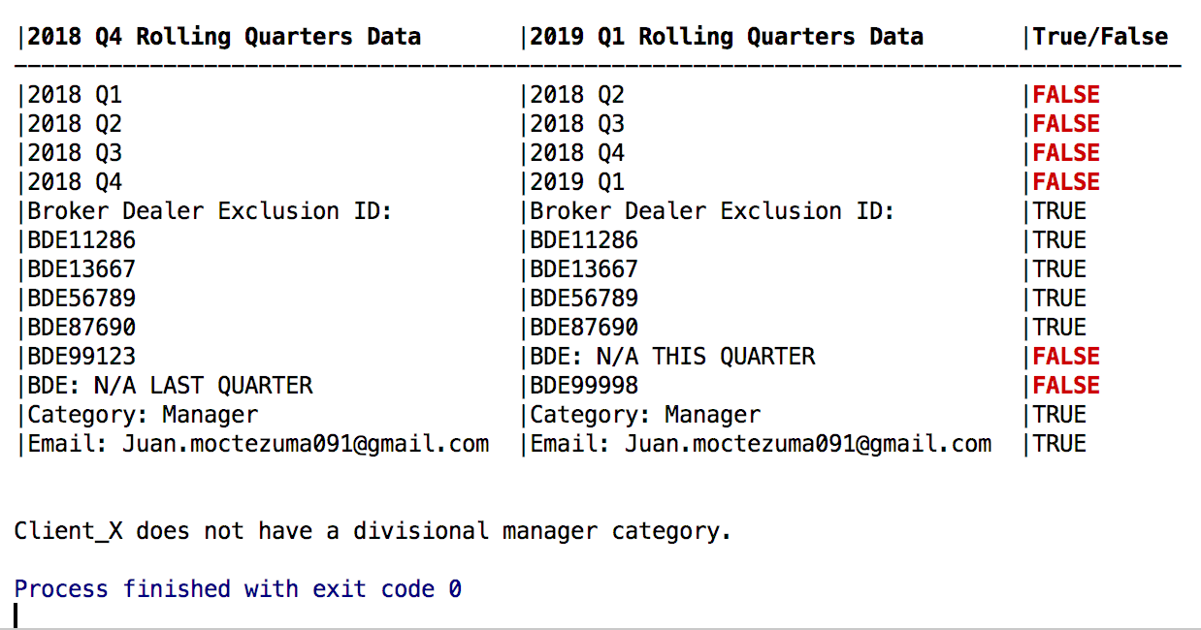
What did results look like when the process was automated?
The picture to the right represents the Python script’s outcome.

Slide 13
How is the Text File Comparer different? (Part 1)
In order for any Python code to run on any computer (Mac or Windows), an Integrated Development Environment or IDE (which is the ‘platform’ or program used to run the actual language) needs to be installed.
In this case the author used PyCharm CE (IDE) on a MacBook.
Once the code starts running, it will prompt the user to enter the name of the client, in this case ‘Client_Z’ and the current quarter linked to the folders containing the most recent data or BDE IDs.
The user simply needs to type those 2 aspects and the code will do the rest. The previous quarter gets selected automatically.

Slide 14
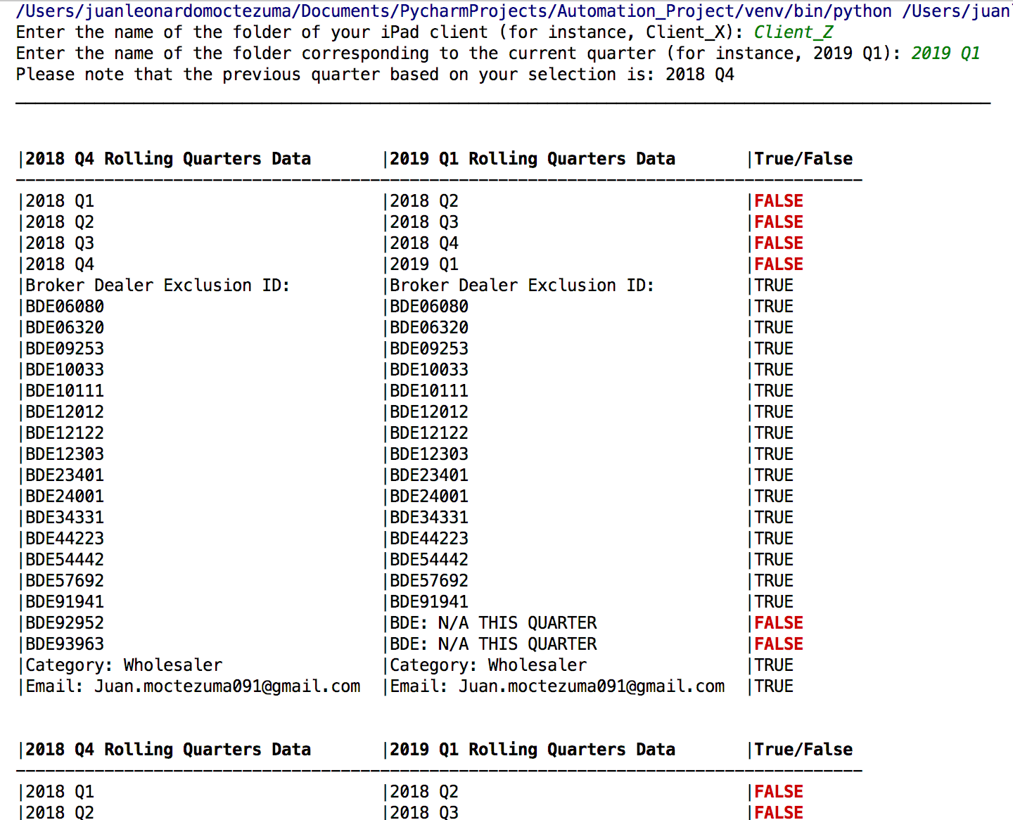
How is the Text File Comparer different? (Part 2)
Right after the user inputs the client and current quarter, every available category (divisional manager, manager, wholesaler) will get printed or displayed. If the client doesn’t have ‘divisional manager’ as a category, then a note will show up. Please recall that the purpose of this script is to extract the data from the txt files – BDE ID lists, print those side by side, and compare those by assigning ‘True’ or ‘False’. Although we only care about the exclusions (BDE IDs), it is important to display all data from the text files and make sure the correct files are being compared.

Slide 15
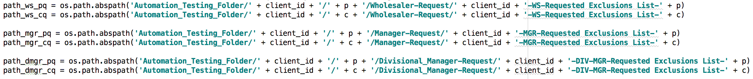
How does the Python script work? (Part 1)
The client’s name and quarter need to match the names of both the folder within the path in which the txt files are located, and the names of these files.
Then the variables created by the author, for instance path_mgr_cq and path_mgr_pq (please look at the picture below), will start searching (within the computer’s folders) for the files that originally were copied and pasted.
If one folder or file is named differently from what these variables are looking for, then the code will not display the desired results.

Slide 16
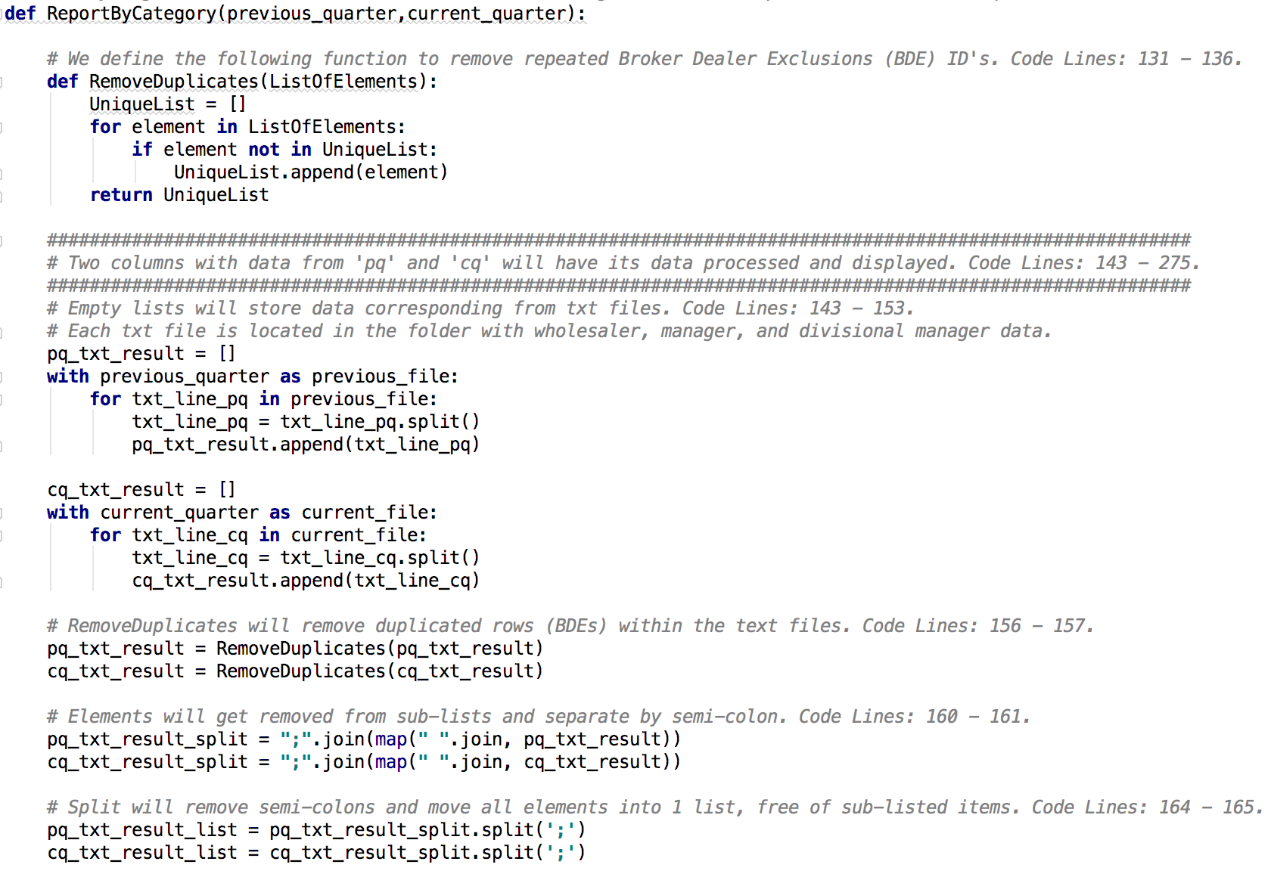
How does the Python script work? (Part 2)
An “object” known as ReportByCategory
was defined in order to import the data
extracted from those files. Once the
object has access to that information,
each row from the text files gets stored
into an empty list (look at the red circles).
Another object titled RemoveDuplicates
was created inside ReportByCategory in
order to avoid listing redundant data.
Consequently, the for-loops
will cause each element to get
stored into its own list. To make each
sub-list disappear, these need to be
mapped and switched to semicolons.

Slide 17
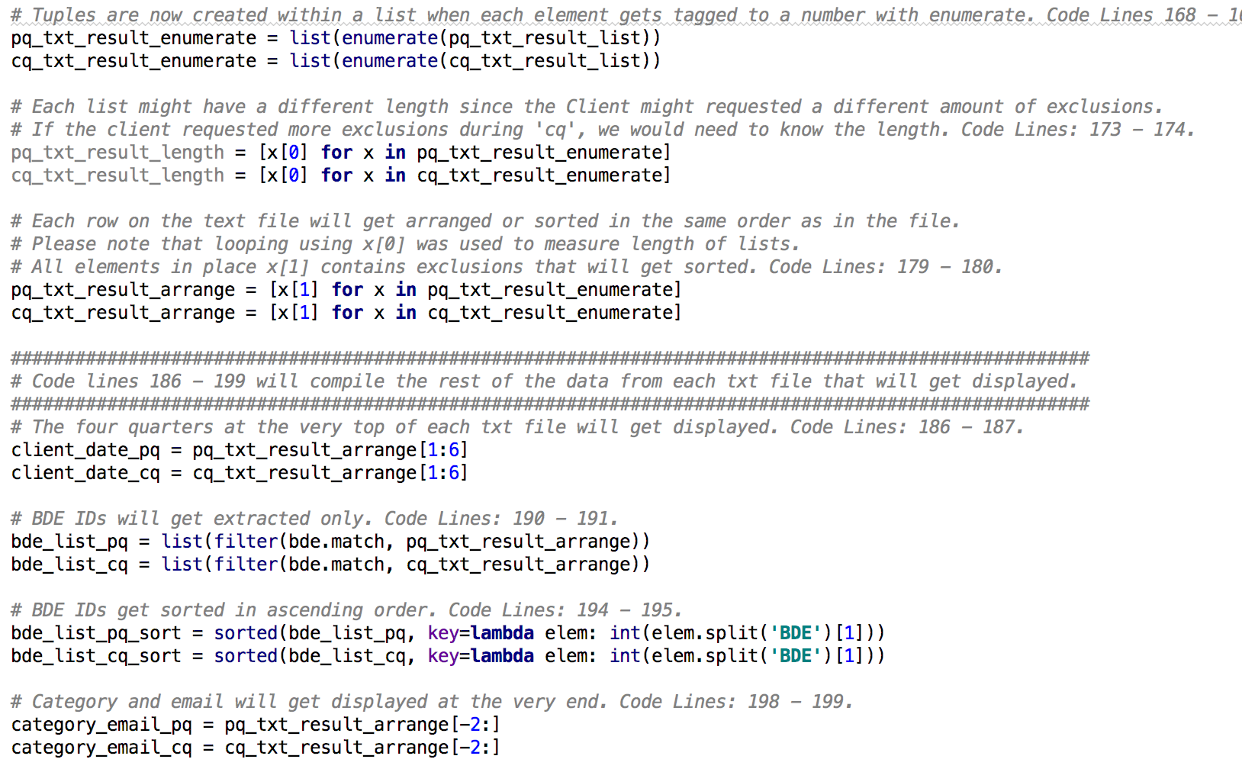
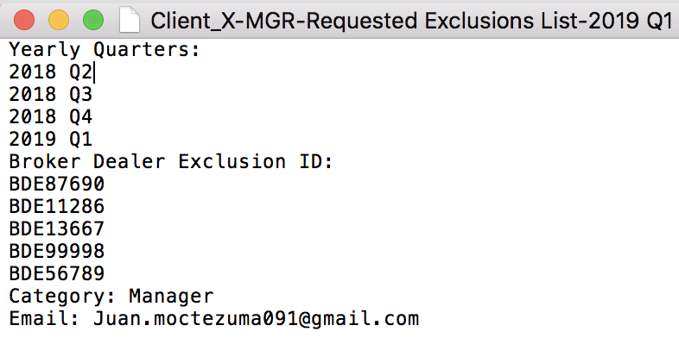
How does the Python script work? (Part 3)
While still inside ReportByCategory, a
new list will get created based on three
sections coming directly from the txt
files. The 1st part consists of 4 rows
containing the quarters. The 2nd section
is based on x number of BDE IDs only.
The last section includes category and
Email.

Slide 18
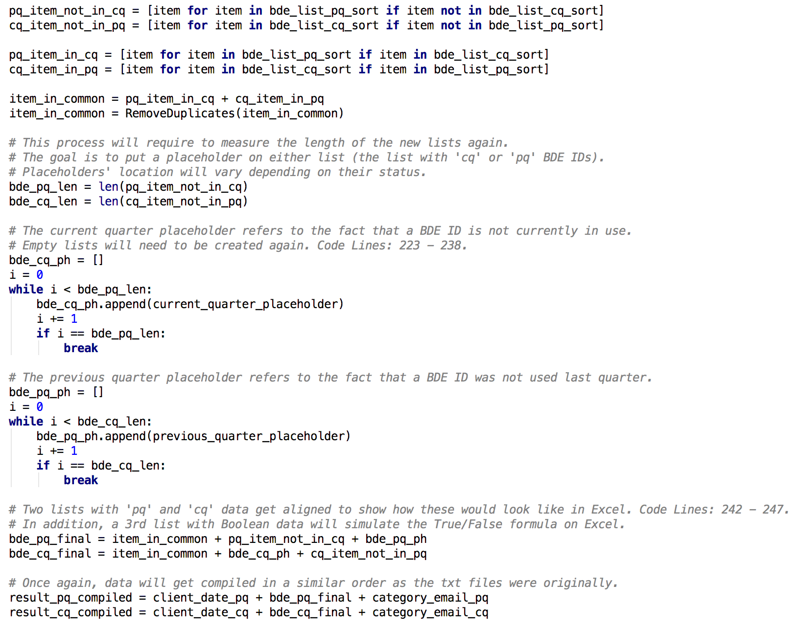
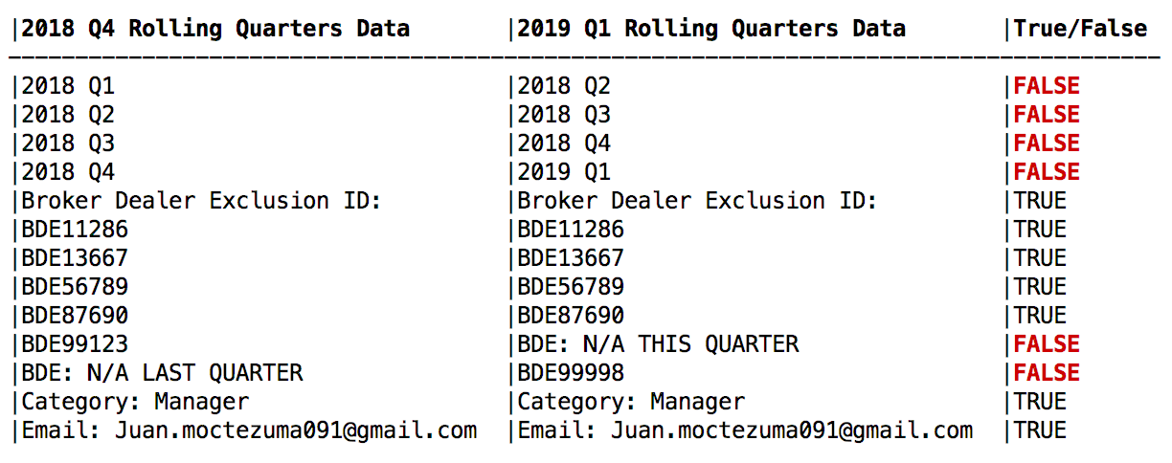
How does the Python script work? (Part 4)
Other important code blocks within the
object ReportByCategory, involve creating
placeholders, which are rows labeled as ‘BDE:
N/A THIS QUARTER’ and ‘BDE: N/A LAST
QUARTER’. These placeholders are lists that
get attached to the list containing the BDE IDs;
without these, the dimensions of the lists being
compared wouldn’t match.

Slide 19
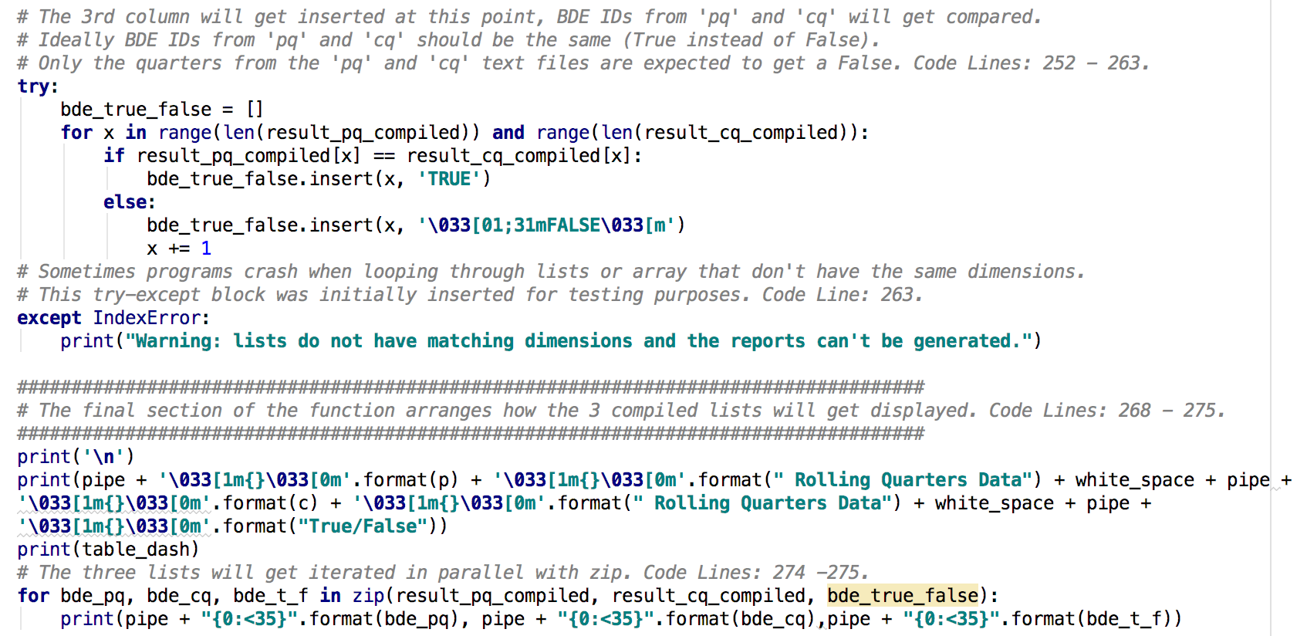
How does the Python script work? (Part 5)
The last code blocks within the
ReportByCategory, will create a
list where each element is either
‘True’ or ‘False’. These elements
will vary depending on the results
from the previous quarter vs. the
current quarter. Once these are
finally aligned, ‘True’ will get
assigned if elements are the same,
but if not, then these will get a
‘False’. Once that last (True/False)
list gets populated, a header will
get attached at the very top of each
list (which will make these look like
columns) and everything will get
printed to simulate the appearance of
a spreadsheet.

Slide 20
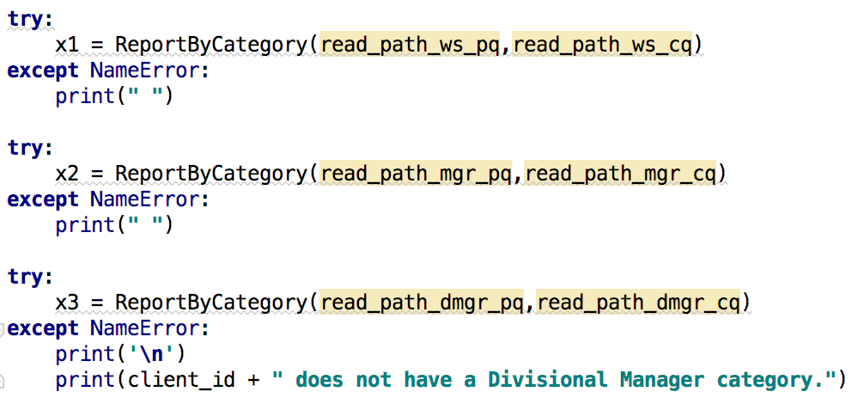
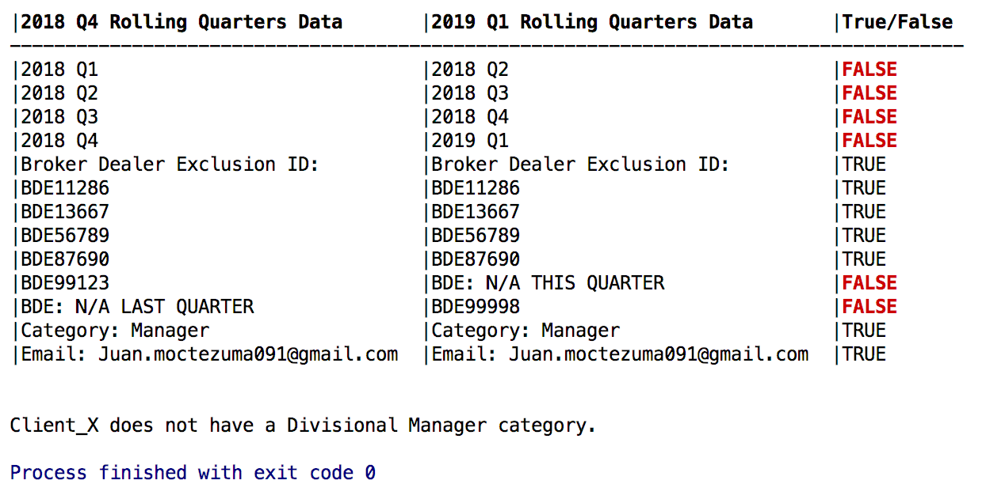
How does the Python script work? (Part 6)
Once the ReportByCategory completes it’s function, variables containing the extracted data from the path can now be “plugged into” the function (or recently mentioned object). These will try and see if there is an error with the data, however, some clients do not have a divisional manager, if that’s the case then a note will get printed.

Slide 21
Summary
The goal of the Text File Comparer code is to mimic a manual process done in Microsoft Excel via automation using Python.
The author came up with this idea after observing that the process of comparing text files with Broker Dealer Exclusion IDs from previous and current quarters consisted mainly of copying and pasting.
The user will get prompted to input the name of a client and the current quarter; and then the code will extract data from the paths (or folders) matching what the user requested. Old data will be compared with the current BDE IDs, and then all categories will get displayed to look like a spreadsheet.
Although some codes/scripts such as the one used during this project is limited to serve only one purpose, it is important to think creatively and use technology to our advantage to save time and resources.

Slide 22
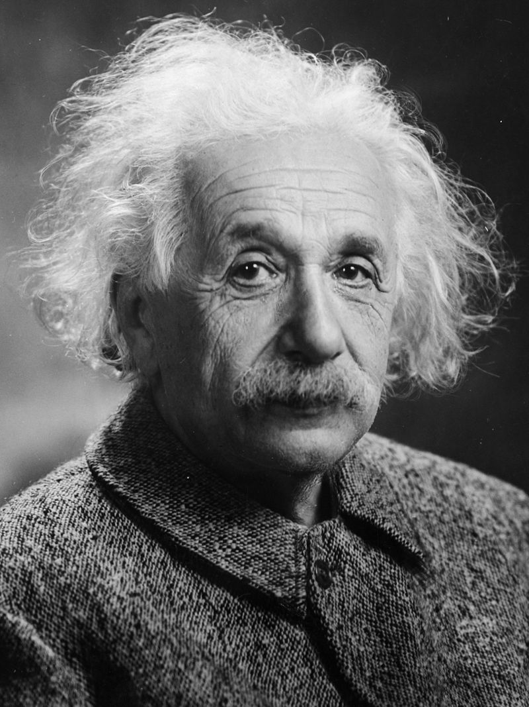
“Imagination is more important than knowledge. For knowledge is limited, whereas
imagination embraces the entire world, stimulating progress, giving birth to evolution.”
– Albert Einstein

Slide 23
References
Brainy Quote. (2019). Retrieved from https://www.brainyquote.com/lists/authors/top-10-albert-einstein-quotes?gclid=CjwKCAiAzuPuBRAIEiwAkkmOSF0puirScNR1KYRgfBuj226LdF_Hf6utt0ZADl3EUVu6WERd0C1YyBoC3WAQAvD_BwE
Computer Hope. (2019). Retrieved from https://www.computerhope.com/jargon/program.htm.
Python 3.8.0 documentation. (Nov 23, 2019). Retrieved from https://docs.python.org/3/.
Stack Overflow. (2019). Retrieved from https://stackoverflow.com.

