Slide 1
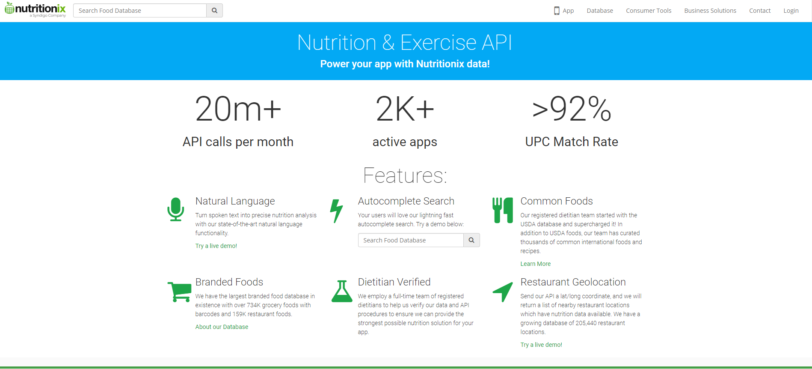
Nutritionix API Homepage

Slide 2
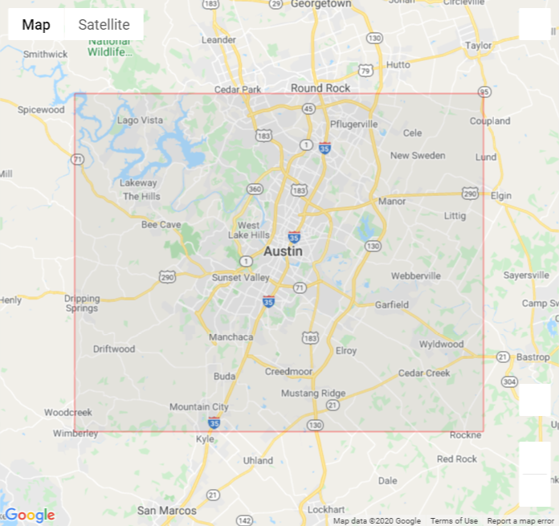
Search Area

Slide 3
Search Procedure

Slide 4
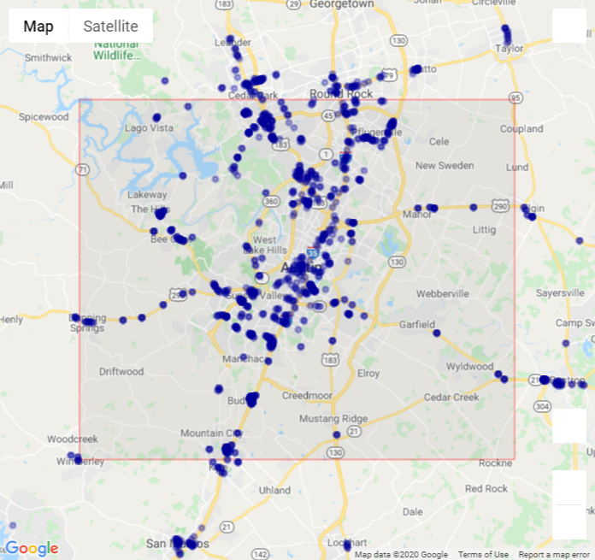
All Locations_Greater Austin Area
1,433 locations

Slide 5
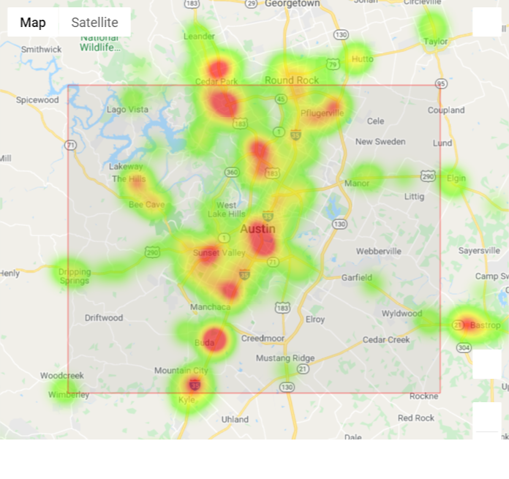
All Locations_Greater Austin Area_Heatmap
1,433 locations

Slide 6
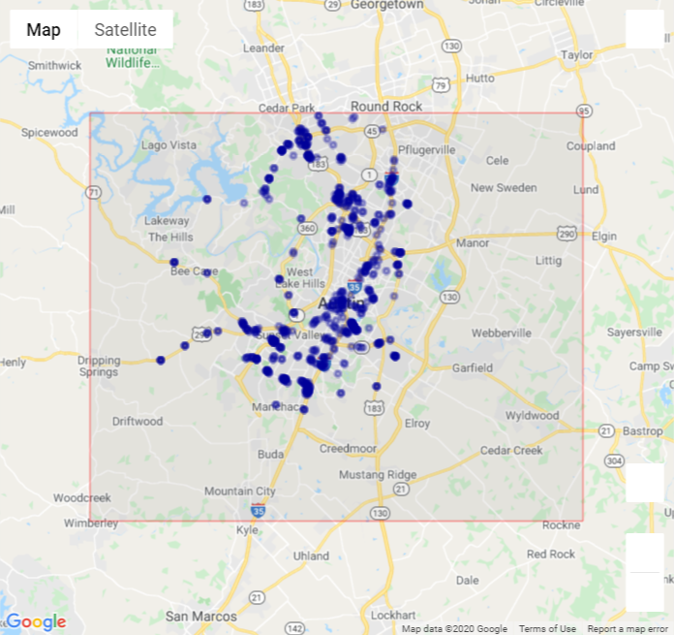
Only Austin Locations
701 locations

Slide 7
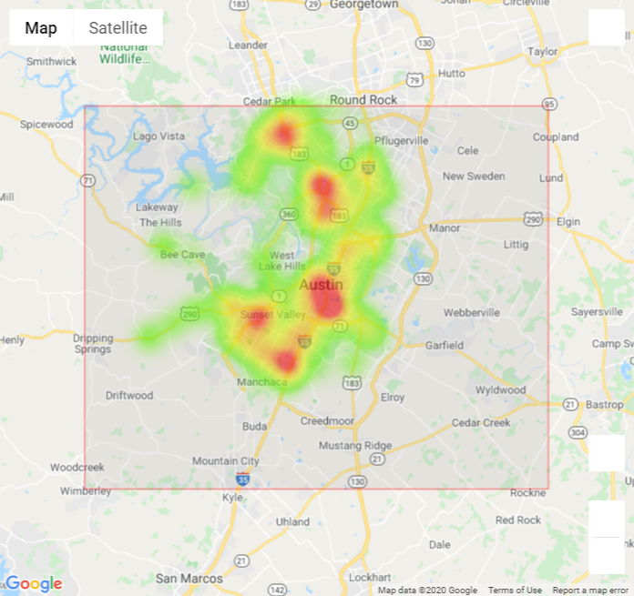
Only Austin Locations_Heatmap
701 locations

Slide 8
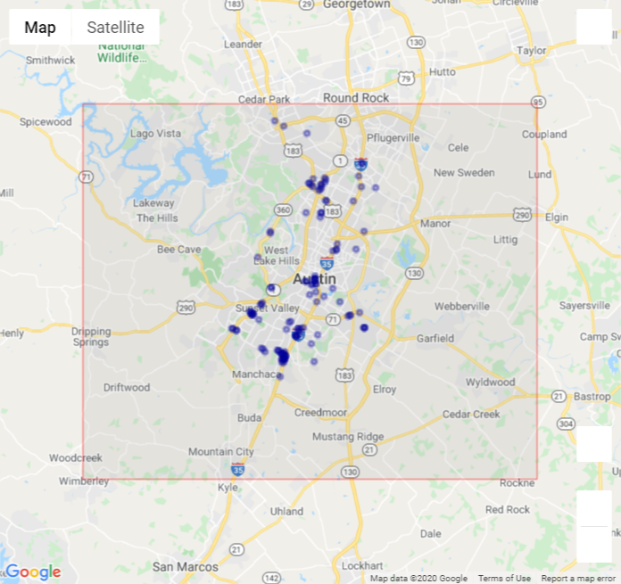
Unique Austin Locations
121 locations

Slide 9
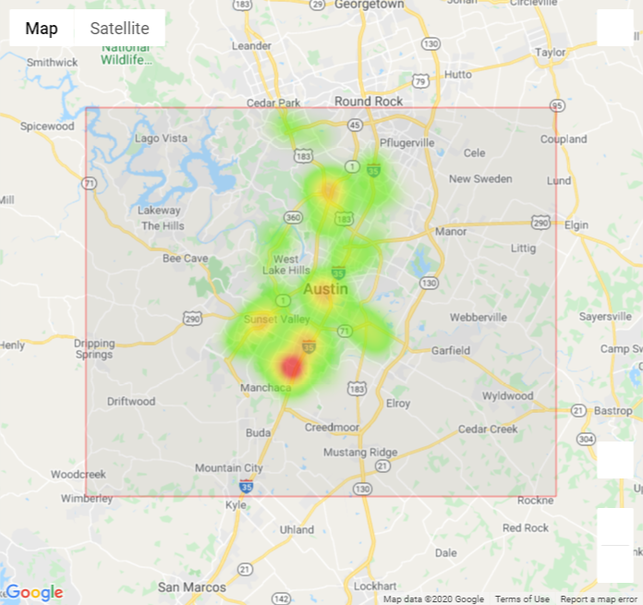
Unique Austin Locations_Heatmap
121 locations

