Slide 1
Establishing a Just, Learning Culture
Week 7 Module 9.2 Assignment
Juan Macias Vasquez
Bellevue University
CSD380-H323 DevOps (2265-DD)
Adam Bailey
February 27th, 2026

Slide 2
What Is a Just & Learning Culture?
Just Culture
A culture where the individuals feel safe to report errors without fear of unjust punishment and the organization learns from incidents rather than assigning blame.
Learning Culture
An environment that promotes continuous improvement, open communication, and reflection to make performance and adaptability better.

Slide 3
Overview: Why It’s Hard to Change Culture
Implementing a just, learning culture needs:
Mindset change at all levels
Consistent leadership behavior
Safe communication practices
Traditional blame-oriented norms and resistance to change make this hard.

Slide 4
Barrier: Resistance to Change
People are accustomed to the old ways and are scared of the new expectations.
Fear of the unknown and comfort in routine slows the adoption.
In DevOps, breaking silos and traditional role boundaries triggers resistance.

Slide 5
Barrier: Fear of Blame and Retribution
Workers hesitate to report mistakes if they are scared of the punishment.
Outcome and attribution bias will lead to punitive responses instead of learning.
This discourages the transparency and even hinders open reporting.

Slide 6
Barrier: Lack of Trust & Leadership Support
A blame-oriented management style undermines trust.
The leaders have to “lead by example”
- inconsistent messaging would weaken the efforts.
Without strong leadership the cultural change would lose momentum.

Slide 7
Barrier: Organizational Norms & Silos
The Deep-rooted habits in departments resist cross-team learning and collaboration.
DevOps need to break down silos that traditional structures usually end up resisting.
Lack of communication and shared goals end up derailing culture efforts.

Slide 8
Barrier: Resource & Training Constraints
Limited training and engagement time will weaken the awareness and buy-in.
Insufficient tools and learning resources would delay or even prevent continuous development.
Organizations often prioritize short-term goals over long-term learning.

Slide 9
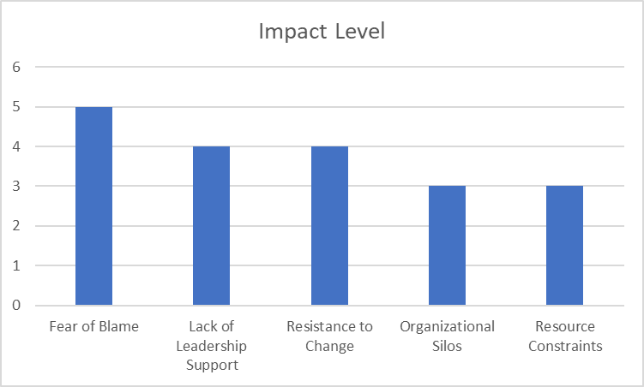
Barrier and Impact level Chart
Barrier | Impact Level
Fear of Blame | 5
Lack of Leadership Support | 4
Resistance to Change | 4
Organizational Silos | 3
Resource Constraints | 3
Made in Word
Made in Excel

Slide 10
References
Textbook: The DevOps Handbook: How to Create World-Class Agility, Reliability, & Security in Technology Organizations Second Edition; Gene Kim, Jez Humble, Patrick Debois, John Willis, & John Allspaw; IT Revolution Press; 2016 - Chapter 19
Building a learning culture article (IT Revolution) - https://itrevolution.com/articles/building-a-learning-culture-in-nine-steps/#:~:text=Leaders%20encourage%20organizational%20learning%20by,are%20comfortable%20and%20encourage%20collaboration.
DASA blog on learning culture - https://www.dasa.org/blog/developing-a-learning-culture-to-enhance-devops-success/
BuiltInNYC article on DevOps culture - https://www.builtinnyc.com/articles/devops-culture

