Slide 1
The Technology Value Stream
Juan Macias Vasquez
Bellevue University
CSD380-H323 DevOps (2265-DD)
Adam Bailey
January 18th, 2026

Slide 2
What Is a Value Stream?
Definition:
A value stream is the sequence of activities required to deliver value to a customer. From the initial request to final delivery. In technology, this includes everything from idea through development and deployment.

Slide 3
What Is the Technology Value Stream?
In DevOps, the technology value stream is:
The process of converting a business idea or hypothesis into a technology-enabled service that creates value for the customer.
It begins with planning and then ends when the software runs in production providing value.

Slide 4
Lead Time vs. Processing Time
Lead Time
Time from when a request is made to when it is fulfilled.
Includes waiting, handoffs, and all delays.
What the customer experiences.
Processing Time
Only the time work is actively being done.
Does not include waiting times.

Slide 5
Why The Lead Time Matters
A primary goal in DevOps is to reduce lead time because it directly affects customer satisfaction and responsiveness.
Reducing lead time means fewer delays and faster delivery of value.

Slide 6
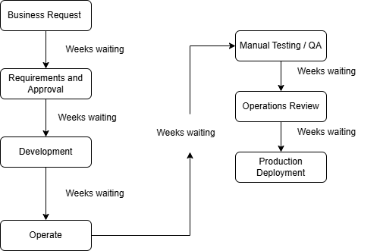
The Common Scenario: Lead Times of Months
Lots of organizations have deployment lead times measured in months because of:
Monolithic architectures
Manual testing processes
Multiple approval steps
Long queues for resources
Example Value Stream (Long Lead Time)

Slide 7
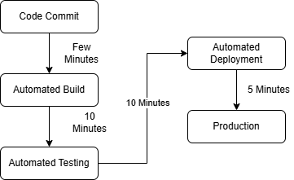
DevOps Ideal: Lead Times of Minutes
In DevOps best practice, teams aim for deployment lead times measured in minutes or hours.
This ideal is achieved by:
Small batch changes
Automated testing & integration
Modular, loosely coupled architecture
Fast feedback loops
Continuous deployment processes
Example Value Stream (Short Lead Time)

Slide 8
Why This Matters
Benefits of Short Lead Times:
Faster customer feedback
Higher team autonomy
Fewer integration problems
More stable releases and higher quality
Greater agility and responsiveness

Slide 9
Sources
https://www.geeksforgeeks.org/devops/introduction-to-devops/
https://www.geeksforgeeks.org/devops/devops-tutorial/
https://itrevolution.com/wp-content/uploads/2022/06/DOHB2_Excerpt.pdf
https://red-green-refactor.com/2020/11/04/book-club-the-devops-handbook-chapter-1-agile-continuous-delivery-and-the-three-ways/

