Slide 1
National Parks
Biodiversity Analysis
Exploring species distributions, conservation risk,
and biodiversity across 4 US National Parks
Great Smoky Mountains • Yosemite • Bryce Canyon • Yellowstone
Data Analysis Report | 2024

Slide 2
Dataset Overview
Two complementary datasets spanning 4 National Parks
23,296
3,570
4
7
Observation Records
(bioparks.csv)
Species Records
(species_info.csv)
National Parks
Covered
Species
Categories
bioparks.csv
species_info.csv
• Columns: scientific_name, park_name, observations • Observation range: 9 – 321 per record • Mean observations: 142 per species–park pair • No missing values — clean, complete dataset • Yellowstone contributed the most total sightings across all species
• Columns: category, scientific_name, common_names, conservation_status • 7 categories: Vascular Plant, Bird, Nonvascular Plant, Mammal, Fish, Reptile, Amphibian • 96% of species have no listed conservation concern • 144 species flagged as at-risk (Endangered, Threatened, Species of Concern, In Recovery)
National Parks Biodiversity Analysis | bioparks.csv & species_info.csv

Slide 3
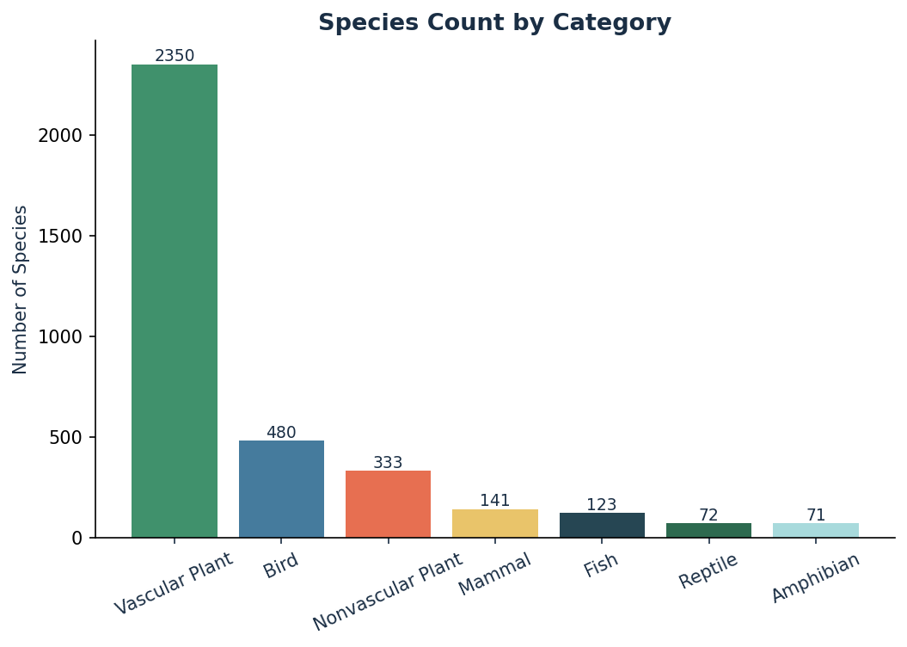
Species Composition
3,570 species across 7 biological categories
65.8%
Vascular Plants (2,350 sp.) — by far the largest group
13.5%
Birds (480 sp.) — second most diverse category
9.3%
Nonvascular Plants (333 sp.) — mosses, liverworts, lichens
3.9%
Fish (123 sp.) — freshwater species from rivers & lakes
2.0%
Amphibians & Reptiles — sensitive indicators of ecosystem health
National Parks Biodiversity Analysis | bioparks.csv & species_info.csv

Slide 4
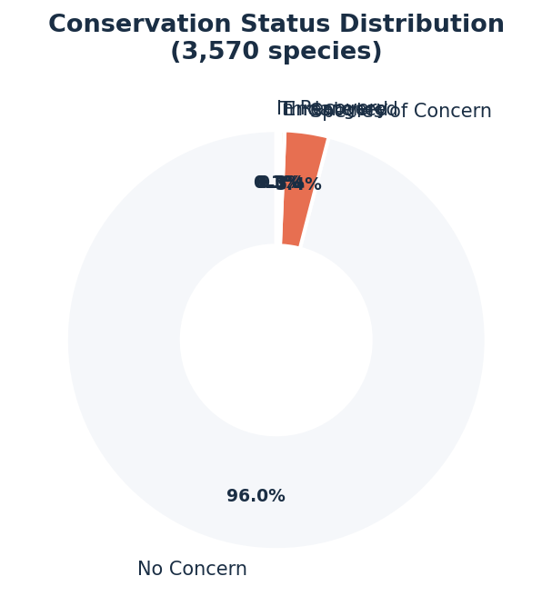
Conservation Status Distribution
Most species are unlisted — but risk concentrates in specific categories
3,426
No Listed Concern
121
Species of Concern
11
Endangered
9
Threatened
3
In Recovery
National Parks Biodiversity Analysis | bioparks.csv & species_info.csv

Slide 5
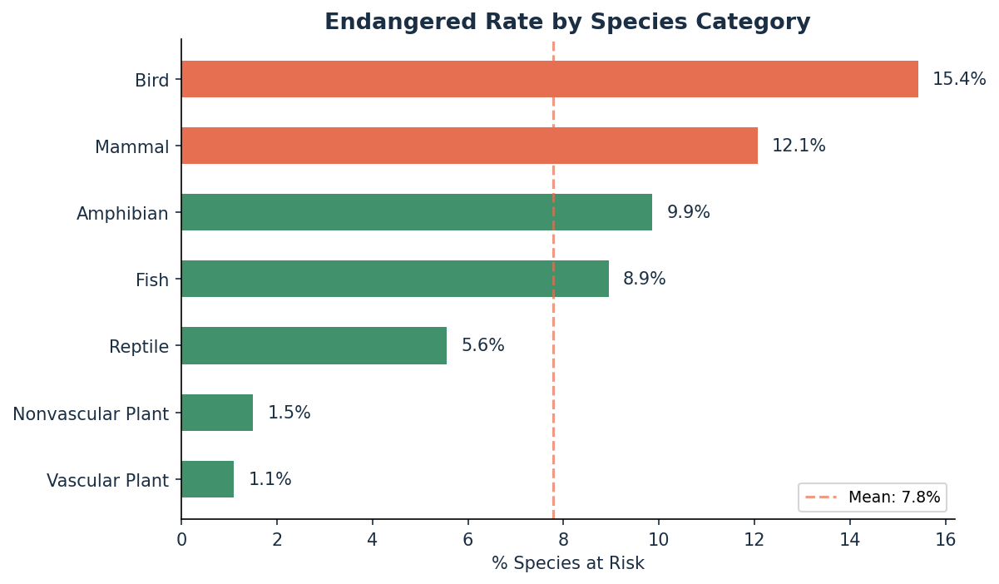
Endangered Rate by Species Category
Birds and Mammals face the highest proportional risk
Key Observations
Birds lead at 15.4% at-risk — nearly 1 in 6 bird species is flagged.
Mammals follow at 12.1%, reflecting well-documented pressures on vertebrates.
Vascular Plants have the lowest rate (1.1%) but the largest raw count.
Amphibians (9.9%) are worryingly high given their role as ecosystem indicators.
The overall mean at-risk rate across all categories is ~4.0%.
National Parks Biodiversity Analysis | bioparks.csv & species_info.csv

Slide 6
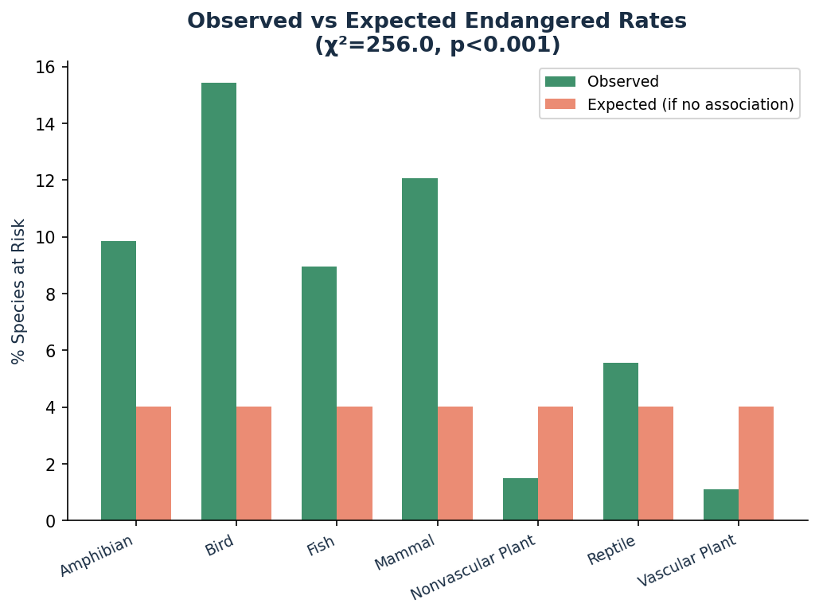
Statistical Significance — Chi-Square Test
Is the association between species category and endangered status significant?
χ² = 255.97
p < 0.001 | df = 6
Interpretation
The extremely low p-value (<0.001) means we reject the null hypothesis that species category and conservation risk are independent.
The observed endangered rates differ significantly from what we'd expect if risk were distributed evenly.
Birds and Mammals are disproportionately over-represented in at-risk categories relative to their population share.
Vascular Plants are under-represented despite having the largest species count.
National Parks Biodiversity Analysis | bioparks.csv & species_info.csv

Slide 7
Recommendations for Conservationists
Based on chi-square results and endangered rate analysis
01 Prioritise Bird & Mammal Conservation
02 Invest in Amphibian Monitoring
With 15.4% and 12.1% at-risk rates respectively, and chi-square confirming statistical significance, these categories warrant immediate targeted intervention programs.
Amphibians (9.9% at-risk) serve as sensitive ecosystem barometers. Declines often precede broader ecological collapse — early monitoring yields outsized protective value.
03 Address Invasive Species Urgently
04 Expand Species Data Collection
All four parks show invasive species topping observation counts (Eurasian collared-dove, velvet grass, catsear). These displace native fauna and elevate risk for already-vulnerable species.
Current data lacks temporal trends and native/invasive classification. Longitudinal datasets with habitat metadata would enable predictive risk modelling and earlier intervention.
National Parks Biodiversity Analysis | bioparks.csv & species_info.csv

Slide 8
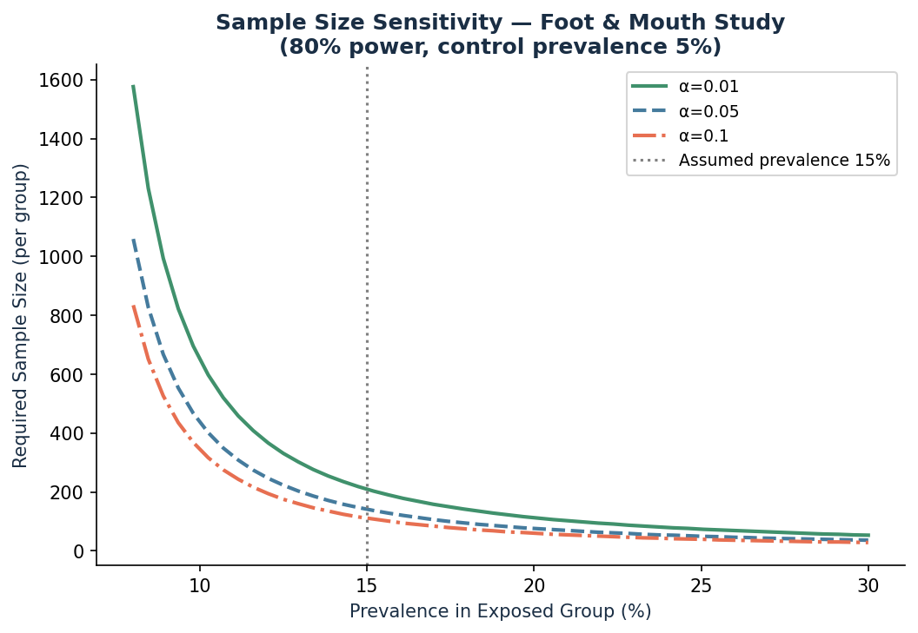
Sample Size Determination — Foot & Mouth Disease Study
How large a study is needed to detect a meaningful difference in prevalence?
Study Parameters
Control prevalence
5%
Assumed exposed prevalence
15%
Statistical power
80%
Required n per group (α=0.05)
141
Key Takeaways
At α = 0.05 and 80% power, a minimum of 141 animals per group are required.
As the exposed prevalence increases (larger effect), the required sample size drops sharply.
Stricter significance thresholds (α = 0.01) demand ~50% more animals per group.
These estimates assume simple random sampling — clustering or stratification would change results.
National Parks Biodiversity Analysis | bioparks.csv & species_info.csv

Slide 9
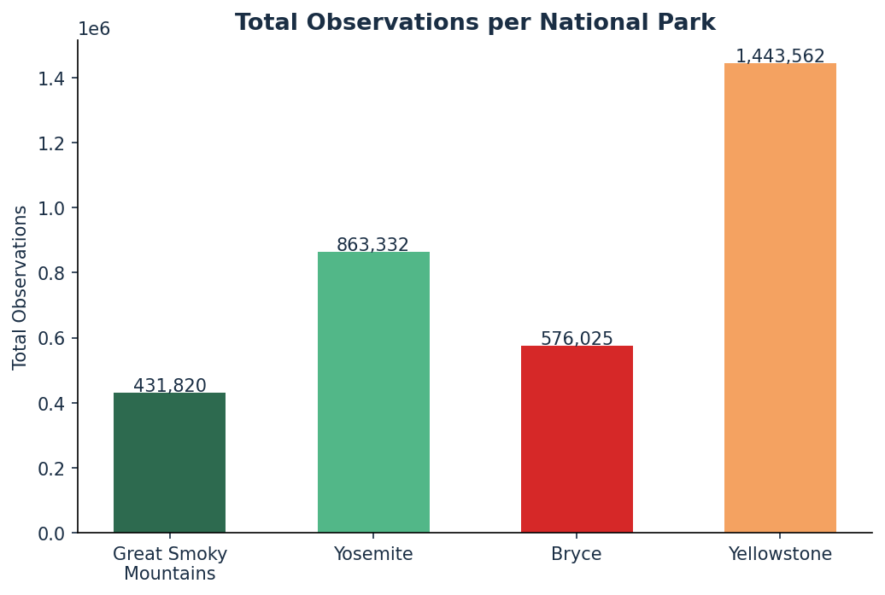
Observations by National Park
Yellowstone dominates total wildlife sightings across all species
Park Highlights
Yellowstone
Highest total observations — likely driven by visitor volume and park size (2.2M acres).
Yosemite
Strong second — diverse habitats from valley floor to alpine support broad species variety.
Great Smoky
Highest species diversity in the eastern US despite lower observation totals.
Bryce Canyon
Smallest park; unique high-desert ecosystem with distinct endemic species.
National Parks Biodiversity Analysis | bioparks.csv & species_info.csv

Slide 10
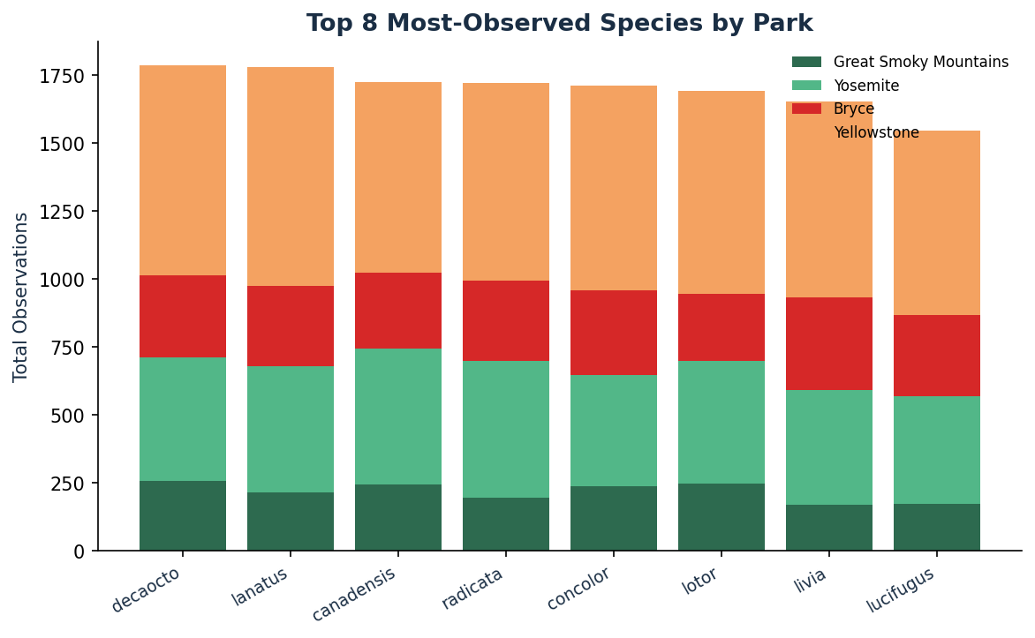
Most-Observed Species Across All Parks
Invasive species dominate the top 8 — a critical conservation signal
⚠ All top-8 most-observed species are non-native or invasive: collared doves, feral pigeons, velvet grass, and catsear out-compete native species for habitat and resources.
National Parks Biodiversity Analysis | bioparks.csv & species_info.csv

Slide 11
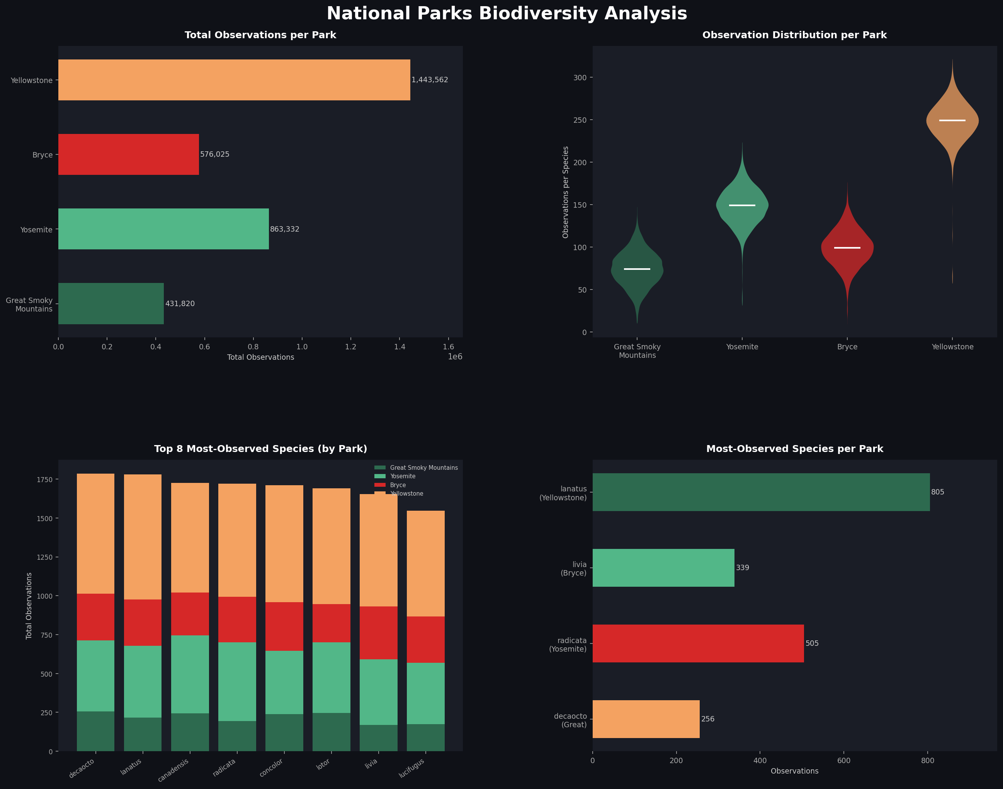
Full Biodiversity Dashboard
Four-panel view: totals, distributions, species breakdown, and park leaders
National Parks Biodiversity Analysis | bioparks.csv & species_info.csv

Slide 12
Key Findings & Takeaways
What the data tells us about biodiversity and conservation risk
Invasive species dominate
The #1 most-observed species in every park is non-native, signalling potential displacement of native biodiversity.
Birds & Mammals most at risk
Chi-square confirmed (p<0.001): these categories are significantly over-represented in endangered listings relative to their population share.
Observer bias shapes the data
High-observation parks reflect visitor volume as much as biodiversity richness. Normalised per-hectare metrics are needed for fair comparisons.
Amphibians are a warning sign
At 9.9% endangered rate, amphibians — sensitive ecosystem indicators — should trigger proactive habitat monitoring.
Data enrichment would unlock more
Adding nativity flags, IUCN status, temporal data, and taxonomic depth would enable predictive modelling and earlier risk detection.
National Parks Biodiversity Analysis | bioparks.csv & species_info.csv

Slide 13
Thank You
Protecting biodiversity starts with understanding it.
Data Sources: bioparks.csv | species_info.csv | 4 US National Parks Methods: Chi-Square Test (scipy.stats) | Power Analysis | Matplotlib / Seaborn Report: Full written analysis available in bioparks_report.docx
National Parks Biodiversity Analysis | 2024

