Slide 1
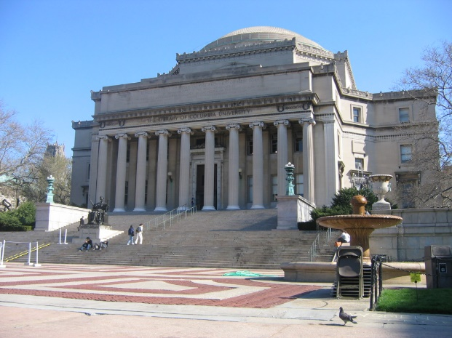
Report The Battle of the Neighborhoods
Universities & Colleges in Manhattan, New York City

Slide 2
Business Problem
In New York City, there are a large number of prestigious universities. In this work, we will focus on finding a location that is free of universities and academies to establish a business based on education. Despite the fact that there are a large number of prestigious schools, a study can be made to see if there is any location where there is more business opportunity

Slide 3
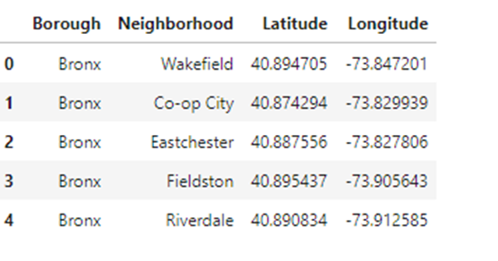
Latitude & Longitude of the head

Slide 4
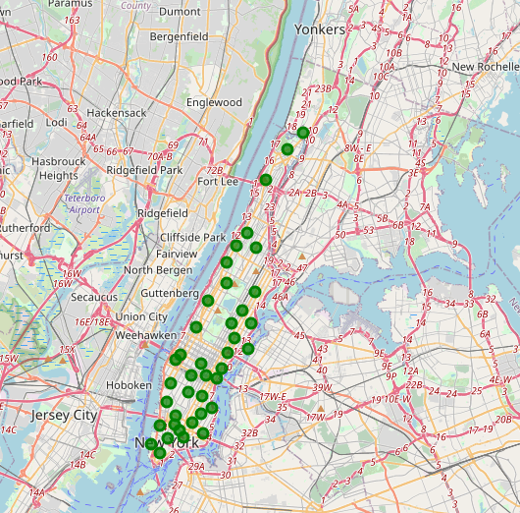
Map of Neighbors in Manhattan

Slide 5
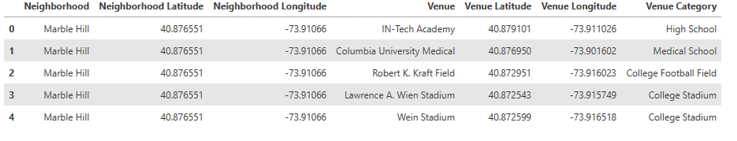
List of Universities & Schools per Neighbors

Slide 6
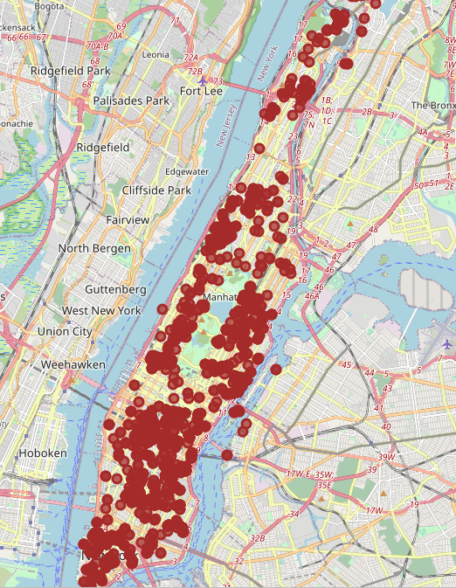
Map of the Universities & Schools in Manhattan

Slide 7
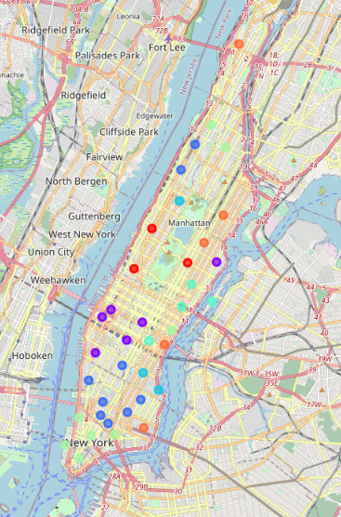
Map of the cluster with the Universities & Schools in Mahattan

Slide 8
CONCLUSION
According with the analyzed data, the best areas of Manhattan for setting up a business are Washington Heights and East Harlem. Moreover, the worse areas are low town and mid-town. In addition, West Harlem is not recommended; in this area are two main Universities: Columbia University and NYU University.
Even though there are many Colleges and Universities, we were able to find the best spot for setting up a business in the educational system. This work could be improved if we aim the study to a specific business such us a High School, Academia, Law School, etc.

