Slide 1



Snakemake Trainning 2025
Juan Leite

Slide 2
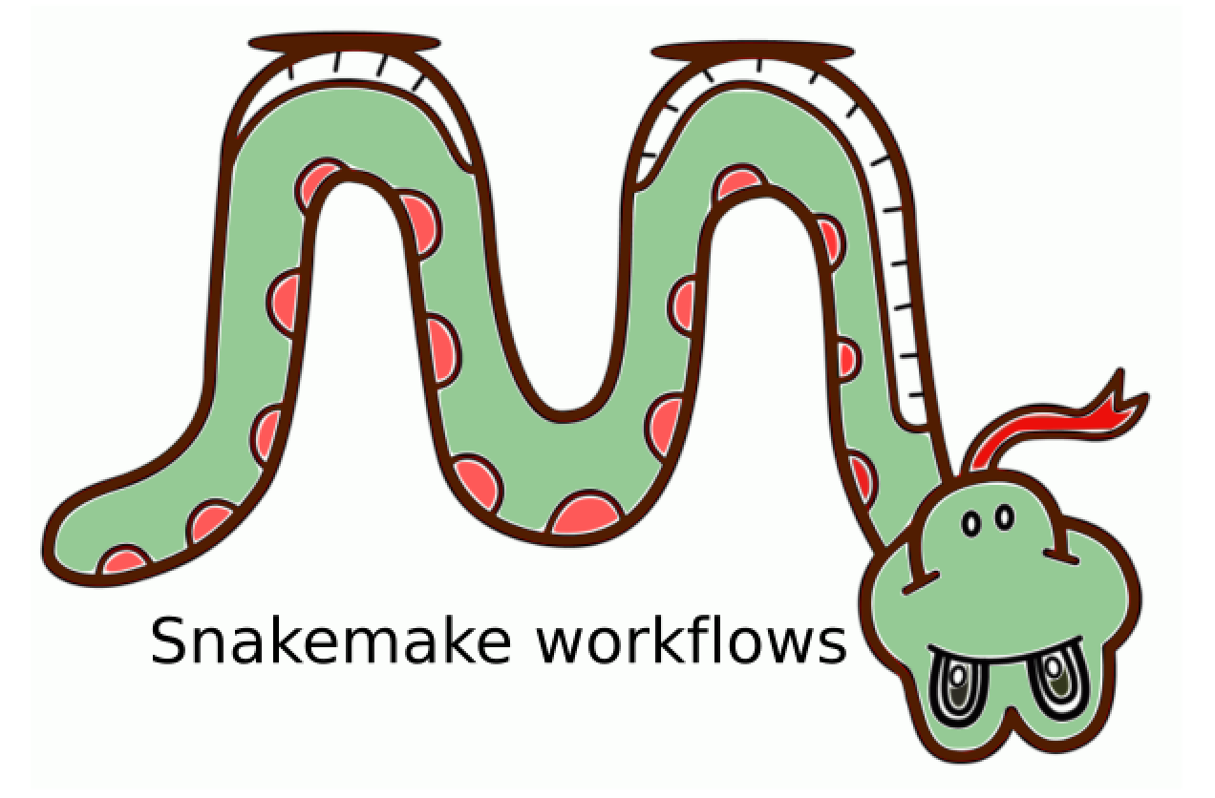
Introducing Snakemake Tool
Reproducible Data Analysis
Snakemake ensures that data analysis processes are easy to reproduce and share, improving research collaboration and reliability.
Python-Based Rule Definition
Users define rules, steps, and dependencies with a straightforward Python-based language, making pipeline creation accessible and flexible.
Automation and Scalability
Snakemake automates complex analysis tasks and scales efficiently across different computing platforms and research environments.
Notes:
Image source: Microsoft 365 content library Snakemake is a workflow management system designed for reproducible data analysis. It uses a Python-based language to define rules and dependencies, making pipeline creation straightforward. The tool automates complex processes, ensures scalability across platforms, and helps researchers organise, track, and share their computational workflows efficiently.

Slide 3
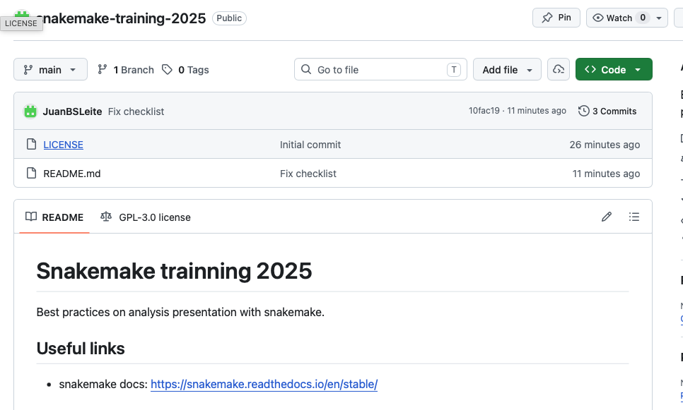
Github
Useful links, Checklist, Slides, Notebooks and Exercises are available at the link below:
- Git hub: https://github.com/JuanBSLeite/snakemake-training-2025#
Notes:
Image source: Microsoft 365 content library Snakemake is a workflow management system designed for reproducible data analysis. It uses a Python-based language to define rules and dependencies, making pipeline creation straightforward. The tool automates complex processes, ensures scalability across platforms, and helps researchers organise, track, and share their computational workflows efficiently.

Slide 4
Basics: An example workflow
Workdir:
Snakefile
rule plotHistogram:
input:
“data/file1.root”,
output:
“plot/file1.png”,
shell:
“python plot.py {input} {output}”
A Snakemake workflow is defined by specifying rules in a Snakefile. Rules decompose the workflow into small steps (for example, the application of a single tool) by specifying how to create sets of output files from sets of input files. Snakemake automatically determines the dependencies between the rules by matching file names.
The input and output directives are followed by lists of files that are expected to be used or created by the rule.
$ snakemake -c1 plotHistogram
The shell directive is followed by a string containing the shell command to execute.
-c is the number of jobs
Notes:
Image source: Microsoft 365 content library Snakemake is a workflow management system designed for reproducible data analysis. It uses a Python-based language to define rules and dependencies, making pipeline creation straightforward. The tool automates complex processes, ensures scalability across platforms, and helps researchers organise, track, and share their computational workflows efficiently.

Slide 5
Generalizing rules
Workdir:
Snakefile
Snakemake allows generalizing rules through the use of named wildcards.
Let’s replace file1 by the wildcard sample in the input and output.
rule plotHistogram:
input:
“data/{sample}.root”,
output:
“plot/{sample}.png”,
shell:
“python plot.py {input} {output}”
Note:
You can have multiple wildcards in your output and input file paths. However, to avoid conflicts with other jobs of the same rule, all output files of a rule have to contain exactly the same wildcards.
$ snakemake -c1 plot/file1.png
When Snakemake determines that this rule can be applied to generate a target file, it will propagate that value to all occurrences of the {sample} wildcard in that rule, thereby determining the necessary input files for the resulting job.
Notes:
Image source: Microsoft 365 content library Snakemake is a workflow management system designed for reproducible data analysis. It uses a Python-based language to define rules and dependencies, making pipeline creation straightforward. The tool automates complex processes, ensures scalability across platforms, and helps researchers organise, track, and share their computational workflows efficiently.

Slide 6
Aggregating Inputs
Workdir:
Snakefile
Snakemake provides a helper function for collecting input files that helps us to describe aggregations.
samples = ["file1", "file2"]
rule all:
input:
expand("plot/{sample}.png", sample=samples)
rule plotHistogram:
input:
"data/{sample}.root"
output:
"plot/{sample}.png"
shell:
"python plot.py {input} {output}"
rule all is the top-level rule.
expand() is a helper function that generates a list of filenames from a pattern.
$ snakemake -c1 all
Notes:
Image source: Microsoft 365 content library Snakemake is a workflow management system designed for reproducible data analysis. It uses a Python-based language to define rules and dependencies, making pipeline creation straightforward. The tool automates complex processes, ensures scalability across platforms, and helps researchers organise, track, and share their computational workflows efficiently.

Slide 7
Aggregating Inputs II
Workdir:
Snakefile
samples = ["file1", "file2"]
exts = [“root”, “png”]
rule all:
input:
expand("plot/{sample}.{ext}", zip, sample=samples, ext=exts)
rule plotHistogram:
input:
"data/{sample}.root"
output:
"plot/{sample}.{ext}"
shell:
"python plot.py {input} {output}"
It is also possible to expand multiple wildcards.
zip pair elements together position-by-position.
[
“plot/file1.root”,
“plot/ file1.png”,
“plot/ file2.root”,
“plot/ file2.png”,
]
$ snakemake -c1 all
Notes:
Image source: Microsoft 365 content library Snakemake is a workflow management system designed for reproducible data analysis. It uses a Python-based language to define rules and dependencies, making pipeline creation straightforward. The tool automates complex processes, ensures scalability across platforms, and helps researchers organise, track, and share their computational workflows efficiently.

Slide 8
Aggregating Inputs III
Workdir:
Snakefile
We can also build complex output patterns using for loops:
rule all:
input:
output
rule plotHistogram:
input:
"data/{sample}.root"
output:
"plot/{sample}.{ext}"
shell:
"python plot.py {input} {output}"
samples = ["file1", "file2"]
exts = [“root”, “png”]
output = list()
for sample in samples:
for ext in exts:
output.expand(f“plot/{sample}.{ext}”)
$ snakemake -c1 all
Notes:
Image source: Microsoft 365 content library Snakemake is a workflow management system designed for reproducible data analysis. It uses a Python-based language to define rules and dependencies, making pipeline creation straightforward. The tool automates complex processes, ensures scalability across platforms, and helps researchers organise, track, and share their computational workflows efficiently.

Slide 9
Using custom scripts
rule all:
input:
output
rule plotHistogram:
input:
"data/{sample}.root"
output:
"plot/{sample}.{ext}"
script:
"plot.py"
Snakemake offers the script directive. It is best practice to use the script directive whenever an inline code block would have more than a few lines of code.
Workdir:
In the script, all properties of the rule like input, output, wildcards, etc. are available as attributes of a global snakemake object.
Snakefile
samples = ["file1", "file2"]
exts = [“root”, “png”]
output = list()
for sample in samples:
for ext in exts:
output.expand(f“plot/{sample}.{ext}”)
plot.py
file = read(“{snakemake.input[0]}/DecayTree”)
…
output = write(“{snakemake.output[0]}”)
$ snakemake -c1 all
Notes:
Image source: Microsoft 365 content library Snakemake is a workflow management system designed for reproducible data analysis. It uses a Python-based language to define rules and dependencies, making pipeline creation straightforward. The tool automates complex processes, ensures scalability across platforms, and helps researchers organise, track, and share their computational workflows efficiently.

Slide 10
Rules chain
rule all:
input:
expand("plot/{sample}.{ext}", zip, sample=samples, ext=exts)
rule selection:
input:
“data/{sample}.root”
output:
“data/{sample}_sel.root”
script:
“apply_sel.py”
rule plotHistogram:
input:
selection.output
output:
"plot/{sample}.{ext}"
script:
"plot.py"
Snakemake offers the possibility of rules chains.
Workdir:
Snakefile
samples = ["file1", "file2"]
exts = [“root”, “png”]
output = list()
for sample in samples:
for ext in exts:
output.expand(f“plot/{sample}.{ext}”)
$ snakemake -c1 all
Notes:
Image source: Microsoft 365 content library Snakemake is a workflow management system designed for reproducible data analysis. It uses a Python-based language to define rules and dependencies, making pipeline creation straightforward. The tool automates complex processes, ensures scalability across platforms, and helps researchers organise, track, and share their computational workflows efficiently.

Slide 11
Listing outputs
Parallelizing tasks
Rule outputs can be listed on shell by using the --summary option or –dry-run.
Tasks can be parallelized by setting the number of workers (-c).
$ snakemake -c1 all --summary
or
$ snakemake -c1 all --dry-run
$ snakemake –c4 all
The previous command run all the 4 tasks and produce the outpus in parallel.
“plot/file1.root”
“plot/ file1.png”
“plot/ file2.root”
“plot/ file2.png”
Notes:
Image source: Microsoft 365 content library Snakemake is a workflow management system designed for reproducible data analysis. It uses a Python-based language to define rules and dependencies, making pipeline creation straightforward. The tool automates complex processes, ensures scalability across platforms, and helps researchers organise, track, and share their computational workflows efficiently.

Slide 12
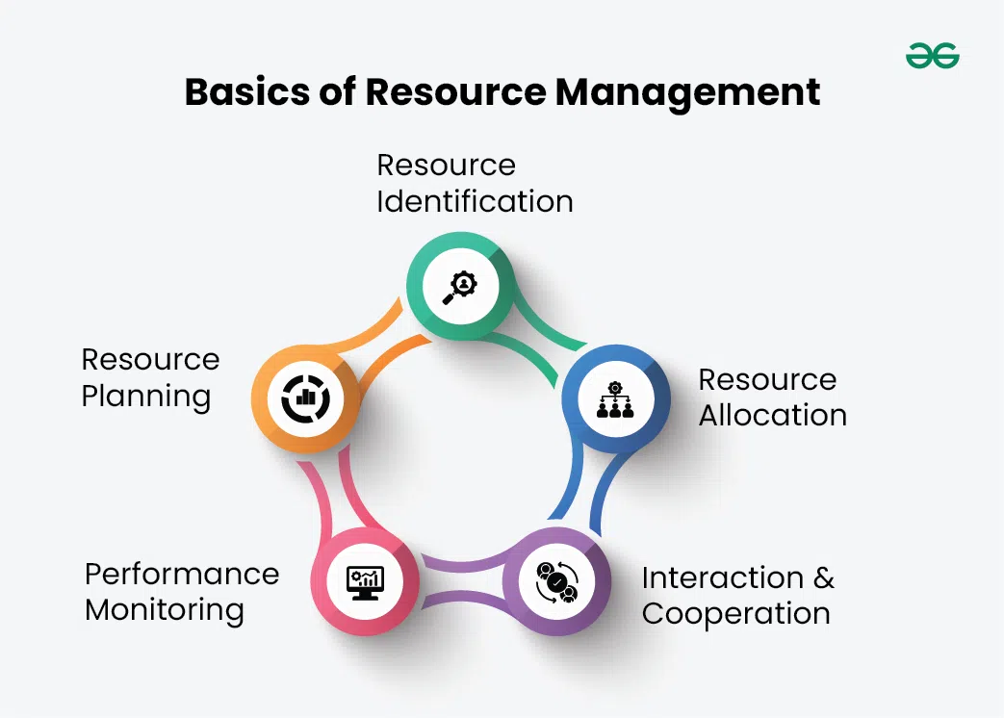
Resource management
Resource management in Snakemake is about controlling how much CPU, memory, and time each rule is allowed to use, so workflows run efficiently on laptops, clusters, or HPC systems.
Snakefile
rule plotHistogram:
input:
"data/{sample}.root"
output:
"plot/{sample}.png"
threads: 2
resources:
mem_mb=2000
runtime=10
threads=4
shell:
"python plot.py {input} {output}"
What each field means?
threads
How many CPU cores the rule can use.
Then you run Snakemake like
$snakemake -j 8
Snakemake will schedule jobs so total threads ≤ 8.
mem_mb
maximum memory per job
runtime
maximum job time.
Notes:
Image source: Microsoft 365 content library Snakemake is a workflow management system designed for reproducible data analysis. It uses a Python-based language to define rules and dependencies, making pipeline creation straightforward. The tool automates complex processes, ensures scalability across platforms, and helps researchers organise, track, and share their computational workflows efficiently.

Slide 13

Environment setting with Conda
Using Conda with Snakemake is one of its most powerful features because it lets each rule run in its own isolated environment.
$ snakemake --use-conda -j 4
Snakemake & Anaconda
Snakefile
envs/plot.yaml
rule plotHistogram:
input:
"data/{sample}.root"
output:
"plot/{sample}.png"
threads: 2
conda:
“envs/plot.yaml”
shell:
"python plot.py {input} {output}"
name: plot-env
channels:
- conda-forge
- defaults
dependencies:
- python=3.10
- matplotlib
- numpy
- uproot
This ensures:
reproducible Python version
correct packages
no system conflicts
Notes:
Image source: Microsoft 365 content library Snakemake is a workflow management system designed for reproducible data analysis. It uses a Python-based language to define rules and dependencies, making pipeline creation straightforward. The tool automates complex processes, ensures scalability across platforms, and helps researchers organise, track, and share their computational workflows efficiently.

Slide 14
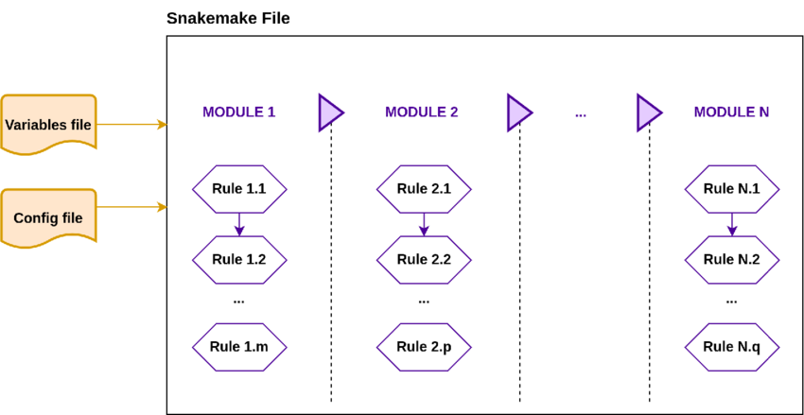
Modularization
Modularisation in Snakemake means splitting a large workflow into smaller reusable files (modules) instead of keeping everything in one huge snakefile.
Basic idea: Instead of one big snakefile, you split into:
Usage:
workflow/
Snakefile
rules/
plotting.smk
envs/
scripts/
module mapping:
snakefile:
"rules/plot.smk"
Then use exported rules:
use rule * from plot
use rule plotHistogram from plot
Notes:
Image source: Microsoft 365 content library Snakemake is a workflow management system designed for reproducible data analysis. It uses a Python-based language to define rules and dependencies, making pipeline creation straightforward. The tool automates complex processes, ensures scalability across platforms, and helps researchers organise, track, and share their computational workflows efficiently.

Slide 15
Config files
In Snakemake, config files are used to separate parameters and settings from the workflow logic.
Instead of hardcoding values in your Snakefile (like sample names, file paths, thresholds), you put them in a YAML or JSON config file.
Accessing config values
config["samples"]
config["outdir"]
config.yaml
Snakefile
samples:
- file1
- file2
threshold: 0.05
outdir: plot/
configfile: "config.yaml"
rule all:
input:
expand("{outdir}{sample}.png",
sample=config["samples"],
outdir=config["outdir"])
Overriding config from command line
$snakemake --config outdir=new_plots
Notes:
Image source: Microsoft 365 content library Snakemake is a workflow management system designed for reproducible data analysis. It uses a Python-based language to define rules and dependencies, making pipeline creation straightforward. The tool automates complex processes, ensures scalability across platforms, and helps researchers organise, track, and share their computational workflows efficiently.

Slide 16

That’s enough to start with the snake way.
Thanks!
Notes:
Image source: Microsoft 365 content library Snakemake is a workflow management system designed for reproducible data analysis. It uses a Python-based language to define rules and dependencies, making pipeline creation straightforward. The tool automates complex processes, ensures scalability across platforms, and helps researchers organise, track, and share their computational workflows efficiently.

