Slide 1
Movie Data Analysis Presentation
Data visualization and interpretation from movies_data.csv Juan Barrera

Slide 2
Overview of movies_data.csv
The CSV file contains information about 10 movies, including:
- Movie Title
- Genre
- Release Year
- IMDb Rating
- Box Office Earnings ($M)
This dataset was created in Python using pandas and saved as movies_data.csv.

Slide 3
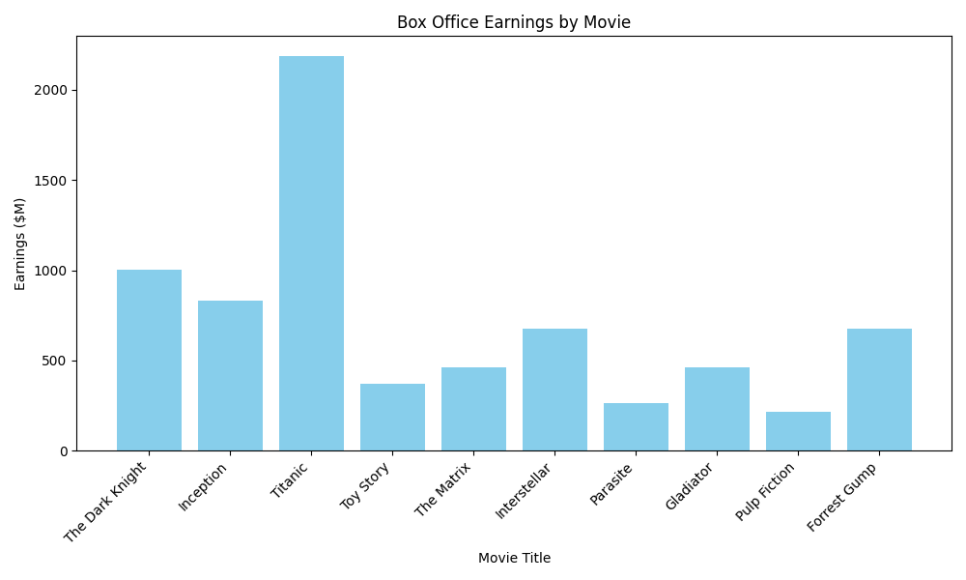
Box Office Earnings by Movie
This bar chart shows the total box office earnings for each movie.
- Titanic is the top earner with over $2 billion.
- The Dark Knight, Inception, Forrest Gump and Interstellar also earned over $600 million.
- Parasite and Pulp Fiction are the lowest earners in this dataset.

Slide 4
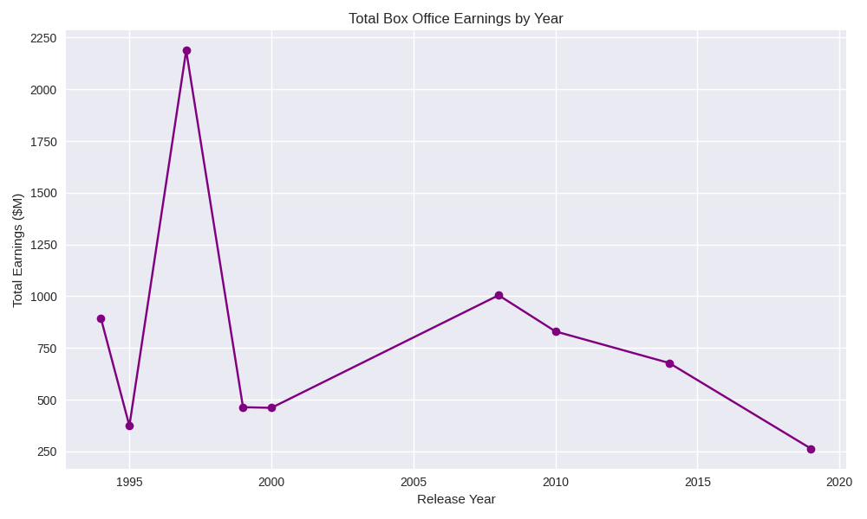
Total Box Office Earnings by Year
This line graph aggregates total box office earnings per release year.
- The 1997 spike corresponds to Titanic’s massive earnings.
- 1994 also has a high combined total due to Forrest Gump and Pulp Fiction.
- More recent films (2014–2019) show a downward trend in total earnings.

Slide 5
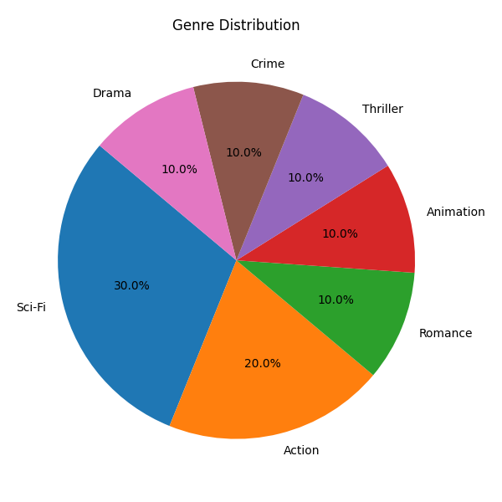
Genre Distribution
This pie chart shows the proportion of movie genres in the dataset.
- Sci-Fi dominates with 30% (3 movies).
- Action follows with 20% (2 movies).
- Other genres (Romance, Animation, Thriller, Crime, Drama) each represent 10%.

Slide 6
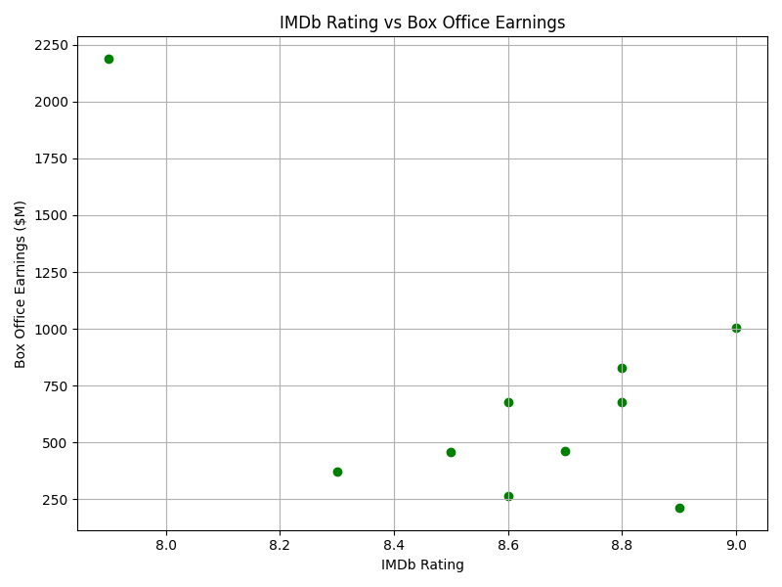
IMDb Rating vs Box Office Earnings
This scatter plot compares IMDb ratings and box office earnings.
- Titanic (7.9 rating, $2.18B) is an outlier, showing that a lower rating can still yield high revenue.
- Most movies cluster between 8.5–9.0 ratings and $400M–$1000M earnings.
- There is no direct correlation between rating and earnings in this small dataset.

Slide 7
Summary and Insights
- The dataset includes high-grossing and critically acclaimed films.
- Genre diversity is balanced, though Sci-Fi is most common.
- Titanic’s success skews overall box office trends.
- IMDb ratings do not strongly predict earnings in this dataset.
This analysis demonstrates how pandas and matplotlib can be used to explore and visualize movie data.

