Slide 1
Trackeo Business Pitch
By Juan Barrera

Slide 2
Introduction
Trackeo is a data-driven athlete management platform designed to improve organization, visibility, and recruitment opportunities for athletes across South America.
This presentation highlights key insights from post-survey analysis showing the measurable impact of Trackeo on athlete experience and market potential.

Slide 3
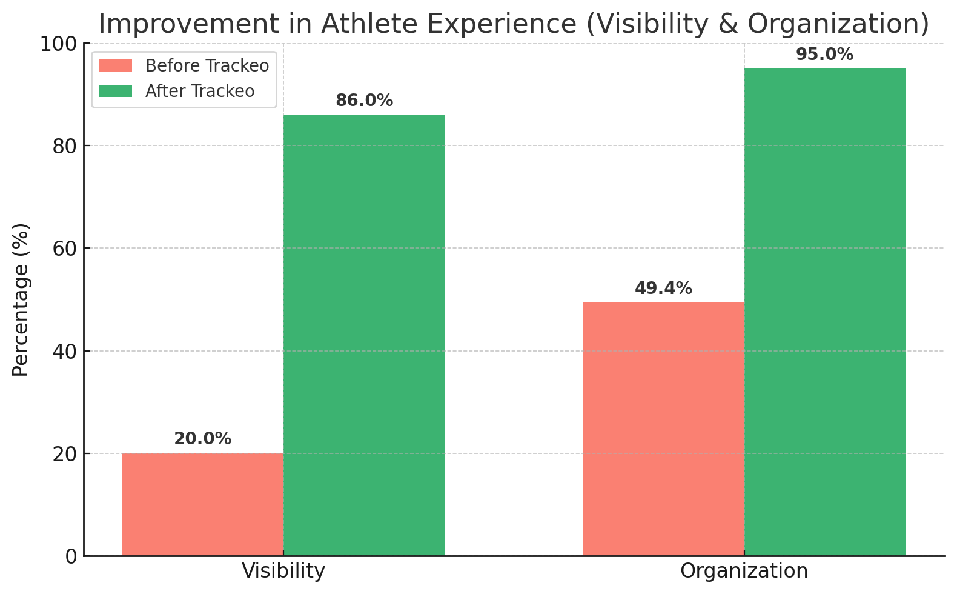
Graph 1: Improvement in Athlete Experience
This graph demonstrates a significant improvement in both visibility and organization after implementing Trackeo. Visibility rose from 20% to 86%, while organization increased from 49.4% to 95%. These results validate Trackeo’s effectiveness in streamlining athlete data and boosting exposure.

Slide 4
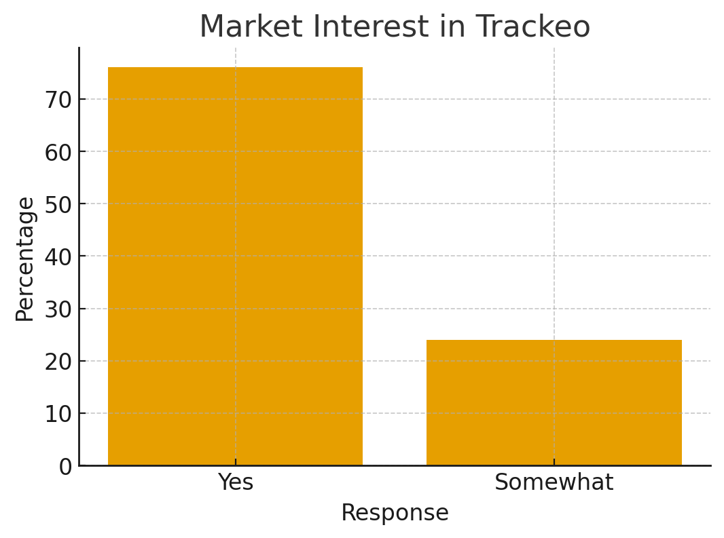
Graph 2: Market Interest in Trackeo
The majority of respondents (76%) expressed strong interest in Trackeo, while 24% showed partial interest. This overwhelming positive response indicates high demand and readiness for adoption ammarketong South American athletes.

Slide 5
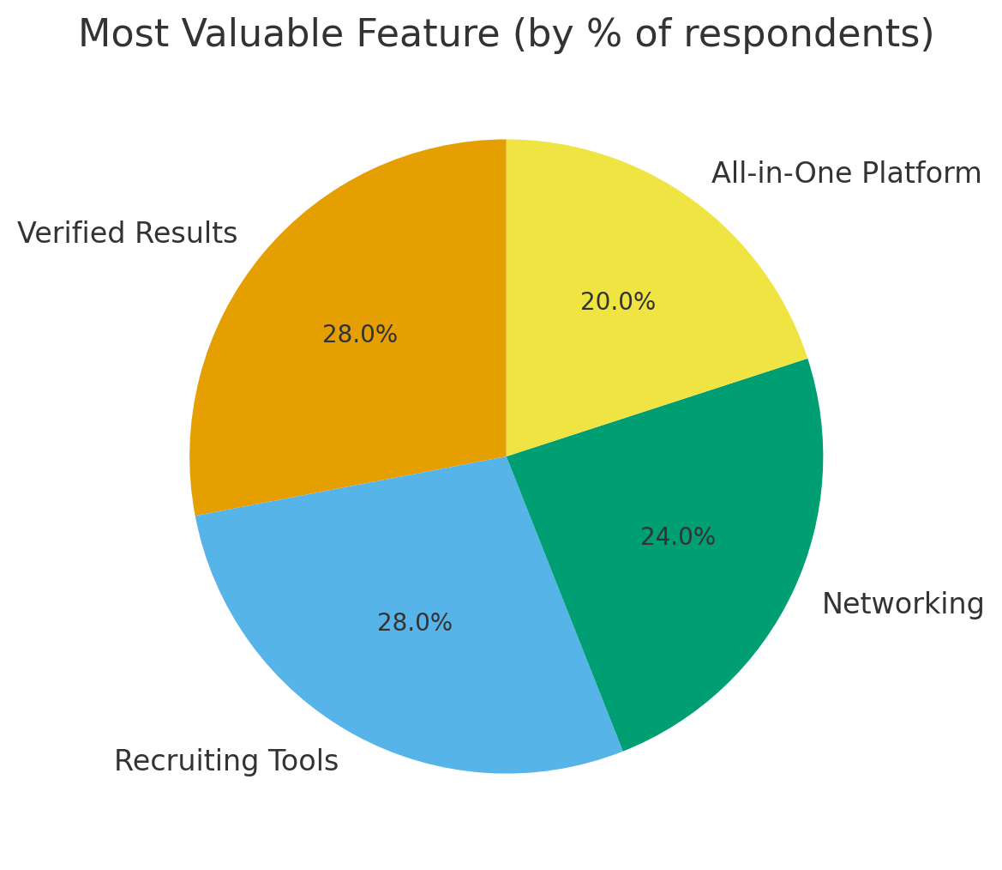
Graph 3: Most Valuable Feature
Respondents identified Verified Results and Recruiting Tools as the top two most valuable features (28% each). These findings align perfectly with Trackeo’s core mission to provide credibility and support athlete visibility for recruiters.

Slide 6
Conclusion
The data confirms Trackeo’s ability to transform athlete management through improved visibility, organization, and verified performance tracking.
Trackeo stands out as a scalable and high-impact solution with strong market interest and measurable results, positioning it as the future of sports data management in South America.

Slide 7
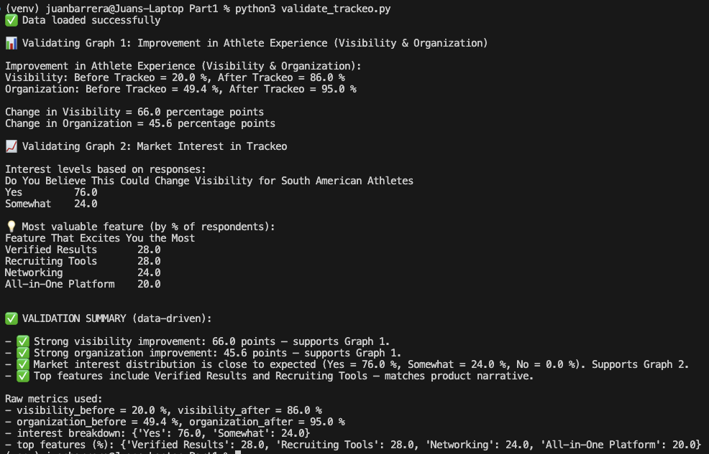
Data Validation Output (Python Analysis)

Slide 8
Datasets Used for Analysis
The analysis was performed using a dataset containing detailed BMW car sales information. This dataset provided the foundation for the Python-based validation and output displayed in this presentation. • BMW_Car_Sales_Classification.csv — Contains information on various BMW models, including year, region, fuel type, transmission, engine size, mileage, price, and sales volume.
The dataset was processed and analyzed in Python to review data statistics, verify structure, and perform multiple searches such as filtering cars by year, price range, model name, region, and mileage. These results demonstrate the ability to extract meaningful insights from real-world car sales data.

Slide 9
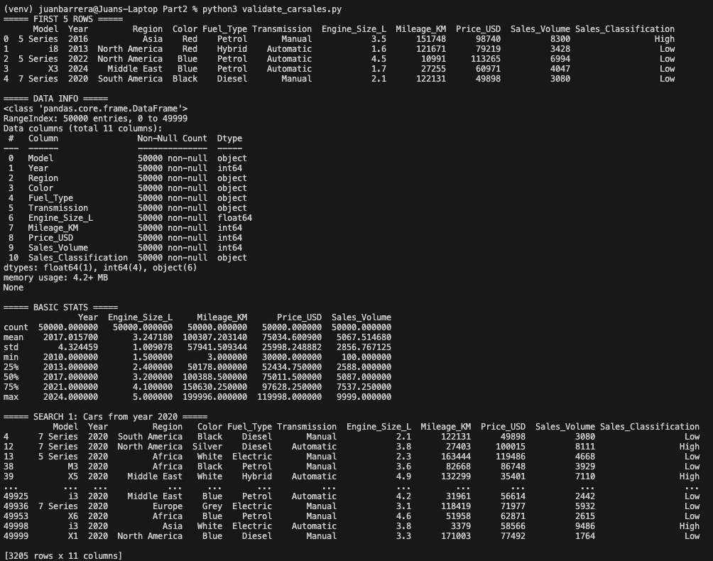
Python Validation Output (Part 2 – Data Analysis)

Slide 10
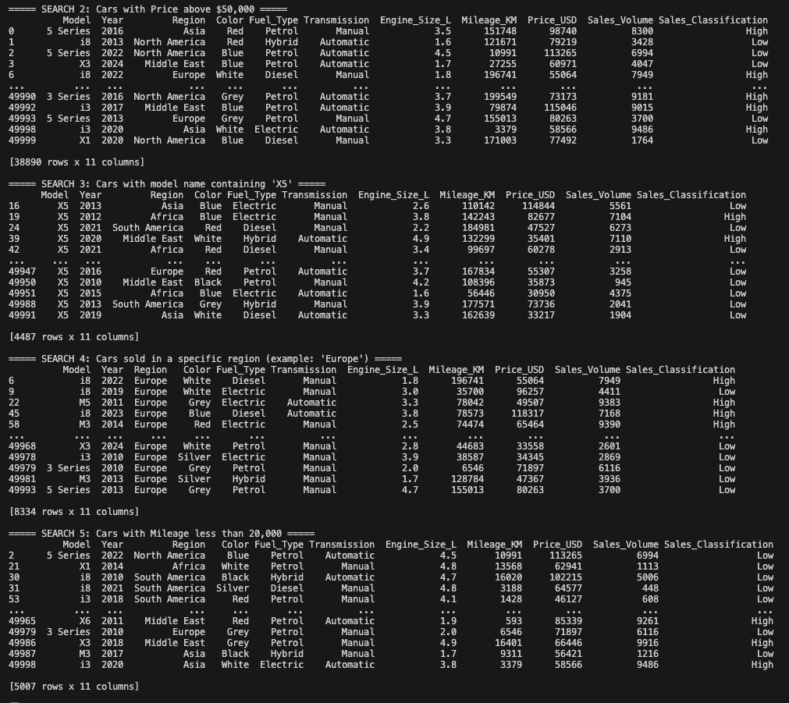
Python Output Results (Console Display)

Slide 11
Link to Github with all files https://github.com/JuanBarrera0305/Data-Analysis-and-visualization/tree/main/Week6/Assignment3

