Slide 1

Final Presentation
Intro To AI
Professor Mark Voortman
Juan Barrera

Slide 2

Problem I will be solving
In this project I will be addressing the challenge of automating and optimizing the structure of a track and field sprint event by solving several interconnected problems: ensuring fair and balanced preliminary heat assignments, preventing lane bias, determining qualifiers accurately and consistently from prelims to semifinals, assigning lanes in a constraint respecting and competition appropriate manner, handling uncertainty in athlete performance, and planning the final race configuration through a structured decision making model. Together, these problems represent a real world scenario where search algorithms, logical inference, constraint satisfaction, probabilistic reasoning, and planning must work in combination to produce a fair, explainable, and data driven competition layout.

Slide 3
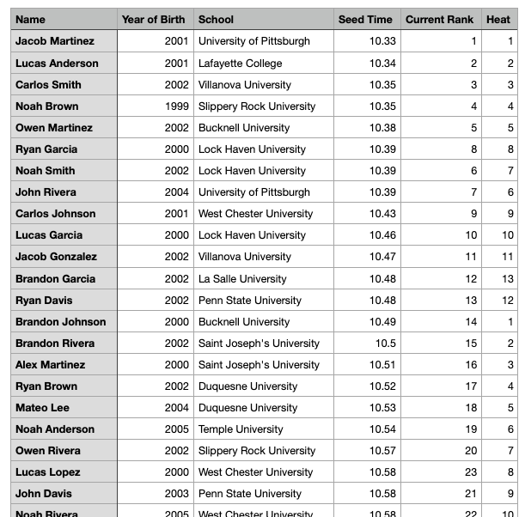
Step 1- The Data
This dataset represents the initial list of athletes entered in the 100-meter event, including their personal information and competitive metrics used for heat assignments. Each athlete is identified by name, year of birth, school affiliation, and an official seed time, which reflects their prior performance and determines their projected competitiveness. The “Current Rank” column orders athletes from fastest to slowest based on seed time, and the “Heat” column assigns them to preliminary heats using a round-robin method before any AI optimization is applied. This raw dataset serves as the foundation for the entire project, providing the input needed for local search algorithms, adversarial search, logical inference, CSP based lane assignments, and probabilistic modeling throughout the race planning pipeline.

Slide 4
Explanation
This code processes the initial athlete dataset (Entries.csv) and generates the first version of preliminary heat assignments using a combination of sorting, structured distribution, and optimization. After loading the data and cleaning column formatting, athletes are sorted by their Current Rank so the fastest competitors appear first; this ordering is critical for ensuring fair heat distribution. Heats are then assigned in a round robin fashion cycling through 13 heats so that athletes are spread evenly rather than clustered by speed. Within each heat, lanes are initially assigned randomly to avoid bias and create a diverse starting configuration. The core of the algorithm is a hill climbing optimization step that iteratively improves fairness by swapping lanes between athletes whenever the swap increases the heat’s fairness score, which is calculated using a lane preference model that rewards central lanes and penalizes edge placements. This iterative process continues until no further improvement is possible, producing a locally optimal arrangement of lanes within each heat. Finally, the heats and lanes are sorted for readability and exported as Heats_hillclimb.csv, which becomes the foundation for subsequent AI steps in the project.

Slide 5
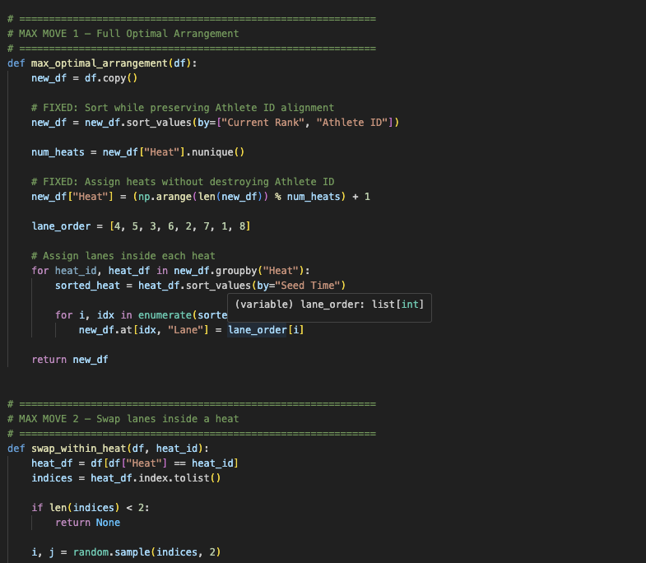
Step 2 – Alpha Beta
This code applies an adversarial search framework to improve the preliminary heat assignments created in Step 1, treating heat optimization as a competitive decision making problem. After loading and cleaning the hill-climb–generated schedule, the system evaluates fairness by rewarding athletes placed in desirable central lanes and penalizing heats with low school diversity. Three different “MAX moves” represent strategic ways to improve the schedule: (1) generating a full optimal arrangement based on rank and preferred lane order, (2) swapping lanes between athletes within the same heat, and (3) swapping athletes across different heats. These moves act as the maximizing player, attempting to create the fairest configuration possible. The “MIN player,” implemented as a simple judge function, evaluates the schedule and returns the fairness score, representing the worst case scenario in adversarial reasoning. The hybrid alpha–beta pruning algorithm recursively explores these move options up to a specified depth, pruning branches that cannot produce better results than already evaluated ones. This dramatically reduces computation while guaranteeing optimal decisions under adversarial assumptions. At the end, the best schedule found is sorted by heat and lane and saved as Heats_alpha_beta.csv, representing a more strategically robust heat arrangement than the initial hill-climbed version.

Slide 6
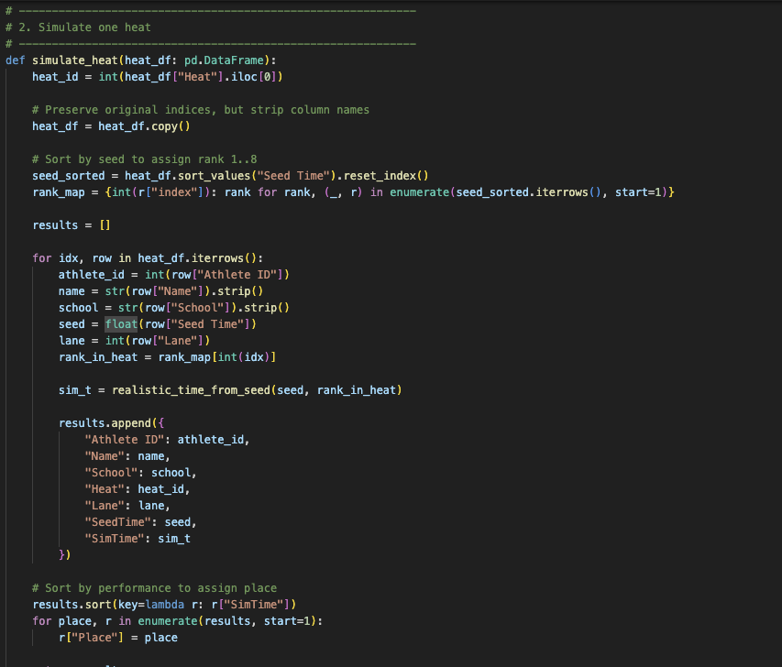
Step 3 Planning & Acting in the Real World
This step uses a realistic simulation model to generate preliminary race results from the heat assignments produced in Step 2. The script begins by loading Heats_alpha_beta.csv and then applies a rank-aware sprint performance model that mimics NCAA level variability. Each athlete’s simulated time is computed using their seed time, an estimate of their expected placement within the heat, and several probabilistic behaviors such as rare meltdowns, breakout personal records, and performance adjustments based on whether they are elite, mid-level, or developing sprinters. These conditional probability rules create a realistic distribution of race outcomes while preserving the identity and attributes of each athlete. The script then simulates each heat independently, assigning lane-neutral outcomes based solely on performance, and ranks athletes by their simulated time to determine their place within the heat. Importantly, this step does not select qualifiers; it only produces performance data, which is exported as resultsprelims.csv for use in later logic-based and inference-based qualification stages. Overall, this step serves as a planning-based forward model that predicts how the prelims “should” unfold under realistic uncertainty, forming the foundation for downstream reasoning in Steps 4–8.

Slide 7
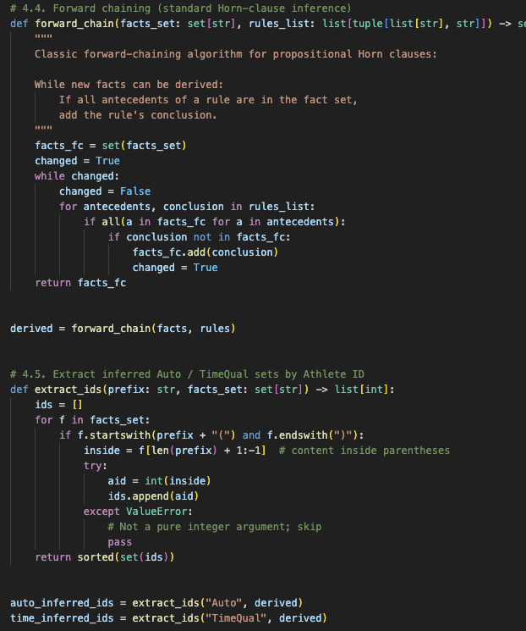
Step 4 - CSP + Logical Inference System for Selecting Finalists
This step takes the simulated prelim results and applies a formal decision-making process combining Constraint Satisfaction and Horn-clause inference to determine the 32 athletes who advance to the semifinals. The script first loads resultsprelims.csv and identifies the top two finishers in each heat, assigning them as automatic qualifiers, which are forced constraints in the CSP. All remaining athletes form a pool from which exactly six additional qualifiers must be selected based strictly on the fastest simulated times, using tie breakers on SeedTime and Athlete ID to maintain determinism. Together, the Auto + Time qualifiers must total exactly 32, and this condition is enforced through CSP variable assignments of Qualify[a] ∈ {0,1}. Once the CSP determines the Auto and Time qualifiers, the script constructs a qualification table and exports Semifinals_Qualifiers_from_sim.csv. To validate the logical correctness of the CSP solution, the program then builds a set of Horn-clause rules and ground facts encoding performance data (Place, SimTime) and CSP decisions (CSPAuto, CSPTime). A forward-chaining algorithm derives new logical facts (Auto(a), TimeQual(a), Qualifies(a)), and the system checks that these inferred sets exactly match the CSP output. When both chapters agree, the qualification process is verified as logically sound and complete. This step ensures that semifinal qualifiers are selected in a formal, explainable, and constraint-consistent manner.

Slide 8
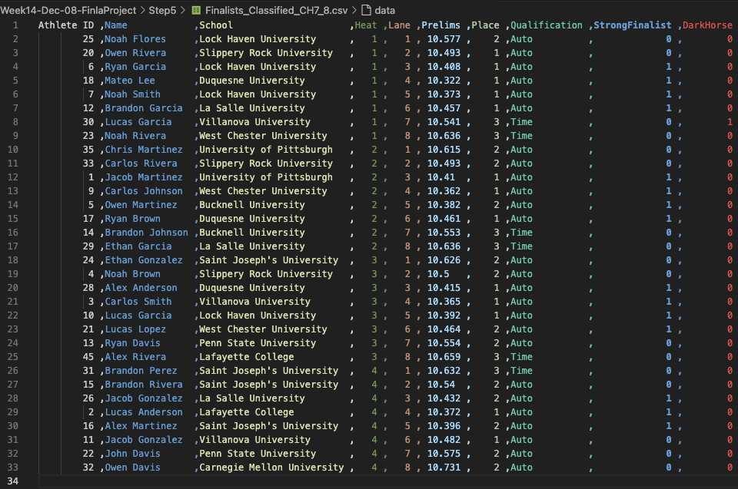
Step 5 - Logical Agents & First-Order Inference System
In this step, the project shifts from numerical simulation to symbolic reasoning, using Chapters 7 and 8 to treat semifinalists as entities inside a logical agent’s knowledge base. The script loads the semifinal heat assignments and converts every attribute athlete identity, school, heat, lane, seed time, place, and qualification type into first-order facts such as SeedTime(a,t), LaneOf(a,l), AutoQualCSV(a), and TimeQualCSV(a). With this fact base established, the system applies a set of Horn-clause axioms that define how new knowledge should be inferred. For example, Auto qualifiers from the CSV automatically entail AutoQual(a) and Qualifies(a), athletes with seed times under 10.50 entail FastSeed(a), central lanes entail LaneAdv(a), and combinations of these facts produce higher level classifications such as StrongFinalist(a) for fast Auto qualifiers or DarkHorse(a) for advantaged Time qualifiers. A forward-chaining engine repeatedly scans the KB and adds every fact implied by the axioms until no further conclusions can be drawn. After inference completes, the system verifies consistency by checking whether the Auto and Time qualifiers predicted by the KB match those listed in the input CSV which validates that symbolic reasoning and data-driven qualification agree. Finally, the code extracts the logically derived categories StrongFinalist and DarkHorse and saves them to Finalists_Classified_CH7_8.csv, producing a semantically enriched database used for final-round planning in later steps. This represents implementation of declarative representation with formal inference .

Slide 9
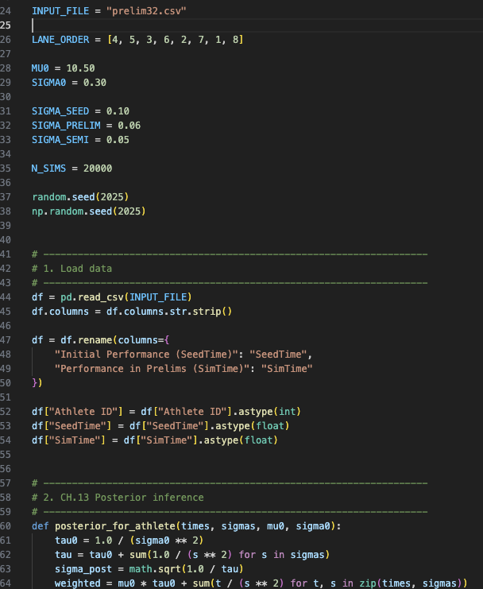
Step 6 - Probabilistic Selection
At this point, the project employs a combination of Bayesian updating and probabilistic reasoning to choose the finalists and make predictions about the race outcomes. The preliminary data in prelim32.csv is used as the starting point, and the first thing that happens in the code is cleaning and standardizing the two columns: seed and preliminary time. Following the Bayesian inference method (Chapter 13), the posterior mean and standard deviation for each athlete's hidden skill (PostMean, PostStd) are derived by integrating the athlete's seed time and prelim time with prior knowledge about the performance in the sprint category. The posterior parameters serve as a compact and collective representation of the adjusted conviction regarding the individual capability of each athlete to run fast after viewing both pieces of evidence.
The 16 athletes with the highest posterior means are deterministically chosen as semifinalists, then seeded 1–16 and separated into two heats, with lanes distributed according to the usual preferred lane order (4, 5, 3, 6, 2, 7, 1, 8). In order to simulate the uncertainty on the day of the event and the results of the race, the script makes use of probabilistic reasoning (Chapter 14) by conducting 20,000 Monte Carlo simulations of the semifinal round. During each simulation, race times are drawn from the predictive distribution of the posterior for each athlete, and progression is decided based on the finishing order within the respective heat.
The code, from these simulations, calculates the probability of each athlete's advancement (AdvanceProb) and presents the summary of the posterior predictive distribution of semifinal times using the mean, median, best-case, worst-case, and a representative "DisplayedSemiTime" which is similar to a realistic race outcome. These findings are documented in Semifinals_CH13_CH14.csv. The four athletes with the highest probability of advancing per heat are then selected as finalists, re-ordered based on their displayed semifinal performance, assigned final lanes following the same preferred lane pattern, and exported to Finalists_CH13_CH14.csv.

Slide 10
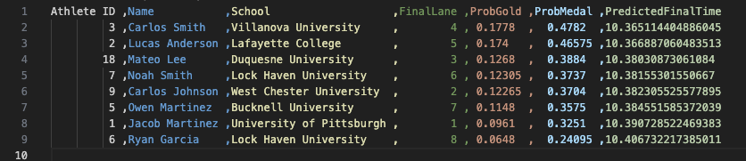
Step 7 Final Race
In the final step, the project integrates knowledge representation, planning, and probabilistic reasoning to simulate the championship race and determine the most likely final outcomes. The script begins by loading the eight finalists produced in the previous step and applies Chapter 12 knowledge representation, assigning each athlete a semantic category Elite, Competitive, or Borderline based on their semifinal performance. It also infers higher-level classifications such as StrongFinalistFinal (top three semifinalists) and DarkHorseFinal (athletes who improved versus their seed time). These knowledge driven labels are then used in Chapter 11 to plan the final lane assignments using a STRIPS-style action model: each finalist must be assigned exactly one lane, and the planner prioritizes central lanes for strong finalists, then dark horses, then the remaining athletes.
After the final lanes are planned, the system performs race simulations using each athlete’s semifinal performance as their posterior mean. A model with controlled variance samples again 20,000 possible final races, producing distributions of finishing times for every finalist. From these simulations, the script computes each athlete’s probability of winning gold, probability of medaling, and predicted mean final time. The results are and exported to FinalRace_CH11_12_13_14.csv, forming a comprehensive, data projection of the final race. This step demonstrates the full synergy of symbolic reasoning, planning, and uncertainty modeling, culminating in an AI-generated final race outcome that is realistic.

Slide 11
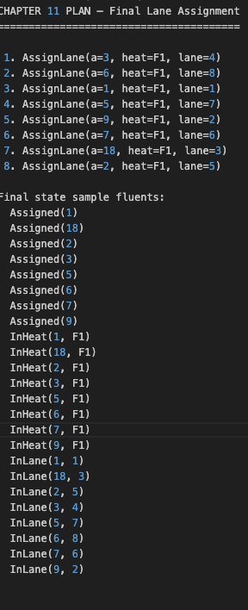
Step 6 STRIPS Style Planning
This plan is a STRIPS-style solution where the task is to assign eight finalists to lanes in the championship final heat (F1). Each step applies the AssignLane action to one athlete, which requires that the athlete is currently unassigned and that the lane is still free. When the action is executed, the athlete becomes assigned, they are placed in heat F1, and a specific lane is reserved for them. After all eight assignment actions are completed, every finalist has exactly one lane, every lane from 1 to 8 is used once, and the initial constraints are successfully satisfied. The resulting fluents in the final state confirm that each athlete is marked as Assigned, belongs to heat F1, and occupies the intended lane demonstrating a valid and logically consistent plan that reaches the goal state defined for Chapter 11.

Slide 12
Conclusion
Across all steps, this project builds a complete decision pipeline for track & field competition management=
It does a progressing from raw athlete data to a simulated, fully planned championship final. It begins by structuring and optimizing preliminary heats using hill climbing and adversarial search to improve fairness in lane and heat assignments. It then models uncertainty with realistic performance simulations and applies formal constraint satisfaction and logical inference to determine which athletes advance. Next, symbolic reasoning and probabilistic modeling enrich the understanding of athletes’ strengths, enabling smarter semifinal and final selections. Finally, STRIPS-style planning combines with Monte Carlo race simulations to assign the optimal final lanes and predict the most likely outcomes in the championship race.
Overall, the system demonstrates how logical agents, planning, and adversarial reasoning complement each other to produce a fully explainable, realistic, and fair AI-designed competition from Entries.csv all the way to the projected medalists.

