Slide 1
Cruising Altitude Unveiling the Verdict of Airline Survey
By: Juan Borque
Bethel School of Technology

Slide 2
About Me: My Background
My background is in logistics and business intelligence.
I hold a master’s degree in business intelligence and analytics from Rockhurst University.
I have a bachelor's degree in International Business from Regent University.
Currently I work as a data designer for a company in Rochester, NY
Before that I was the lead business intelligence developer for BNSF Logistics
I focused on flight information due to frequent travel and personal interest in the subject.

Slide 3
Project Introduction / Background
Pre-Pandemic Boom (2019): Nearly half a billion people (4.5 billion!) took to the skies annually.
Pandemic Turbulence (2021): Travel restrictions and plummeting demand grounded countless dreams, with passenger numbers nosediving to 2.2 billion.
Recovery Winds (2022): With restrictions easing and wanderlust reignited, passenger numbers took flight again, reaching an estimated 3.8 billion.
Notes:
Pre-Pandemic Boom (2019): Nearly half a billion people (4.5 billion!) took to the skies annually, according to the International Civil Aviation Organization. Imagine the bustling airports, the diverse faces boarding planes, the global connections forged in transit.
Pandemic Turbulence (2021): Travel restrictions and plummeting demand grounded countless dreams, with passenger numbers nosediving to 2.2 billion. Empty terminals and quiet skies served as a stark reminder of the pandemic's impact on global mobility.
Recovery Winds (2022): With restrictions easing and wanderlust reignited, passenger numbers took flight again, reaching an estimated 3.8 billion. While not quite back to pre-pandemic levels, it marked a significant step towards normalcy, reconnecting people and reviving the aviation industry.

Slide 4
Project Introduction / Background, con’t
Overarching Question: Beyond a thumbs up or down: Unveiling the intricate tapestry of factors woven into airline passenger satisfaction.
Sub-Questions:
Beyond Gender Stereotypes: Does "She Said, He Said" Ring True in Aviation Satisfaction?
Skyward Sojourns: First-Timers vs. Frequent Flyers - Casting Your Satisfaction Ballot!
From Budget Backpacker to Luxury Lounger: Does Travel Class Influence Satisfaction's Altitude?
Age is Just a Number, But Does it Affect How Passengers Rate Their Flights?

Slide 5
Methods - DataSet
The dataset, titled "Airline Passenger Satisfaction," was obtained from Maven Analytics, containing 129,880 rows and 24 columns.
The dataset comprises a single response variable, binary categorical in nature.
It includes fourteen ordinal variables derived from survey responses.
Four continuous variables, and four categorical variables represented as strings.
I am developing a predictive model aimed at identifying the factors that lead to a satisfactory outcome, with “Satisfaction" serving as the dependent variable within the dataset.

Slide 6
Methods – Data Wrangle
Data wrangling:
1) 393 rows in the dataset where the Arrival Delay column had missing values.
2) Eliminating these rows reduced the dataset size to 129,487 rows.
3) Created new dataset named "airline_cleaned" after completing the cleaning process.
Four string categorical variables converted to numerical values.
1) Created new dataset named "airline_cleaned1" to store the transformed variables.
Partitioned data into distinct training and testing sets.
Split datasets 80/20.
80% of the data for training purposes and the remaining 20% for testing.
Notes:
During data wrangling, I found 393 rows in the dataset where the Arrival Delay column had missing values, posing a risk of errors or exceptions during analysis. Moreover, this data absence could bias the model's results. Consequently, I eliminated these rows, reducing the dataset size to 129,487 rows. To maintain the original dataset's integrity, I created a new dataset named "airline_cleaned" after completing the cleaning process.
The four string categorical variables required conversion to numerical values for the correlation matrix computation. To accommodate these changes, I established a new DataFrame named "airline_cleaned1" to store the transformed variables.
To facilitate the application of my machine learning models, I partitioned the data into distinct training and testing sets. Utilizing an 80/20 data split strategy, I allocated 80% of the data for training purposes and reserved the remaining 20% for testing. This approach allows for the evaluation of how new data interacts with the training dataset.

Slide 7
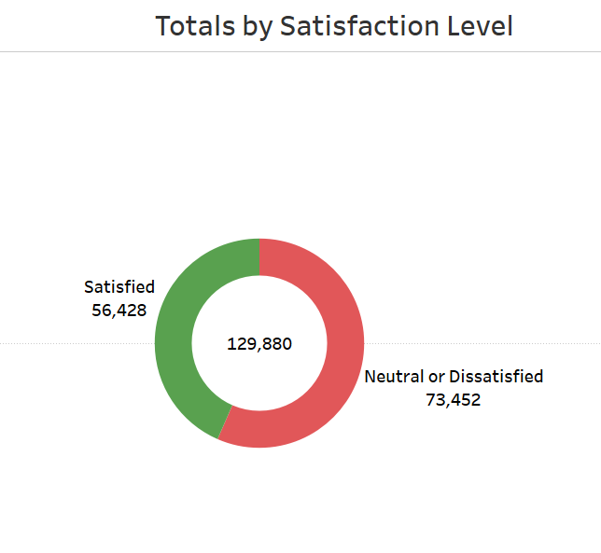
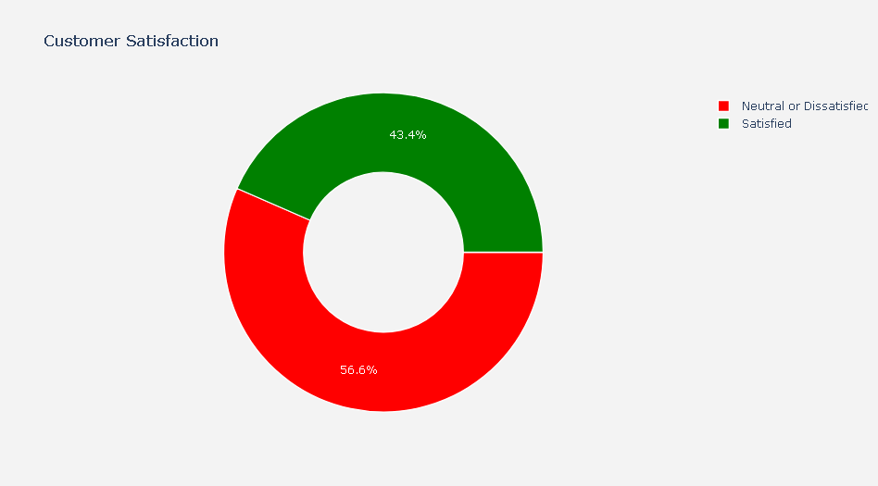
Results: Number & Percentage of Satisfied Customers vs Those That Are Not

Slide 8
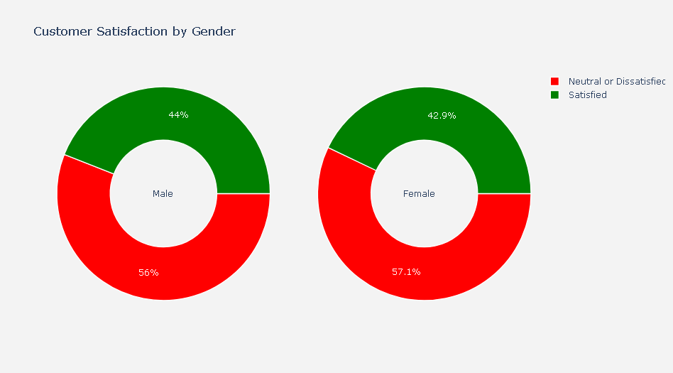
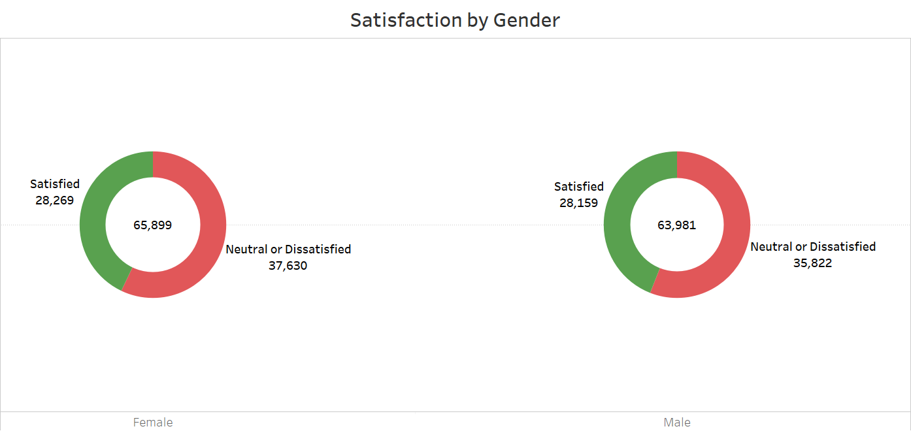
Results: Satisfaction by Gender

Slide 9
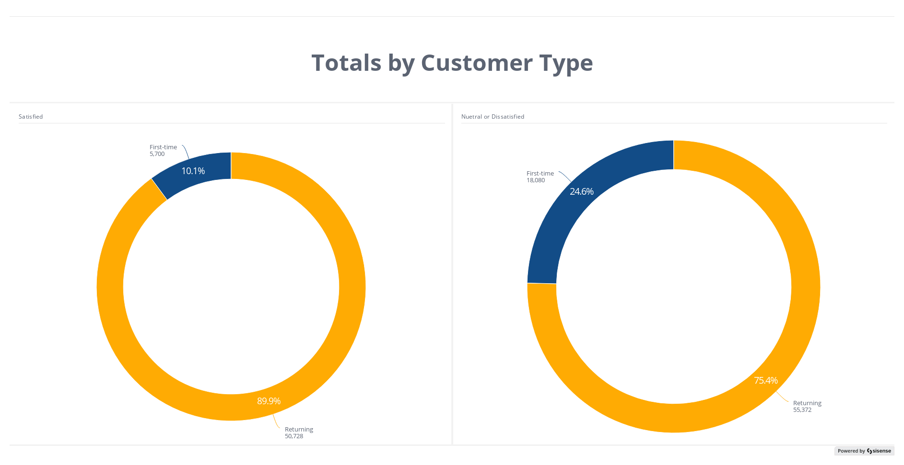
Results: Customer Type

Slide 10
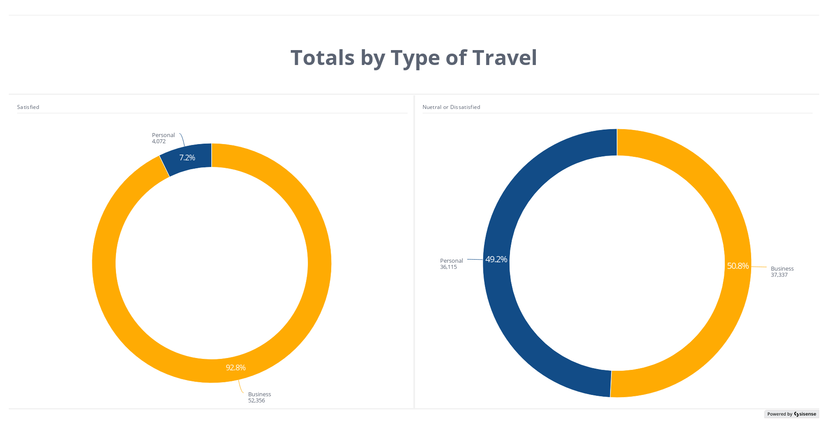
Result: Satisfaction by Type of Travel

Slide 11
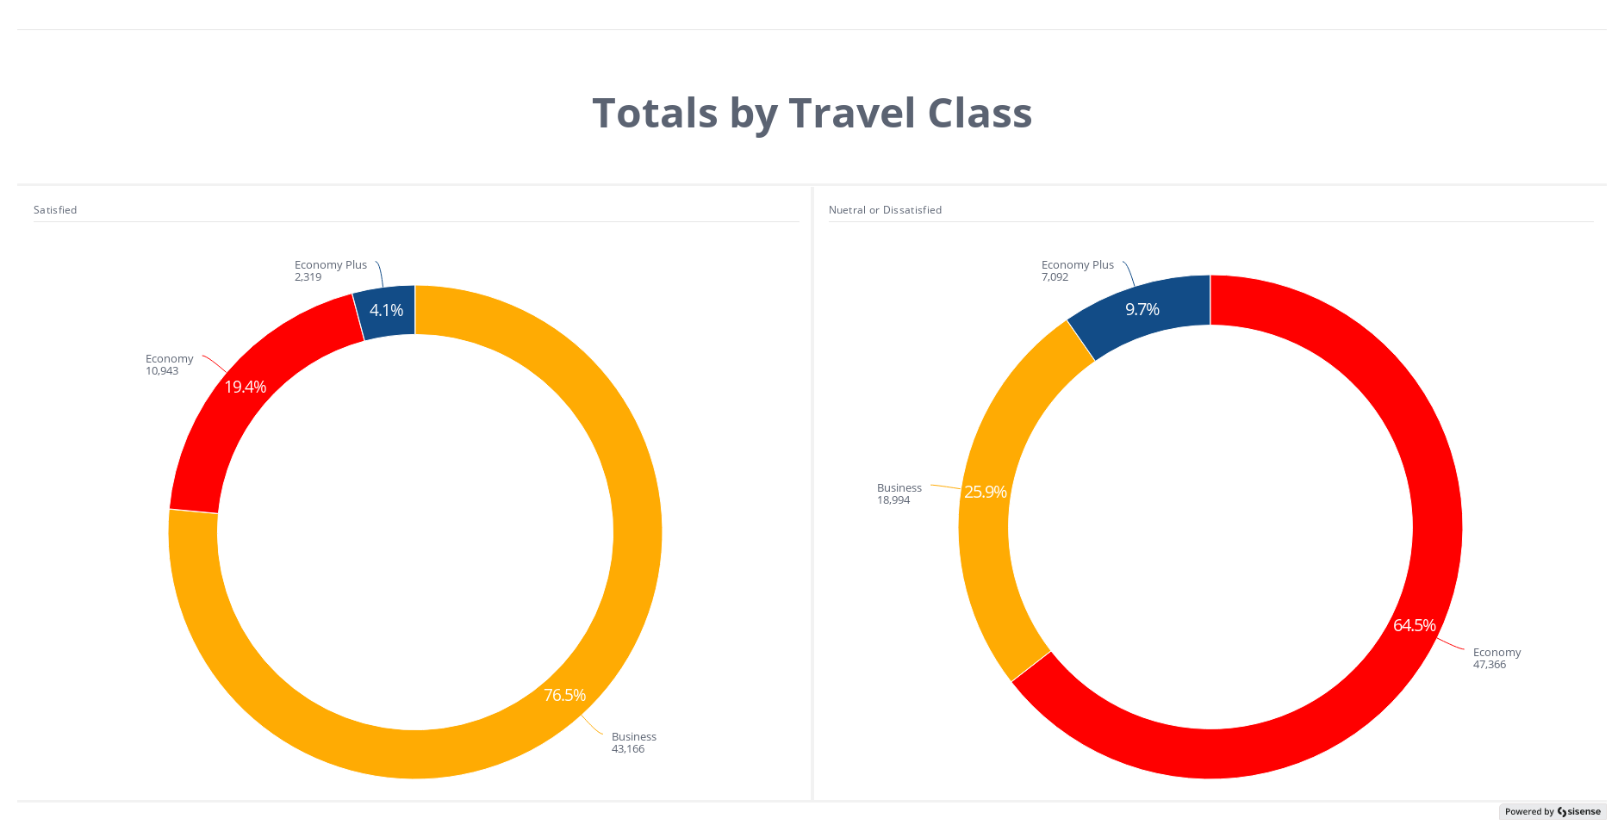
Result: Satisfaction by Travel Class

Slide 12
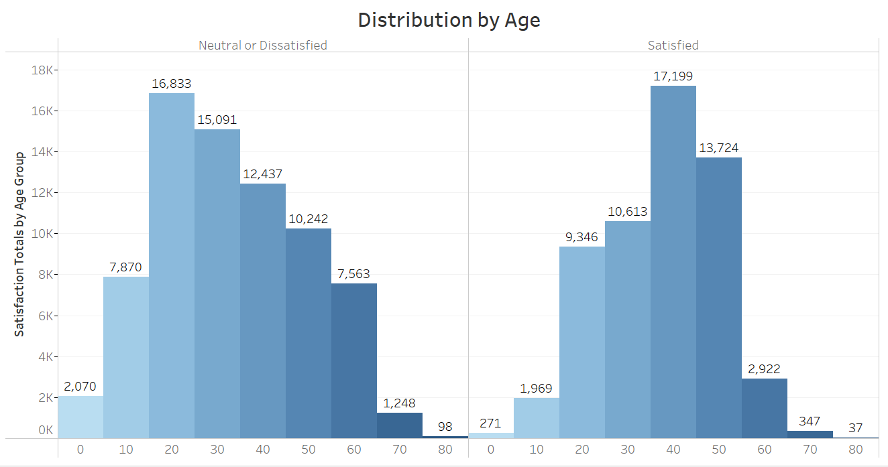
Result: By Age Group

Slide 13
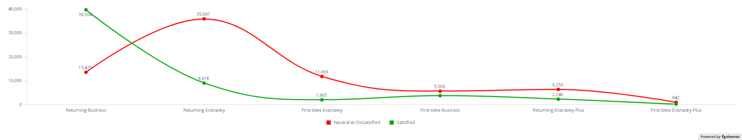
Result: Customer Type and Class

Slide 14
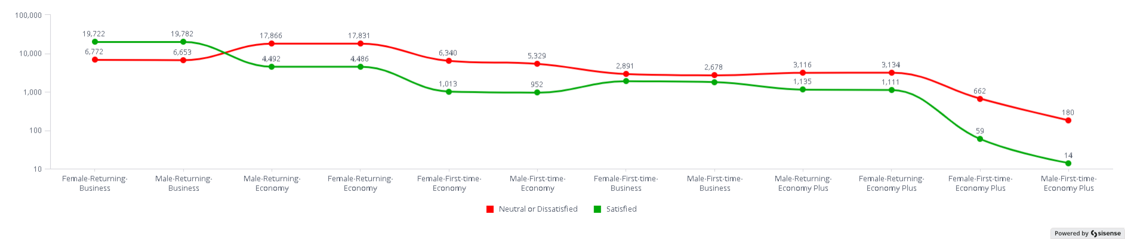
Result: Gender, Customer Type, Class

Slide 15
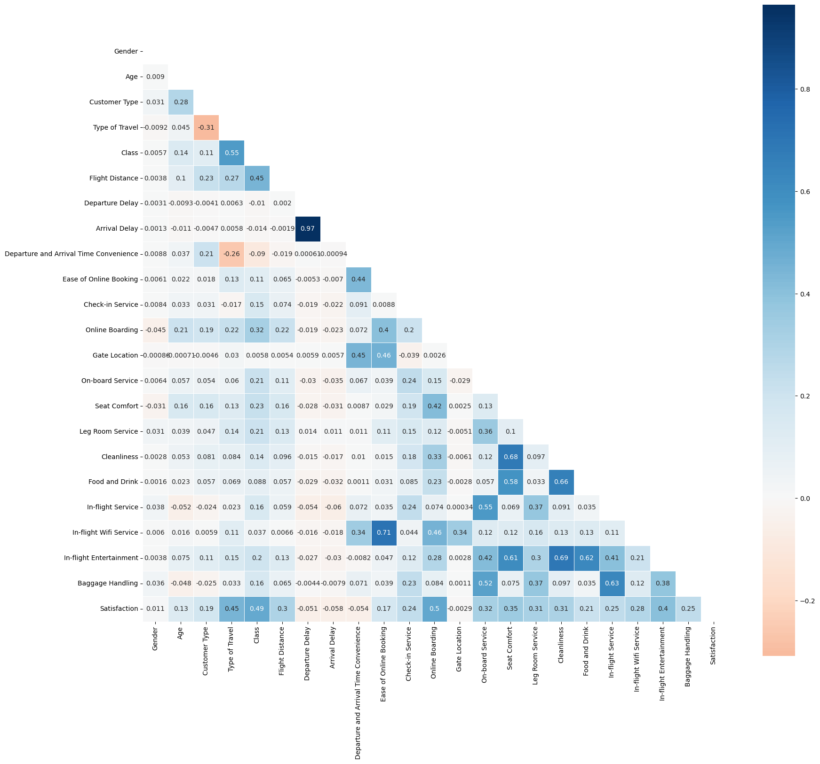
Result: Correlation Matrix

Slide 16
Correlation Matrix Interpretation
Linearity: Correlation only measures linear relationships between variables.
Directionality: Correlation doesn't tell you the direction of the relationship.
Confounding variables: Correlation doesn't consider the influence of other variables.
Noise: Correlation is sensitive to noise in the data.
Notes:
Linearity: Correlation only measures linear relationships between variables. If the relationship is non-linear, a correlation matrix will miss it. Machine learning algorithms can capture more complex relationships, including non-linear ones.
Directionality: Correlation doesn't tell you the direction of the relationship. A variable X might affect Y, but Y might not affect X, leading to a low correlation. However, this information about causality might be captured by a machine learning algorithm.
Confounding variables: Correlation doesn't consider the influence of other variables. If a third variable, Z, affects both X and Y, it can create a spurious correlation or mask a true one. Machine learning algorithms can often identify and account for the influence of other variables.
Noise: Correlation is sensitive to noise in the data. If the data is noisy, it can obscure a true relationship between X and Y. Machine learning algorithms can sometimes denoise the data and still uncover the underlying relationship.

Slide 17
Result: Summary of EDA
There are proportionately more unsatisfied customers than satisfied.
There are more female travelers than males. Gender role satisfaction to dissatisfaction proportion are not statistically much different.
Customer type, whether first-time or returning, significantly influences satisfaction scores, with returning customers consistently providing higher ratings.
Business travelers type consistently rate their satisfaction higher.
Business class travelers tend to rate their satisfaction higher, whereas economy class travelers tend to rate their satisfaction lower.

Slide 18
Result: Summary of EDA
Satisfaction levels tend to increase with age.
Returning customers flying business class reported the highest satisfaction scores.
Returning customers flying economy class reported the highest dissatisfaction scores.
Male and female returning business customers consistently reported the highest satisfaction scores.
Male and female returning economy customers reported the highest dissatisfaction scores.
The correlation table is not a good indicator of the relationship between variables because the measures are not linear.
Focus on predicting a binary qualitative (categorical) response .
Logistic Regression
Decision Tree Classifier.
Naïve Bayes.
Notes:
Slide 18:
Satisfaction levels tend to increase with age, with the highest levels observed in the 40-49 age group.
Returning customers flying business class reported the highest satisfaction scores, while returning customers flying economy class reported the highest dissatisfaction scores.
Male and female returning business customers consistently reported the highest satisfaction scores, while male and female returning economy customers reported the highest dissatisfaction scores.
The correlation table is not a good indicator of the relationship between variables because the measures are not linear.
Given the nonlinear nature of the variables, I'll focus on predicting a binary qualitative (categorical) response using algorithms suited for this type of data. I've opted for Logistic Regression and Decision Tree Classifier. Additionally, I've included Naïve Bayes due to its simplicity, efficiency, and effectiveness with high-dimensional data.

Slide 19
Result: Logistics Regression
The model performed consistently well on both the training and testing sets. Test data results:
Accuracy:
It's calculated as (TP + TN) / (TP + TN + FP + FN).
The model correctly classified about 87.15% of all instances.
Precision:
It's calculated as TP / (TP + FP).
86.46% of instances predicted as positive by the model were truly positive.
Recall:
It's calculated as TP / (TP + FN).
The model correctly identified about 83.37% of all actual positive instances.
F1 Score:
It's calculated as 2 * (Precision * Recall) / (Precision + Recall).
F1 Score in this case is approximately 84.89%.
Notes:
Slide 19:
The model performed consistently well on both the training and testing sets. Test data results:
Accuracy:
Accuracy is the proportion of correctly classified instances among all instances.
It's calculated as (TP + TN) / (TP + TN + FP + FN).
Accuracy in this case is approximately 0.8715, meaning the model correctly classified about 87.15% of all instances.
Precision:
Precision is the proportion of true positive predictions among all positive predictions.
It's calculated as TP / (TP + FP).
Precision in this case is approximately 0.8646, indicating that about 86.46% of instances predicted as positive by the model were truly positive.
Recall:
Recall (also known as sensitivity) is the proportion of true positive predictions among all actual positive instances.
It's calculated as TP / (TP + FN).
Recall in this case is approximately 0.8337, indicating that the model correctly identified about 83.37% of all actual positive instances.
F1 Score:
F1 Score is the harmonic mean of precision and recall.
It's calculated as 2 * (Precision * Recall) / (Precision + Recall).
F1 Score in this case is approximately 0.8489, providing a single metric that balances both precision and recall

Slide 20
Result: Logistics Regression
Top 10 features affecting satisfaction level:
Online boarding
Type of travel
On-board service
Customer type
Leg room service
Check-in service
Cleanliness
In-flight wifi
Class
Ease of online boarding

Slide 21
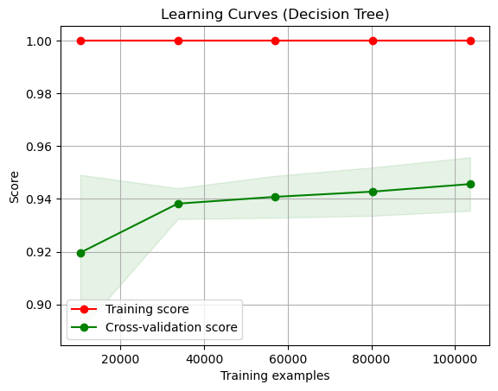
Result: Decision Tree
Training dataset predicted 100% accuracy. Wow! But highly sketch.
Testing set was more realistic at 95.41% accuracy.
Testing for overfitting using cross validation method.
Hyperparameter tuning yielded the same accuracy score as the original decision tree.
Notes:
Slide 21:
Training dataset predicted 100% accuracy. Wow! But highly sketch.
Testing set was more realistic at 95.41% accuracy.
Testing for overfitting using cross validation method.
Hyperparameter tuning yielded the same accuracy score as the original decision tree, but it predicted true negatives better.

Slide 22
Result: Decision Tree Feature Importance
Top 10 feature importance ranking
1. Online Boarding
2. In-flight Wifi Service
3. Type of Travel
4. In-flight Entertainment
5. Customer Type
6. Check-in Service
7. Class
8. Gate Location
9. Baggage Handling
10. In-flight Service

Slide 23
Result: Naïve Bayes
Accuracy: 86.16%
Precision:
For class 0: 87%
For class 1: 85%
Recall:
For class 0: 89%
For class 1: 82%
F1-score:
For class 0: 88%
For class 1: 84%
Notes:
Slide 23:
The model has reasonably good accuracy, indicating that it performs well in classifying instances correctly.
Precision and recall for both classes are relatively high, suggesting that the model makes accurate positive predictions (class 1) while maintaining a good balance with false positives and false negatives.
The F1-scores, which consider both precision and recall, are also high, indicating a good balance between precision and recall for both classes.

Slide 24
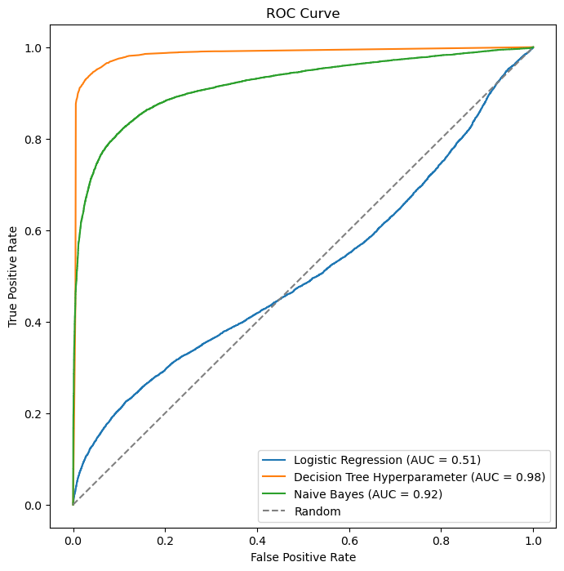
What Model do I use
The ROC (Receiver Operating Characteristic) curve plots the true positive rate against the false positives.
The AUC (Area Under the Curve) score summarizes the performance of a classifier across all thresholds. Higher score equals better overall performance.
The tuned Decision Tree performed exceptionally well in this scenario, achieving a prediction accuracy of 98%. It accurately identified the features associated with satisfactory or unsatisfactory scores.

Slide 25
Result: What are the Features Impacting Satisfaction Scores
Top 10 features affecting satisfaction level:
Online boarding
Type of travel
On-board service
Customer type
Leg room service
Check-in service
Cleanliness
In-flight wifi
Class
Ease of online boarding

Slide 26
Summary
Gender does not significantly impact the data.
Customer type, distinguishing between first-time flyers and returning customers, notably influences satisfaction scores.
Type of travel, whether personal or business, is a significant driver.
Class type has a considerable impact on satisfaction scores.
Age also plays a role in satisfaction scores.
The most effective algorithm for predicting satisfaction scores is the hyper-tuned decision tree model, achieving 98% accuracy.

Slide 27

Conclusions
What you can’t control: Gender, customer type, traveler category, flight class, and passenger age.
Ten key areas where airlines can focus their efforts to ensure a better customer experience:
1) Online Boarding 6) In-flight Service
2) In-flight WiFi Service 7) On-board Service
3) In-flight Entertainment 8) Leg Room Service
4) Check-in Service 9) Ease of Online Booking
5) Baggage Handling 10) Cleanliness
Concentrating on optimizing these aspects, airlines can effectively improve customer satisfaction ratings.
Returning customers tend to yield higher satisfaction scores, airlines could benefit from incentivizing repeat patronage by offering discounts or leveraging points rewards for free flights. This strategy encourages customer loyalty and fosters repeat business.
Notes:
Slide 27:
In any airline operation, certain factors lie beyond their immediate control. These include passenger gender, customer type, traveler category, flight class, and passenger age. However, proactive measures can be taken by airlines to enhance the overall traveler experience and elevate satisfaction scores, as indicated by our analytical algorithms.
I identified ten key areas where airlines can focus their efforts to ensure a better customer experience:
Online Boarding 6) In-flight Service
In-flight WiFi Service 7) On-board Service
In-flight Entertainment 8) Leg Room Service
Check-in Service 9) Ease of Online Booking
Baggage Handling 10) Cleanliness
By concentrating on optimizing these aspects, airlines can effectively improve customer satisfaction ratings. It's noteworthy that a significant portion of these factors caters to the preferences of the younger, tech-savvy generation, emphasizing the importance of meeting their expectations for entertainment options. On the other hand, some factors are more aesthetically oriented, appealing to passengers with different preferences and inclinations.
Given that returning customers tend to yield higher satisfaction scores, airlines could benefit from incentivizing repeat patronage by offering discounts or leveraging points rewards for free flights. This strategy encourages customer loyalty and fosters repeat business.

Slide 28
The End
Questions?

