Slide 1
Aerial Traffic Monitoring Using UAVs

Slide 2
PROBLEM STATEMENT
Challenges in traffic management and congestion cause huge financial, environmental, and physiological costs to the individual and to the government. On an average, a person spends anywhere between 30 minutes to 2 hours of their day commuting, accounting to almost 520 hours a year. It is estimated that the traffic congestion in the four metro cities costs the nation approximately Rs. 1.5 lakh crore (more than the annual Railway budget for this year) {Reference:1,2}. This problem statement focuses on developing a specialized aerial solution for automatic aerial analysis of traffic activity in highways and city roads using Unmanned aerial vehicles. The end goal is to explore new possibilities in the field of traffic analysis by its fully automatic calculation of a wide range of traffic parameters such as speed, densities, time, and pollution levels.

Slide 3
PROBLEM DESCRIPTION
These data can be used for:
o Betterment of road condition: Detecting potholes and inefficient speed breakers
o Detecting traffic anomalies: Identifying root cause of traffic and other emergencies
o Toll-gate efficiency: Prevent choking of traffic at toll gates
o Maintain strict traffic regulations: Identifying traffic violations
o Aid in controlling city pollution levels: detecting and publishing noise and air pollution levels
Aerial Monitoring using drones overcome the limitations of traditional methods of traffic data collection due to its mobility, complexity, and ability to cover large areas.
i

Slide 4
Technology Bucket: Robotics & Drones
Category: Software
Company Name: MathWorks India Pvt Ltd
Problem Code: AG1
Team Leader Name: Kopparti Sai Srinivas
College Code: 1-3515861256

Slide 5
Team Name:
Tech Ninjas
Team Leader Name:
Kopparti Sai Srinivas - 111716106075
Team Members:
Rudraraju Raman Kumar -111716106129
Roshini Sukumaran -111716106127
Roshni.S -11716106128
Vella Keerthana –111717106167
Soma Siva Harshitha-111717106146
Mentor:
Ms. Jothi D ECE.Asst. Professor

Slide 6
Idea/Solution/Prototype
Video from drone is fed as input to pre-trained model designed using OpenCV, CNN and KNN for clustering and counting objects. Object count(vehicles, pot holes) is mapped to GPS co-ordinates. A density map is created using this object count depending on GPS co-ordinates of drone at that time for pot holes, vehicles etc. Data from sensors like pollution sensor(MQ 135), humidity and temperature sensor(DHT 22), GPS module is sent using IoT(MQTT) to computer and visual graphs and charts are provided using Mat Lab. All the data is logged in a NoSQL database for feasibility and future use.
Technology Stack
Hardware
Software
Mat lab
Tensor flow API for Mat lab
OpenCV
Matplotlib Library
NoSQL Database
Google Map API
Dht22-Moisture and Humidity Sensor
MQ-135-Air Quality Sensor
GPS module
RTC (Real Time Clock) Unit
Quad band GSM/GPRS Module
Microcontroller Unit(MCU)

Slide 7
Block Diagram
Video Data
Sensor Data
Image Processing using ML
Temperature
Pollution
Humidity
GPS
Clustered Data
Visualization
Pot Hole
Vehicles
Ambulance
Pothole Density Map
Google Map API
Vehicle Density Map
All Data is logged in NoSQL Database for future use.

Slide 8
Use Cases
The processed data is used to predict the Traffic density in a region and this information can be used in controlling the traffic flow at the junction by managing traffic lights based on the density and this data can even be used by ML and AI system for preventing various traffic problems.
The sensor data collected can be used in tacking necessary measures based on the pollution levels in a region.
If any emergency service vehicle is stuck in the traffic based on predictions of ML, it’ll be forwarded to concerned authorities to take appropriate actions.
Show Stopper/Dependencies
Requires high quality surveillance video from drone for accurate processing of data.
Internet connection is required for collecting IOT data from the sensors.

Slide 9
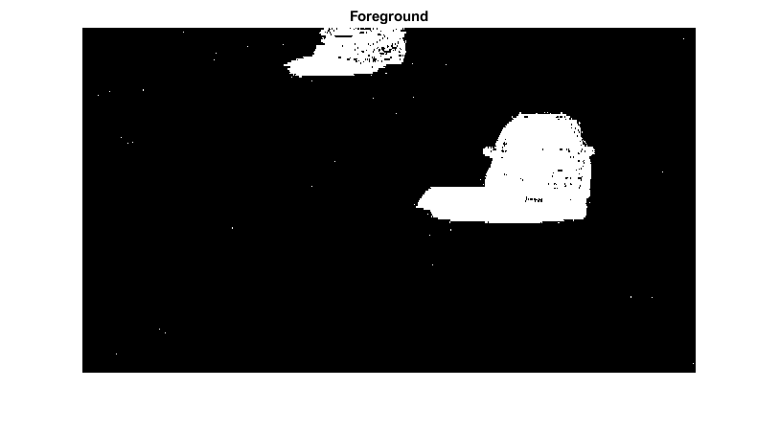
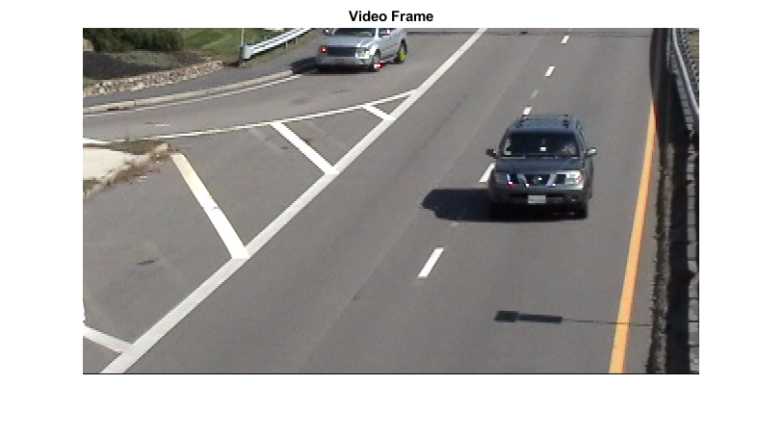
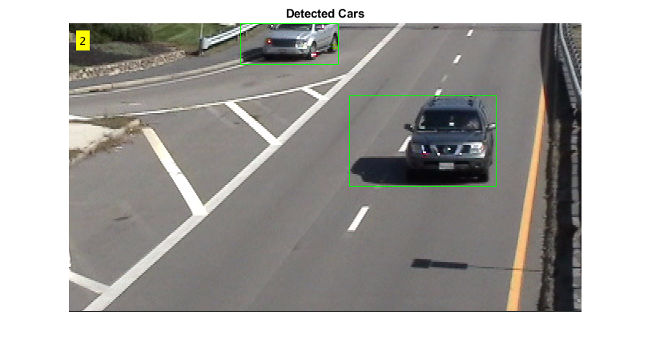

Slide 10
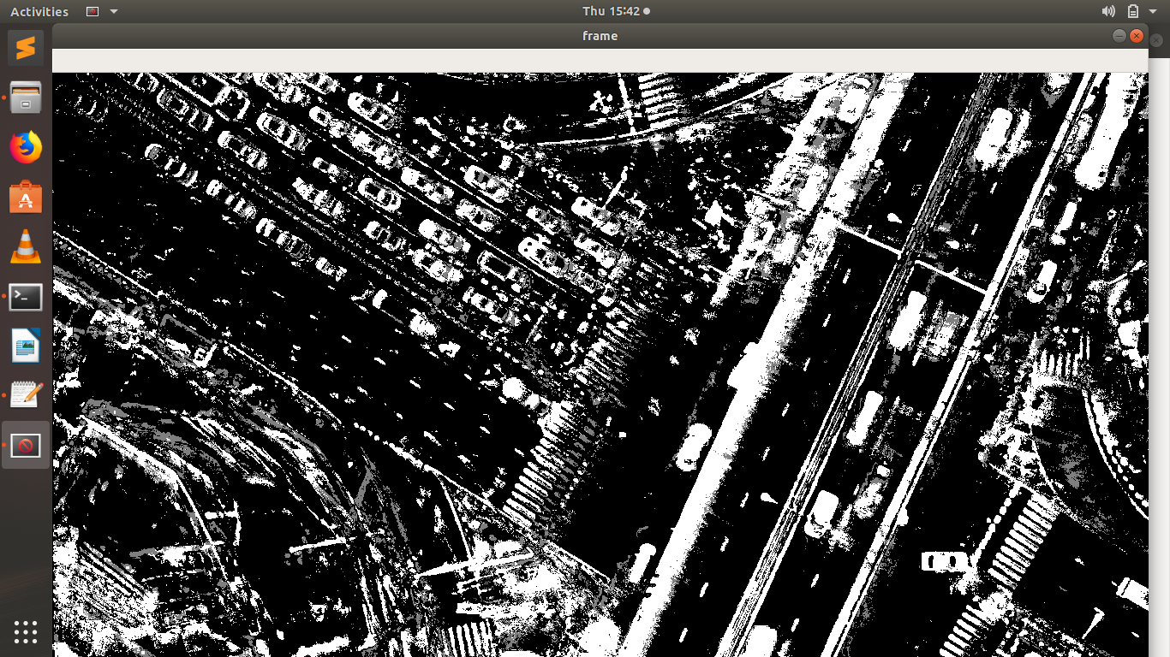
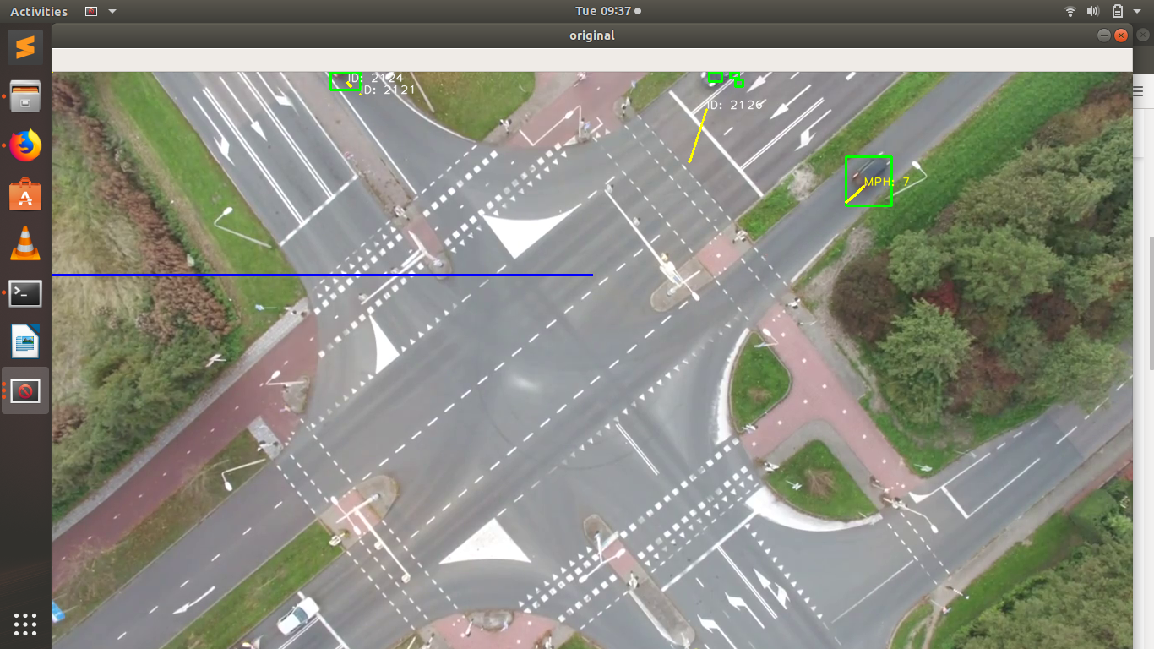


Slide 11
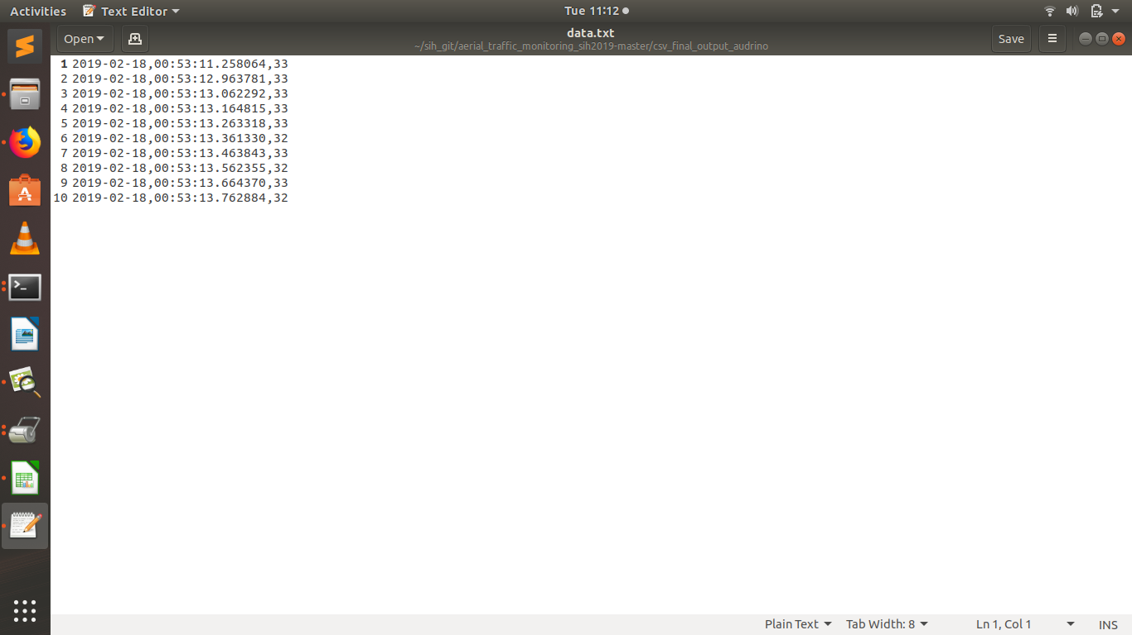

Slide 12
References
IEEE References 1)https://ieeexplore.ieee.org/document/7546916/ 2)https://ieeexplore.ieee.org/abstract/document/1253218/ 3)https://ieeexplore.ieee.org/abstract/document/1041184 4)https://ieeexplore.ieee.org/abstract/document/1253218 External references: 1)https://medium.com/data-from-the-trenches/object-detection-with-deep-learning-on-aerial-imagery-2465078db8a9 2)https://gregtinkers.wordpress.com/2016/03/25/car-speed-detector/ 3)https://brilliant.org/wiki/gaussian-mixture-model/ 4)https://in.mathworks.com/help/vision/ 5)https://docs.opencv.org/2.4/index.html github: 1)https://github.com/ronitsinha/speed-detector 2)https://github.com/alex-drake/OpenCV-Traffic-Counter Datasets: 1)https://gdo152.llnl.gov/cowc/ 2)https://www.highd-dataset.com/#commercial 3)https://captain-whu.github.io/DOTA/dataset.html

