Slide 1
Leyenda de colores
Order_number
Reference
Quantity
Ship_out_date
Arrival_date

Slide 2
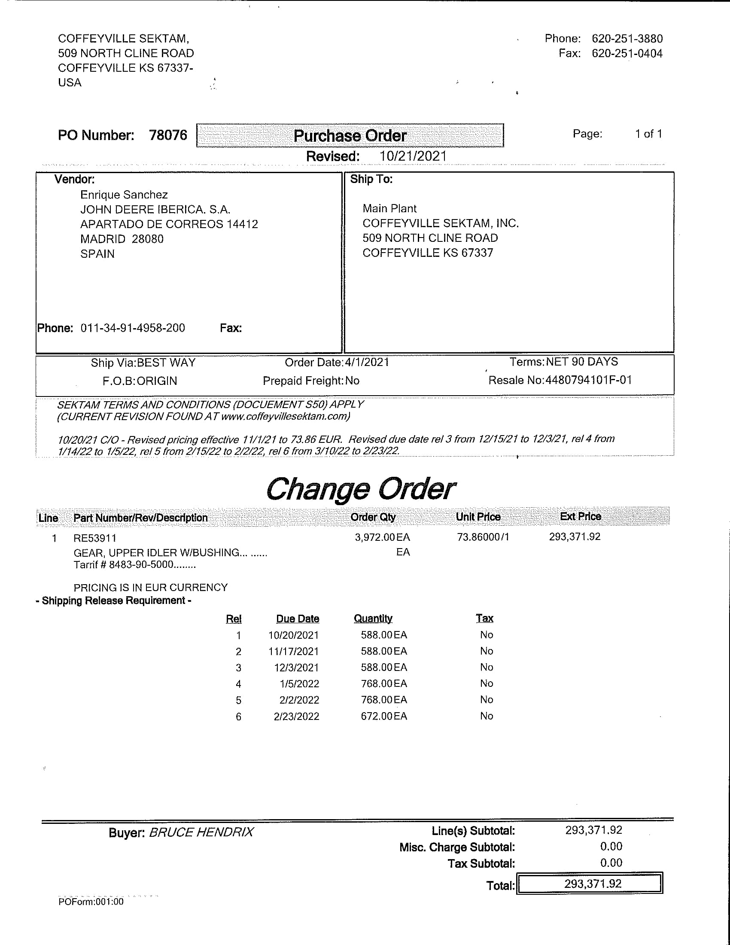
Coffeyville Sektam

Slide 3
Concentric
Concentric Pumps Pune Pvt ltd (Eou div) |  |  |  |  |  |  | 31/07/2021
Supplier Schedules For the month of Aug-21 to Apr-22
 |  |  |  | Firm |  | Tentative
Sr.No. | Part. No. | Supplier | Description | Aug-21 | Sep-21 | Oct-21 | Nov-21 | Dec-21 | Jan-22 | Feb-22 | Mar-22 | Apr-22
1 | R527691B | JD Iberica | Gear JD T4 OP | 0 | 0 | 0 | 1000 | 0 | 0 | 0 | 0 | 0
2 | R527010 | JD Iberica | Gear JD T4 OP | 4725 | 3780 | 4725 | 3780 | 3780 | 4725 | 3780 | 3780 | 3780

Slide 4
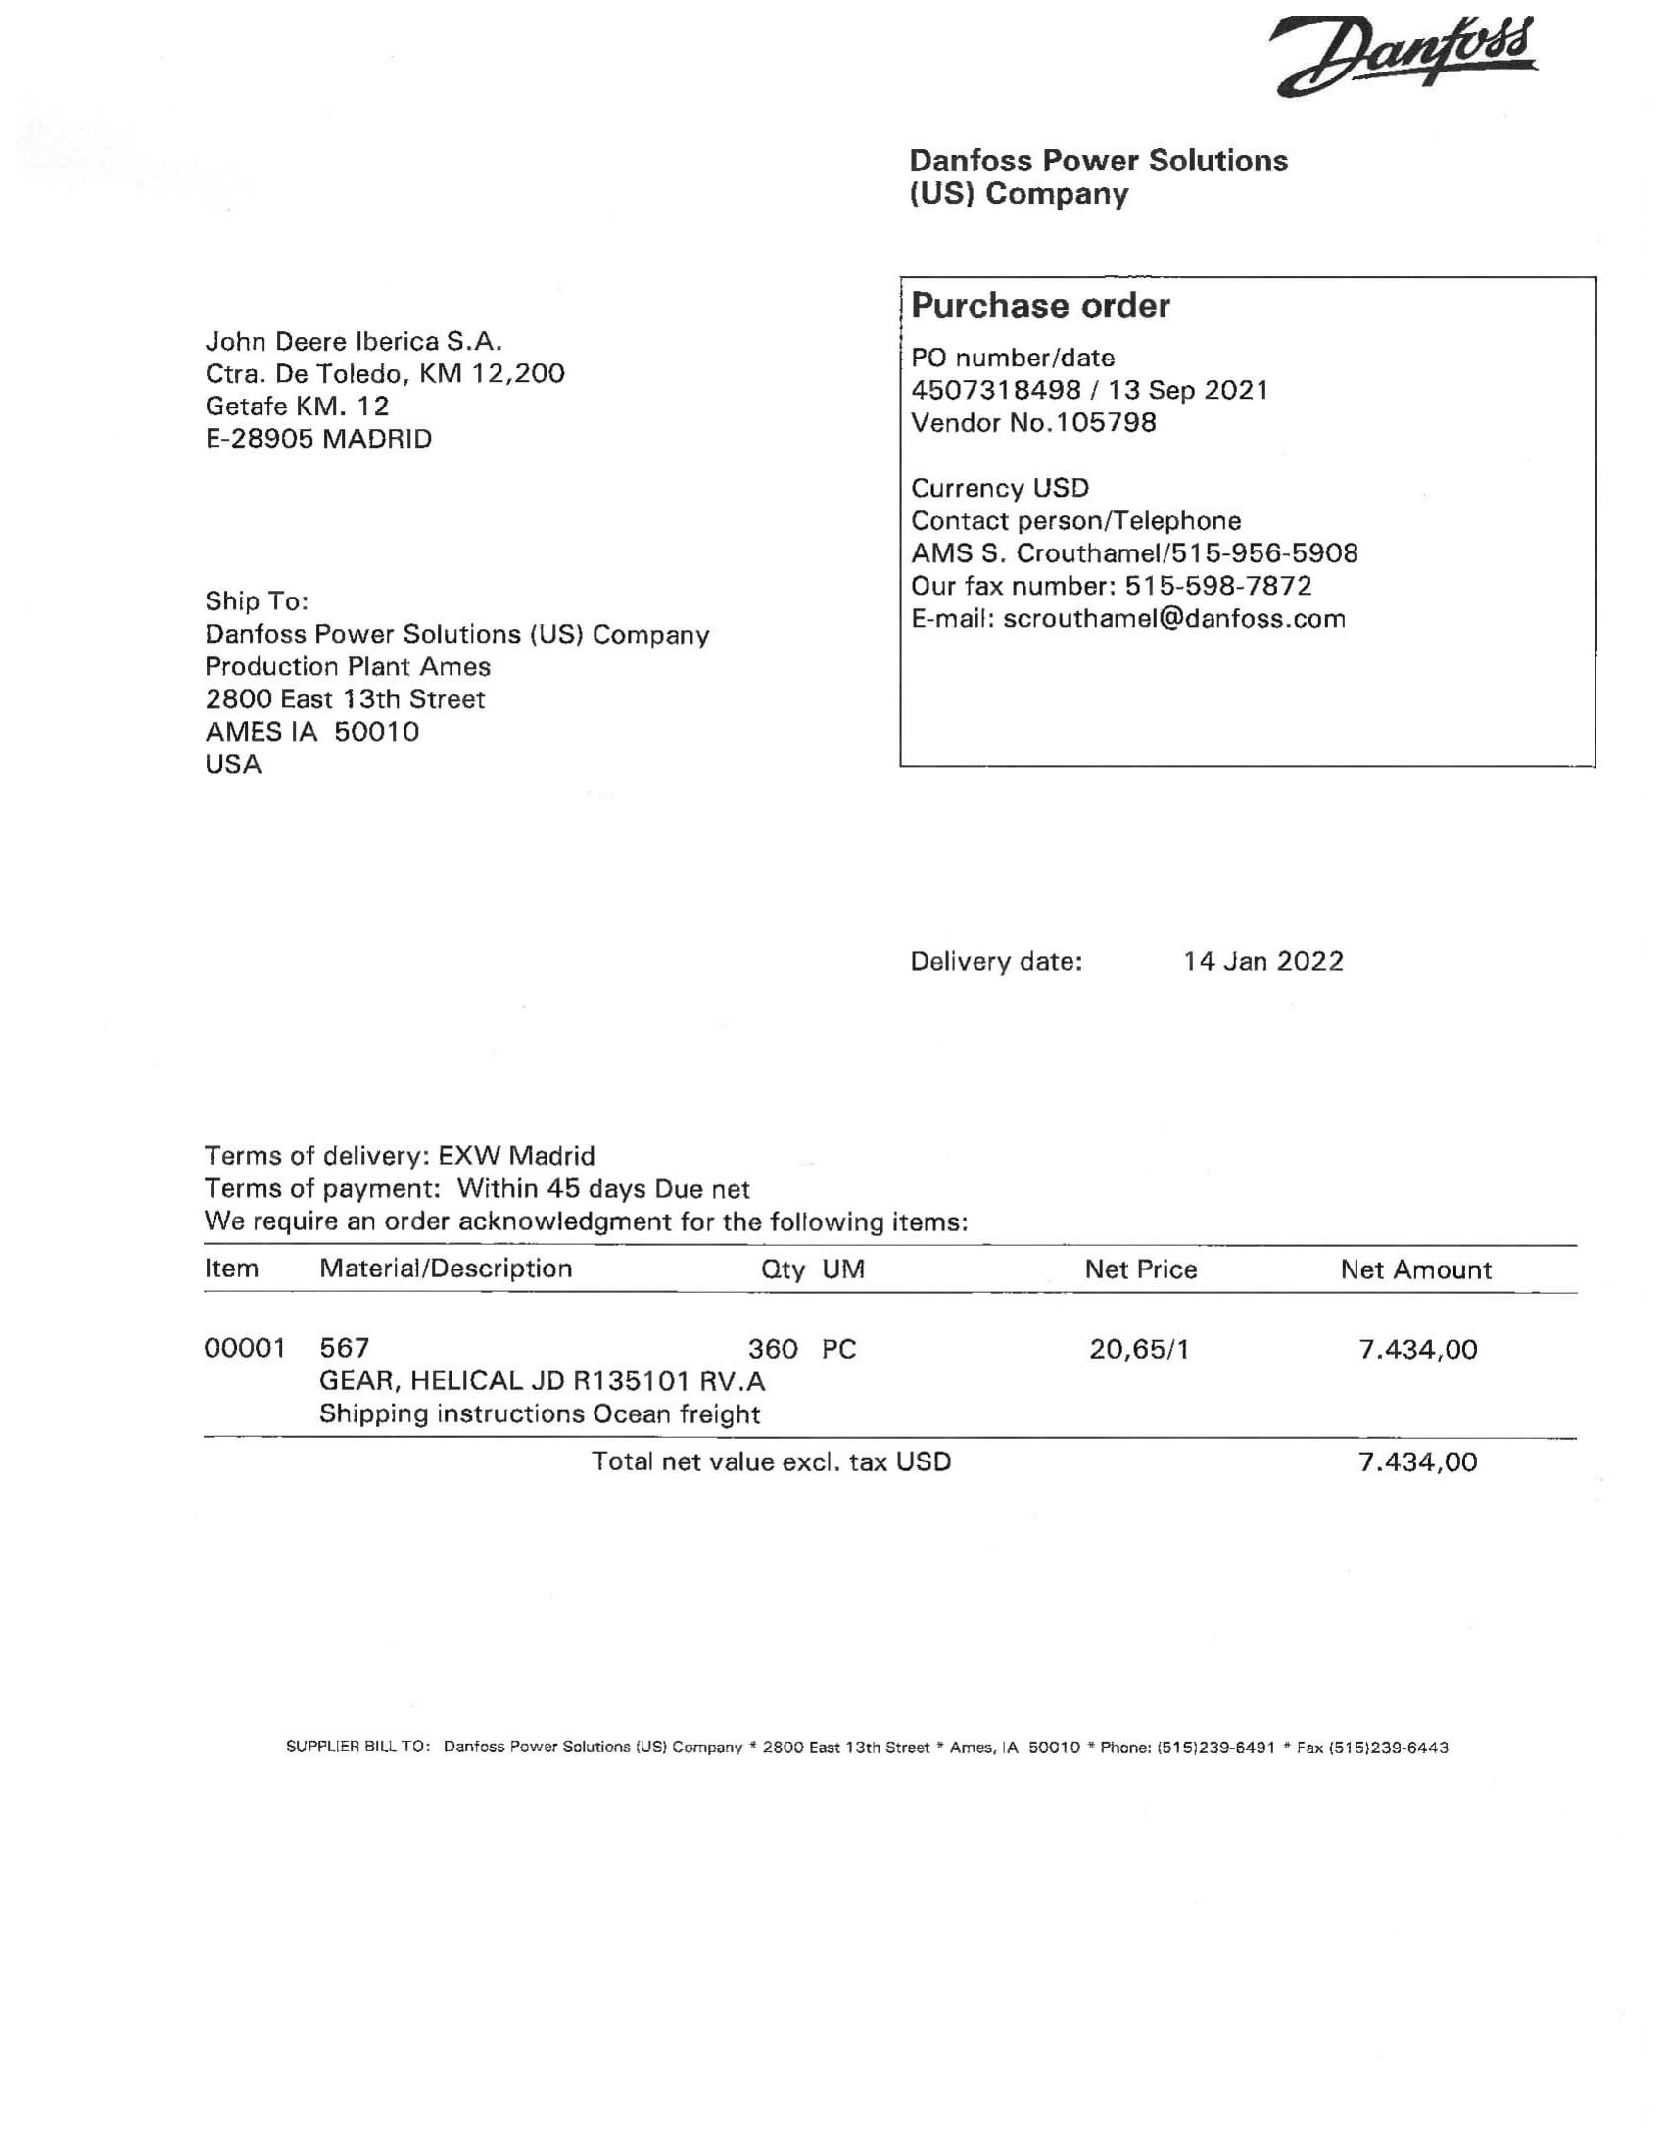
Danfoss

Slide 5
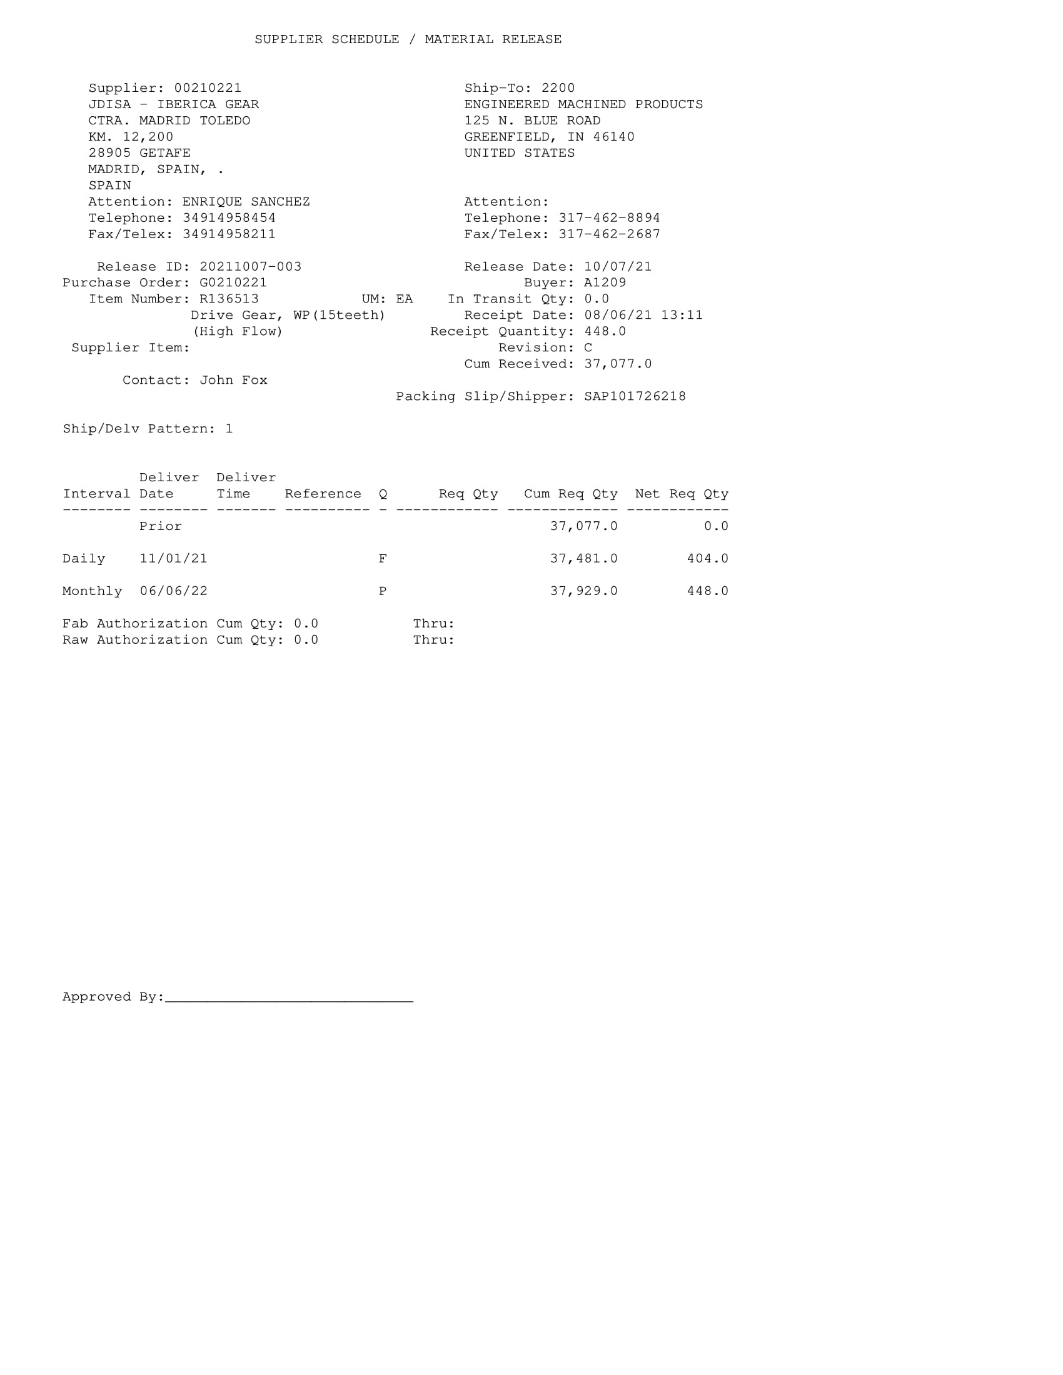
EMP
Campos validos

Slide 6
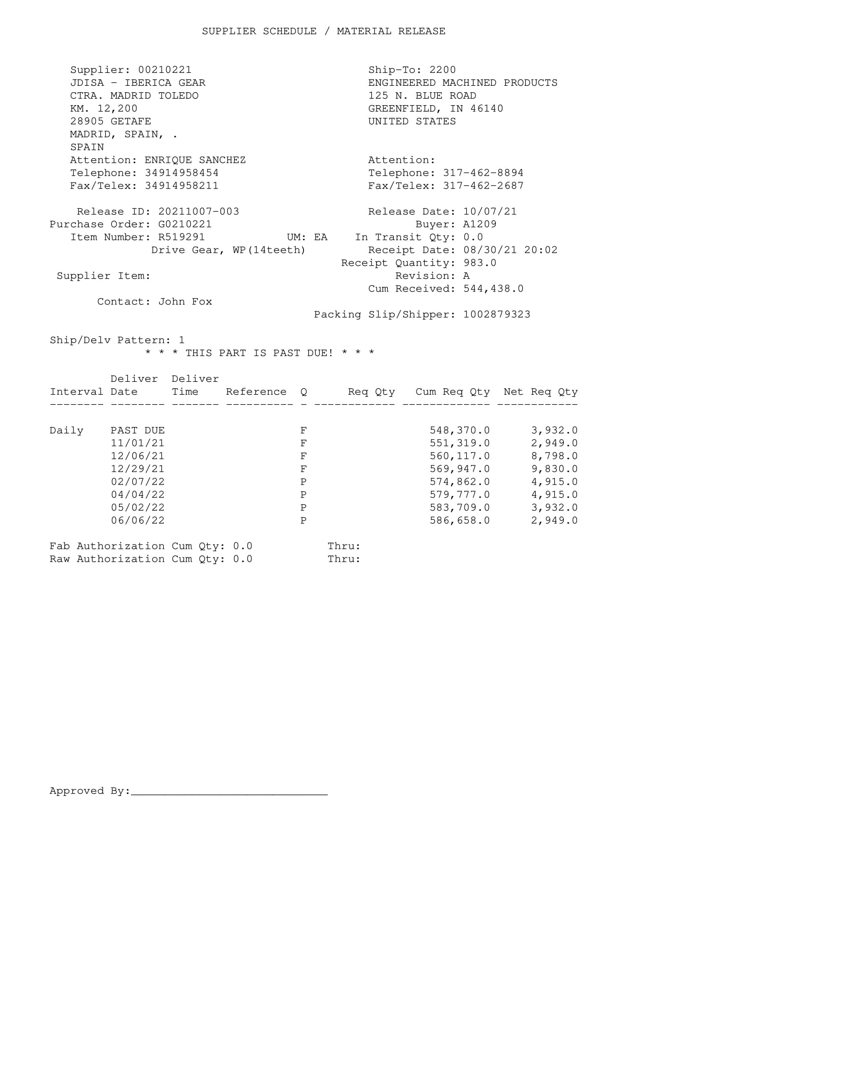
EMP
Campos validos

Slide 7
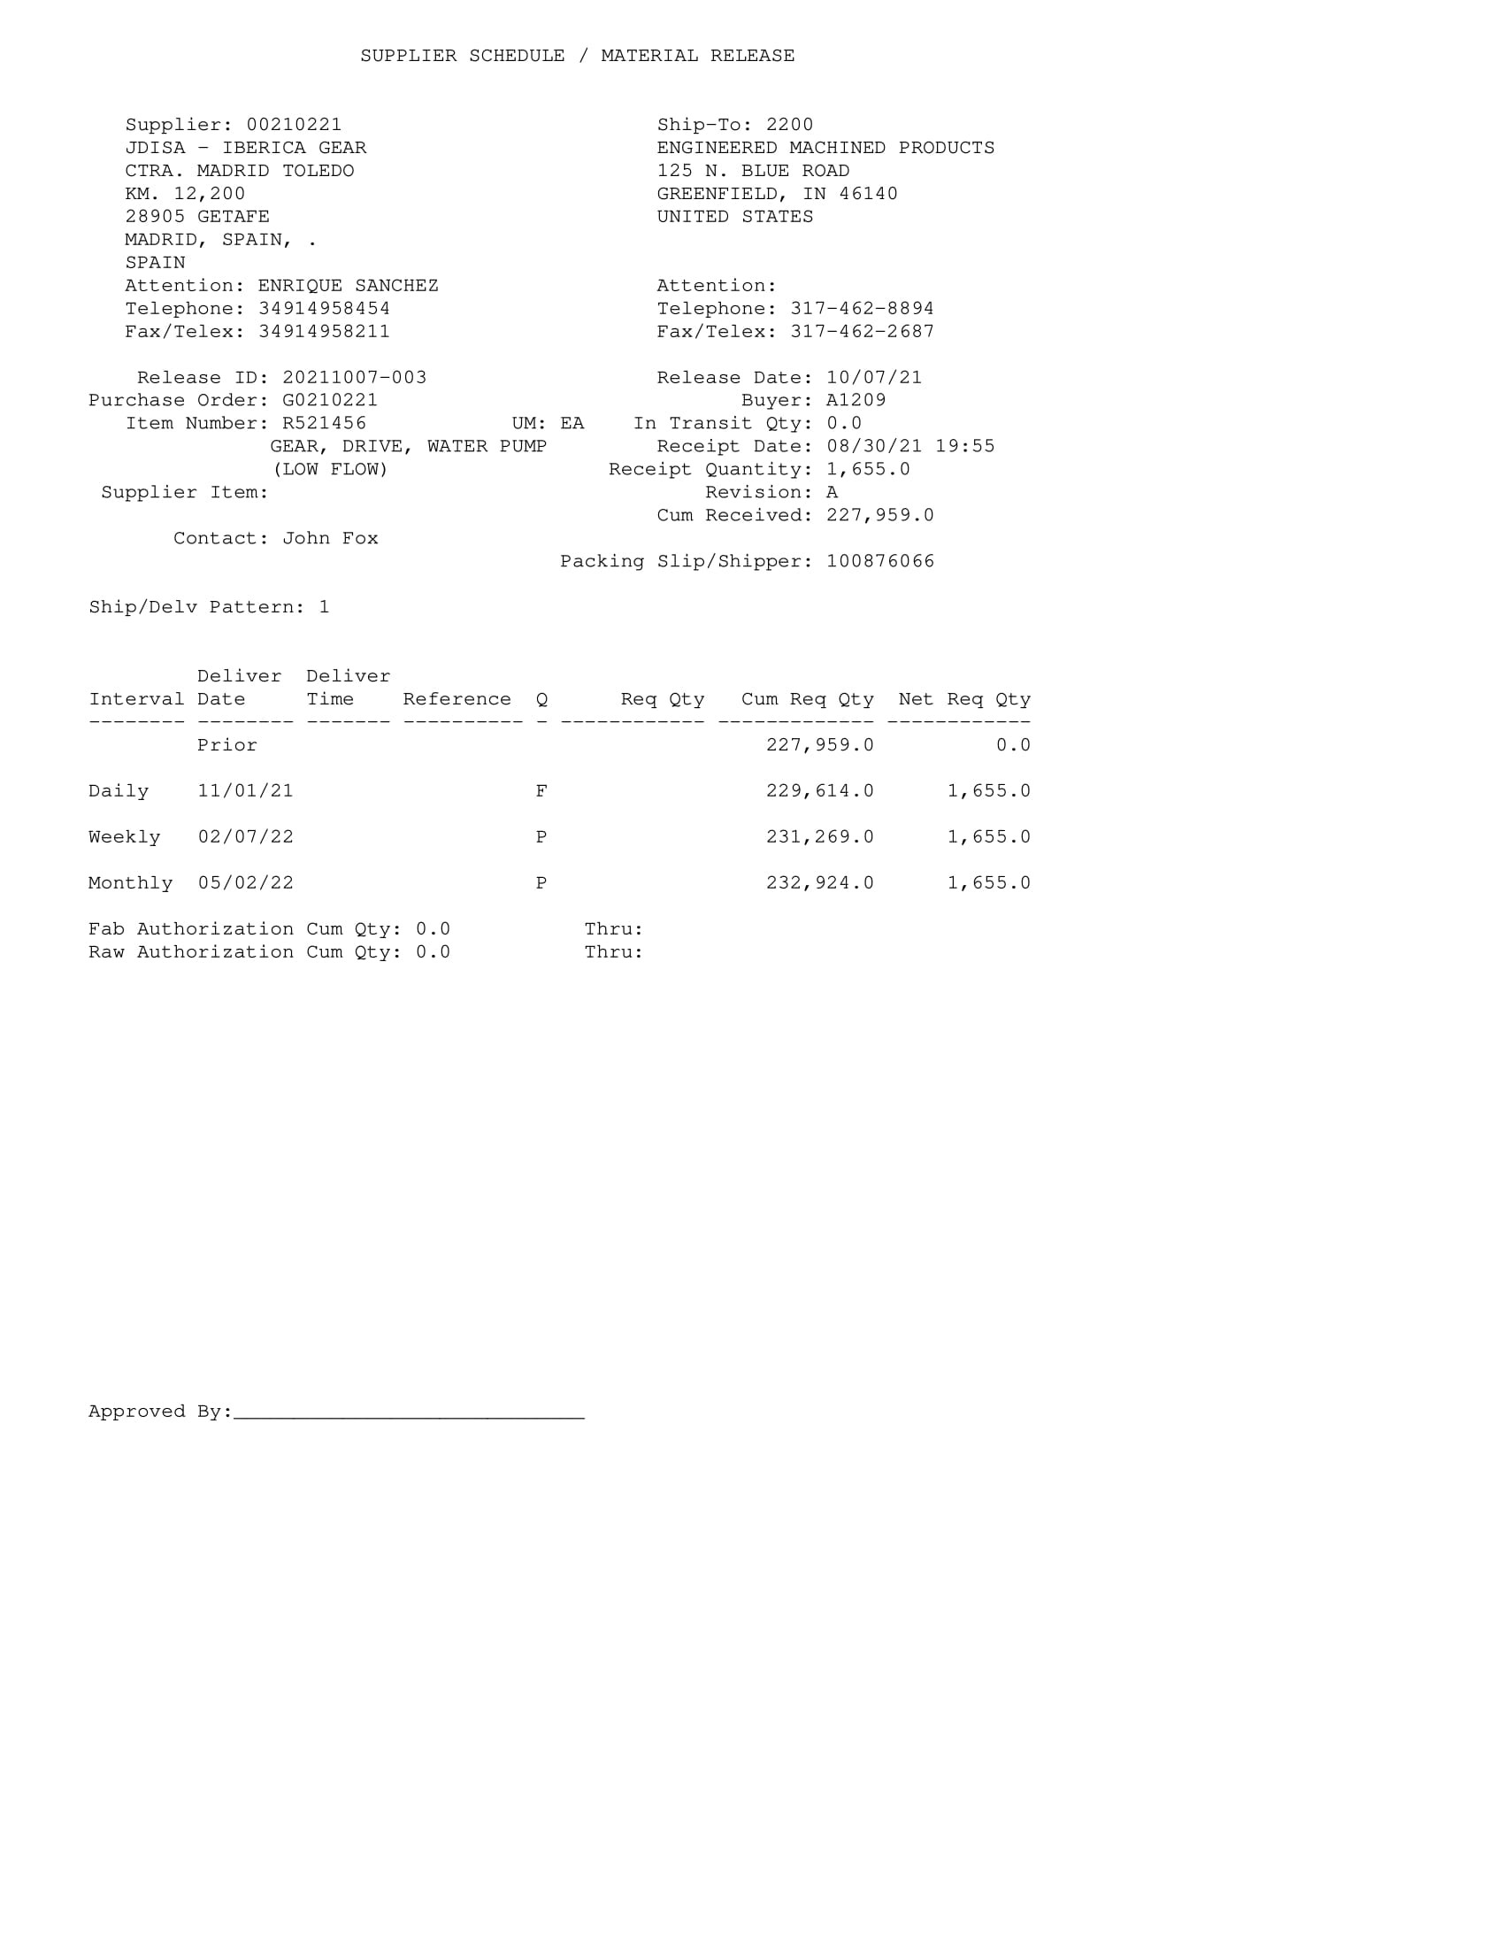
EMP
Campos validos

Slide 8
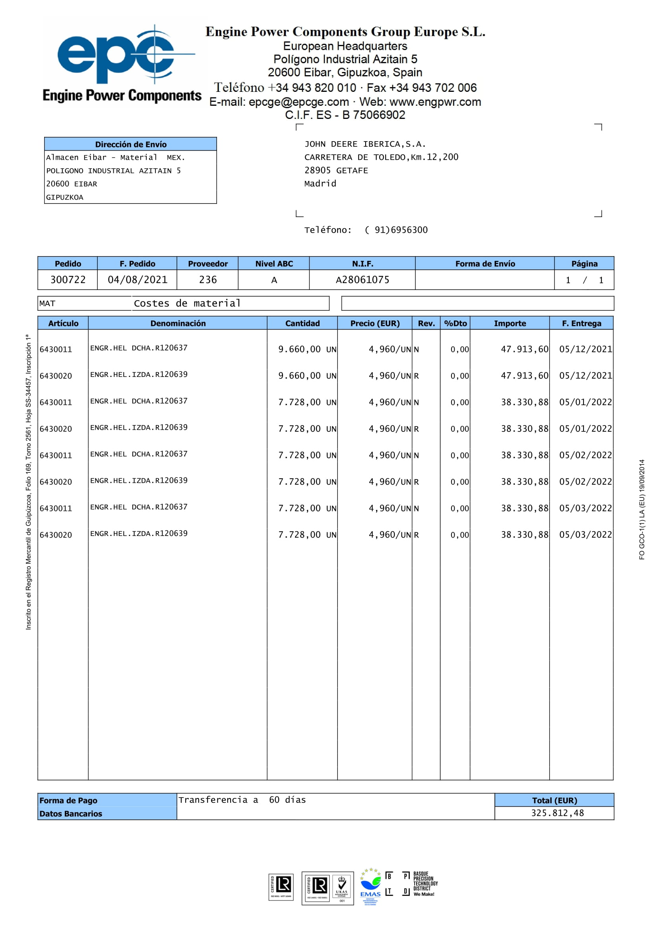

Engine Power Compoments
Campos validos

Slide 9
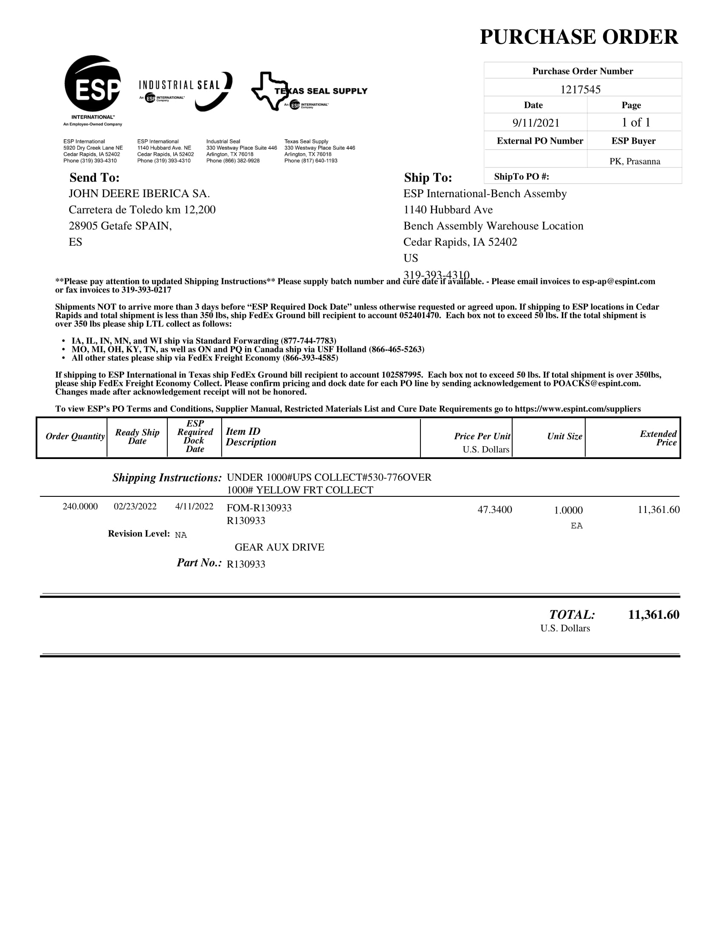
ESP

Slide 10
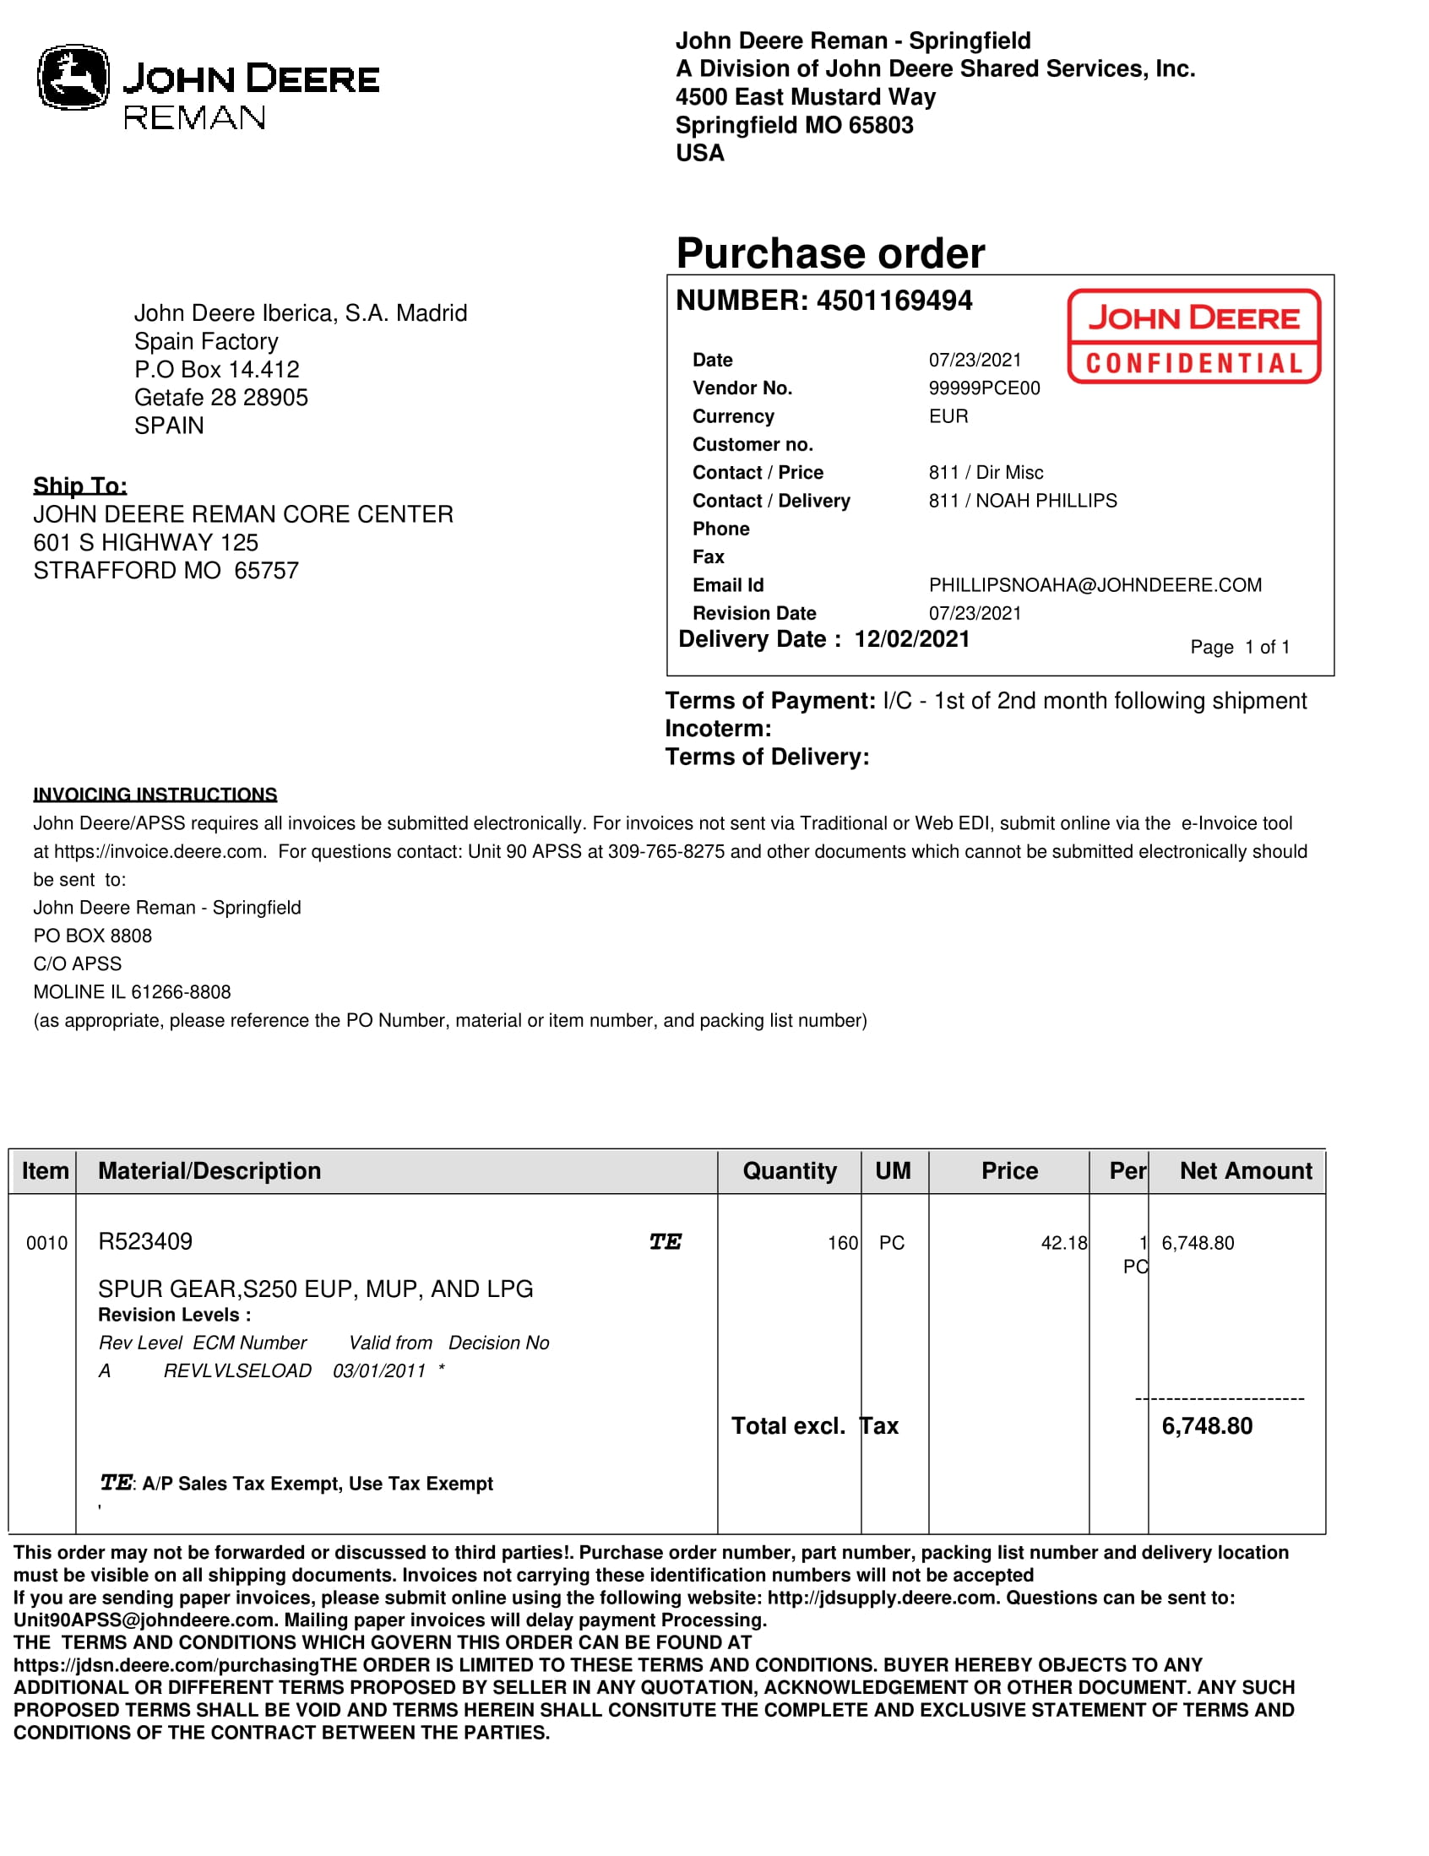
JD REMAN

Slide 11
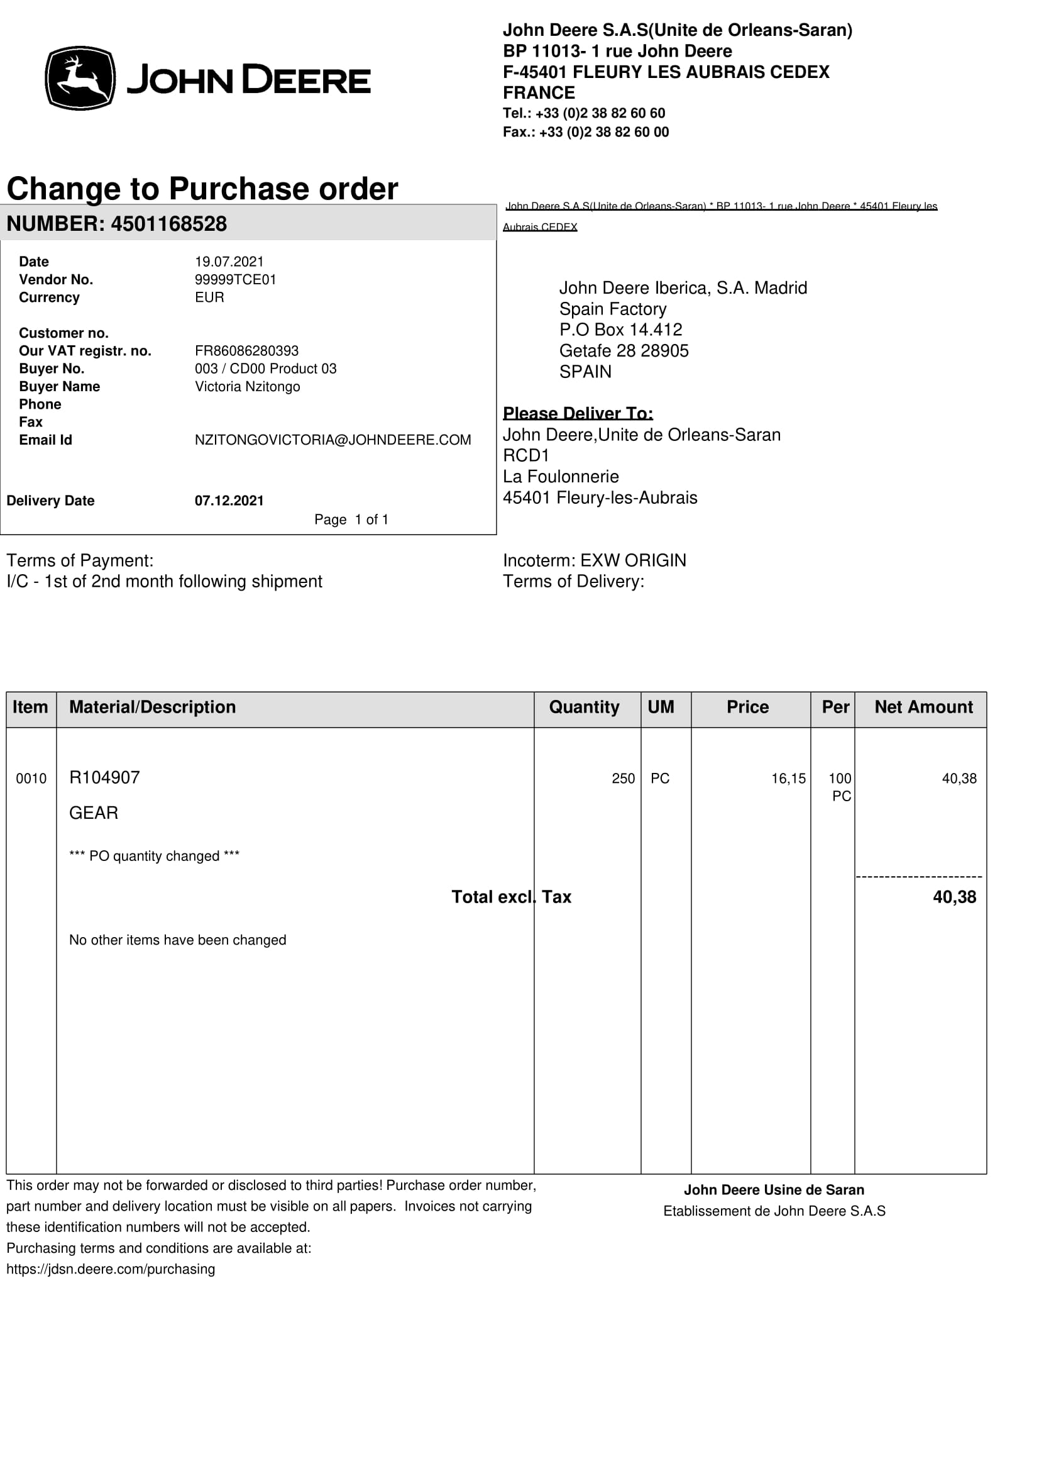
JD SARAN

Slide 12
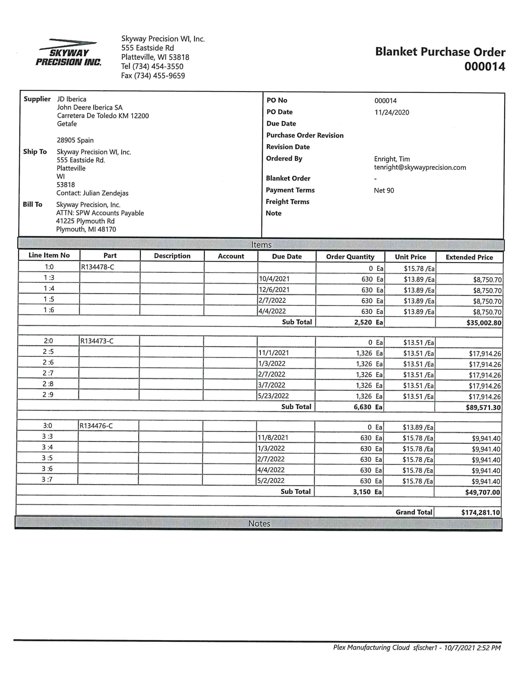
Skyway

Slide 13
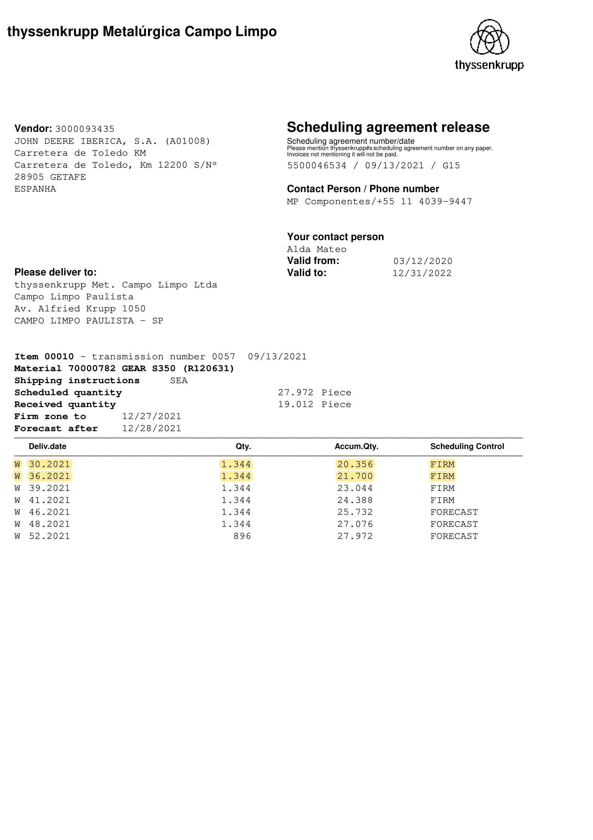
Thyssenkrupp Campo Limpo
Campos validos

Slide 14
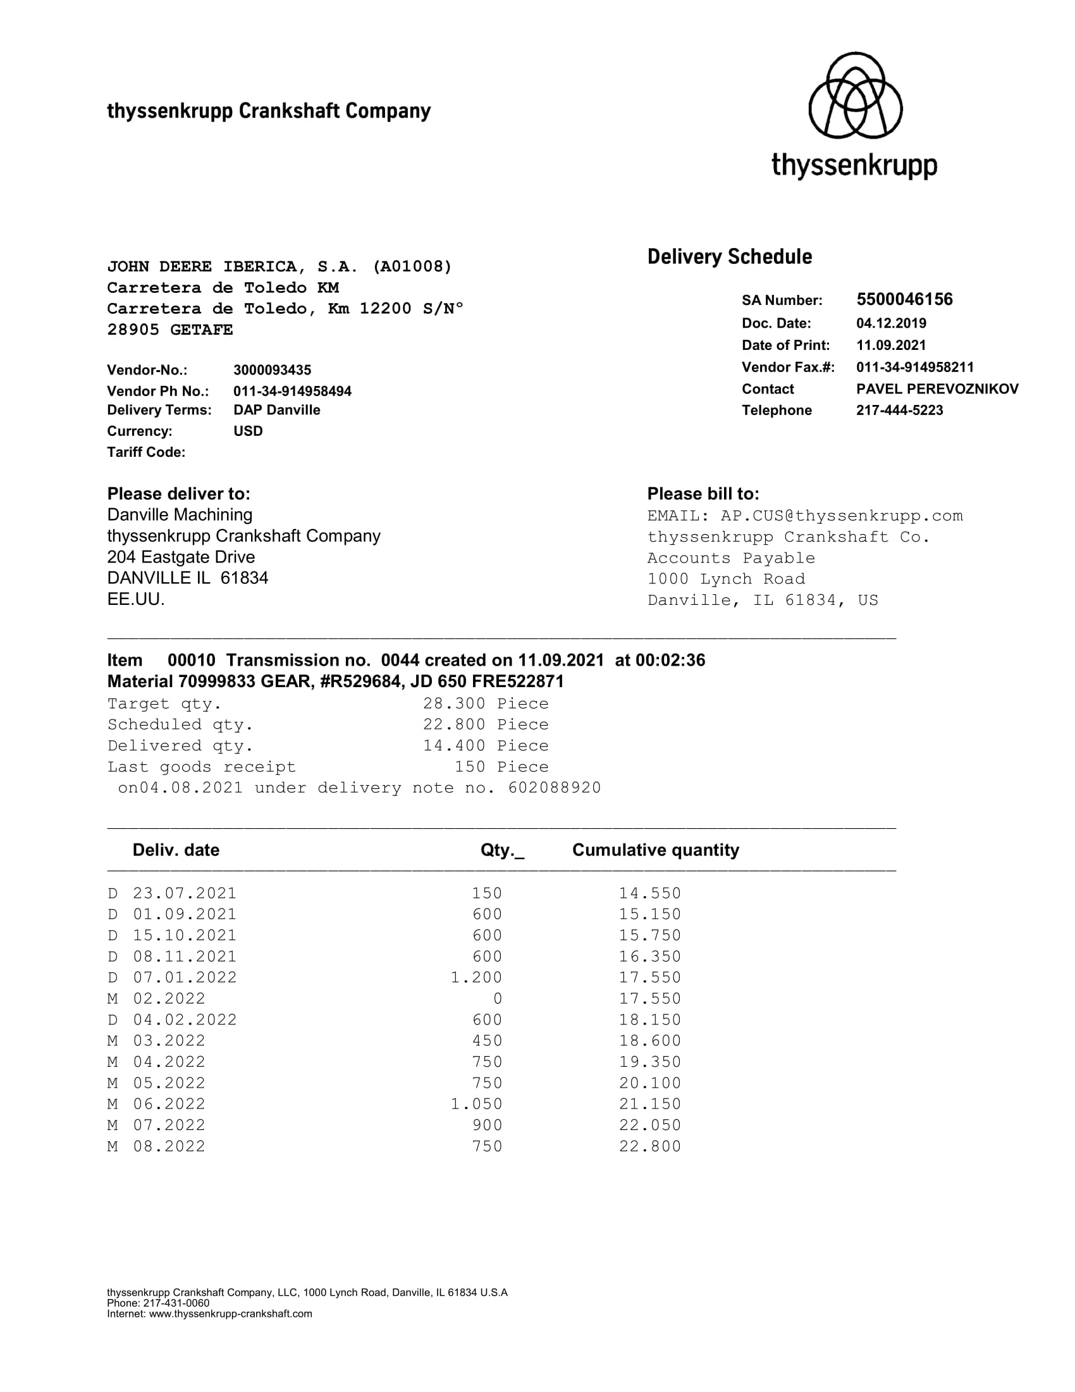
Thyssenkrupp Crankshaft
Campos validos

Slide 15
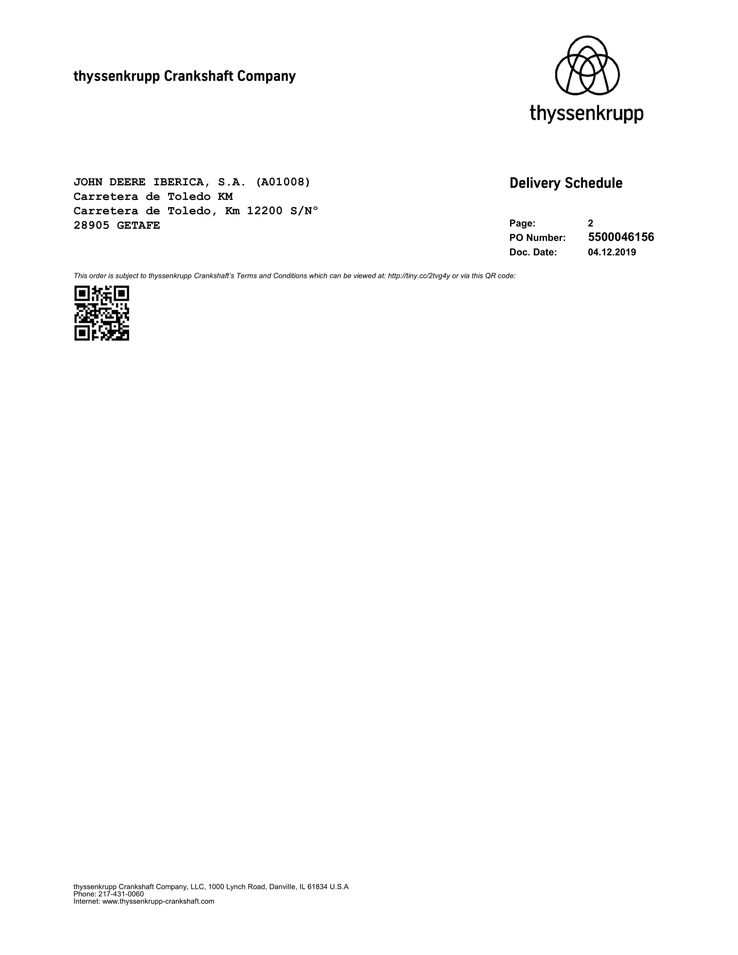
Thyssenkrupp Crankshaft
Campos validos

Slide 16
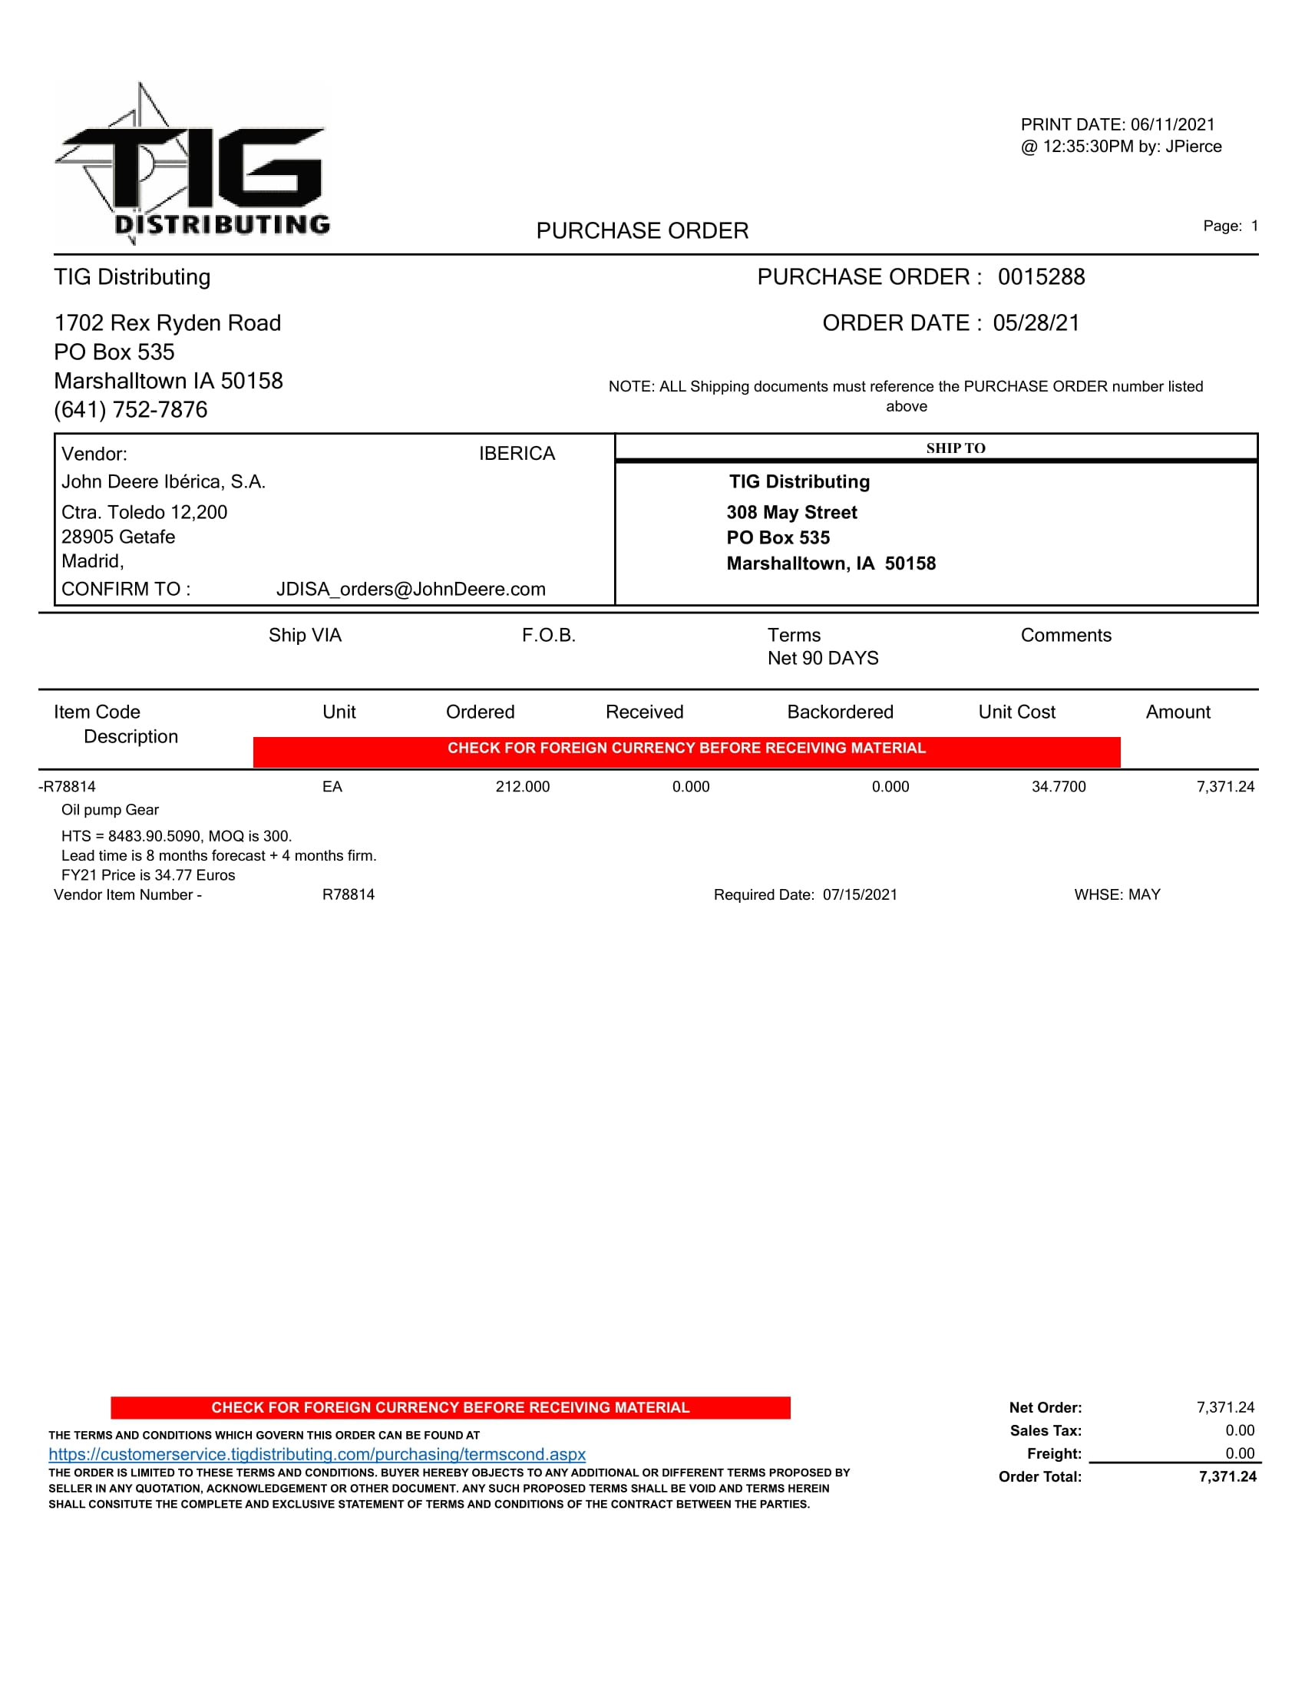
TIG

Slide 17
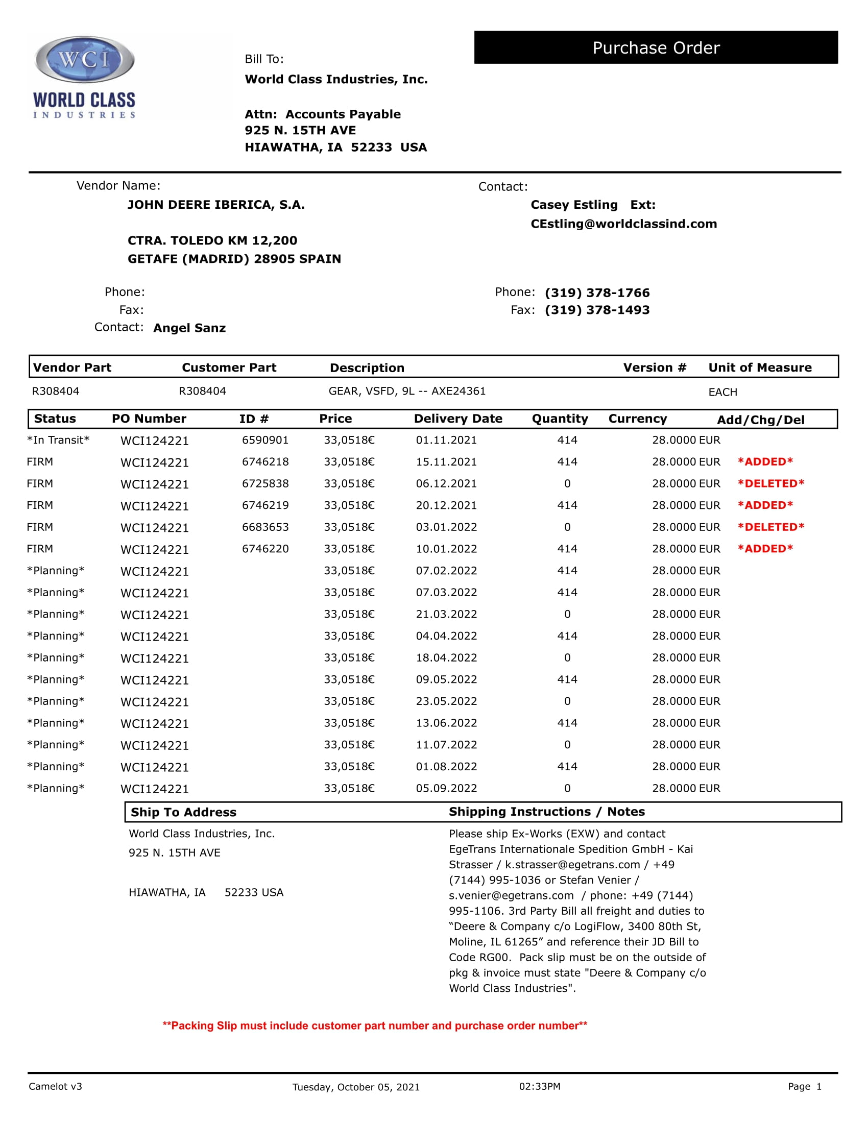
WordClass Industries
Campos validos

Slide 18
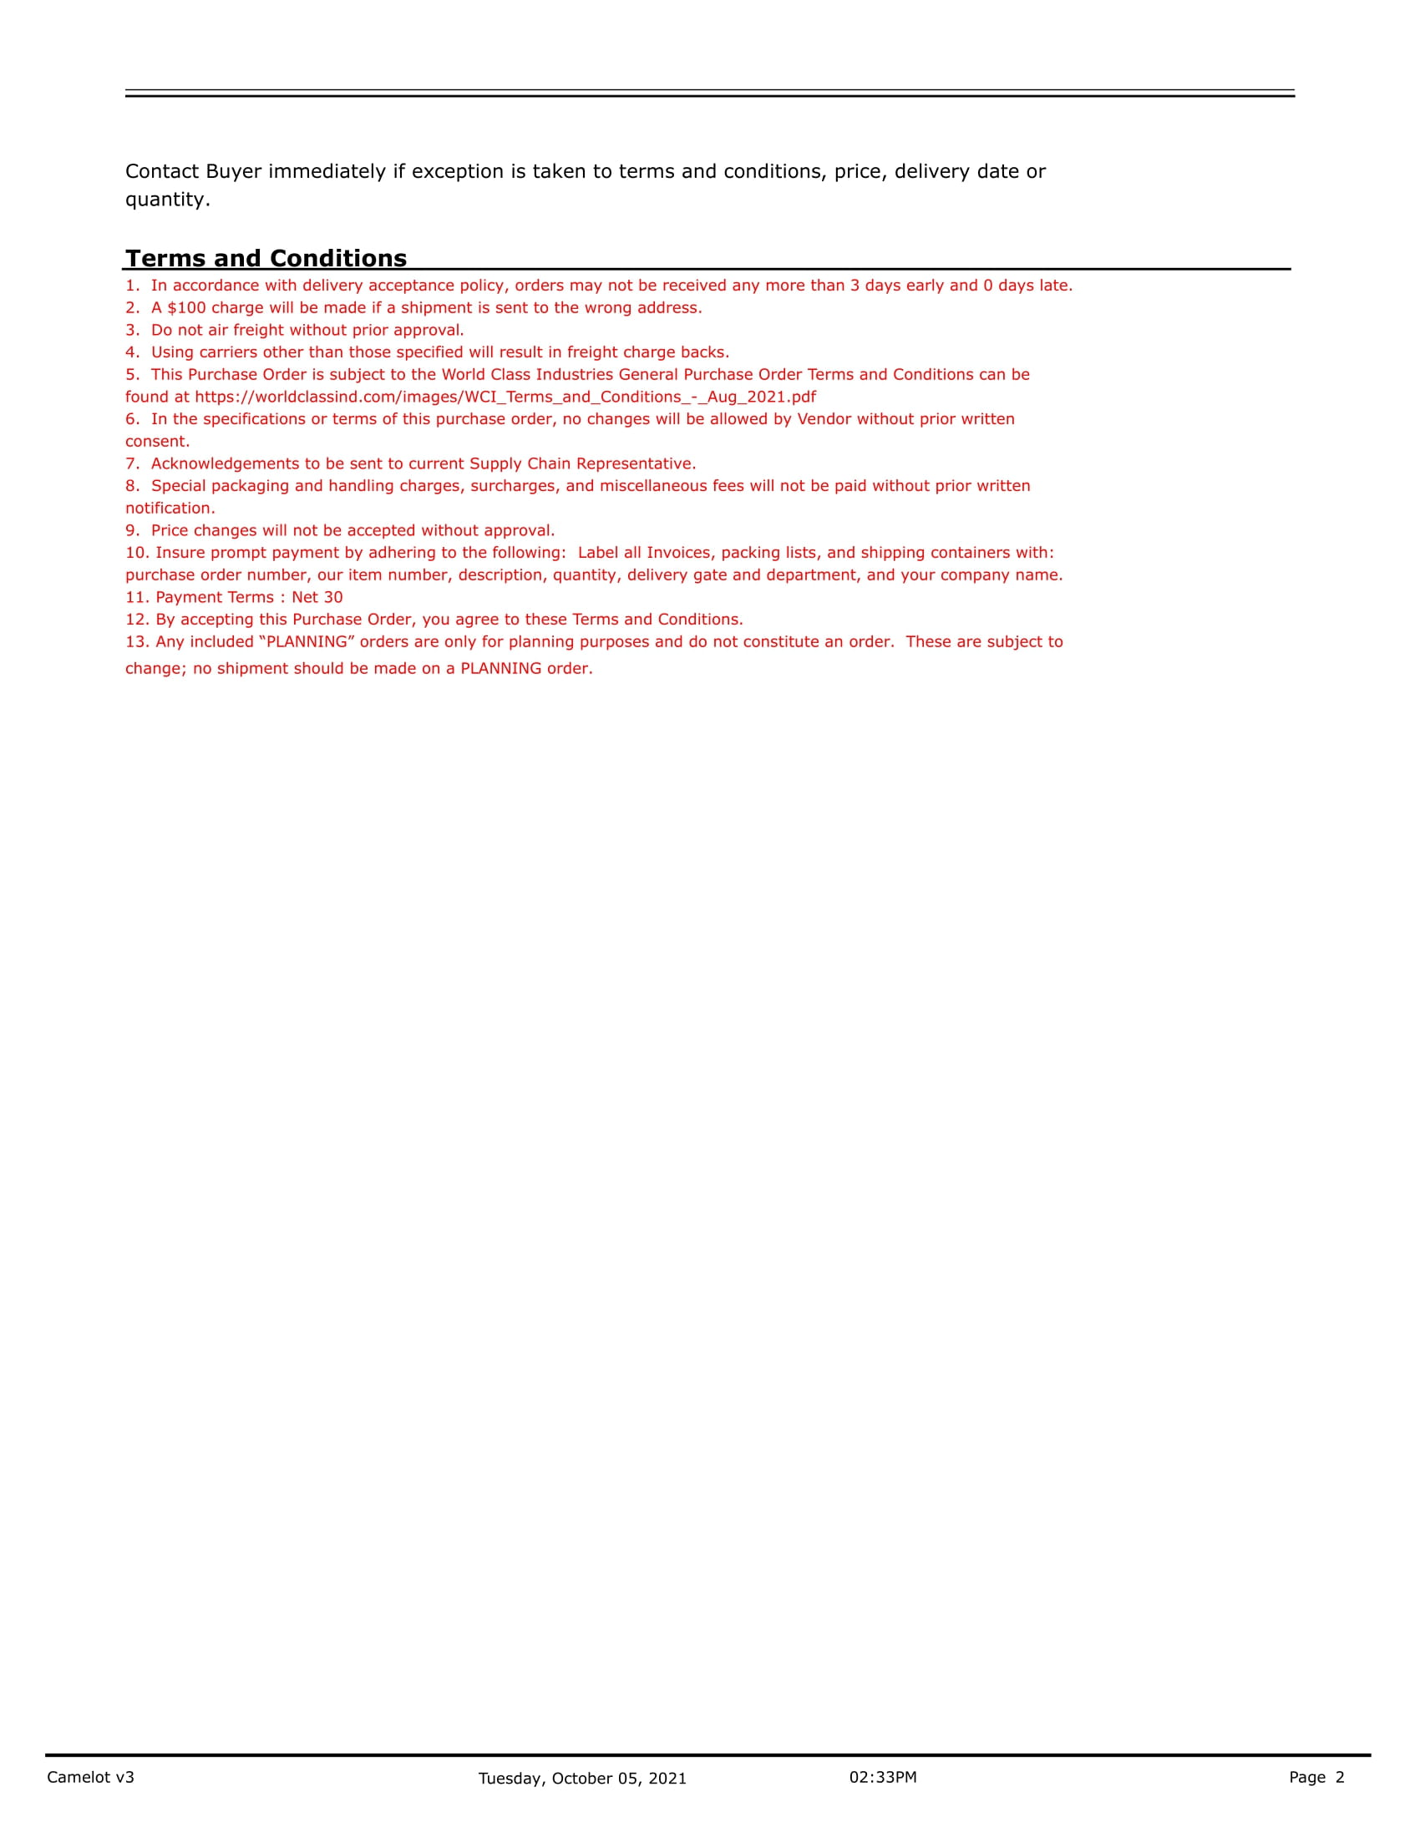
WordClass Industries
Campos validos

