Slide 1
Leyenda de colores
Order_number
Reference
Quantity
Ship_out_date
Arrival_date

Slide 2
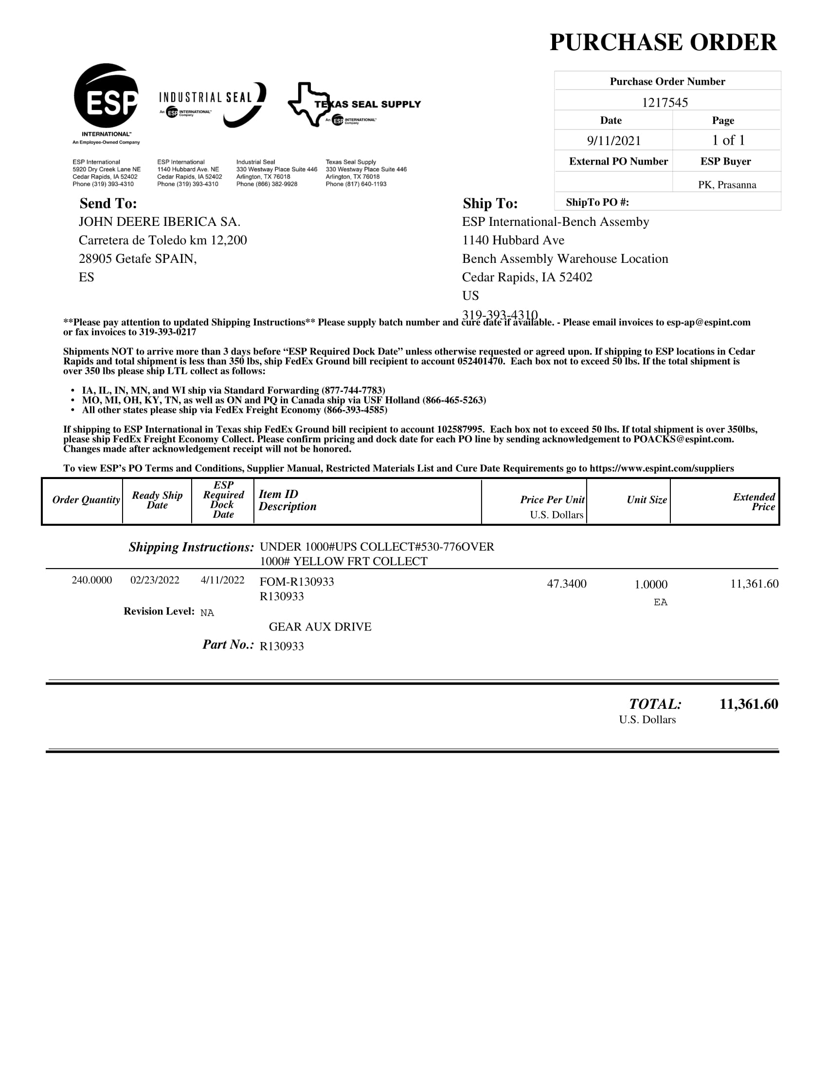

ESP (70001256)
No escaneado

Slide 3
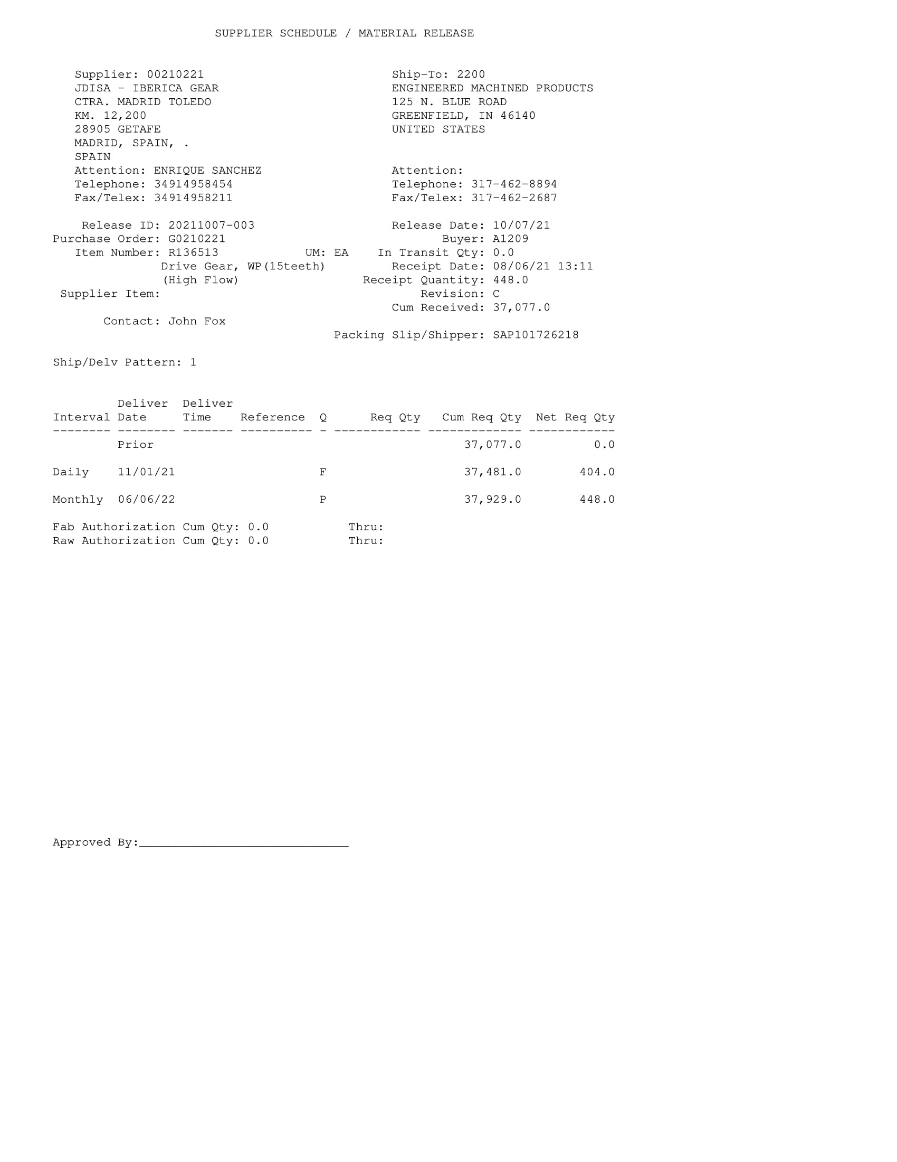
EMP (70012672)
No Escaneado

Slide 4
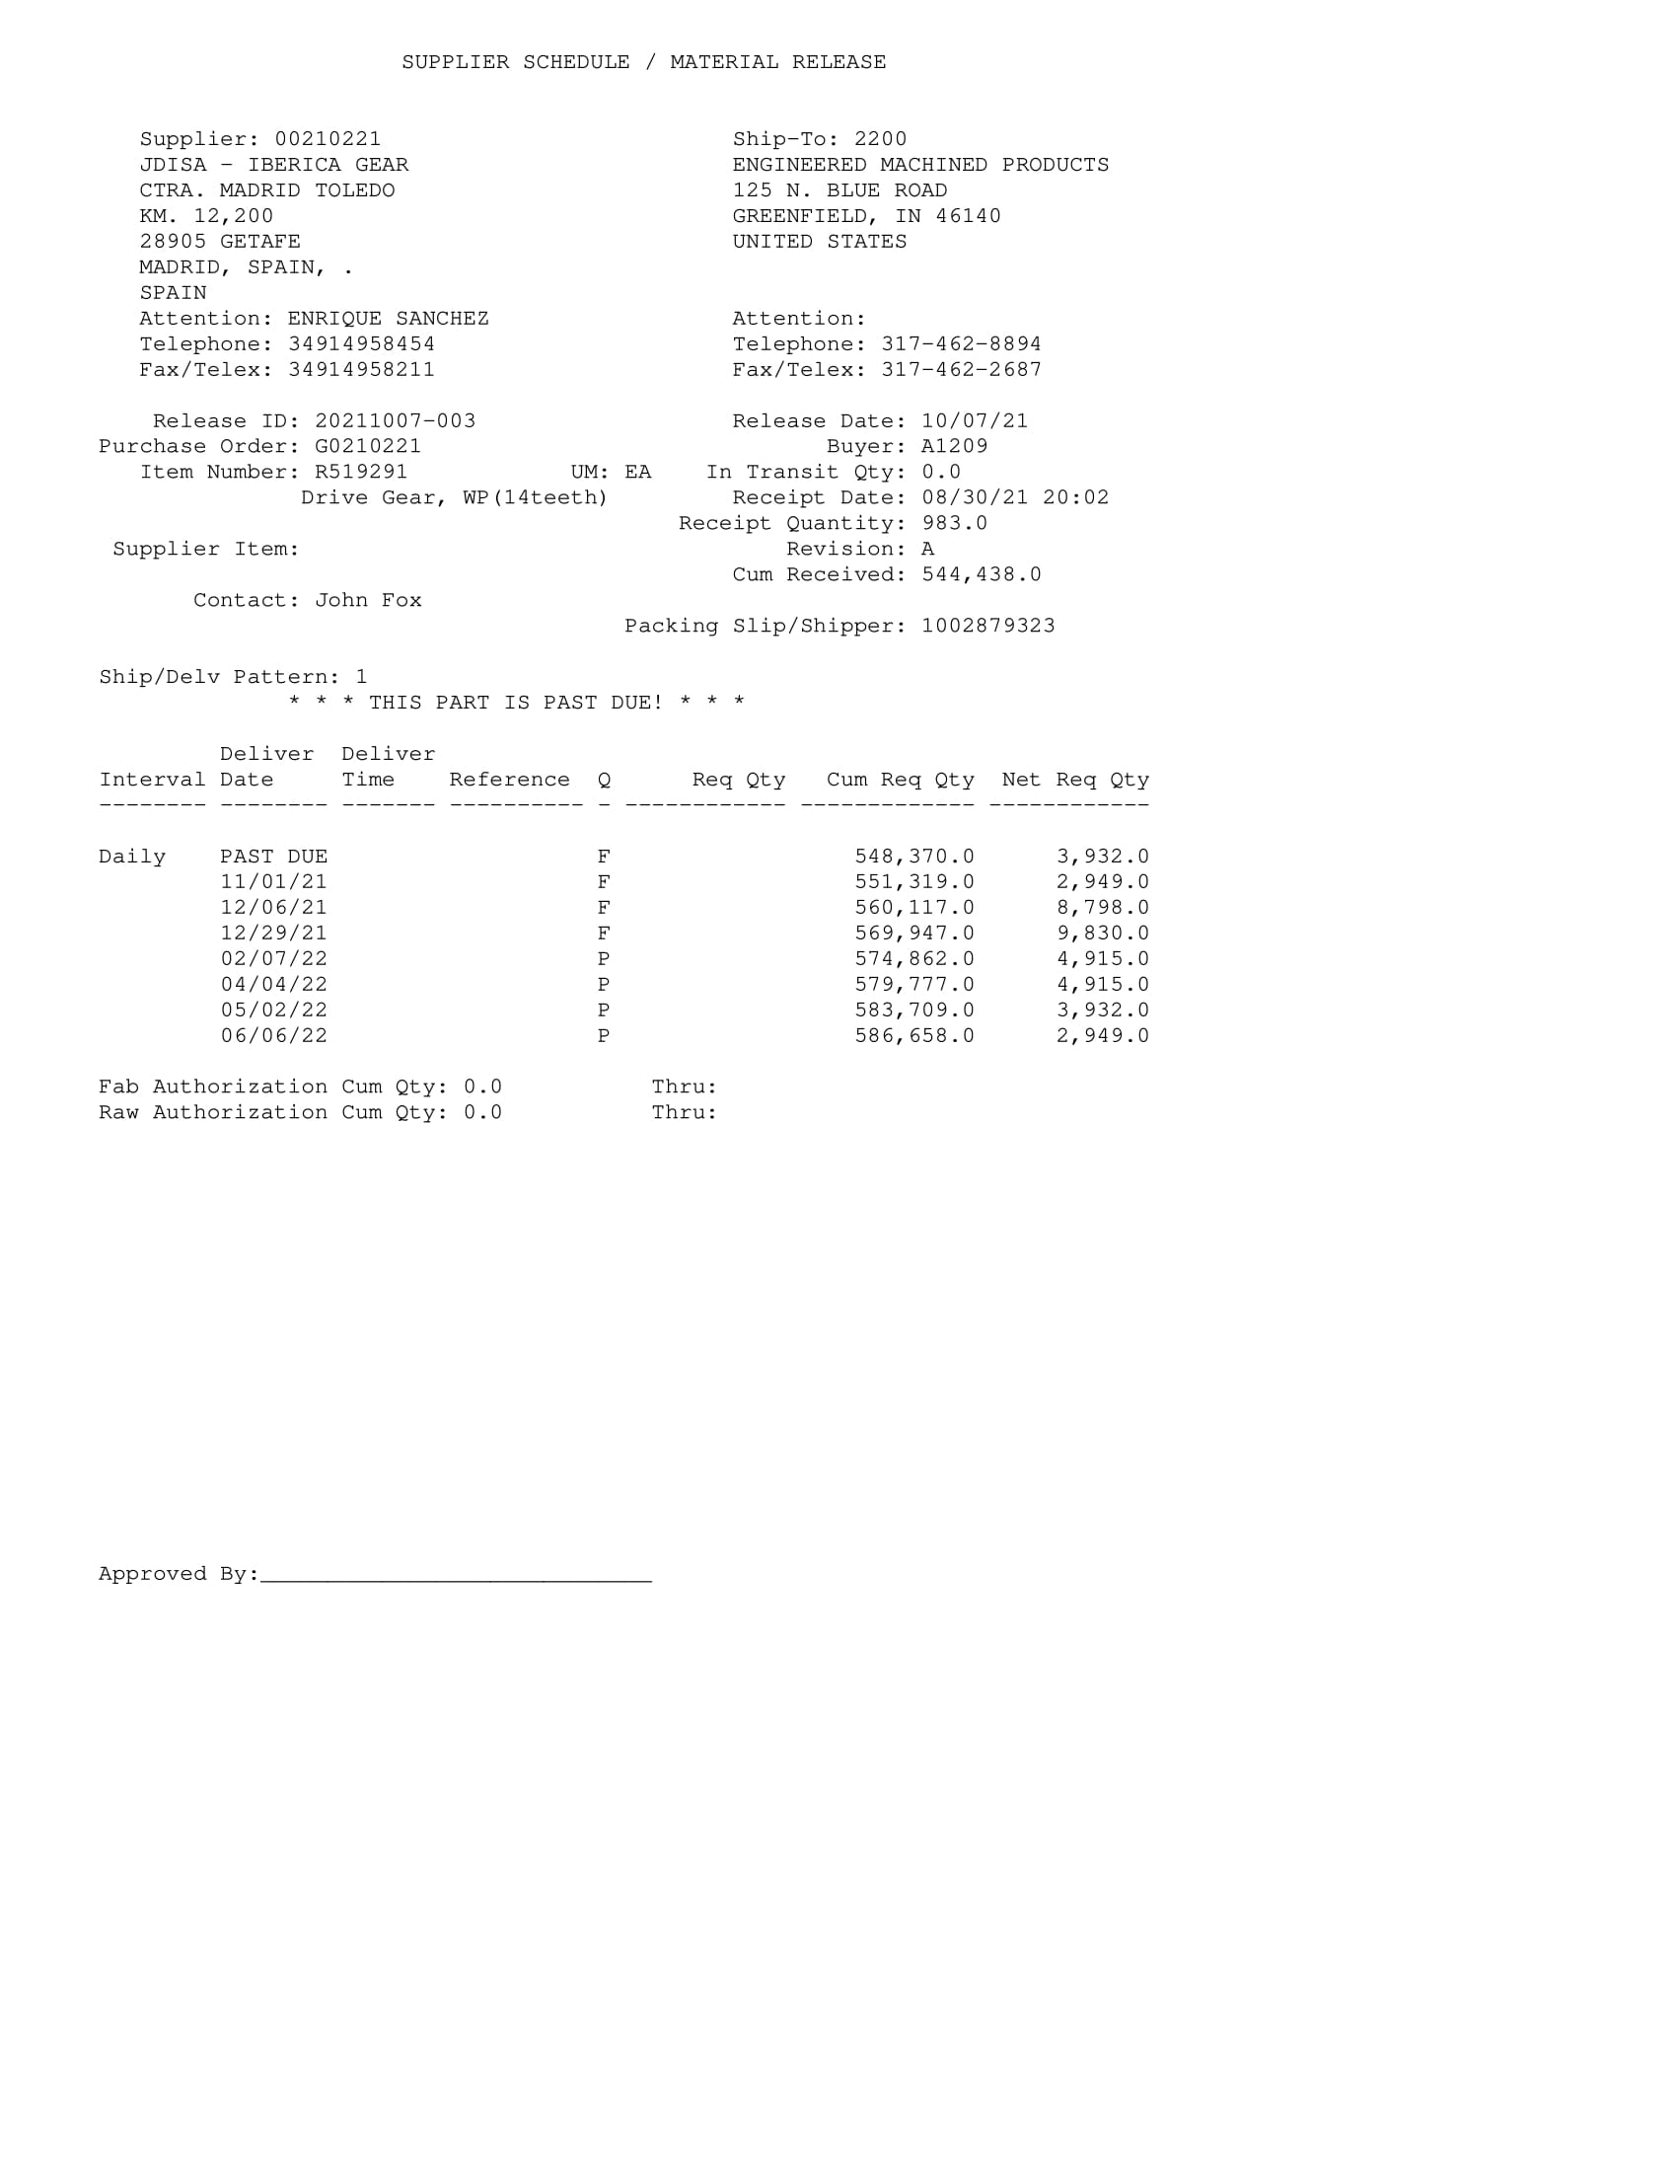
EMP
No escaneado

Slide 5
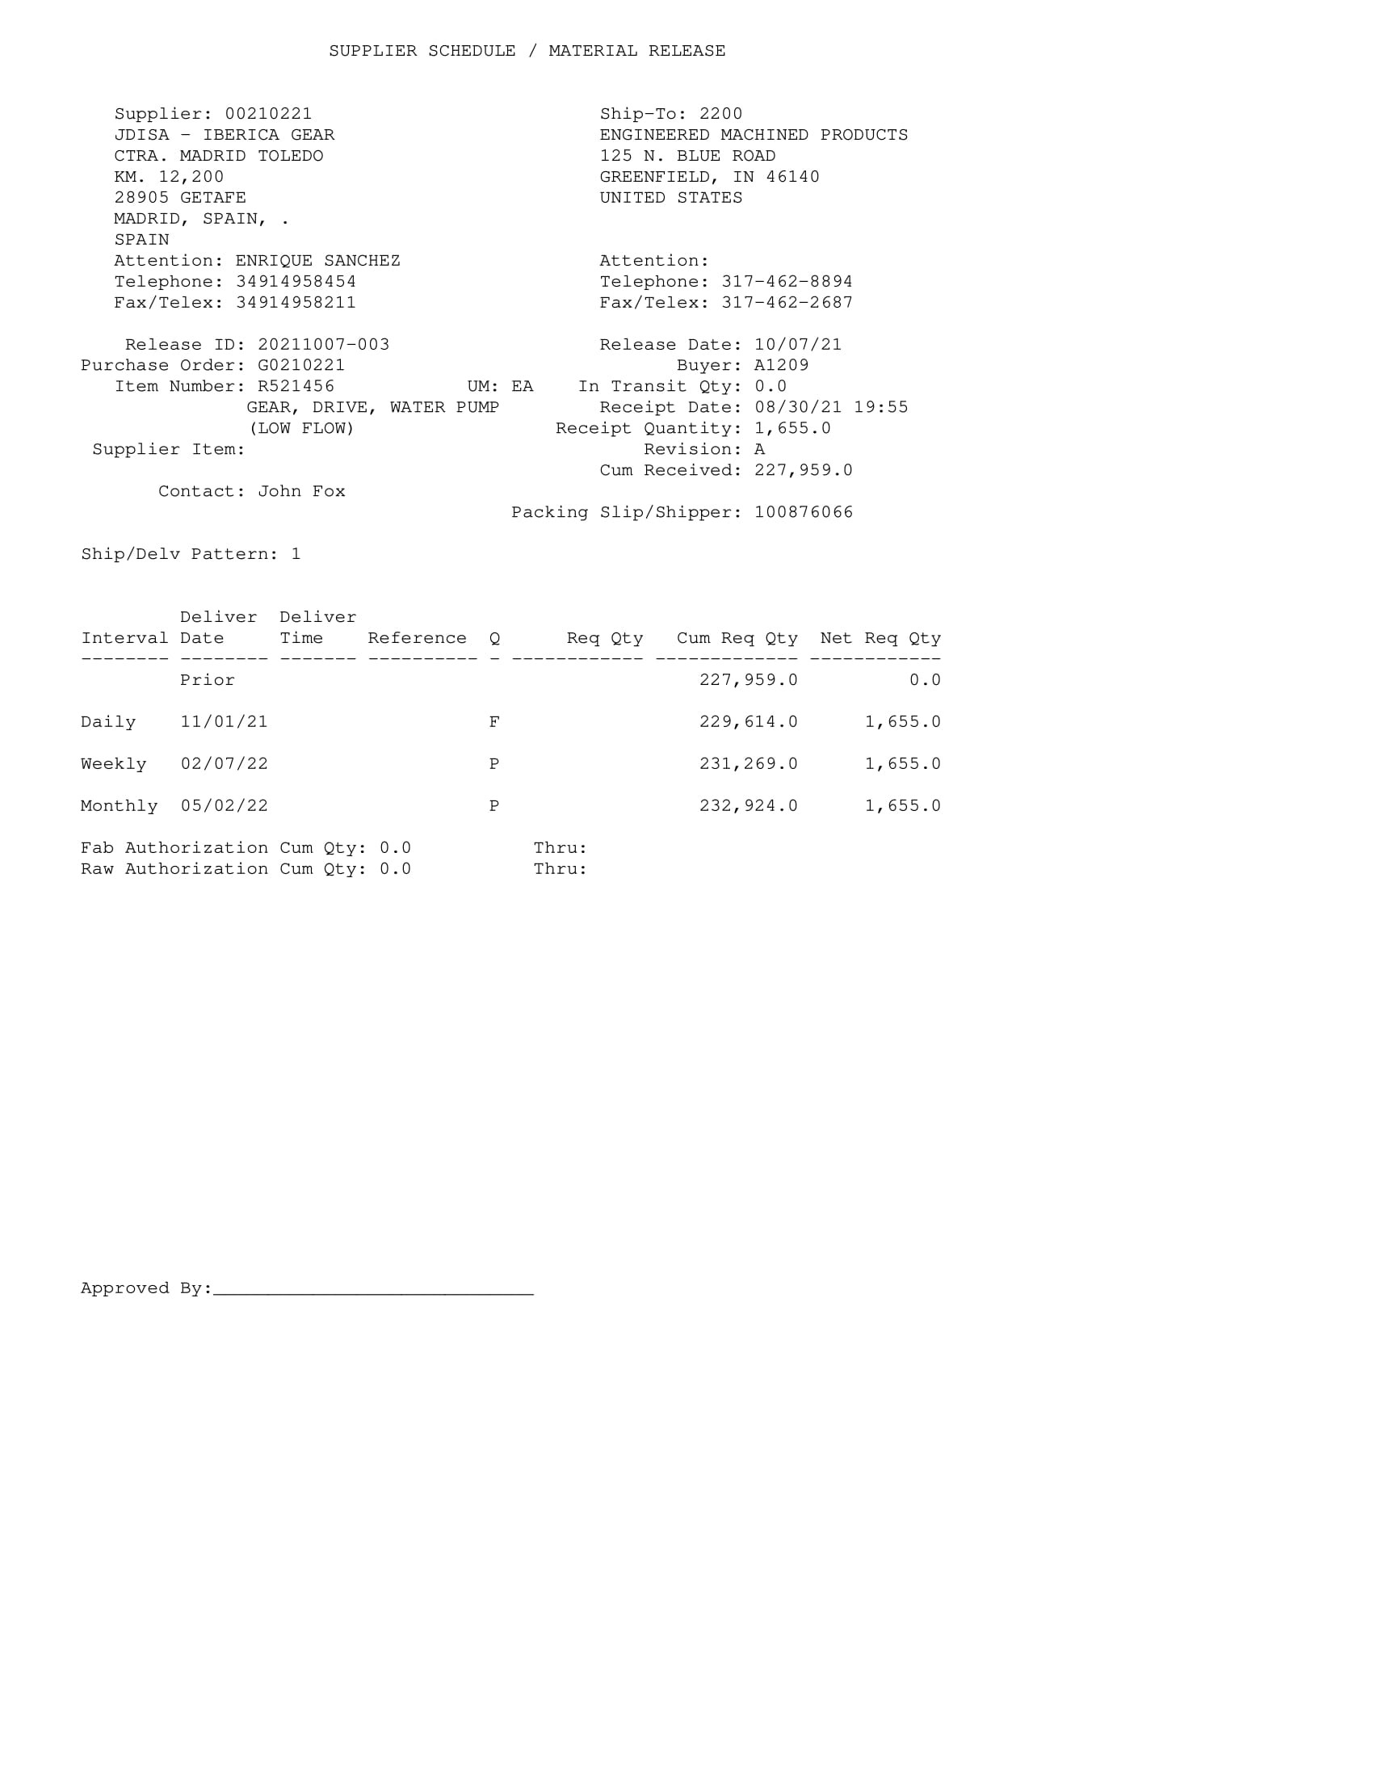
EMP
No escaneado

Slide 6
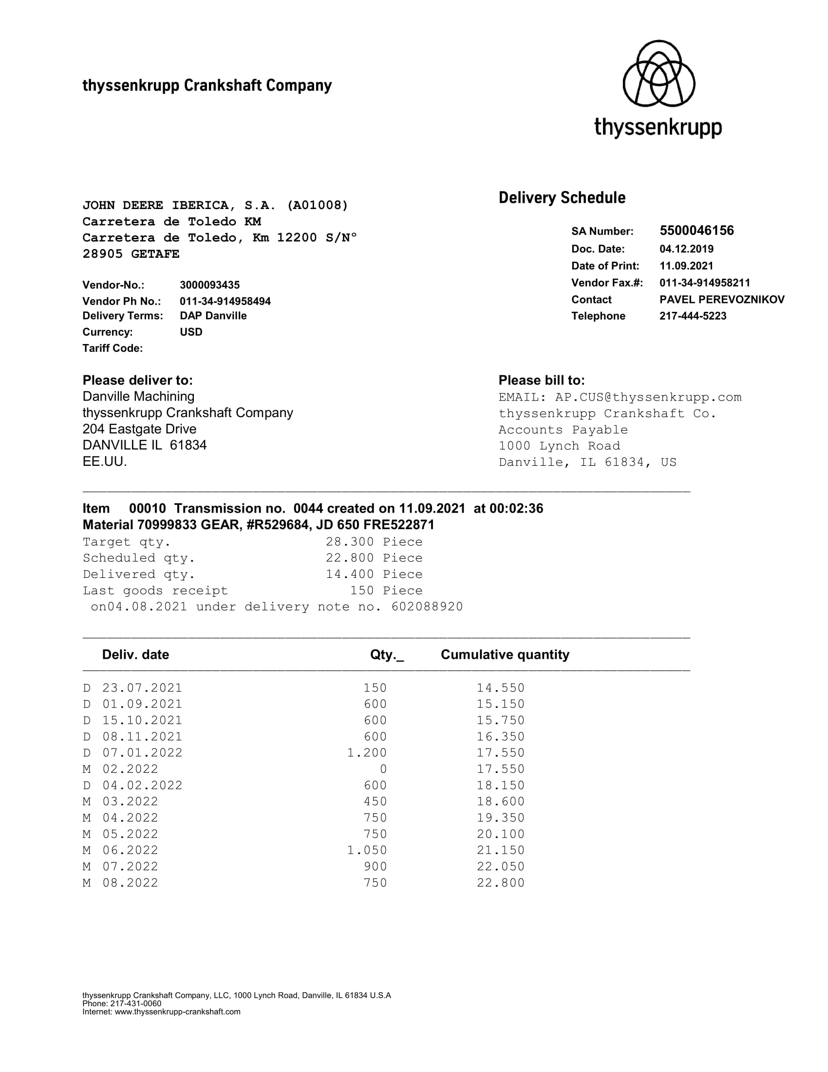
Thyssenkrupp Crankshaft (70017048)
No escaneado

Slide 7
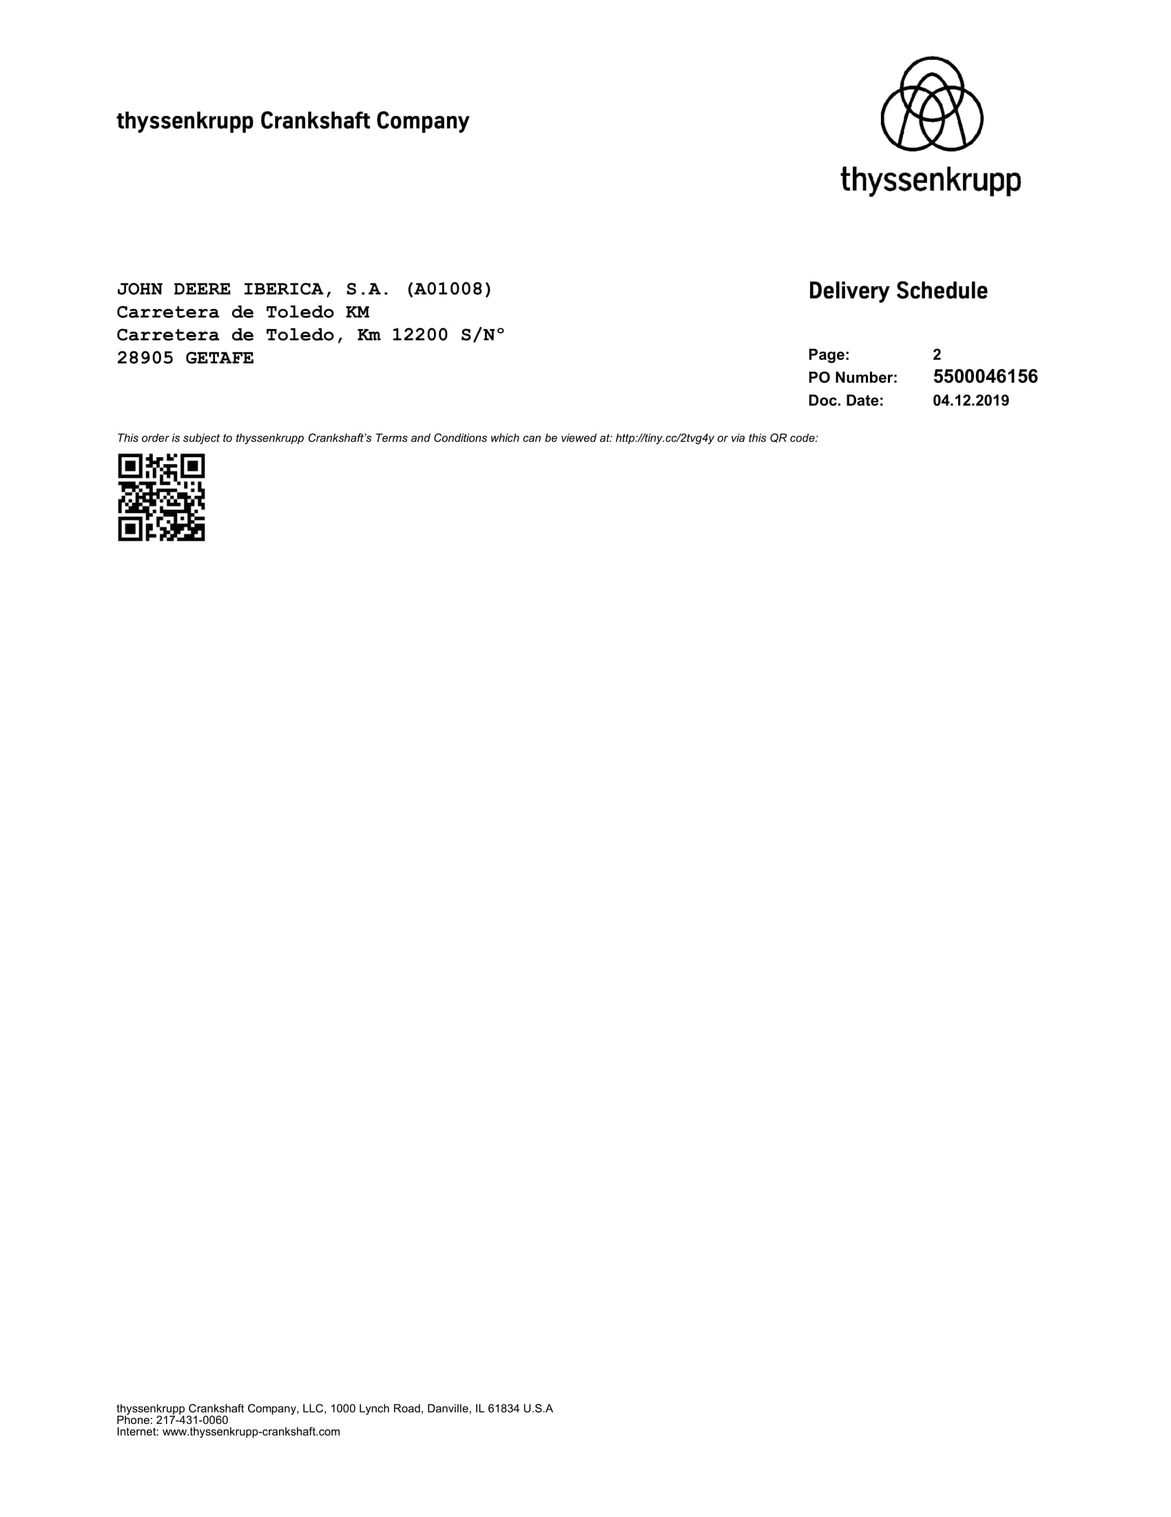
Thyssenkrupp Crankshaft (70017048)
No escaneado

Slide 8
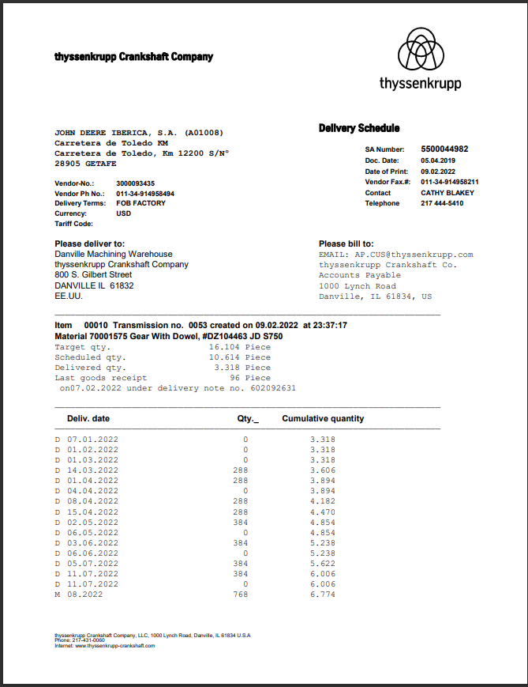
Thyssenkrupp Crankshaft (70017048)
No escaneado

Slide 9
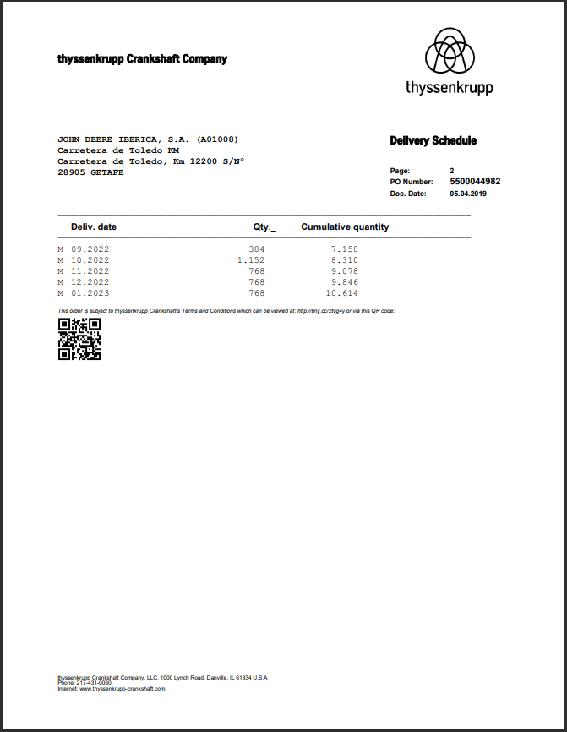
Thyssenkrupp Crankshaft (70017048)
No escaneado

Slide 10
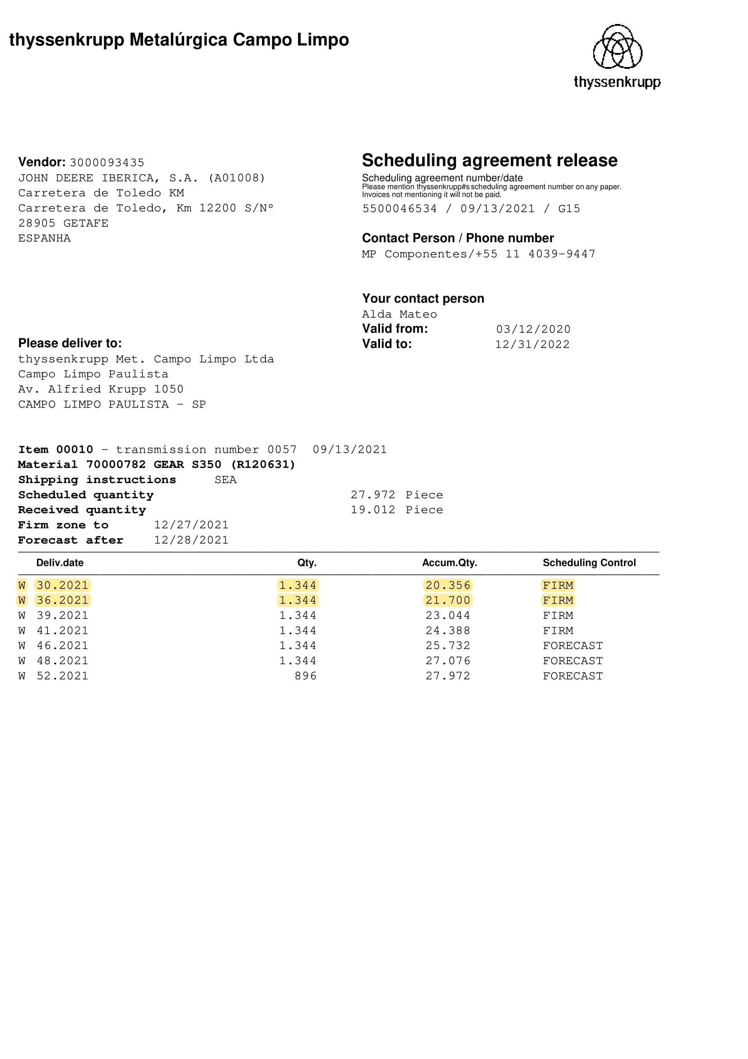
Thyssenkrupp Campo Limpo (70017078)
No escaneado

Slide 11
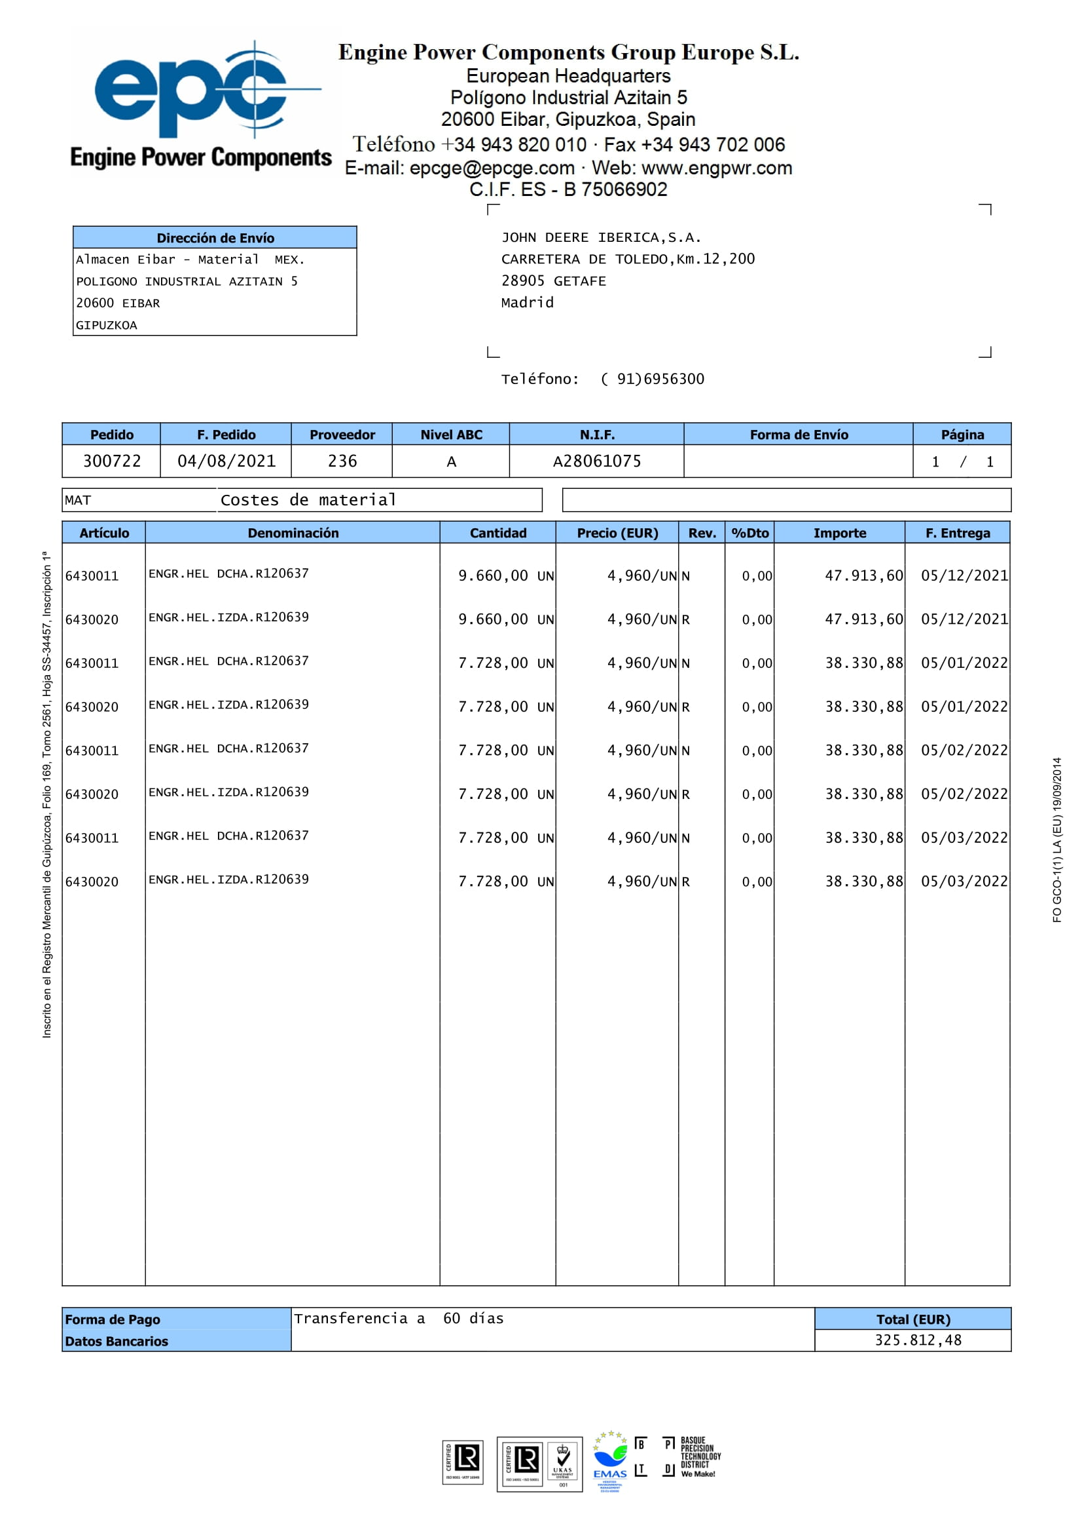
Engine Power Compoments (70017703)
No escaneado

Slide 12
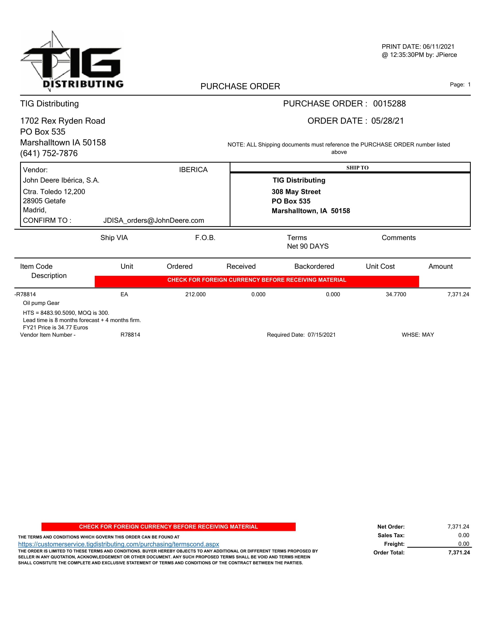
TIG (70017869)
No escaneado

Slide 13
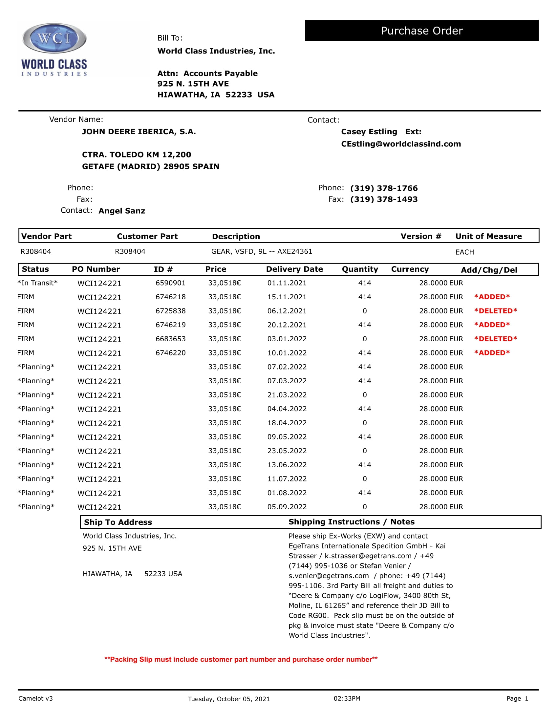
WordClass Industries (70018938)
No escaneado

Slide 14
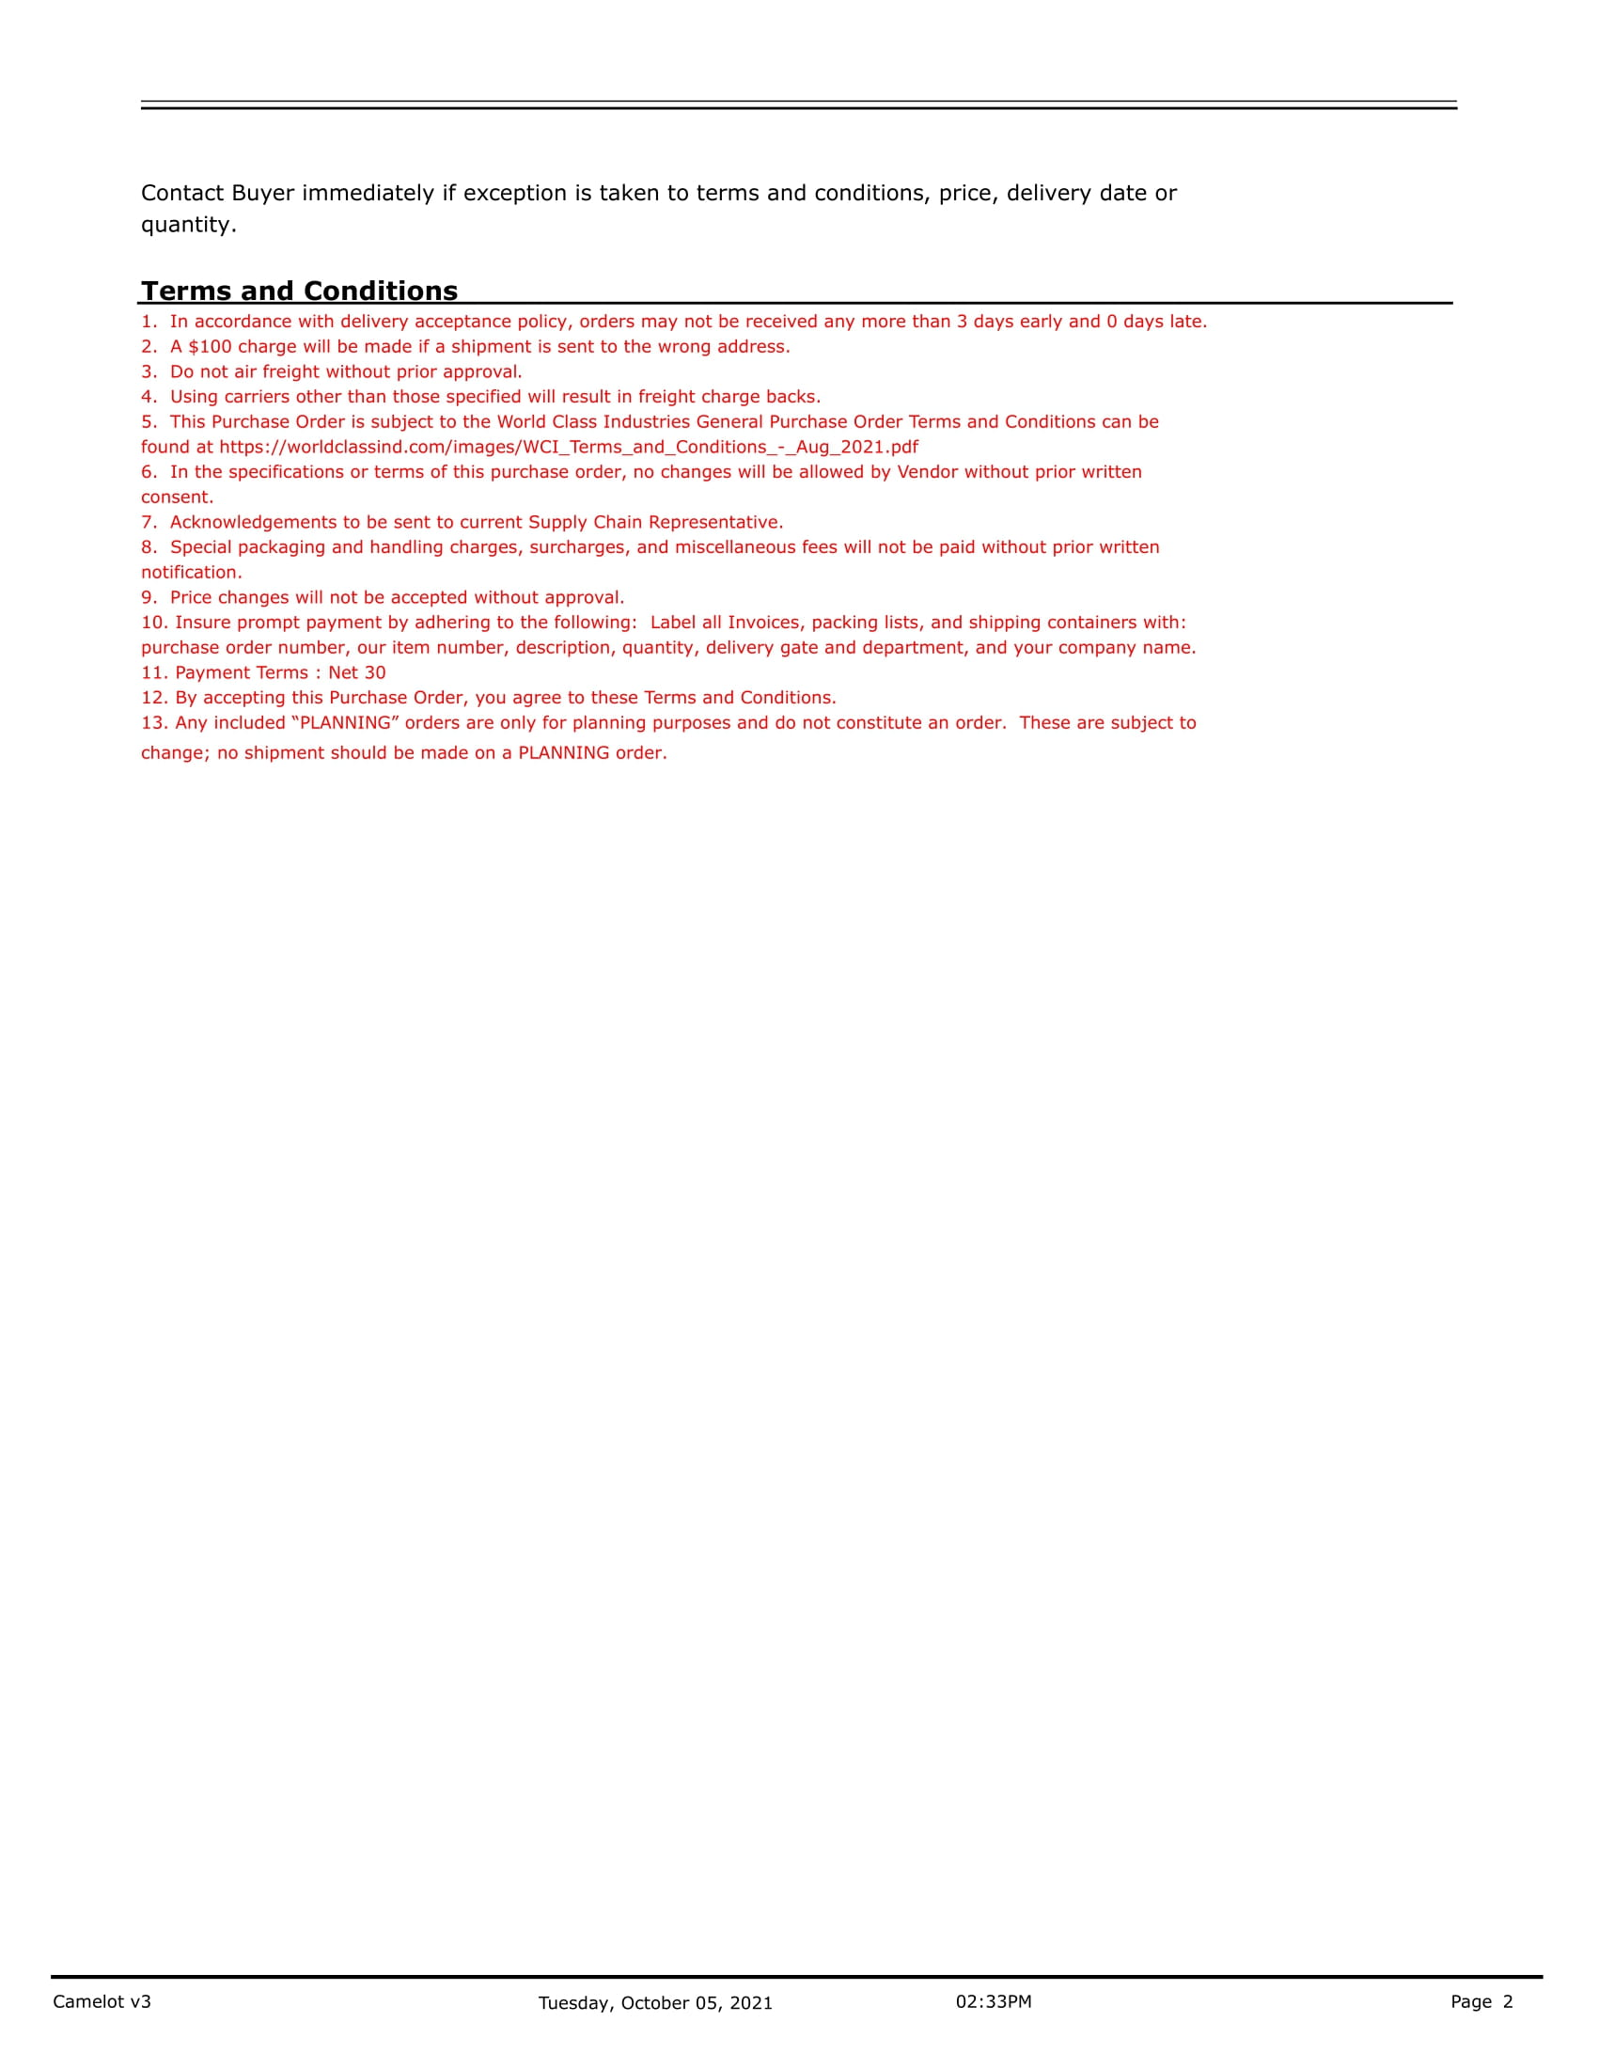
WordClass Industries (70018938)
No escaneado

Slide 15
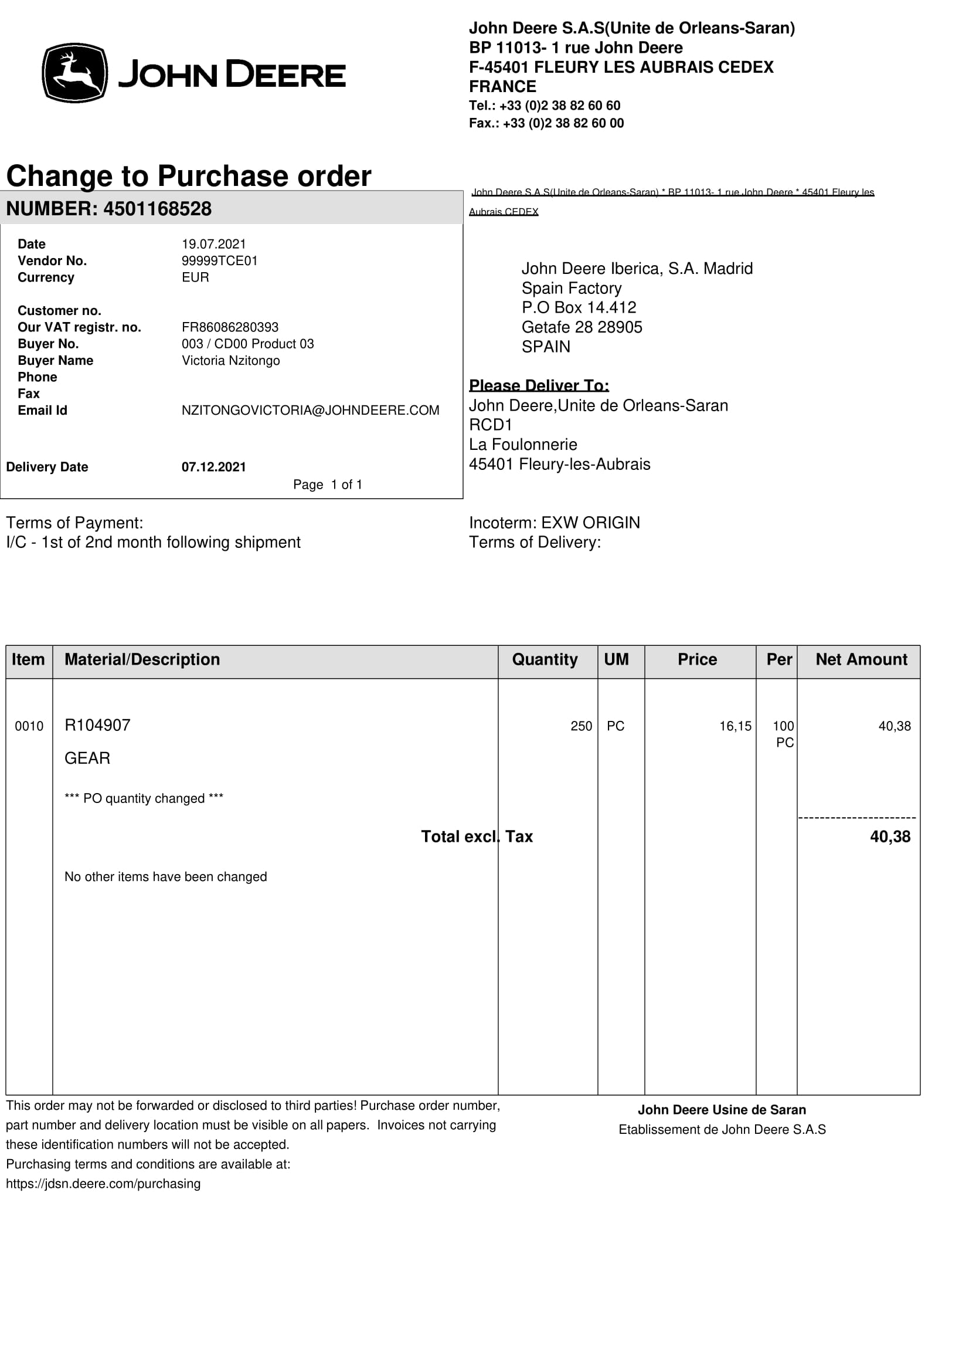
JD SARAN (99999TCD00)
No escaneado

Slide 16
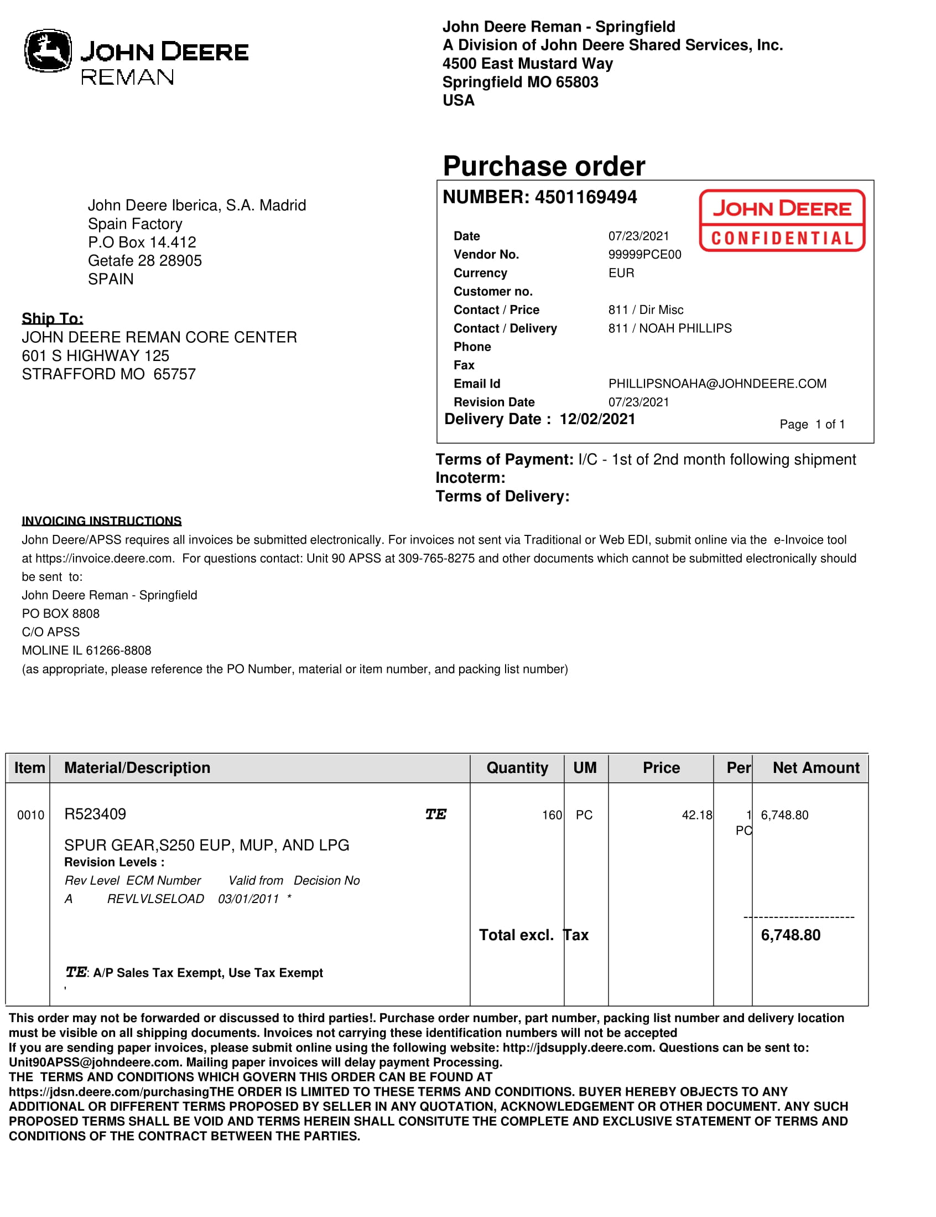
JD REMAN (99999TSE01)
No escaneado

Slide 17
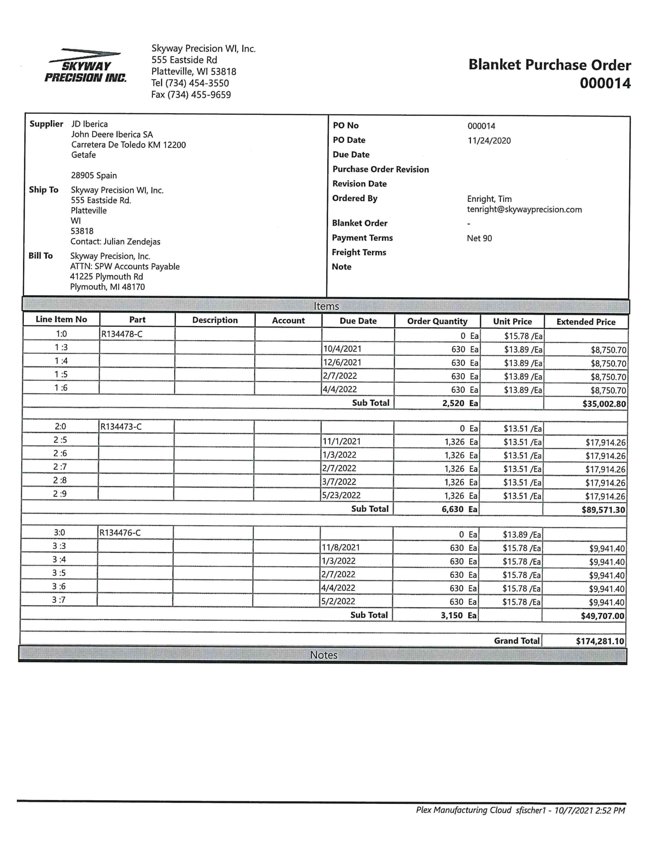
Skyway (70001353)
No escaneado

Slide 18
Concentric (70016983)
Concentric Pumps Pune Pvt ltd (Eou div) |  |  |  |  |  |  | 31/07/2021
Supplier Schedules For the month of Aug-21 to Apr-22
 |  |  |  | Firm |  | Tentative
Sr.No. | Part. No. | Supplier | Description | Aug-21 | Sep-21 | Oct-21 | Nov-21 | Dec-21 | Jan-22 | Feb-22 | Mar-22 | Apr-22
1 | R527691B | JD Iberica | Gear JD T4 OP | 0 | 0 | 0 | 1000 | 0 | 0 | 0 | 0 | 0
2 | R527010 | JD Iberica | Gear JD T4 OP | 4725 | 3780 | 4725 | 3780 | 3780 | 4725 | 3780 | 3780 | 3780

Slide 19
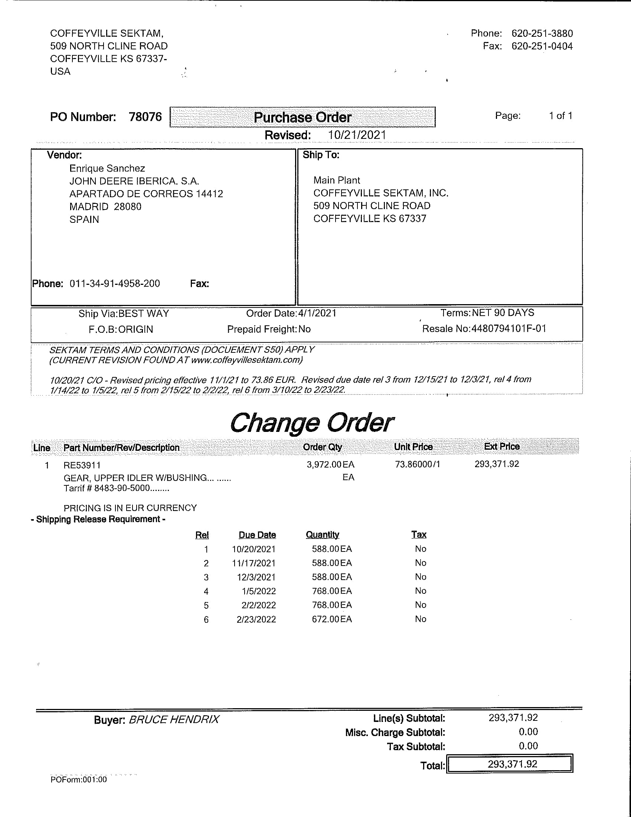
Coffeyville Sektam (70004530)
DESCARTADO
Escaneado

Slide 20
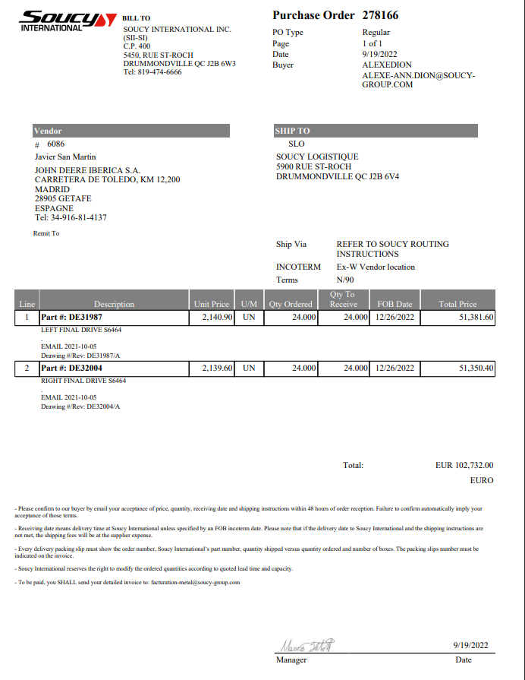
Soucy (?)
No escaneado

Slide 21
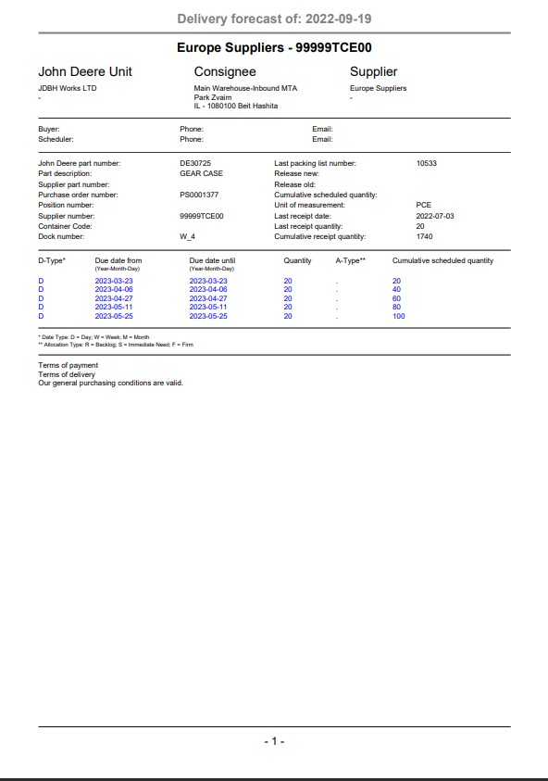
JD ISRAEL (99999TCE00)
No escaneado

Slide 22
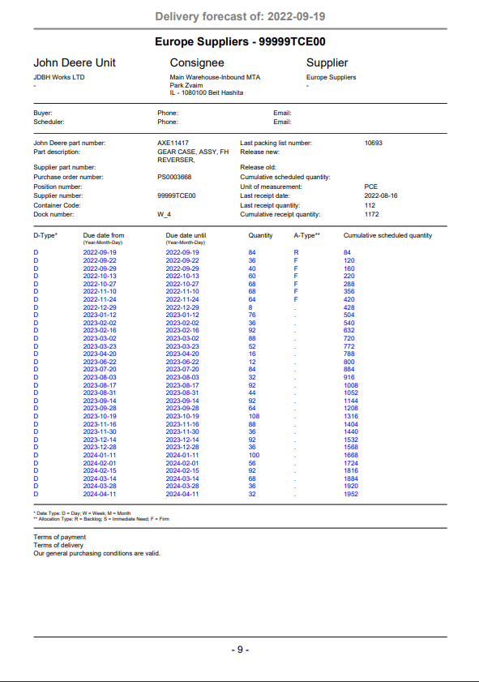
JD ISRAEL (99999TCE00)
No escaneado

Slide 23
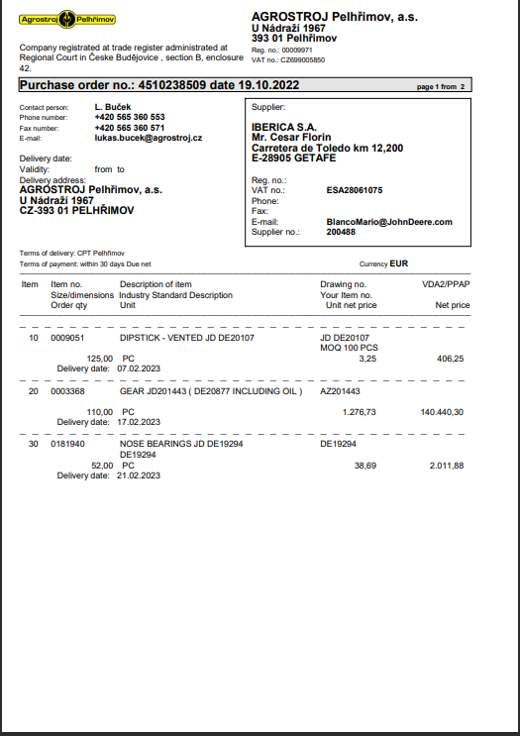
Agrostroj (?)
No escaneado

Slide 24
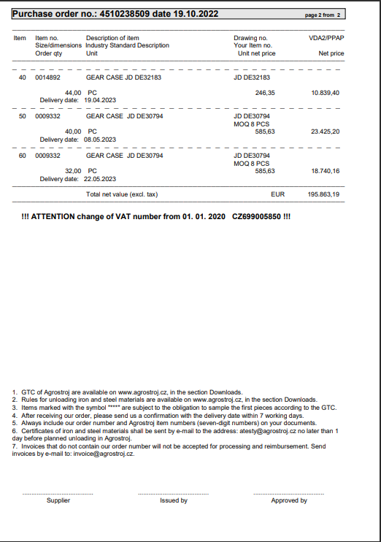
Agrostroj (?)
No escaneado

Slide 25
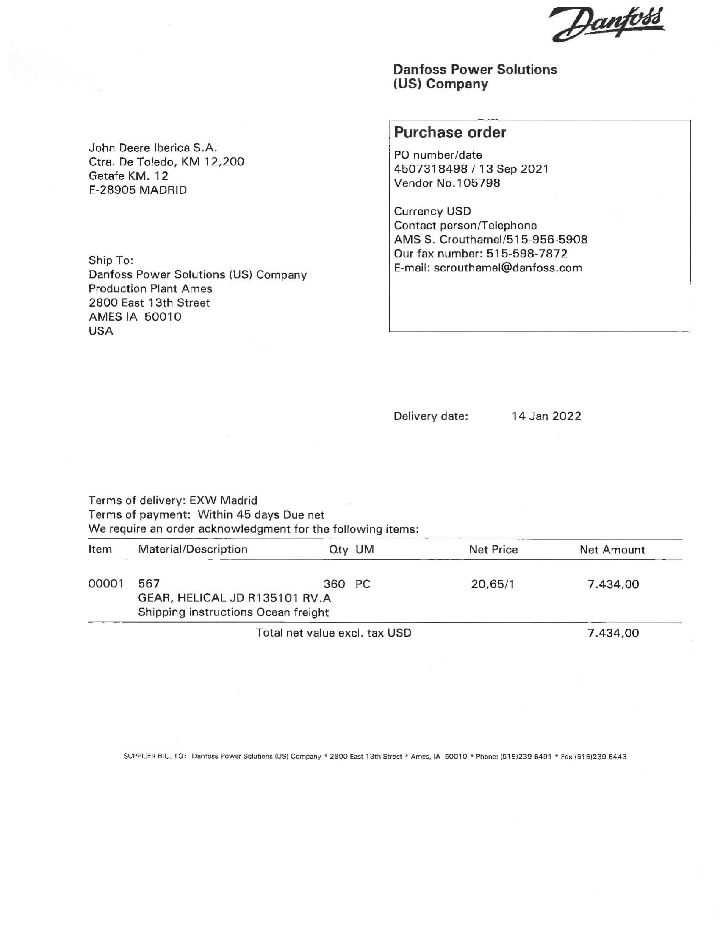
Danfoss (70013219)
Escaneado

